Slide 1
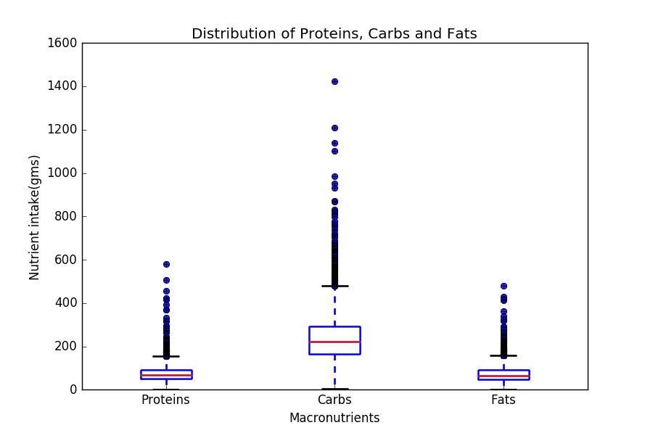
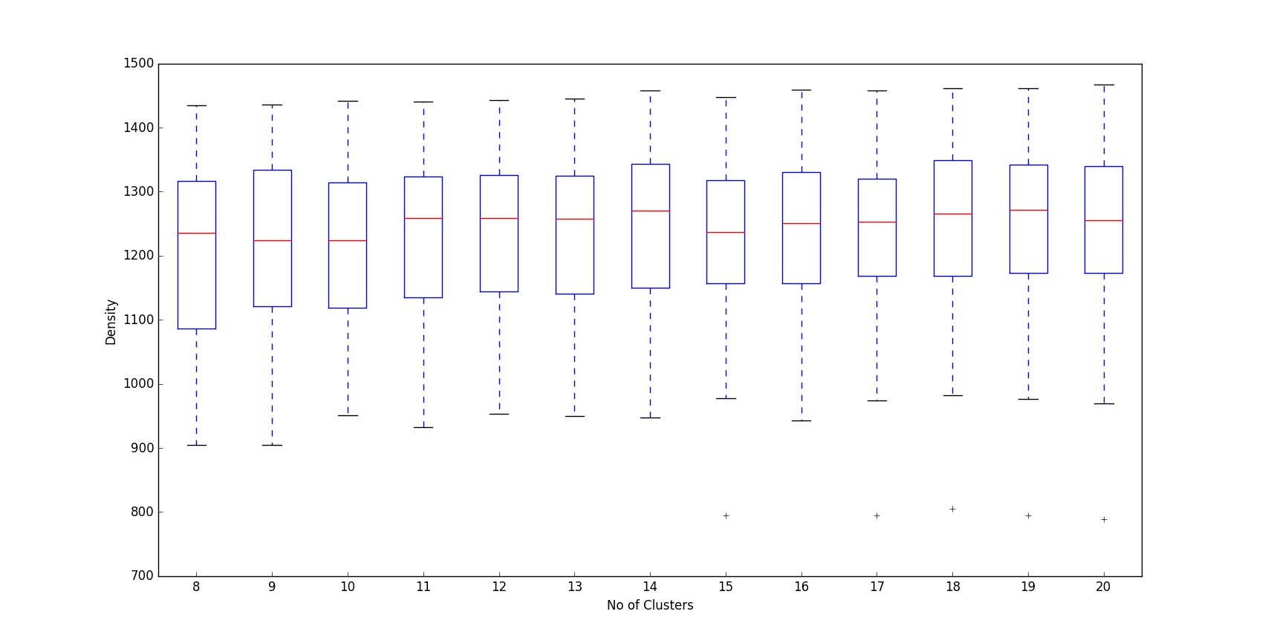
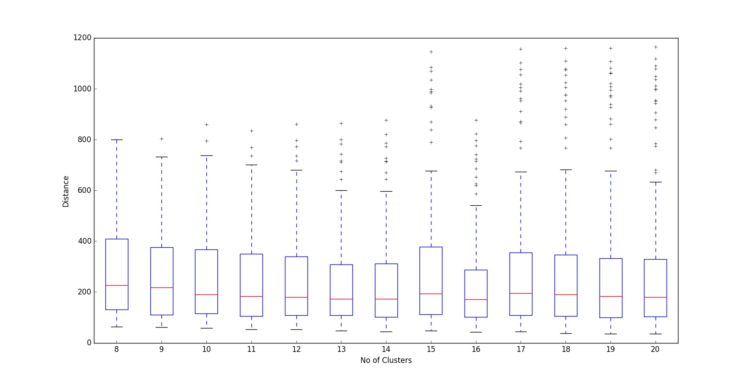
Consumption of Macronutrient intake in different ethnicity
Pranjal Singi, Yashita Jain
Advisor: Michela Taufer
MOTIVATION
It is very essential to examine dietary content from different ethnicity to investigate the metabolic syndrome of every individual
Macronutrients like proteins, carbohydrates and fats are daily nutrient intake of every individual
There are one third population in the US still facing the metabolic syndrome
GOAL
Cluster the macronutrient, proteins, carbohydrates and fat with their ethnicity using Kmeans-Kprototype clustering algorithm
Find the best k by looking at the separation distance and density of clusters
Validate our results with the previous literature studies
Hypothesis: Are Macronutrients responsible for metabolic syndrome in different ethnicities ?
DATA PRE-PROCESSING
Used the NHANES data surveying the US population’s demographics, dietary, and medical data over 16 years
Calculated the average of two day of each macronutrient intake, proteins, carbohydrates, and fat of all individuals
Merged the demographic and dietary dataset from NHANES
Removed missing values (i.e., no values for all the macronutrient)
Ethnicity | Counts | Count after removing missing values | Percentage of values removed
Mexican American | 1730 | 1465 | 15.31%
Other Hispanic | 960 | 815 | 15.10%
Non-Hispanic White | 3674 | 3190 | 13.17%
Non-Hispanic Black | 2267 | 1869 | 17.55%
Non-Hispanic Asian | 1074 | 818 | 23.83%
Other Race | 470 | 378 | 19.57%
Only an average of 20% of data is lost from each ethnicity Total number of records used is 8535
METHODOLOGY
Examine the distribution of every individual's macronutrient intake
Find the best k, distance between each cluster and density between points of each cluster were plotted
Distribution of Proteins, Carbs, and Fat
Density among clusters
Nutrient Intake (gms)
Density
The lower, the better
Proteins
Carbs
Fat
Number of clusters
Boxplot of each macronutrient with the amount of intake by every individuals
Boxplot of distance of each points between each cluster ranging from cluster 8 to 20
Distance among clusters
RESULTS & CONCLUSION
Grouped into 9 clusters with different level of proteins, carbohydrates and fat
All the ethnic groups were included in each clusters.
Distance
Low Low Low
Low High Low
Medium Medium Medium
The higher, the better
Number of clusters
Medium High High
High Medium High
High High High
Box Plot of distance between each cluster with clusters ranging from 8 to 20
FUTURE WORK
Our study motivates to look at other factors to determine the risk of metabolic syndrome in different ethnicities.
Our study also promotes to use other clustering algorithms to have a better understanding of the nutrient intake in each ethnic group.
Percentage of each ethnic group
REFERENCES
Huang, Z.: Clustering large data sets with mixed numeric and categorical values, Proceedings of the First Pacific Asia Knowledge Discovery and Data Mining Conference, Singapore, pp. 21-34, 1997.
Martorell R. Diabetes and Mexicans: Why the Two Are Linked . Preventing Chronic Disease. 2005;2(1):A04.
Type 2 Diabetes Prevalence in Asian Americans. Marguerite J. McNeely, Edward J. Boyko Diabetes Care Jan 2004, 27 (1) 66-69; DOI: 10.2337/diacare.27.1.66
Mexican American
Non-Hispanic White
Other Hispanic
Non-Hispanic Black
Other races
Non-Hispanic Asian
6 clusters with different macronutrient levels. The order of levels is proteins carbs and fat
Acknowledgements / funding- We would like to thank Dr. Michela Taufer for all the assistance throughout the course.

