Slide 1
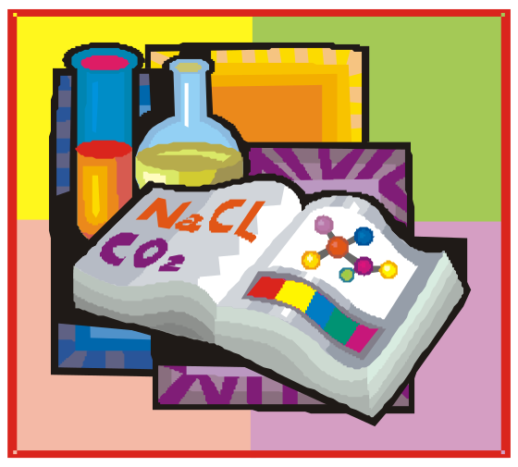
Chemistry

Slide 2
BASIC CONCEPTS OF CHEMISTRY–1

Slide 3
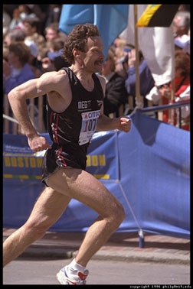

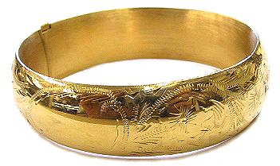
Session Opener

Slide 4

Session Objectives

Slide 5
Session Objectives
Branches of chemistry
Importance of chemistry
Units
Significant figures
Calculation involving significant figures
Dimensions
Matter

Slide 6
What is Chemistry ?
Chemistry
Properties
Structure
Composition

Slide 7
Branches of chemistry
Physical chemistry
Organic chemistry
Inorganic chemistry
Analytical chemistry
Industrial chemistry
Bio chemistry
Nuclear chemistry
Agricultural chemistry
Geo chemistry

Slide 8

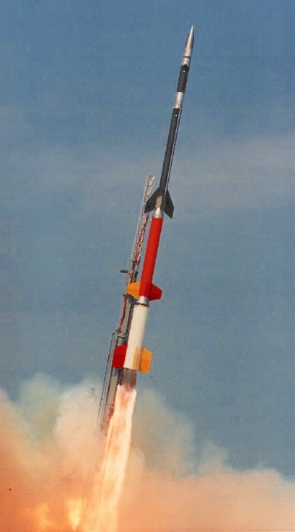

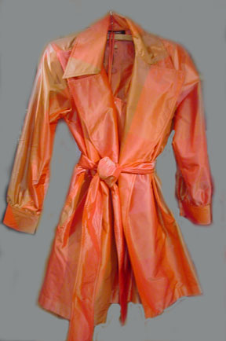

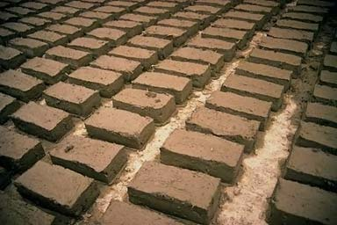


Uses of chemistry
Notes:
Medicines(vitamins, tonic)
Fertilizers
Industry
Polymers
Soaps
Detergents
Water proof clothes and fire proof
Building material

Slide 9
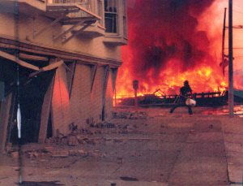
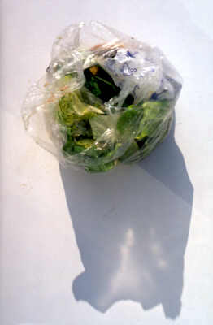
Abuses of chemistry
Notes:
War chemicals, brown sugar ,polyethylene

Slide 10
Standards and Units
Physical quantities : expressed in terms of fundamental quantities.
Fundamental quantities : defined by
measurements and expressed by
standards.
Measurements : comparison with a standard.
Standards are defined and universally accepted by competent authority.

Slide 11
Unit
Any standard measure used to
express a physical quantity is a unit
Convenient size (not too large or too small)
Universally followed
Easily reproducible
Invariable with physical conditions
Notes:
A unit have the following characteristics

Slide 12
Fundamental and derived units
Fundamental units
Units used to express the fundamental
quantities which are not expressed in
any other form
e.g., mass, length, time etc
Derived units
Units which are expressed in terms of the
fundamental units
e.g., area, volume,speed etc

Slide 13
Derived units
Physical quantity | Relation with other basic quantities | SI units
Area | Length square | m²
Volume | Length cube | m³
Density | Mass per unit volume | kg m^{–3}
Speed | Distance travelled per unit time | m s^{–1}
Acceleration | Speed change per unit time | m s^{–2}

Slide 14
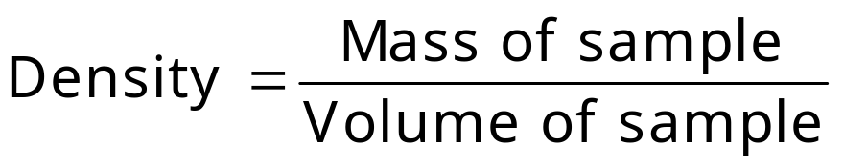
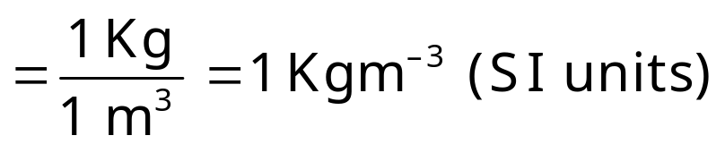
Physical quantity | Relation with other basic quantities | SI units
Force | Product of mass and acceleration | Kg m s^{–2} (= Newton, N)
Pressure | Force per unit area | Kg m ⁻¹ s^{–2} (= Pascal, Pa)
Energy | Product of force and distance traveled | Kg m² s^{–2} (= Joule, J)

Slide 15
Metric system
Fundamental units of metric systems:
Mass | Gram
Length | Meter
Volume | Litre
These units are related by power of ten (10).
1 kilometer = 10³ meters

Slide 16
Do you know
1791–French academy of science in 1971 introduced
metric system.

Slide 17
System of units
FPS– Foot, pound and second
CGS–Centimetre, gram and second
MKS–Metre, kilogram and second
SI–Modified form of MKS. System in which besides
metre, kilogram and second, kelvin,candela,
ampere and mole are also used to express
temperature,luminous intensity, electric current
and quantity of matter

Slide 18
SI (International system of units) system
 | Basic physical quantity | Name of SI unit | Symbol of SI unit
1. | Length | Meter | m
2. | Mass | Kilogram | kg
3. | Time | Second | s
4. | Electric current | Ampere | A
5. | Temperature | Kelvin | K
6. | Luminous intensity | Candela | Cd
7. | Amount of substance | Mole | mol

Slide 19
Do you know
Metric system in India– 1957
General conference of weights
and measures in 1960– called same as S.I system
with improvements

Slide 20
Significant figures and their use in calculations
(i) Accuracy
Concentration of Ag in a sample is 24.15 ppm True value is 25 ppm,
Absolute error (accuracy) is – 0.85 ppm.
Sign has to be retained while expressing accuracy.
Accuracy is the degree of agreement of a measurement with the true (accepted) value.

Slide 21
(ii) Precision
% of tin in an alloy are 3.65,
3.62 and 3.64
% of tin determined by another analyst are 3.72, 3.77 and 3.83.
Which set of the measurement is more precise?
Precision is expressed without any sign.
The precision is the degree of agreement between two or more measurements made on a sample in an identical manner.
Notes:
The first set is more precise

Slide 22
Significant figures
Significant figures in 1.007,
12.012 and 10.070 are 4, 5 and
5 respectively.
Significant figures are the meaningful digits in a measured or calculated quantity.

Slide 23
Rules to determine significant figures
137 cm, 13.7 cm – what’s common?
Both have three significant figures.
All non-zero digits are significant.
2.15, 0.215 and 0.0215 — what’s common?
All have three significant figures.
Zeroes to the left of the first non-zero digit are not significant.
How many significant figures are there in 3.09?
Three Zeroes between non-zero digits are significant.

Slide 24
Rules to determine significant figures
How many significant figures can you find in 5.00?
Three.
Zeroes to the right of the decimal point are significant.
How many significant figures in 2.088 x 10⁴?
Four.

Slide 25

Questions

Slide 26
Illustrative Problem
Determine the number of significant figures in each of the following numbers.
Five significant figure
Two significant figure
Three significant figure
Four significant figure
Three significant figure
705.67
0.0065
432
5.531 x 10⁵
0.891

Slide 27
Illustrative Problem
Express 0.0000215 in scientific notation and determine the number of significant figures.
Solution
In scientific notation, a number is generally
expressed in the form of N x 10^{n}
where N is number (digit) between 1.000 to 9.999
0.0000215 = 2.15 x 10^{–5}
It has three significant figures.

Slide 28
Calculation involving significant figures:
Rule 1:
To express the results to three significant figures.
5.314 is rounded off to 5.31
6.216 is rounded off to 6.22
3.715 is rounded off to 3.72
4.725 is rounded off to 4.72

Slide 29
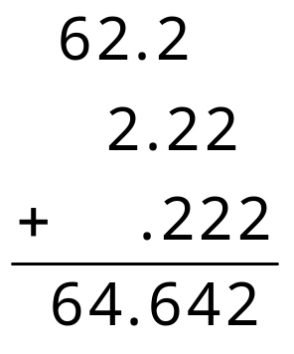
Rule 2a: Addition
Since 62.2 has only one digit after decimal place, the correct answer is 64.6.

Slide 30
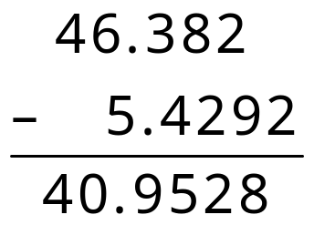
Rule 2b: Subtraction
Similarly, for subtraction
Since 46.382 has only three digit after decimal place, the correct answer is 40.953.

Slide 31
Rule 3:Multiplication
22.314 x 3.09 = 68.95026
Since 3.09 has only three significant figures, the correct answer is 68.9

Slide 32
Question

Slide 33
Illustrative Problem
Express the results of the following
calculation to the correct number of
significant figures.
0.582 + 324.65
25.4630 – 24.21
6.26 x 5.8
5.2756/ 1.25

Slide 34
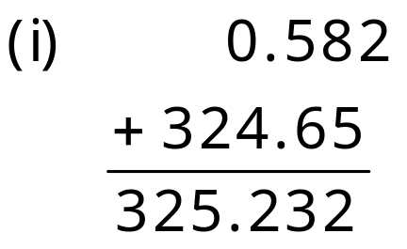
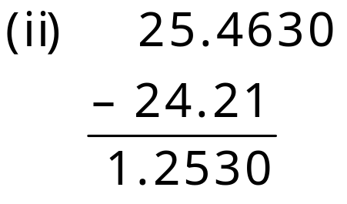
Solution
Correct answer is 325.23
Correct answer is 1.253

Slide 35
Solution
(iii) 6.26 x 5.8 = 36.308
Since 5.8 has only two significant figures, the correct answer is 36.
(iv) 5.2765/1.25 = 4.2212
Since 1.25 has only three significant figures, the correct answer is 4.22.

Slide 36

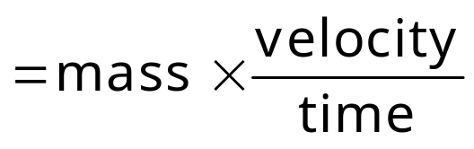
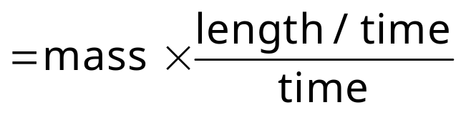
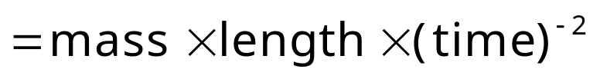
Dimensions
M¹ L¹ T²
Dimensions of M, L and T are 1, 1 and 2 respectively.

Slide 37
Dimensional analysis
Convert 35 meter to centimeter,
1m = 100 cm
Therefore, 35m = 35 x 100
= 3500 cm
The systematic conversion of one set of units to another.

Slide 38
Question

Slide 39
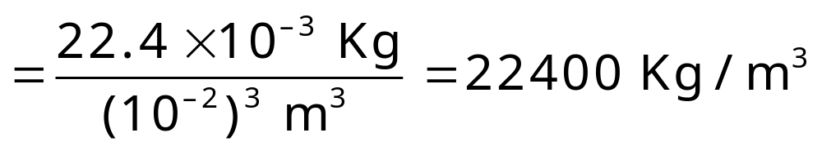
Illustrative Problem
The density of a substance is
22.4 g/cm³. Convert the density to units of Kg/m³.
Solution
Density = 22.4 g/cm³

Slide 40

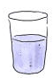
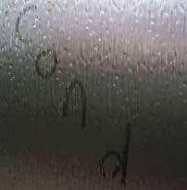
Matter
Matter occupies space and mass.
Solid
Matter
Liquid
Gas

Slide 41
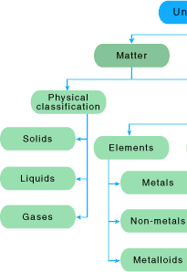
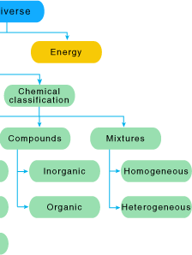

Slide 42
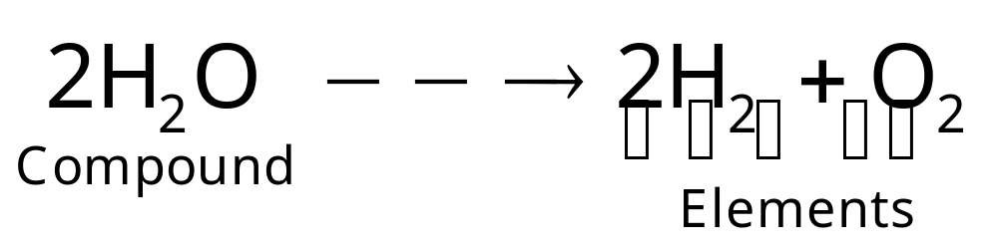
Compound
A compound is a substance which can be decomposed into two or more dissimilar substances.
For example,

Slide 43


Mixture
Mixture contains two or more
components.
Homogenous mixture: Same or uniform composition.
Air is a mixture of gases like O₂, N₂, CO₂, etc.
Heterogeneous mixture: Different compositions in different phases.
Smog.

Slide 44
Question

Slide 45
Illustrative Problem
Which of the following is not a homogeneous mixture?
(a) A mixture of oxygen and Nitrogen
(b) Brass
(c) Solution of sugar in water
(d) Milk
Solution
Milk
Milk contains solid casein protein particles and water.
Hence answer is (d).

Slide 46

Class Test

Slide 47
Class Exercise - 1
Express the following numbers to
three significant figures.
(i) 6.022 × 10²³ (ii) 5.356 g
(iii) 0.0652 g (iv) 13.230
Solution
6.02 × 10²³
5.36 g
0.0652 g
13.2

Slide 48
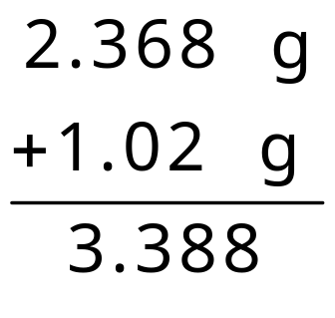
Class Exercise - 2
What is the sum of 2.368 g and
1.02 g?
Solution
= 3.39 g

Slide 49
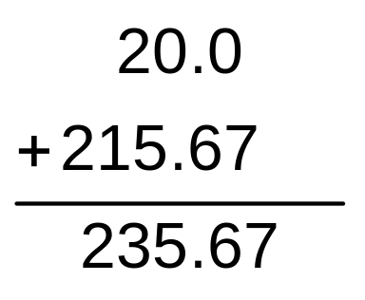
Class Exercise - 3
Express the result of the following
calculation to the appropriate number
of significant figures
816 × 0.02456 + 215.67
Solution
816 × 0.02456 = 20.0
Product rounded off to 3 significant figures because
the least number of significant figure in this
multiplication is three.
Rounded off to 235.7

Slide 50
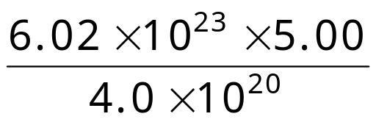
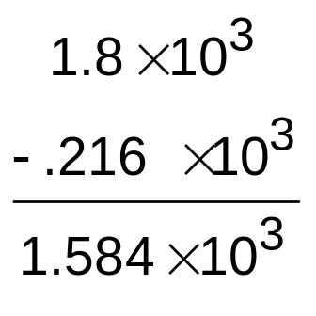
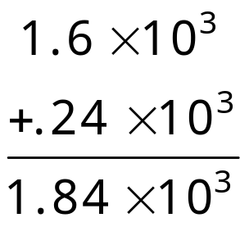
Class Exercise - 4
Solve the following calculations and
express the results to appropriate
number of significant figures.
(i) 1.6 × 10³ + 2.4 × 10² – 2.16 × 10²
(ii)
Solution
(i) 1.6 × 10³ + .24 × 10³
Rounded off to 1.8 × 10³

Slide 51
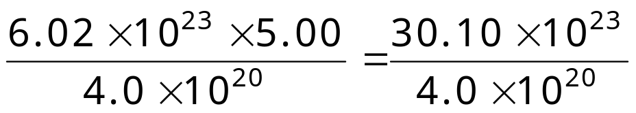
Class Exercise - 4
Rounded off to 1.6 × 10³ or 16 × 10²
(ii)
= 7.525 × 10³ (rounded off to 7.5 × 10³)

Slide 52

Class Exercise - 5
Convert 10 feet 5 inches into SI unit.
Solution
10 feet 5 inches = 125 inches
1 inch = 2.54 × 10⁻² m
125 inches = 2.54 × 10⁻² × 125 m
= 317.5 × 10⁻² m
Rounded off to 317 × 10^{–2} m

Slide 53
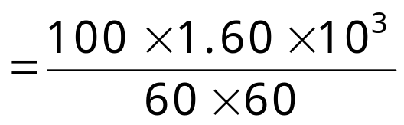
Class Exercise - 6
A football was observed to travel at a speed
of 100 miles per hour. Express the speed
in SI units.
Solution
1 mile = 1.60 × 10³ m
100 miles per hour
= 4.4 × 10⁻⁴ × 10⁵ m/s
= 4.4 × 10 m/s
= 44 m/s

Slide 54
Class Exercise - 7
What do the following abbreviations
stand for?
(i) O (ii) 2O (iii) O₂ (iv) 3O₂
Solution
Oxygen atom
2 moles of oxygen atom
Oxygen molecule
3 moles of oxygen molecule

Slide 55
Class Exercise - 8
Among the substances given below
choose the elements, mixtures and
compounds
(i) Air (ii) Sand
(iii) Diamond (iv) Brass
Solution
Air - Mixture
Sand (SiO₂) - Compound
Diamond (Carbon) - Element
Brass (Alloy of metal) - Mixture

Slide 56
Class Exercise - 9
Classify the following into elements
and compounds.
H₂O
He
Cl₂
CO
Co
Solution
Element: He, Cl₂, Co
Compound: H₂O and CO

Slide 57
Class Exercise – 10
Explain the significance of the
symbol H.
Solution
Symbol H represents hydrogen element
Symbol H represents one atom of hydrogen atom
Symbol H also represents one mole of atoms, that is,
6.023 × 10²³ atoms of hydrogen.
Symbol H represents one gm of hydrogen.

Slide 58

Contact your faculty
shikha.mishra@careerlauncher.com
9810904968

Slide 59
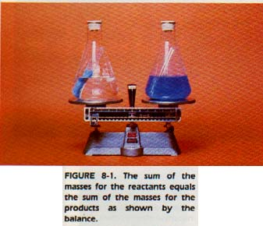
Law of conservation of mass
Total mass of the product remains equal to the total mass of the reactants.
H₂ + Cl₂ 2 HCl
2g
71g
73g

Slide 60
Question

Slide 61
Illustrative Problem
8.4 g of sodium bicarbonate on reaction with 20.0 g of acetic acid (CH₃COOH) liberated 4.4 g of carbon dioxide gas into atmosphere. What is the mass of residue left?
Solution
8.4 + 20 = m + 4.4
m = 24 g
It proves the the law of conservation of mass.
Notes:
the

Slide 62
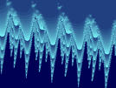


Law of definite proportions
Ice water H₂O 1 : 8
River water H₂O 1 : 8
Sea water H₂O 1 : 8
A chemical compound always contains same elements combined together in same proportion of mass.

Slide 63
Question

Slide 64
Illustrative Problem
Two gaseous samples were analyzed.
One contained 1.2g of carbon and
3.2 g of oxygen. The other contained
27.3 % carbon and 72.7% oxygen. The
above data is in accordance with, which law?
Law of conservation of mass
Law of definite proportions
Law of multiple proportions
Law of reciprocal proportions

Slide 65
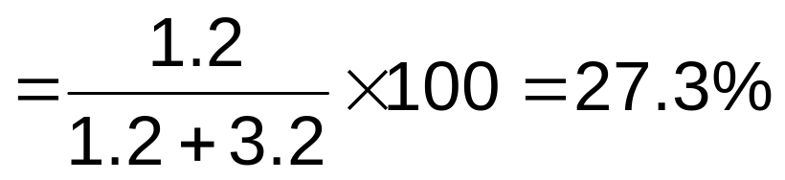
Solution
% of C in the 1st sample
Which is same as in the second sample.
Hence law of definite proportion is obeyed.

Slide 66

Thank you

