Slide 1
Basic’s Of Chemistry
Powered By PresentMam

Slide 2
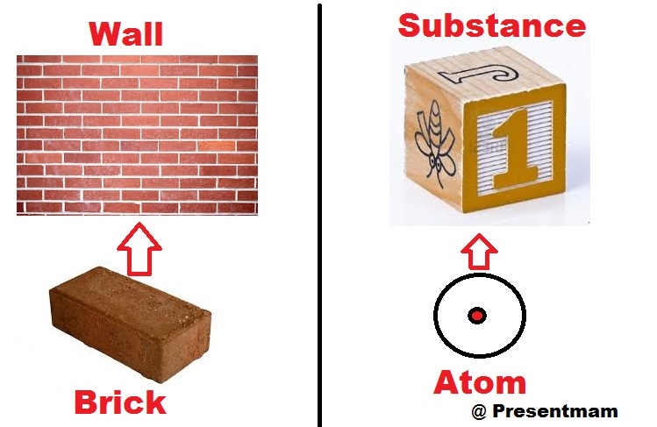
What Are Atom’s ?

Slide 3
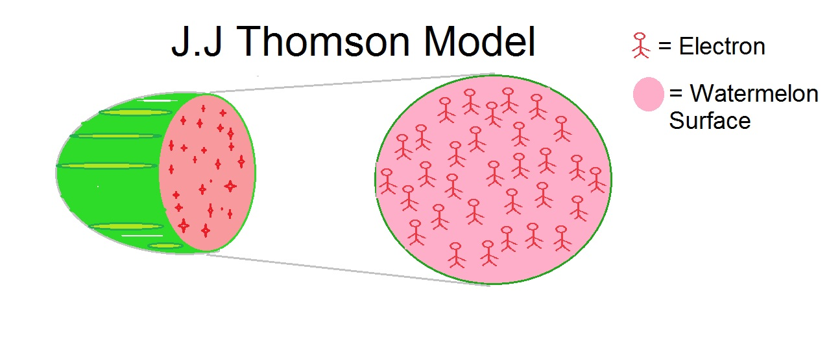
Structure Of Atom

Slide 4
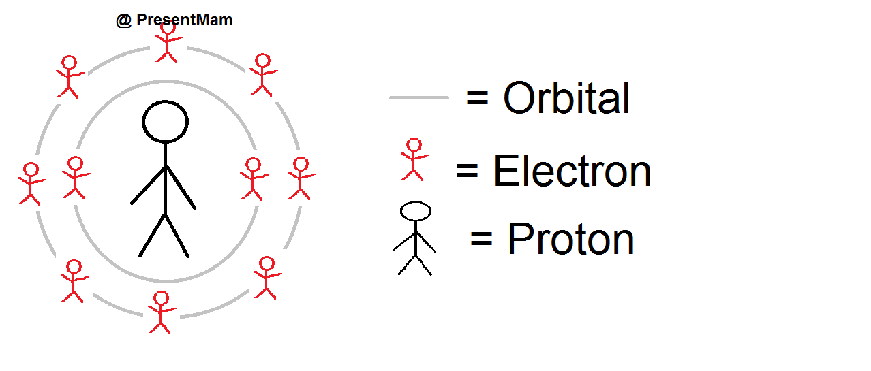
Rutherford Structure Of Atom

Slide 5
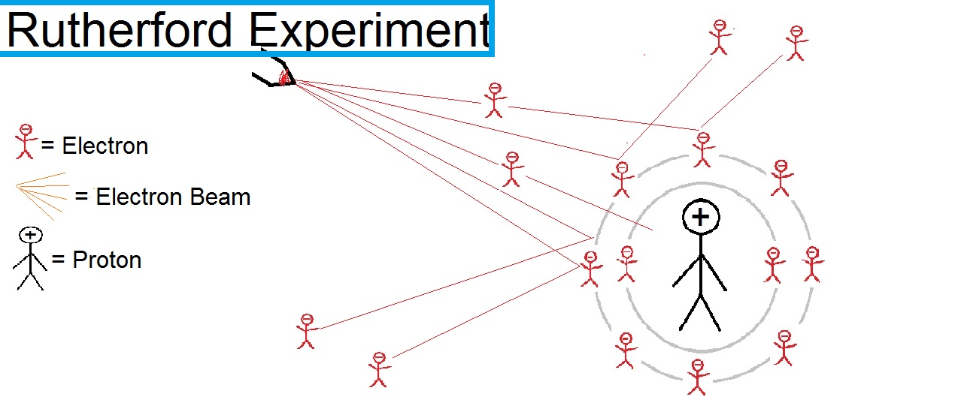
Rutherford Scattering Experiment

Slide 6
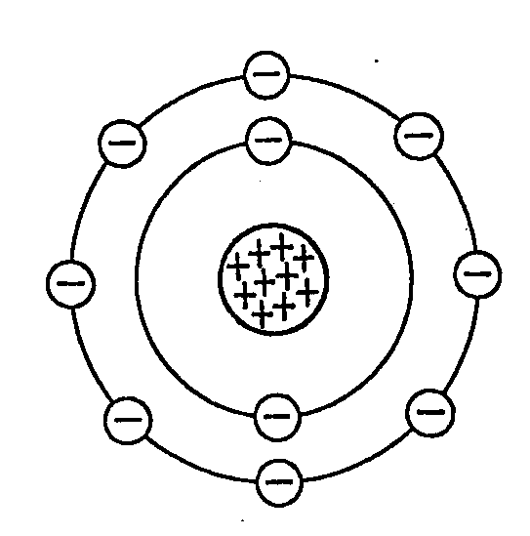
General Structure

Slide 7
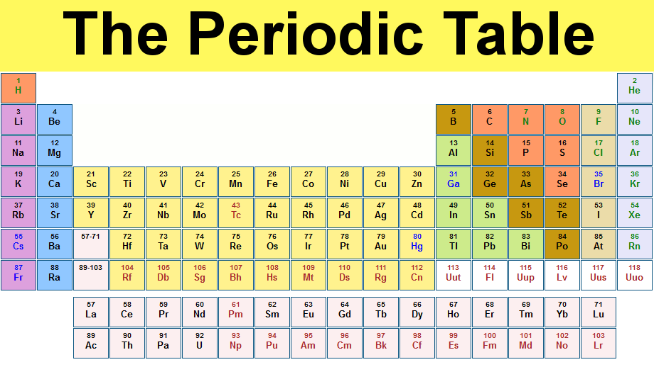
Periodic Table

Slide 8
Atom On Periodic Table
Element or atom arranged in Increasing atomic Number
Total 118 Element Present In Periodic Table
Periodic table having total 4 Main Block , in Which Element or atom Divided

Slide 9
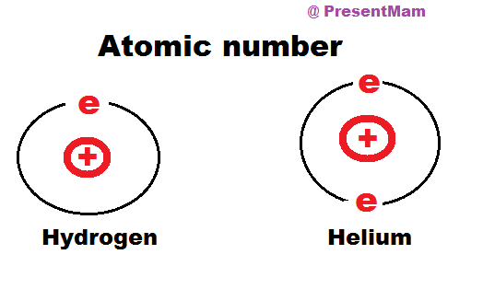
Atomic Number

Slide 10
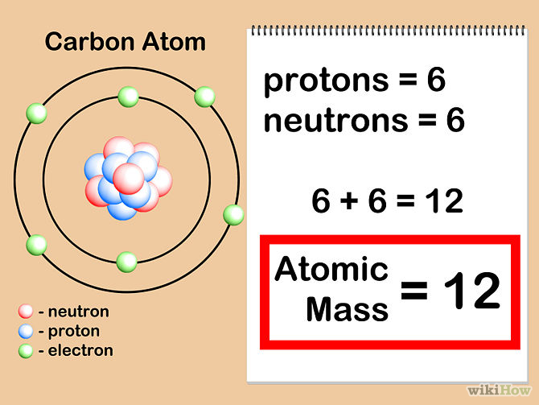

Slide 11
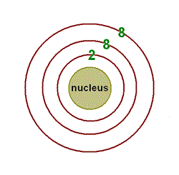

Slide 12
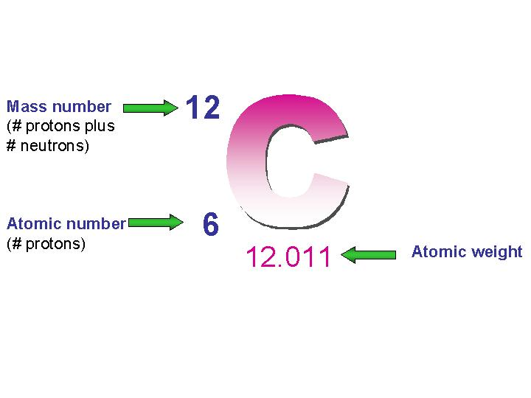

Slide 13
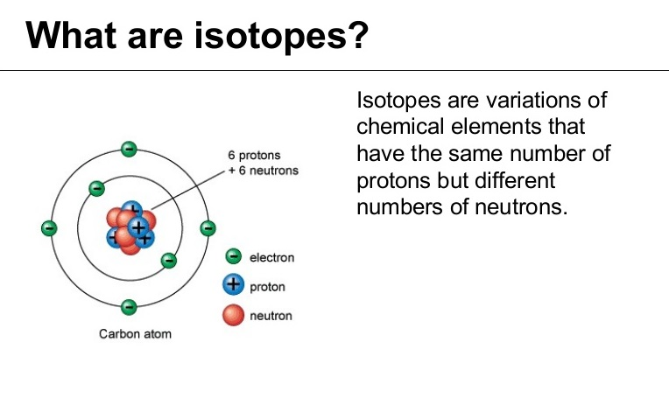

Slide 14
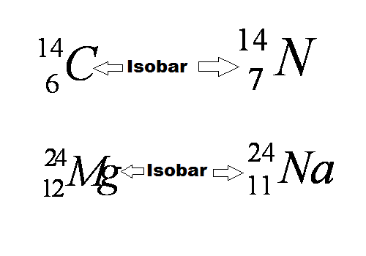

Slide 15
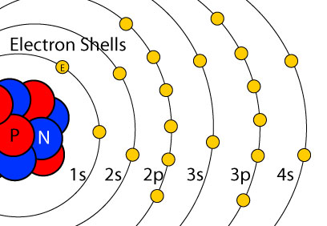

Slide 16
