Slide 1
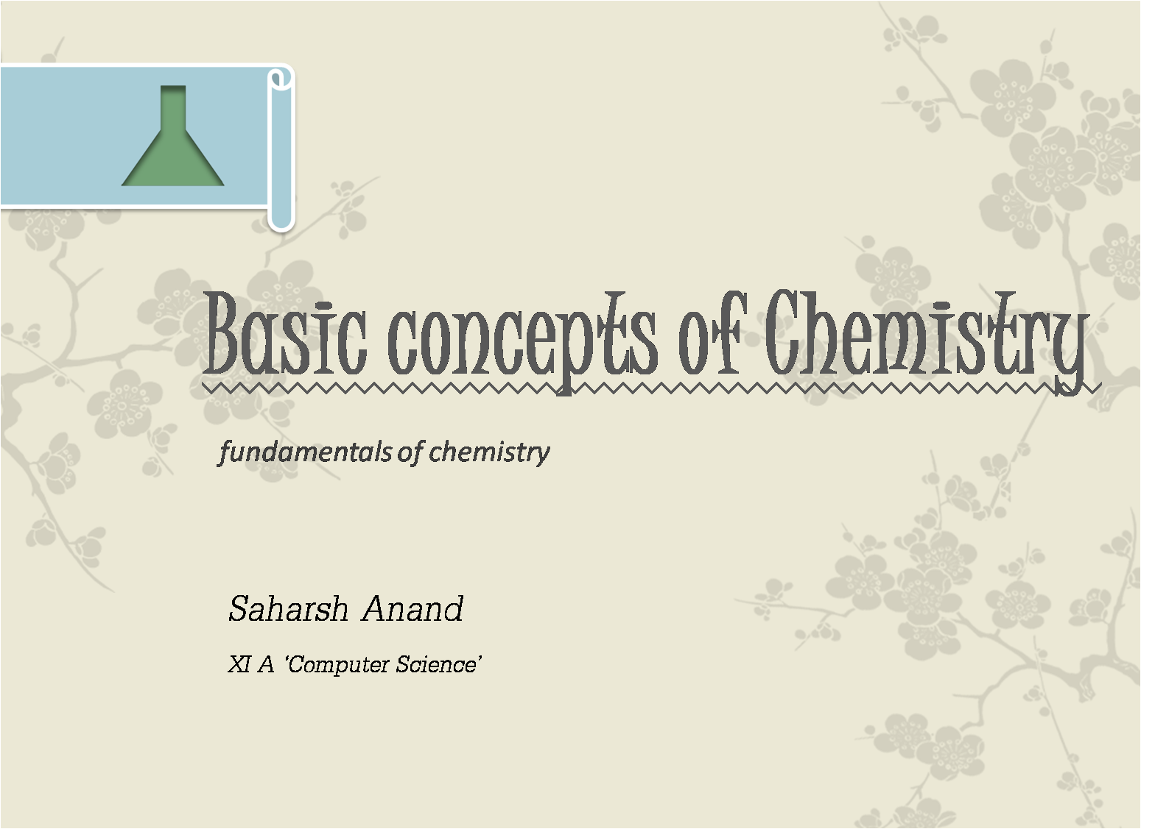

Slide 2



The Science and Chemistry….
fundamental of life

Slide 3
Man has always been curious about the changes taking place in the surrounding and this curiosity led him to study, observe and experiment with the changes taking place.
When these observations are systematically arranged, it is called Science.
However, it’s quite difficult to wrap up the definition of Chemistry in just one line, but still it can be stated as...
“Chemistry is the study of composition, structure, properties and interaction of matter”
Science
& Chemistry
“science is the great antidote to the poison of enthusiasm and superstition.”
- Adam Smith(Scottish Philosopher)

Slide 4
Chemistry had been very important role in our daily life whether it is Chemical, Computing or even Economical activities.
Computer chips is made up of highly purified elemental silicon that is chemically modified at the microscopic level, both in chemical composition and in spatial organisation.
Different chemical composition of atmosphere make different weather at different places on the earth. For example, higher concentration of oxides of sulphur and nitrogen in atmosphere causes acid rain, similarly green house gases lead to extreme weather events such as drought, flooding, high wind and storm. Here principal of geo-chemistry are involved.
Even in our brain, nitric oxide (NO) acts as a messenger compound in the transmission of brain waves and in immune system it slow down the growth of tumor cells. Here process of bio-chemical processes are important.
USE

Slide 5
Contribution in Economical Development
Chemistry play an important role in the field of economic condition of the country by having its role in various industrial processes like manufacturing chemical fertilisers like urea, ammonium sulphate etc, which help in better production of crops.
Alkalis, acids, salts, dyes are important in synthesis of various chemical compounds and products of commercial value. Chemical industries involved in production of drugs, soaps, detergent, metals, alloys and various organic and inorganic compounds have a very big role in the economic growth of a nation.

Slide 6
Chemistry, for our daily domestic use
Preservatives like sodium benonate and sodium meta-bi-sulphate for better preservation of food and check its wastage.
Insecticides and pesticides like D.D.T., gammexane etc are helpful for crop protection and storage of food grains.
Products of domestic consumption like soap, cosmetics, oils, perfumes etc are outcomes of chemical synthesis.
Health-care products, skin cream and soaps contain chemical compounds, similarly disinfectants and germicides also contains chemical compounds.

Slide 7

What is the “MATTER”?
a constituent part…

Slide 8
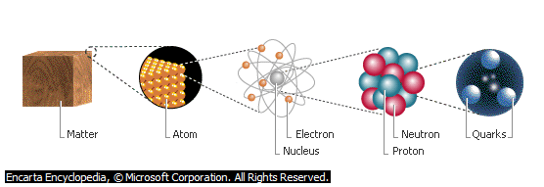
“
Anything that occupies, posses mass and can be felt by one or more of our sense is matter.
Examples of matter includes,
Air, Water, living things, metal, books, table, chalk etc.

Slide 9
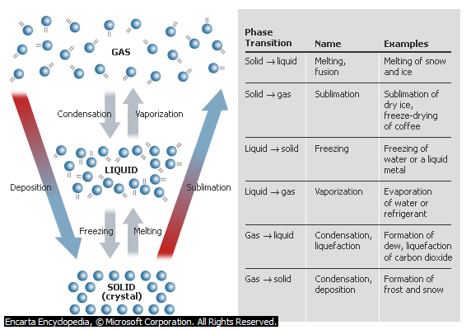
CLASSIFICATION & PROPERTIES OF MATTER

Slide 10
Matters have been further divided on the basis of their chemical and physical properties.
Based on Physical property,
Matter had been divided into,
SOLIDS
MATTER
LIQUID
GAS
Notes:
Qq aA

Slide 11
Matters have been further divided on the basis of their chemical and physical properties.
Based on Chemical property,
Matter had been divided into,
MIXTURE
MATTER
PURE SUBSTANCE

Slide 12

Physical Properties
v/s
Chemical Properties

Slide 13
Different kind of matter around us have several characteristics which when used in combination, adequately describe a kind of matter. Therefore chemists broadly divided the properties of matter in two kinds, named “physical” and “chemical” properties.
Physical properties are those properties which can be measured or observed without change the identity or the composition of the substance. Eg. Taste, Colour, Melting Point, Boiling Point, Density etc.
Chemical Properties are those which can be measured only by a chemical reaction. These can’t be observed just by touching or viewing the substance. Eg. Acidity, Basicity, Combustibility, Reactivity etc.

Slide 14

The International System of Units
Le System International d’ Unités – SI Units

Slide 15
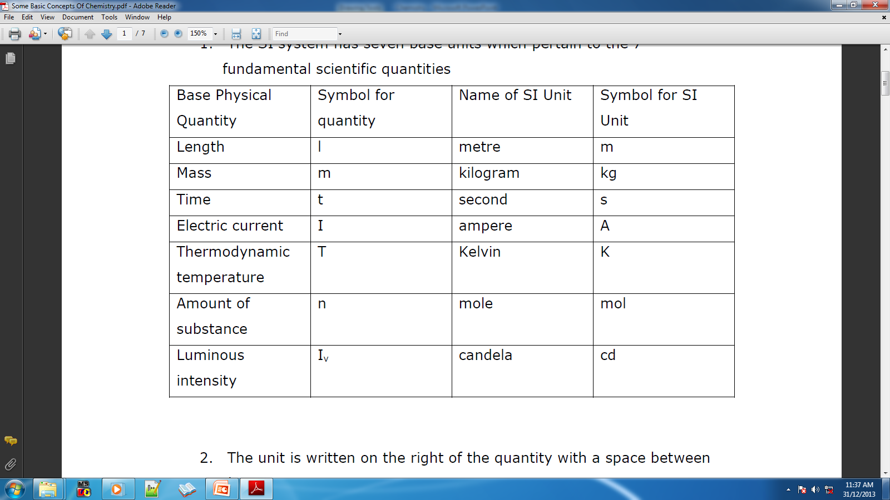
Seven fundamental scientific quantities or base units,

Slide 16
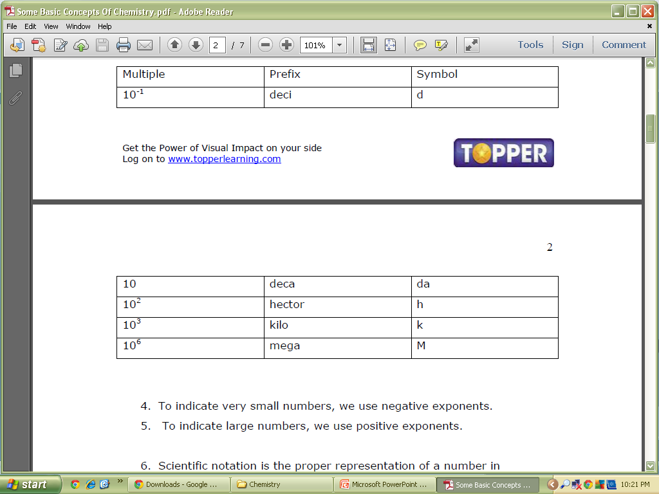
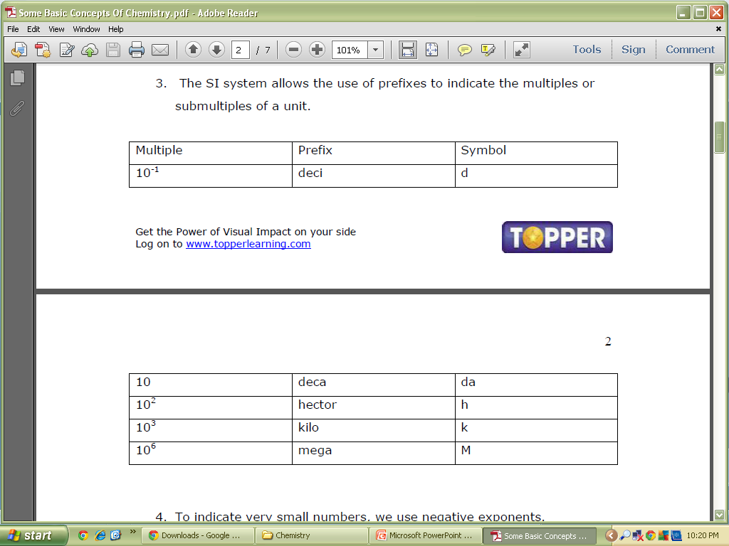
Scientific unit system ,

Slide 17
To indicate very small numbers, we use negative exponents.
To indicate large numbers, we use positive exponents.
Scientific notation is the proper representation of a number in exponential form.
Precision indicates how closely repeated measurements match each other.
Accuracy indicates how closely a measurement matches the correct or expected value.
A result is valid only if it is both accurate and precise.
Some Important notes!

Slide 18

Significant figures
Significant figures

Slide 19
Significant figures are meaningful digits which are known with certainty,
There are certain rules for determining the number of significant figures:
All non-zero digits are significant
Zeros preceding the first non-zero digit are not significant
Zeros between two non-zero digits are significant.
Zeros at the end or right of the number are significant provided they are on the right side of the decimal point. But, if otherwise, the zeros are not significant.
During addition and subtraction, the result cannot have more digits to the right of the decimal point than either of the original numbers.
In multiplication and division with significant figures, the answer cannot have more significant figures than either of the original numbers.

Slide 20

Laws & Postulates

Slide 21
There are 5 basic laws of chemical combinations that govern every reaction,
Law of Conservation of mass
Law of definite proportion
Law of multiple proportions
Gay Lussac’s law of gaseous volumes
Avogadro law

Slide 22
Law of Conservation of mass
Antoine Lavoisier established the Law of Conservation of Mass. It states that matter can neither be created nor destroyed. In other words, we can say that during any physical or chemical change, the total mass of reactants is equal to the total mass of products.

Slide 23
Law of definite proportion
Joseph Proust showed that a given compound always contains exactly the same proportion of elements by weight.

Slide 24
Law of multiple proportions
Dalton proposed the law of multiple proportions. According to this law if two elements can combine to form more than one compound, the mass of one element that combines with the fixed mass of the other element is in the ratio of small whole numbers

Slide 25
Gay Lussac’s law of gaseous volumes
When gases combine or are produced in a chemical reaction they do so in a simple ratio by volume, provided all the gases are at same temperature and pressure.

Slide 26
Avogadro law
At the same temperature and pressure, equal volumes of gases contain equal number of molecules.

Slide 27
Dalton’s atomic theory
In 1808, Dalton published ‘A New System of Chemical Philosophy’ in which he proposed the following :
Matter consists of indivisible atoms.
All the atoms of a given element have identical properties including identical mass. Atoms of different elements differ in mass.
Compounds are formed when atoms of different elements combine in a fixed ratio.
Chemical reactions involve reorganization of atoms. These are neither created nor destroyed in a chemical reaction.
Dalton’s theory could explain the laws of chemical combination.

Slide 28
Important Terms

Slide 29
6.022 x 10²³ is called Avogadro’s constant or Avogadro’s number.
A mole is a collection of 6.022 x 10²³ particles.
One mole is the amount of a substance that contains as many particles or entities as there are atoms in exactly 12 g (or 0.012 kg) of the C-12 isotope.
The mass of one mole of a substance in grams is called its molar mass.
The molar mass in grams is numerically equal to the atomic/molecular/formula mass in u.(u is the unified mass)
Molarity is the number of moles of solute in per liter of solution. Unit is moles per liter.

Slide 30
Molality is the number of solute present in 1kg of solvent.
Atomic Mass: Average relative mass of an atom of an element as compared with the mass of a carbon atom taken as 12 amu.
Atomic mass expressed in grams is called gram atomic mass.
Molecular Mass: Sum of the atomic masses of elements present in a molecule.
Molecular mass expressed in grams is called gram molecular mass.
Formula Mass: Sum of atomic masses of all atoms in a formula unit of the compound

Slide 31
An empirical formula represents the simplest whole number ratio of various atoms present in a compound.
Molecular formula shows the exact number of different types of atoms present in a molecule of a compound.
If the mass per cent of various elements present in a compound is known, its empirical formula can be determined.
where n is a simple number and may have values 1, 2, 3…. Molecular formula = n (Empirical formula)

Slide 32
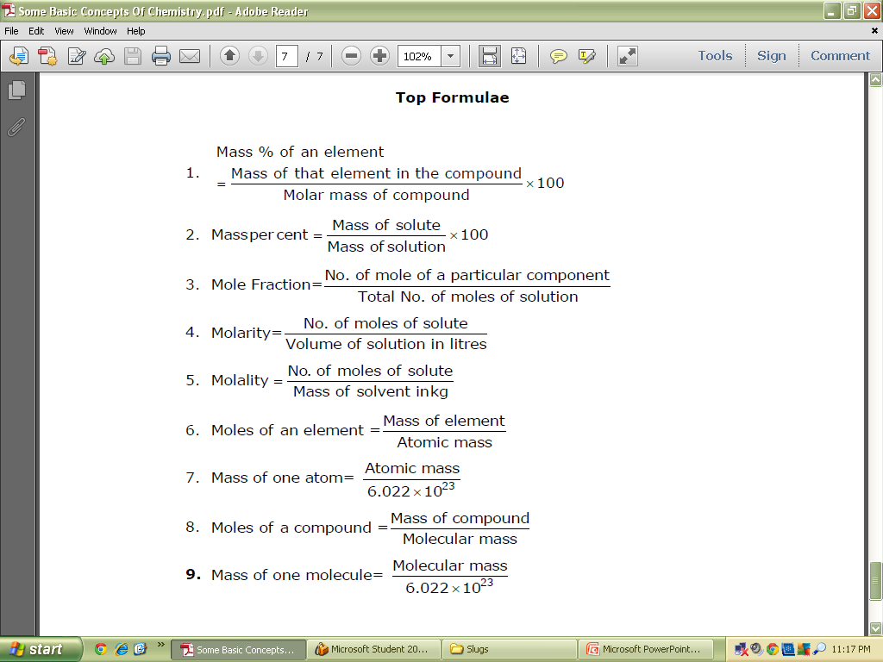
Top Formulae

Slide 33

end…….

