Slide 1
The History of the Modern Periodic Table

Slide 2
During the nineteenth century, chemists began to categorize the elements according to similarities in their physical and chemical properties. The end result of these studies was our modern periodic table.

Slide 3
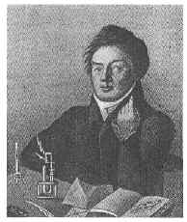
Johann Dobereiner
In 1829, he classified some elements into groups of three, which he called triads. The elements in a triad had similar chemical properties and orderly physical properties.
(ex. Cl, Br, I and Ca, Sr, Ba)
Model of triads
1780 - 1849

Slide 4
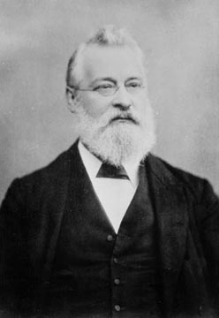
John Newlands
In 1863, he suggested that elements be arranged in “octaves” because he noticed (after arranging the elements in order of increasing atomic mass) that certain properties repeated every 8th element.
Law of Octaves
1838 - 1898

Slide 5
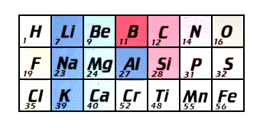
John Newlands
Newlands' claim to see a repeating pattern was met with savage ridicule on its announcement. His classification of the elements, he was told, was as arbitrary as putting them in alphabetical order and his paper was rejected for publication by the Chemical Society.
1838 - 1898
Law of Octaves

Slide 6
John Newlands
His law of octaves failed beyond the element calcium.
WHY?
Would his law of octaves work today with the first 20 elements?
1838 - 1898
Law of Octaves

Slide 7
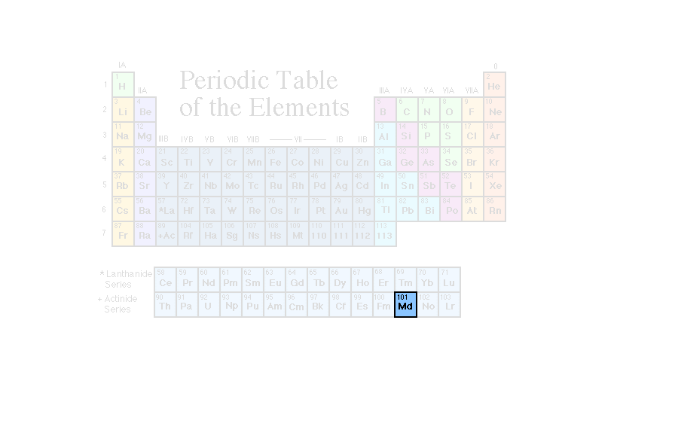
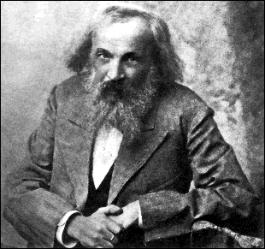
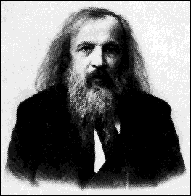
Dmitri Mendeleev
In 1869 he published a table of the elements organized by increasing atomic mass.
1834 - 1907

Slide 8
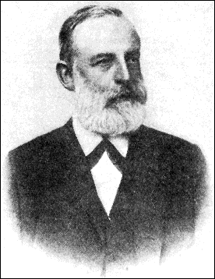
Lothar Meyer
At the same time, he published his own table of the elements organized by increasing atomic mass.
1830 - 1895

Slide 9
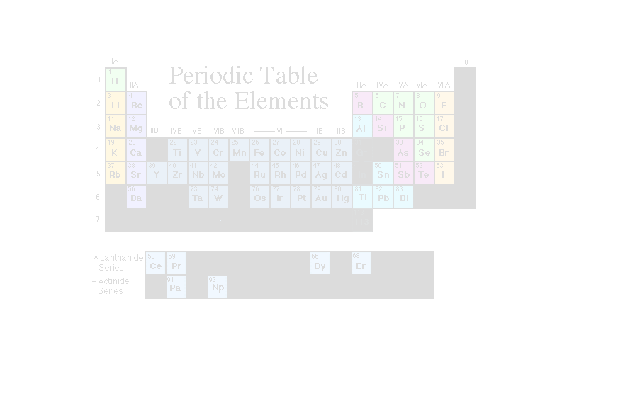
Elements known at this time

Slide 10
Both Mendeleev and Meyer arranged the elements in order of increasing atomic mass.
Both left vacant spaces where unknown elements should fit.
So why is Mendeleev called the “father of the modern periodic table” and not Meyer, or both?

Slide 11
Mendeleev...
stated that if the atomic weight of an element caused it to be placed in the wrong group, then the weight must be wrong. (He corrected the atomic masses of Be, In, and U)
was so confident in his table that he used it to predict the physical properties of three elements that were yet unknown.

Slide 12
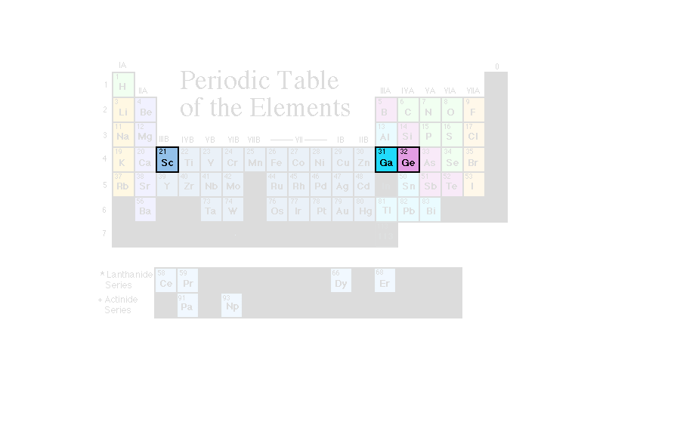
After the discovery of these unknown elements between 1874 and 1885, and the fact that Mendeleev’s predictions for Sc, Ga, and Ge were amazingly close to the actual values, his table was generally accepted.

Slide 13
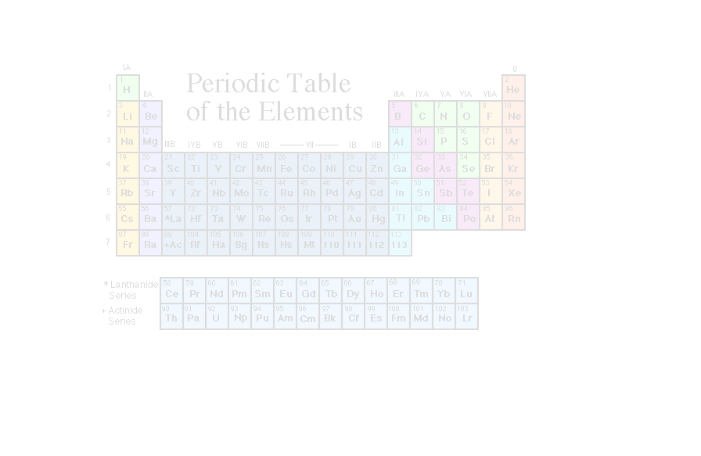
However, in spite of Mendeleev’s great achievement, problems arose when new elements were discovered and more accurate atomic weights determined. By looking at our modern periodic table, can you identify what problems might have caused chemists a headache?
Ar and K
Co and Ni
Te and I
Th and Pa

Slide 14
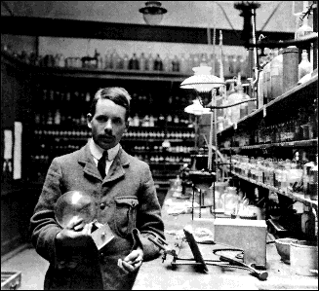
Henry Moseley
In 1913, through his work with X-rays, he determined the actual nuclear charge (atomic number) of the elements*. He rearranged the elements in order of increasing atomic number.
*“There is in the atom a fundamental quantity which increases by regular steps as we pass from each element to the next. This quantity can only be the charge on the central positive nucleus.”
1887 - 1915

Slide 15
Henry Moseley
His research was halted when the British government sent him to serve as a foot soldier in WWI. He was killed in the fighting in Gallipoli by a sniper’s bullet, at the age of 28. Because of this loss, the British government later restricted its scientists to noncombatant duties during WWII.

Slide 16
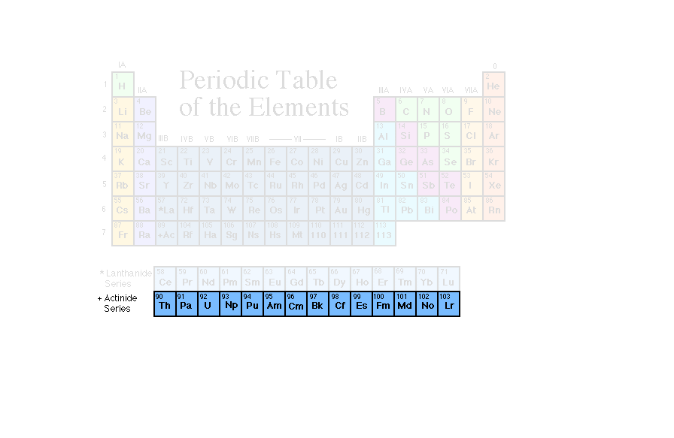
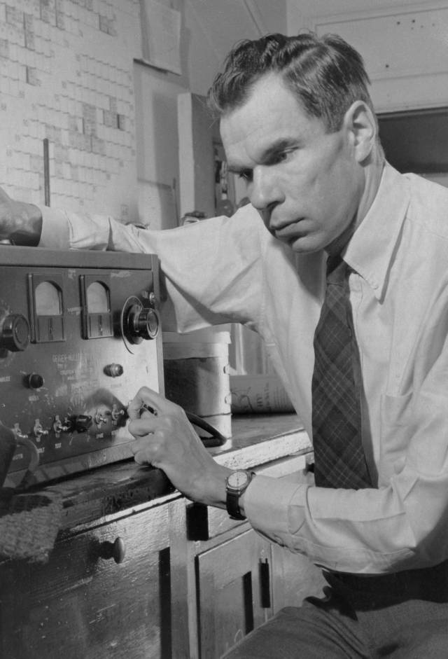
Glenn T. Seaborg
After co-discovering 10 new elements, in 1944 he moved 14 elements out of the main body of the periodic table to their current location below the Lanthanide series. These became known as the Actinide series.
1912 - 1999

Slide 17
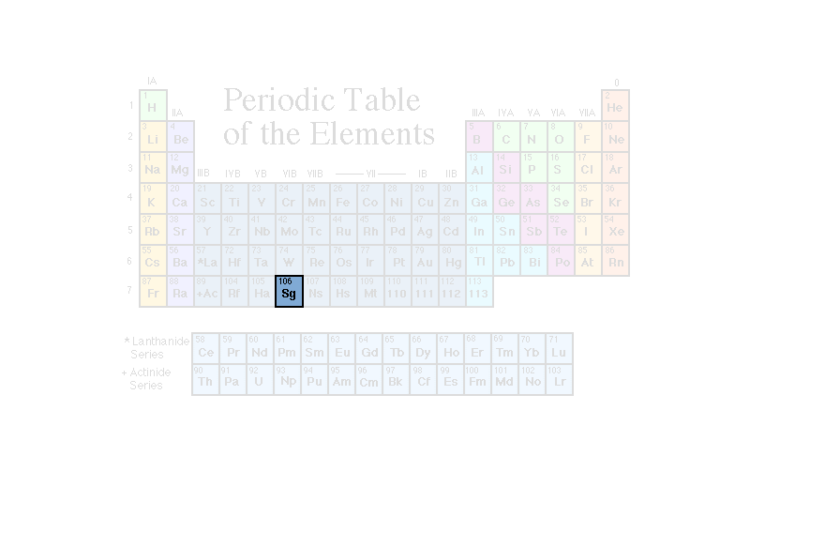
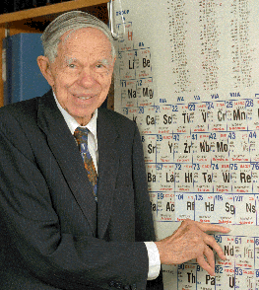
Glenn T. Seaborg
He is the only person to have an element named after him while still alive.
"This is the greatest honor ever bestowed upon me - even better, I think, than winning the Nobel Prize."
1912 - 1999

