Slide 1
FREQUENCY MODULATION
“The process of changing the frequency of a carrier wave in accordance with the AF signal.”
The Chapter includes:
Wave Forms
Theory
Modulation Index
Bandwidth & Bessel functions
Merits & Demerits
Created by Santosh Varma Datla, Faculty Of Physics, S B E G

Slide 2
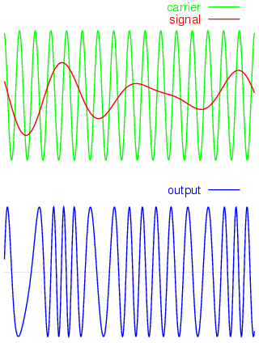
Wave Forms
(Courtesy: Internet)
Uniform AF signal modulating the Carrier wave frequency
Non-uniform AF signal modulating the Carrier wave frequency
Created by Santosh Varma Datla, Faculty Of Physics, S B E G

Slide 3
Theory:
Created by Santosh Varma Datla, Faculty Of Physics, S B E G
e _{m}= E_{m} cos ω_{m}t
& e_{c} = E_{c} cos (ω_{c}t + φ)
The instantaneous frequency ‘ν’of modulated wave is:
ν = ν_{c} + kE_{m} cos ω_{m}t (where k is proportionality constant which depends on the modulating system)
If cos ω_{m}t = ± 1, then ν = ν_{c} ± kE_{m}
or ν = ν_{c} ± δ (where δ = kE_{m} is maximum or peak deviation in carrier frequency) Note that δ depends on the magnitude of E_{m} and not upon ν_{c}.
Instantaneous value of FM voltage is: e = E_{c} cos θ
θ is given by the following steps:
d θ = ω dt ⇒ d θ = 2π ν dt ⇒ d θ = 2π (ν_{c} + kE_{m} cos ω_{m}t ) dt
On integration, we get
θ = ω_{c}t + (δ/ ν_{m}) sin ω_{m}t
∴ e = E_{c} cos [ω_{c}t + (δ/ ν_{m}) sin ω_{m}t] = E_{c} cos (ω_{c}t + m_{f} sin ω_{m}t)
where m_{f} = δ/ ν_{m} is modulation index for FM

Slide 4
Deviation: The amount by which the frequency of the carrier wave is changed from its original unmodulated frequency.
The rate at which this change occurs is equal to modulating frequency.
Modulation Index: M I for F M is the ratio of maximum frequency deviation to the modulating frequency. m_{f} = δ/ ν_{m}
Observations:
1. m_{f} is measured in radians.
2. Eqn. for frequency modulated wave is sine of sine function which gives a complex solution whereby the modulated wave consists of a carrier frequency and infinite number of pairs of side bands (Bessel functions).
3. In F M, the overall amplitude and hence the total transmitted power remains constant.
Created by Santosh Varma Datla, Faculty Of Physics, S B E G

Slide 5
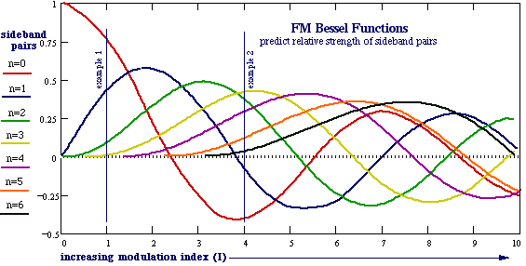
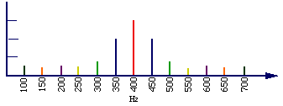
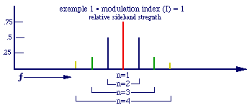
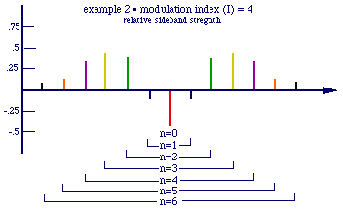
Band Width & Bessel Functions
(Courtesy: Internet)

Slide 6
Merits:
FM is inherently and practically free from noise.
Noise can be further reduced by increasing δ.
FM receivers can further be improved with the help of limiters to remove amplitude changes, if any.
4. All the transmitted power is useful in FM.
Many independent transmitters can be operated on same frequency without interference.
Demerits:
About 10 times wider channel is required by FM as compared to AM.
Area of reception for FM is much smaller than for AM.
FM receivers and transmitters are very complex and costly.
Created by Santosh Varma Datla, Faculty Of Physics, S B E G
END

