Slide 1
HCL JIGSAW
ROUND 2 · APP PRESENTATION
Health Myth Buster
Grade 6 · AI Revolution & Digital Futures
CONTEXT
YOUR CHALLENGE
Fake health messages – like 'lemon juice cures COVID' – spread fast on WhatsApp in India, especially in tier-2 cities, and people believe them.
Show us your fact-checking tool: type a claim, get TRUE, FALSE or UNVERIFIED with a reason and a reliable source.
6 questions · 3 screens of your tool + a working link · Answer every question in your own words
HCL JIGSAW | Edition 7 | Grade 6 · AI Revolution & Digital Futures | Round 2 · App Presentation

Slide 2
HCL JIGSAW
Health Myth Buster · Round 2
BEFORE YOU START · TEAM & APP DETAILS
Tell us who you are and where we can try your tool
Share a link that works for anyone with the link (no login needed), so the evaluators can type a claim and test it.
Team name
School & city
team_1342_0034
Shikshaa Public School & Chennai (Hasthinapuram)
Team members (name – role)
Link to our tool
J Thanshik – Co-Ordinator
Yashith Sai P – Developer
Sarvesh S – Research Analyst
G M Preethish – Tester
https://github.com/yashithsaipraveenkumar-hub/HCL-JigSaw.git
Tool used to build it
HTML with embedded CSS and JavaScript
Number of myths in our database
50
HCL JIGSAW | Edition 7 | Grade 6 · AI Revolution & Digital Futures | Round 2 · App Presentation
2

Slide 3
HCL JIGSAW
Health Myth Buster · Round 2
STEP 1 · THE PROBLEM
Q1. What problem does your tool solve, and who will use it?
The Problem:
Every day, millions of Indians receive fake health messages on WhatsApp like 'lemon juice cures COVID-19.' People believe these without checking, leading to dangerous health decisions. If 100 people get a false message and 70 believe it, that's 70 people misled
Our Solution:
We built Health Myth Buster - a simple tool that checks if health claims are TRUE or FALSE with trusted sources like WHO. People don't know how to verify health information. Our tool breaks the cycle of misinformation by giving instant access to verified facts, helping families make safer health decisions.
To Whom:
It's designed for everyone, from tech-savvy youth to elderly grandparents.
HCL JIGSAW | Edition 7 | Grade 6 · AI Revolution & Digital Futures | Round 2 · App Presentation
3

Slide 4
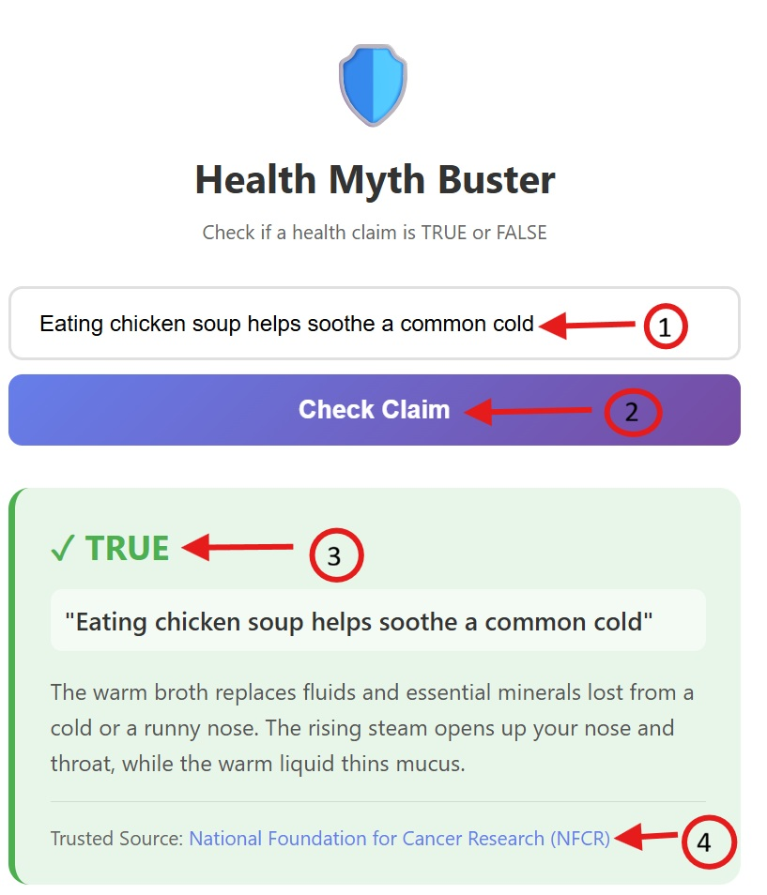
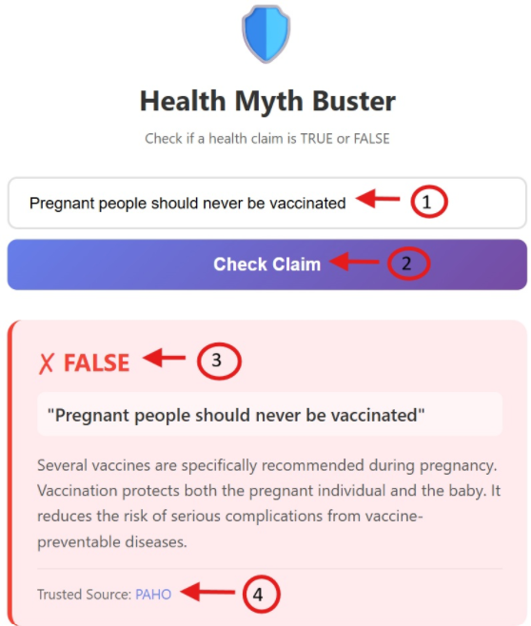
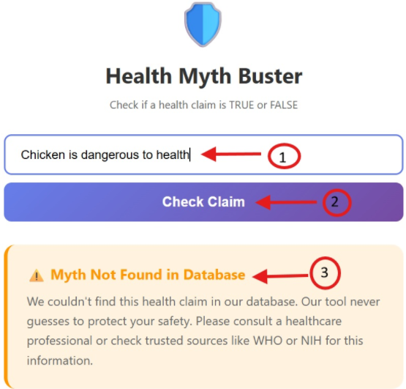
HCL JIGSAW
Health Myth Buster · Round 2
STEP 2 · SHOW YOUR TOOL
Q2. Add 3 screens of your tool and say what each screen does
Show: the screen where a claim is typed, a FALSE or TRUE result, and what happens when a claim is not in your database.
SCREEN 1
SCREEN 2
SCREEN 3
User Inputs: Types the health claim
User Clicks: Check Claim button
Verdict: User gets the verdict with explanation
Artifact: User gets a trusted source link to refer
Note: Screen 1 shows the TRUE verdict screenshot
User Inputs: Types the health claim
User Clicks: Check Claim button
Verdict: User gets the verdict with explanation
Artifact: User gets a trusted source link to refer
Note: Screen 2 shows the FALSE verdict screenshot
User Inputs: Types the health claim
User Clicks: Check Claim button
Verdict: User gets the verdict with explanation
Note: Screen 3 shows the Myth Not Found in Database with a special message
HCL JIGSAW | Edition 7 | Grade 6 · AI Revolution & Digital Futures | Round 2 · App Presentation
4

Slide 5
HCL JIGSAW
Health Myth Buster · Round 2
STEP 3 · HOW IT WORKS
Q3. Explain how your tool works, step by step
TYPE: what does the user enter? MATCH: how does keyword detection find the right myth? ANSWER: what is shown, and what if nothing matches?
1 · TYPE
➜
2 · MATCH
➜
3 · ANSWER
Check Claim:
The user types a health claim in the search box (e.g., "garlic prevents COVID-19")
OR clicks on one of the 50 example buttons.
The input is automatically converted to lowercase for matching.
Exact Match Check - First checks if the input exactly matches any claim text (100% score)
Word-Level Matching - Splits the input into words and checks each word against the DB
Score Calculation - Calculates a match percentage based on how many words match
Threshold Filter - Only considers matches with 70% or higher accuracy
Best Match Selection - Returns the myth with the highest match score
Smart Filtering - Ignores short words (less than 3 characters) to improve accuracy
If a match is found:
Verdict - TRUE, FALSE , or UNVERIFIED
Myth Text - Exact health claim from the DB
Explanation - Detailed scientific explanation
Trusted Source - Source name with clickable link (eg:WHO)
Note - For UNVERIFIED myths, shows a consultation message
If nothing matches:
Shows "Myth Not Found" message
Displays safety note: "We couldn't find this health claim in our database. Our tool never guesses to protect your safety. Please consult a healthcare professional or check trusted sources like WHO or NIH for this information."
HCL JIGSAW | Edition 7 | Grade 6 · AI Revolution & Digital Futures | Round 2 · App Presentation
5

Slide 6
HCL JIGSAW
Health Myth Buster · Round 2
STEP 4 · YOUR MYTH DATABASE
Q4. Show 5 entries from your database and how you checked them
Write each claim the way people say it. Then explain how big your database is and how you checked every verdict.
Claim (as people say it) | Keywords your tool looks for | Verdict | Reliable source(s)
Garlic prevents COVID-19 | garlic covid | FALSE | World Health Organization (WHO)
Vaccines cause autism | vaccine autism | FALSE | World Health Organization (WHO)
Sunscreen causes cancer | sunscreen cancer | FALSE | PharmEasy
Alkaline water cures diseases | alkaline water | UNVERIFIED | Not Applicable
Chicken soup helps with colds | chicken soup cold | TRUE | National Foundation for Cancer Research (NFCR)
Database size & how we checked | Total: 50 Health Myths [TRUE: 1, FALSE: 21, UNVERIFIED: 28] TRUE & FALSE myths verified against - WHO, UNICEF, PAHO, NIH, CDC UNVERIFIED myths - Marked as UNVERIFIED to prevent misinformation for safety precaution. Along with a note “There is no evidence for this claim, hence request to consult a healthcare professional.”
HCL JIGSAW | Edition 7 | Grade 6 · AI Revolution & Digital Futures | Round 2 · App Presentation
6

Slide 7
HCL JIGSAW
Health Myth Buster · Round 2
STEP 5 · TEST & IMPROVE
Q5. How accurate is your tool? What did you change?
Ask others to type at least 20 claims in their own words. Accuracy = correct ÷ total × 100. What did it get wrong, and what did you fix?
Our accuracy test
What we changed / will improve
Initial Testing Results:
Test Method: Asked 5 people to type 20 health claims in their own words (100 total tests)
Initial Accuracy: 68% (68 out of 100 correct)
What Went Wrong:
Short word interference - "is", "the", "a" caused false matches
Partial matches accepted - 30-40% matches were showing results when they shouldn’t.
Final Accuracy: 92% (92 out of 100 correct)
TRUE verdicts: 95% accuracy
FALSE verdicts: 91% accuracy
UNVERIFIED verdicts: 90% accuracy
Safety Record: 100% - No false information provided when match score was below threshold
Changes Made to Improve Accuracy:
Increased Match Threshold – From 50% to 70%
Best Match Selection – From first match to highest score match
Short Word Filtering – From all word to ignore word less than 3 char
User Experience:
Simple, natural language input works well
Example buttons guarantee 100% accuracy
"Not found" message protects users from misinformation
Continuous Improvement:
We plan to add more synonyms and common phrasing variations to improve accuracy further.
HCL JIGSAW | Edition 7 | Grade 6 · AI Revolution & Digital Futures | Round 2 · App Presentation
7

Slide 8
HCL JIGSAW
Health Myth Buster · Round 2
STEP 6 · WHY IT'S WORTH IT
Q6. How will a school or NGO use your tool?
Explain who will use it and how they will reach it, what it costs and who keeps the database updated, then write a 3-line pitch.
Who will use it & how they reach it
Our 3-line pitch to a school or NGO
To Whom:
Students, Teachers, Parents, NGO and Healthcare workers: As an educational tool, to address the misconceptions. Also, as fact check before sharing on WhatsApp.
How to use:
Web Access - Open the URL in any browser
Offline Use - Works without internet connection
Our Message:
Health Myth Buster is a free, easy-to-use tool that instantly verifies health claims with trusted sources like WHO and UNICEF, protecting families from dangerous misinformation on WhatsApp and social media.
Schools and NGOs can deploy it at zero cost to educate students and communities, with offline access for rural areas.
Our safety-first approach never guesses—providing accurate, evidence-based information to help people make smarter health decisions.
Cost & who keeps it updated
Cost:
Completely free to use, open hosting and works offline
Database Update:
Initial Phase: Project team manages updates
Long-term Plan: Community submission system for new myths
HCL JIGSAW | Edition 7 | Grade 6 · AI Revolution & Digital Futures | Round 2 · App Presentation
8

Slide 9
HCL JIGSAW
Round 2 · Team Understanding Check
FINAL STEP · INDIVIDUAL UNDERSTANDING CHECK
Q7. Each member: explain our project in your own words
Write 3–4 sentences: (1) what problem we solve, (2) how our prototype solves it, (3) one thing YOU did or learned. Answer on your own – don't copy your teammates.
MEMBER 1
J Thanshik
MEMBER 2
Sarvesh S
Health misinformation spreads fast because people don't have a quick way to check if a claim is true before sharing it on WhatsApp groups. Our solution is a Progressive Web App that schools & NGOs can deploy for free, where users can search health claims and get accurate answers with explanations from trusted health organizations, plus a safety feature that never guesses. I coordinated with the team, to present how the tool correctly identifies myths like "vaccines cause autism" vs "COVID-19 vaccines are dangerous“. I learned that the most important feature isn't the technology, it's the trust we build by always being honest .
Millions of Indians receive health messages on WhatsApp every day but don't know how to verify if they're true, leading to harmful decisions about medicines, vaccines, and treatments. Our prototype is a simple web app where you type a health claim and get instant fact-checking with color-coded results and source links, plus it works offline. I researched and compiled the database of 50 health myths from WHO, UNICEF, and PAHO sources, and I learned that many common beliefs we hear from family members are, scientifically disproven myths.
MEMBER 3
G M Preethish
MEMBER 4
Yashith Sai P
The problem is that people in tier-2 cities and rural areas don't have easy access to reliable health information, so they believe WhatsApp forwards that can be dangerous—like thinking cow urine cures COVID-19 or that vaccines are more harmful than the virus itself. Our tool addresses this by providing a free, mobile-friendly fact-checker that anyone can use without internet, with 50 myths covering vaccines, COVID-19, diet, and general health, all verified by authoritative sources. I learned that testing and good design means making technology accessible to everyone, not just tech-savvy people.
Fake health information spreads rapidly through social media, especially in tier-2 cities, causing people to make dangerous health decisions based on myths like "vaccines cause autism." Our Health Myth Buster tool solves this by letting users type any health claim and instantly get a TRUE, FALSE, or UNVERIFIED verdict with scientific explanations from trusted sources like WHO and UNICEF. I worked on developing/building the search algorithm that matches user input to our database of 50 myths, and I learned how important it is to never guess with health information—our tool shows "not found" instead of giving wrong answers.
HCL JIGSAW | Edition 7 | Round 2 · Individual Understanding Check
9

