Slide 1

G2M Case Study
Insights for a Cab Investment Firm
20-Mar-2023

Slide 2
Background – G2M(Cab Industry) Case Study
XYZ, a private equity firm based in the United States, is considering investing in the Cab Industry, which has experienced significant growth in recent years and has multiple major players in the market.
Multiple data sets containing information on two taxi companies have been provided. Each provided file (data set) represents a different aspect of the customer profile. XYZ wants to use my actionable insights to help them find the best company for their investment.
Objective : Provide actionable insights that would aid XYZ firm in identifying the most suitable investment opportunity in the Cab Industry.

Slide 3
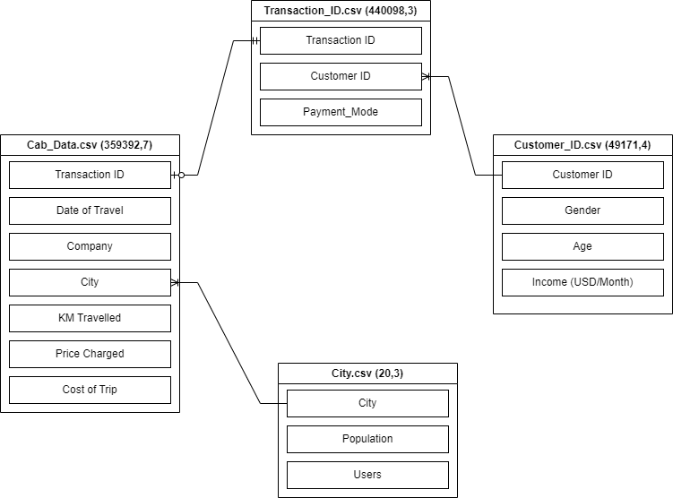
Data Understanding
22 Features( including 10 derived features)
Timeframe of the data: 2016-01-01 to 2018-12-31
Total data points :359,392
No missing values were found.
Assumptions:
Outliers are present in Price_Charged feature but due
to unavailability of trip duration details ,we are not
treating this as outlier.
Profit of rides are calculated keeping other factors
constant and only Price_Charged and Cost_of_Trip
features used to calculate profit.

Slide 4
Data Understanding
Data Understanding (cont.)
We have merged cab_data.csv, Transaction_ID, Customer_ID and also added and holiday columns corresponding to date t see the whether holidays have any impact on profit or price charged by Cab companies.
Few Columns are added into original dataset to help with Exploratory Data Analysis these are Price per km, profit, year, month, day, Distance category, Age range, Income category, Month-year, Holiday.
Added Col
Category / Features | How was it made?
Distance Category | Small trip: up to 10 kms Medium trip: 10 to 30 kms Long Trip: more than 30 kms
Age Range | 18-20, 21-30, 31-40, 41-50, 51-60, 60+
Income Category | Low: up to 1006 USD/Month (No values) Lower-Middle: 1006 to 3955 USD/Month Upper-Middle: 3955 to 12235 USD/Month High: more than 12235 USD/Month

Slide 5
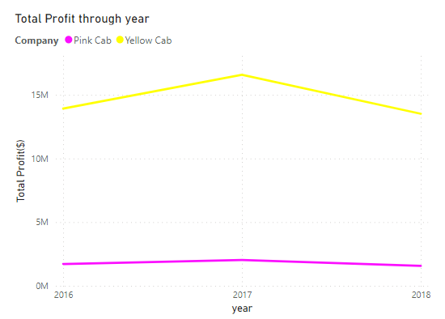
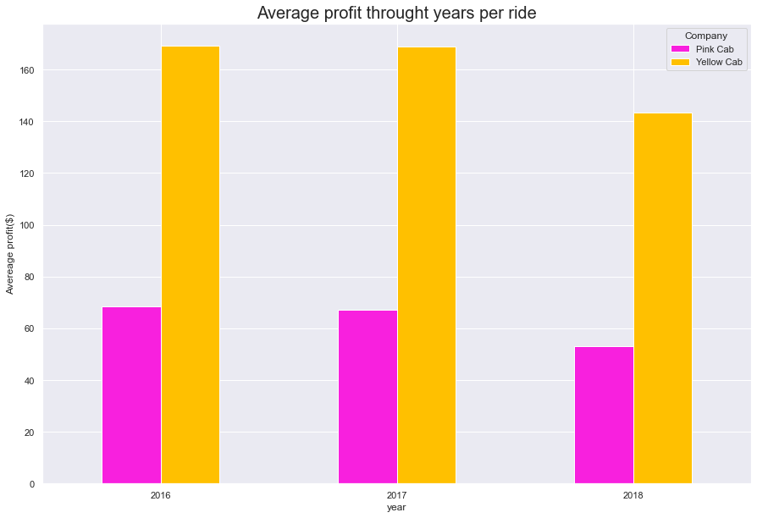
Data Understanding
Profit Analysis (Yearly)
Across all the years, Yellow Cab has consistently earned higher profits per ride compared to Pink Cab.

Slide 6
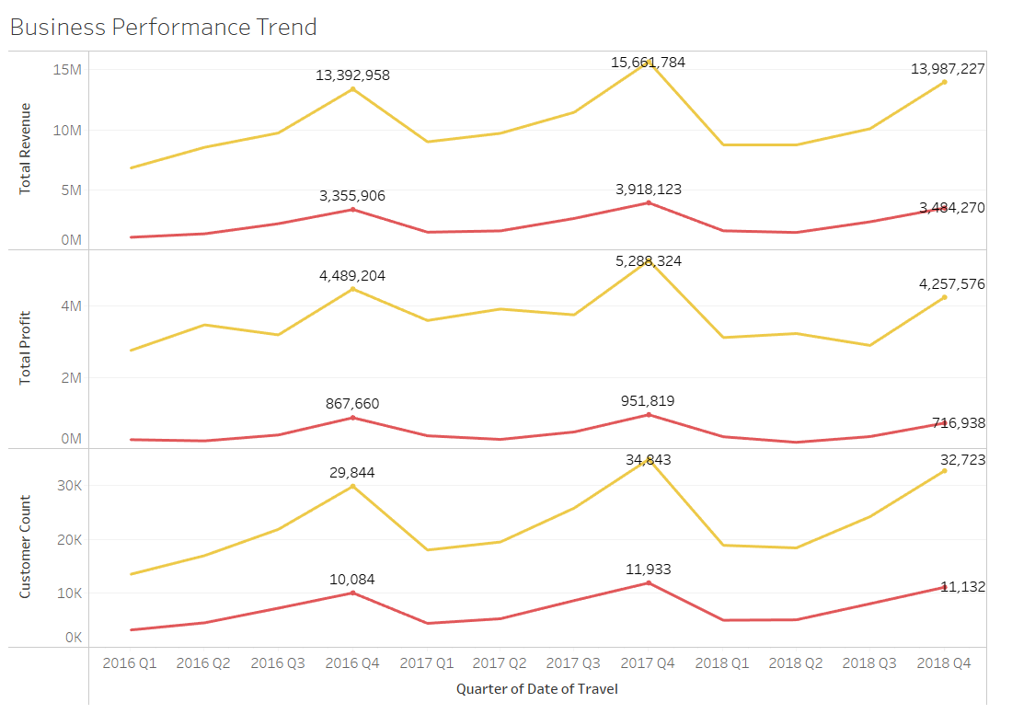
Data Understanding
Profit Analysis (Quarterly)
Yellow Cab has generated higher revenue, achieved greater profitability, and attracted a larger user base than Pink Cab.
While both companies experienced a rise in revenue during the 2016-2017 period, they faced a decline in revenue in 2017-2018, which can be attributed to a similar pattern in their user base.

Slide 7
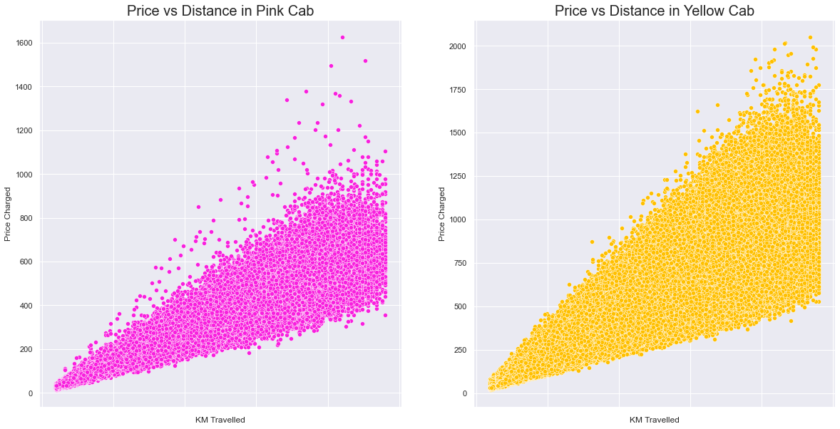
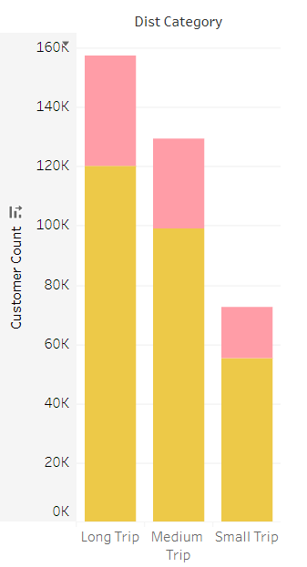
Data Understanding
Price Vs Distance Travelled
Price Charged is highly positively correlated with Distance of the Trip.
People prefer to yellow cabs more than pink Cab for Long Trips.

Slide 8
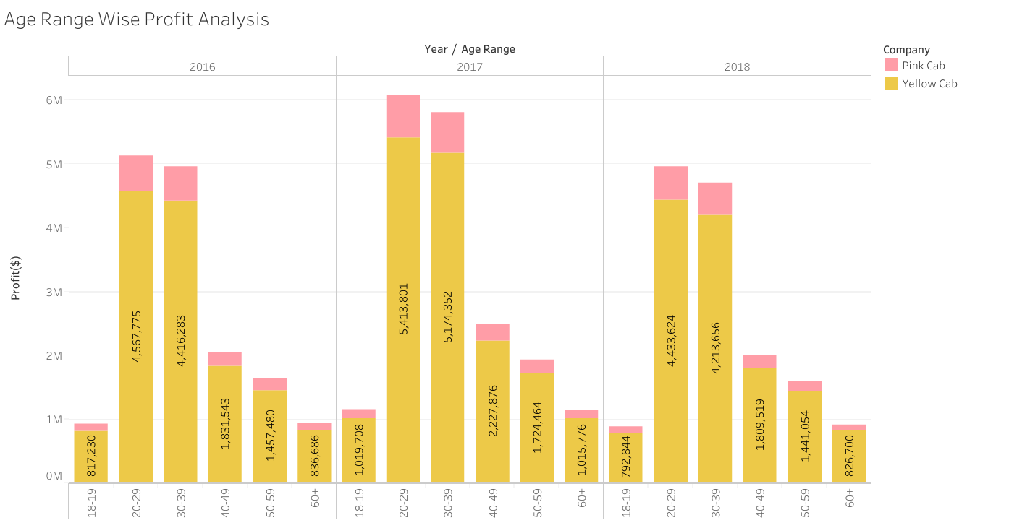
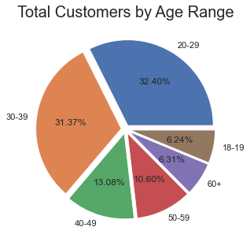
Data Understanding
Age Range wise profit and Customer Analysis
The Number of cab users seems to be decreasing with age.
Most number of users who prefers cab are aged from 20-40.

Slide 9
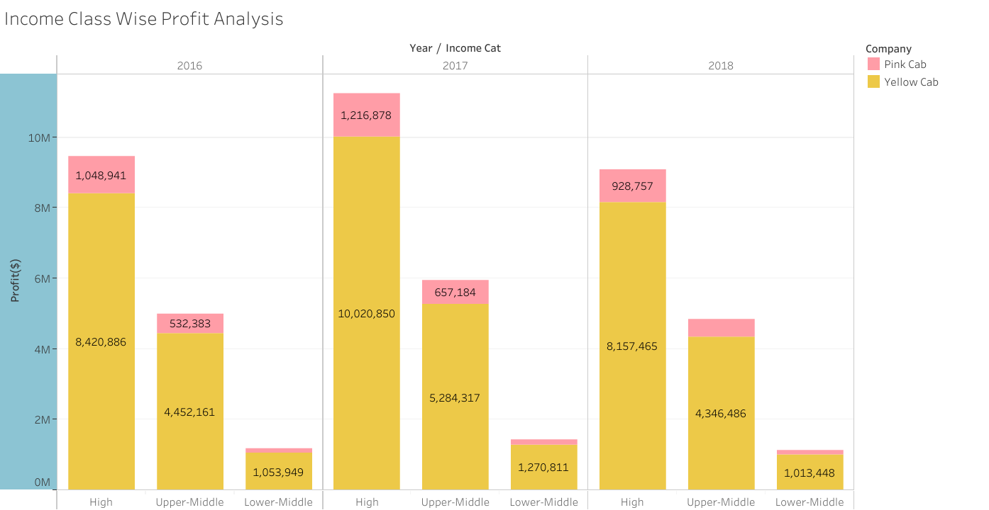
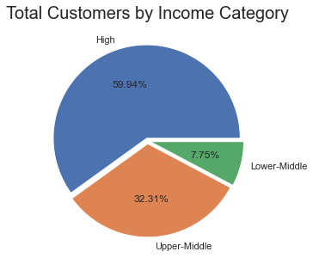
Data Understanding
Income Category wise profit and Customer Analysis
Most users seem to belong to high income class.

Slide 10
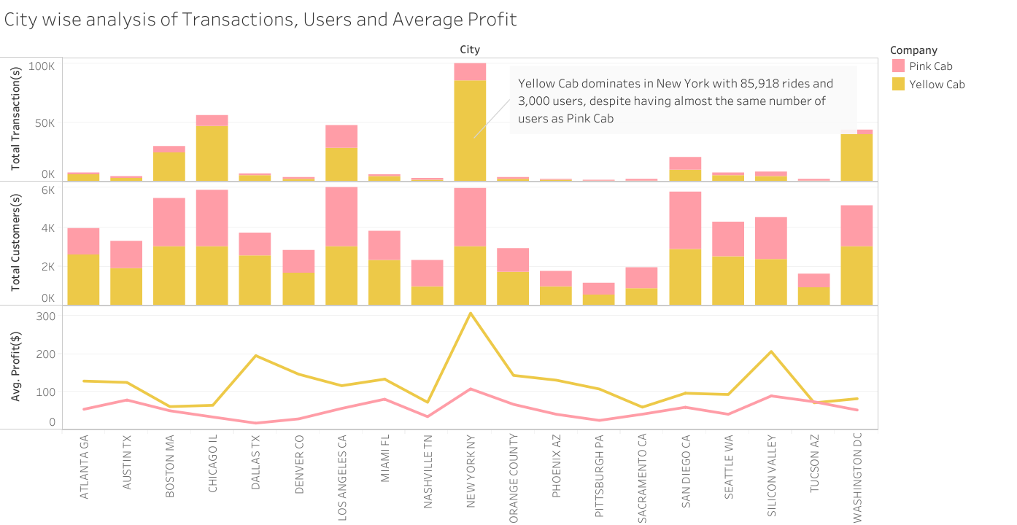
Data Understanding
City Wise analysis

Slide 11
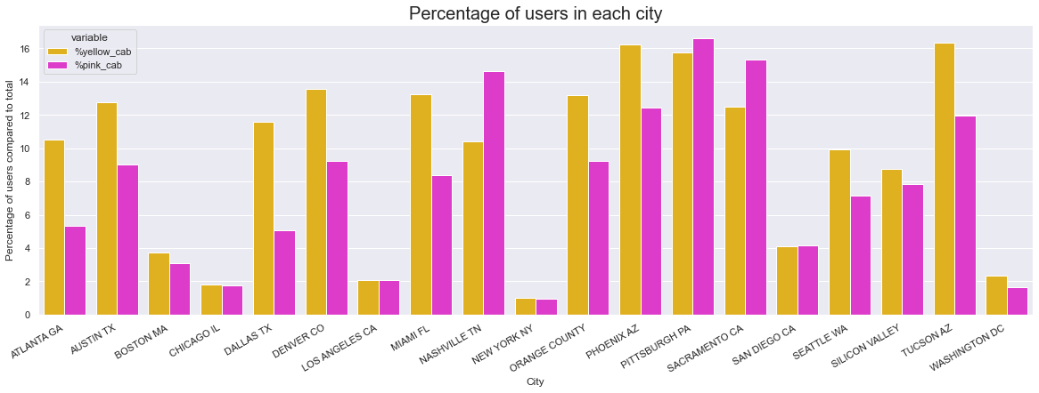
Data Understanding
Customer Base in each city
Except Boston and Washington, less than 10% of the population uses cabs.
Out of the total cab users, Yellow Cab covers 9.46% while Pink Cab covers 7.68% of the market.
Despite having a nearly identical customer base in NY, Yellow cabs receive 90% of trips, which is one of the reasons Yellow cabs generate the most profit in NY, and there is a significant difference in the profits made by Pink cabs and Yellow cabs in NY.
Pink cab has a marginally larger customer base in just four cities.

Slide 12
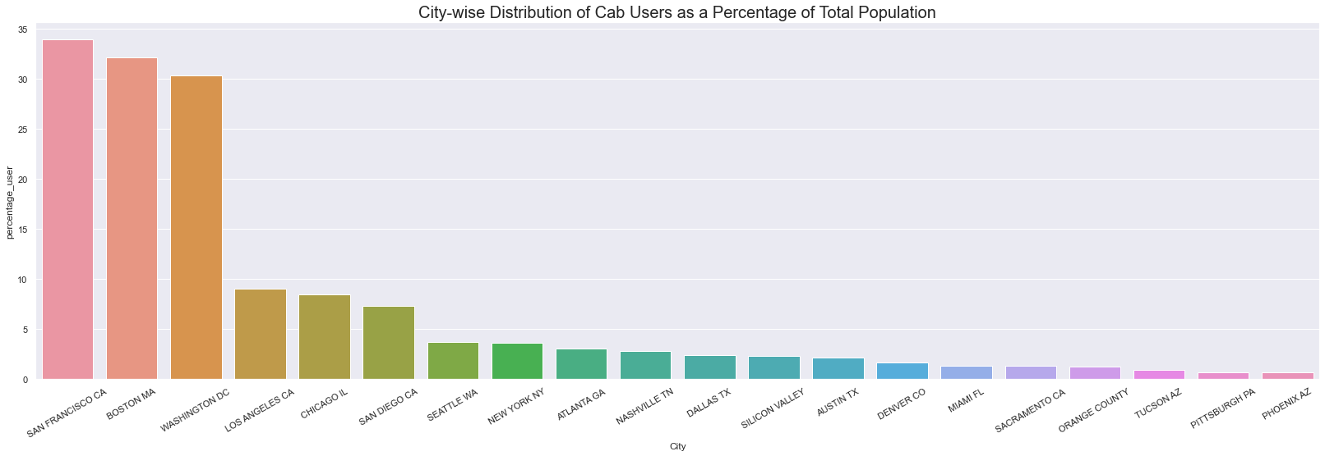
Data Understanding
Total Cab Users in each City
In San Francisco where 33.93% users cab no one uses either of yellow cab or pink cab.

Slide 13
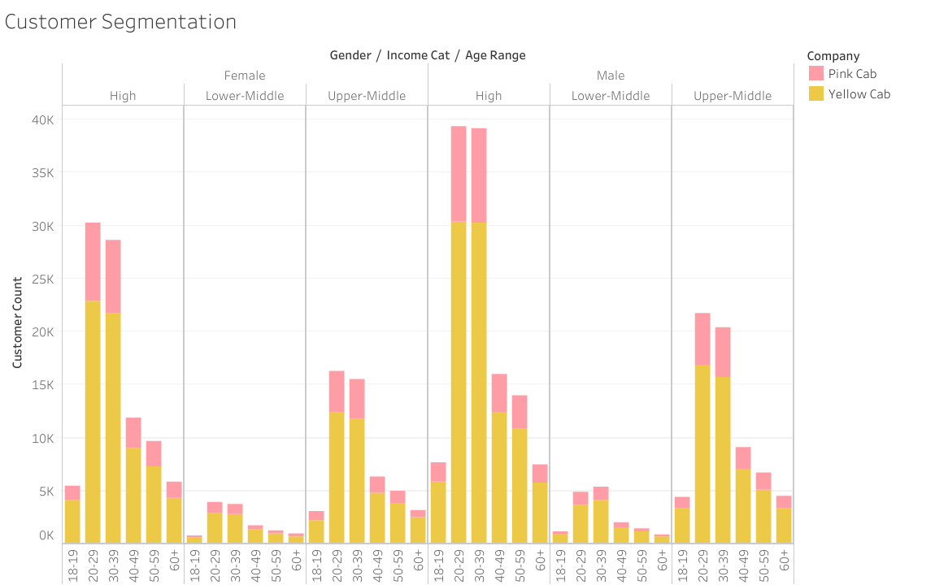
Data Understanding
Customer Segmentation
Yellow Cab outperforms Pink Cab in all customer segments based on customer analysis.
Among cab users, the most frequent users are males in the age range of 20-40 with high income.
Cab usage is higher among males than females.
The majority of cab users belong to the high-income class.
Cab usage appears to decrease with age.

Slide 14
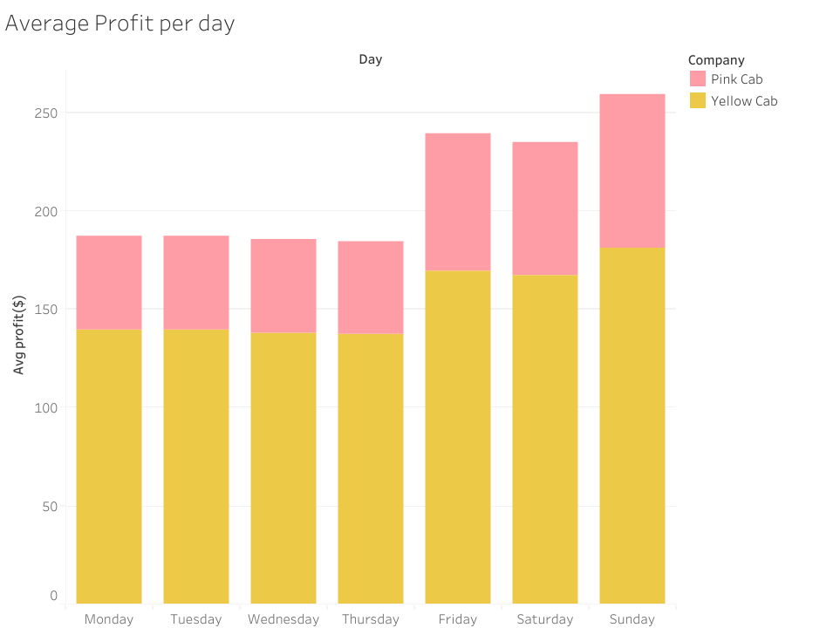
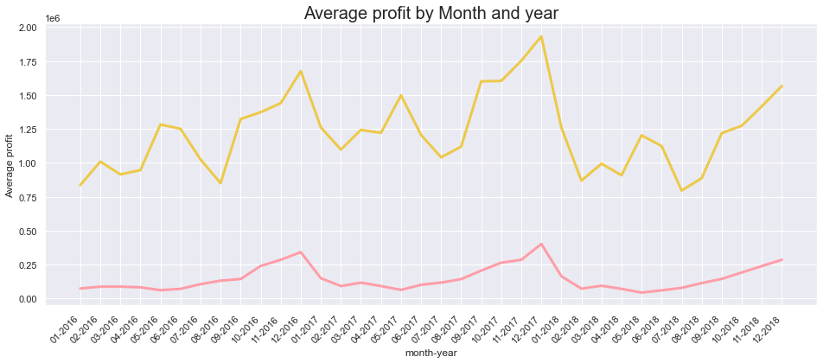
Data Understanding
Average Profit Trend
By examining the average monthly profits, it was found that there were certain months (July and August) when Pink Cab's profits increased while Yellow Cab's profits decreased. This could be attributed to the discounts that Pink Cab offered during those specific months.
During the winter months and on weekends, both Yellow Cab and Pink Cab saw an increase in profits.
Yellow Cab has shown more yearly growth than Pink Cab and has more demand than Pink Cab across all the months.

Slide 15
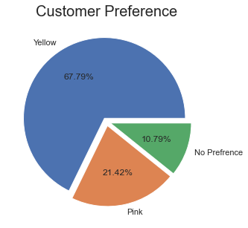
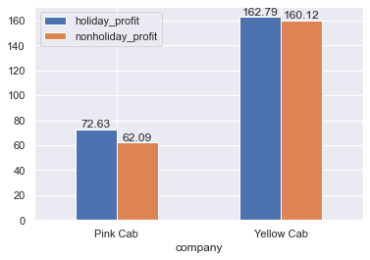
Data Understanding
Customer Preference and Holiday Profits
After analyzing the trips made by customers in both companies and their preferences, a key performance indicator (KPI) was created.
The analysis revealed that over two-thirds of customers prefer Yellow Cab, indicating a higher customer retention rate for the company due to its pricing model during various events and services.
There is a significant difference in Profit for Pink Cab during holidays and regular days.

Slide 16
Recommendation
The EDA results indicate that Yellow Cab outperforms Pink Cab in almost every aspect, making it a better investment choice.
Despite a slight decrease in average profit, Yellow Cab has consistently increased its total profits over the years, demonstrating its success in acquiring and retaining customers. This is further reflected in the rising number of Yellow Cab customers.
Yellow Cab's superior pricing model has engendered greater customer trust, resulting in higher revenues and a larger customer base compared to Pink Cab. Moreover, customers prefer Yellow Cab over Pink Cab for their stable pricing during holiday events.
Yellow Cab customers take significantly more trips than Pink Cab customers, despite traveling the same average distance. This suggests that Yellow Cab has been successful in retaining its customers.
On the basis of above point(s) , we will recommend Yellow cab for investment.

Slide 17

Thank You

