Slide 1


IEEE
Student Branch Jiit
SAKHI APP
ALLPPT.com _ Free PowerPoint Templates, Diagrams and Charts

Slide 2

ABOUT THE TEAM
TEAM MEMBER:-
Team Name:-
Codewarrior
1)Yash jain
Details:-
Year:-First Year(Fresher)
College:-Jaypee Institute Of Information Technology, Sec-62,Noida
Branch:-Computer Science and Engineering(C.S.E)
Degree:-Dual Integrated B.Tech + M.Tech
Batch:-B12
Resident:-Sawai Madhopur,Rajasthan

Slide 3

IDEA/SOLUTION
Inspiration:
In the modern era, women cannot so much as leave their house without being constantly aware of their surroundings for fear that they could be assaulted. Women go out in groups, live in groups, and even go to the bathroom in groups. Being in a group gives them a sense of security, but what about when they go out alone? With our app, even going out alone,you are never alone. This will empower users to embrace their independence and empower them to live full and fulfilling lives.
Solution:
Our goal was to create a simple and creative Appliacation for users to document their feelings, and relieve stress or anxiety. We wanted to create a platform to improve users mental health through a progressive timeline of a meditation and health issues and affirmations that empower users in difficult times

Slide 4
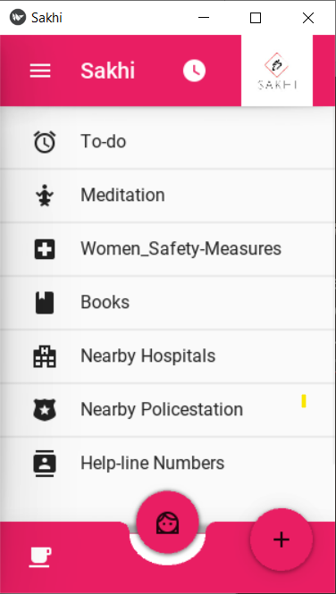
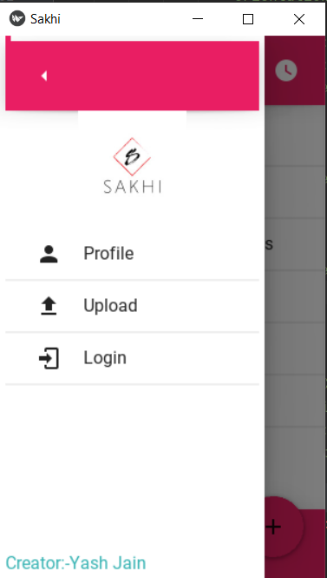
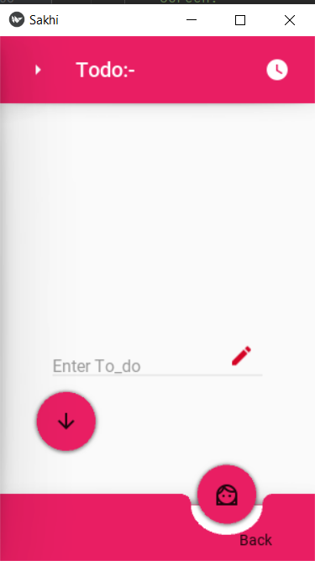
APP-SAKHI
What it does:-
We created a web-app in which we customized various activity .You have options to create a daily entry using To-do .This web App also includes Meditation exercises , Women Safety Measure, Women Motivational Books to read in alone time , Nearby Hospitals details , Nearby Policestation details for safety purpose, and at last important Helpline numbers for women safety.

Slide 5



APP-DESCRIPTION
How we built it:-
We used Kivymd which is a collection of Material Design compliant widgets for use with Kivy, a framework for cross-platform, touch-enabled graphical applications for the app design and implementation. Kivy is a free and open source Python framework for developing mobile apps and other multitouch application software with a natural user interface.
The app is made for Android. It can also run on iOS, GNU/Linux, macOS, and Windows

