Slide 1


Slide 2
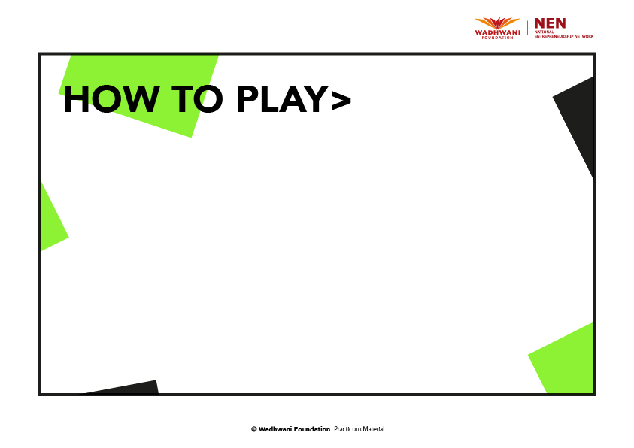
1. TEAM UP.
Pick an Inventor Badge and pair up with your twin. Doubles tournament. 2 vs 2.
2. PLAY.
(The Game begins with the trigger “DERIVE” and ends with “TRANSFORM”. )
• The Trigger is announced.
• A random Object Card is picked by the facilitator and flashed to the class.
• The Timer ticks for 5 mins. Each team aims to generate the maximum number of ideas within that time frame.
• When the time is up, the opponent team counts the ideas and records the score for the trigger round, on the Score Card.
• Each idea fetches one point. (a sketch qualifies as an idea if it has a name and explanation to it).
• Repeat the drill for the next trigger.
3. D.I.S.R.U.P.T. LaunchPad.
After the 7 triggers are played, each team picks their best idea, crafts it out on the Disrupt Card and presents it to the class (2 mins).
4. VOTE.
All the Disrupt Cards are then pinned up. Each player casts their vote for any one best idea (can’t vote for your own team),
by drawing a dot on the side of Disrupt Card. Each vote fetches the team 50 bonus points.
5. SCORE.
Opponent teams total up the scores from all 7 triggers + Disrupt votes (if any).
Team with the maximum points wins.

Slide 3
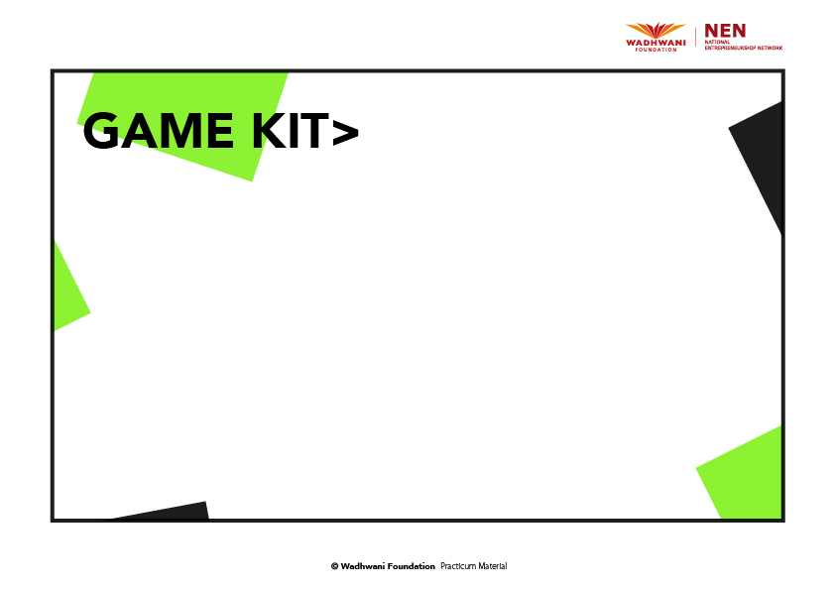
1. TIMER
To keep time. 5 min for each trigger. 30 min for the final Disrupt Card. 2 min for Presentation. 10 min for Vote.
2. INVENTOR BADGES
One badge per Player. Each team will have twin badges. Need to be worn while playing the game. Make sure there are
enough badges or take additional print outs. Provide pins or cases for badge display.
3. OBJECT CARDS
20 objects cards. which will be picked by the facilitator and flashed to all players.
4. IDEA CARDS
Each team gets an unlimited amount of blank sheets to jot down ideas for the 7 Triggers. Use one sheet per idea. Ideally A5 size.
5. D.I.S.R.U.P.T. CARD
One card per Team. All Criteria need to be filled out by the team, for presentation.
6. SCORE CARD
One card per Team. Handed out to the Opponent team for scoring.

Slide 4
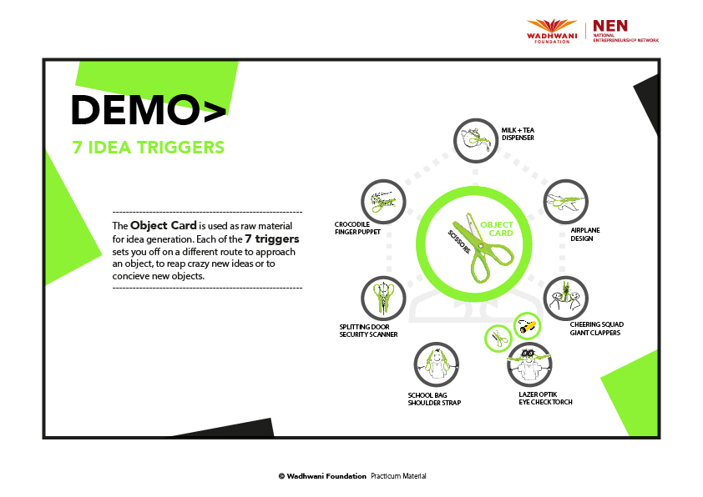

Slide 5
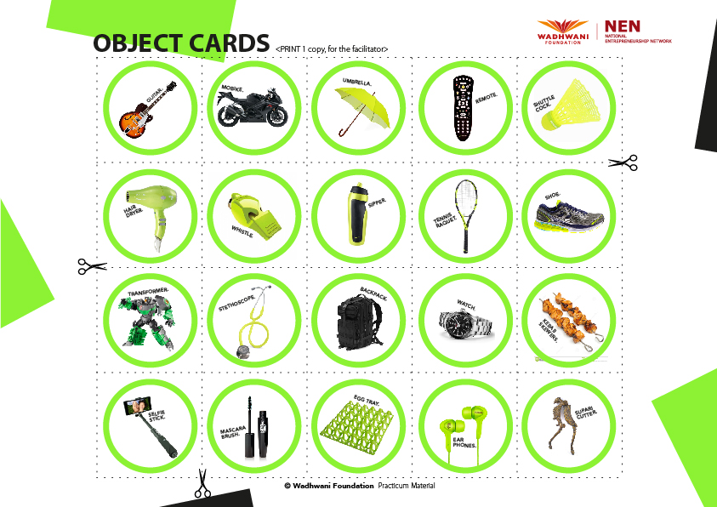

Slide 6
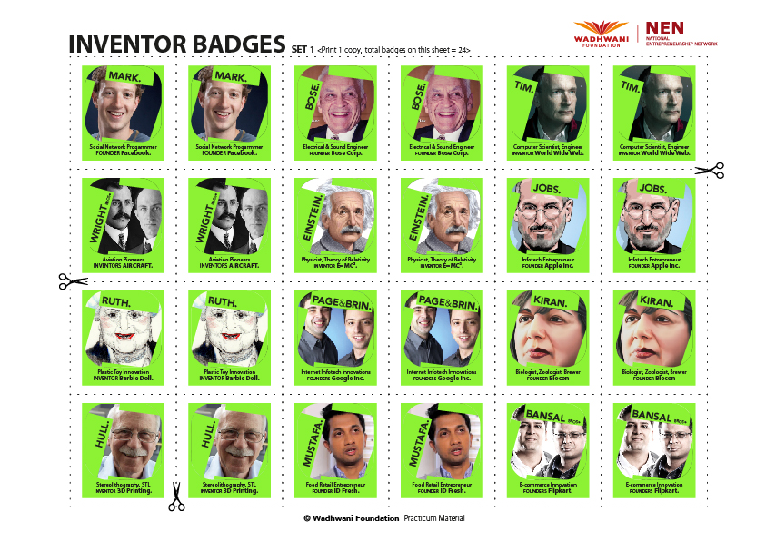

Slide 7
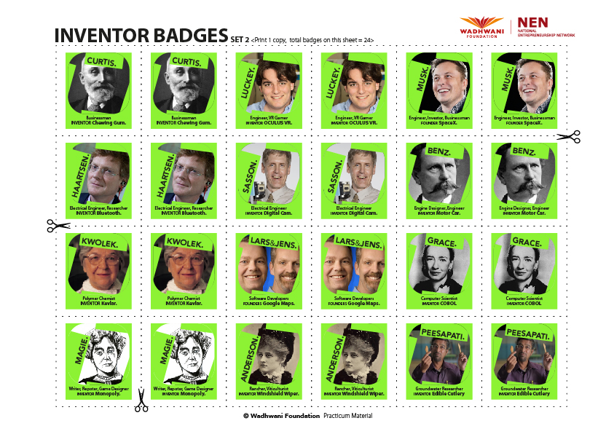

Slide 8
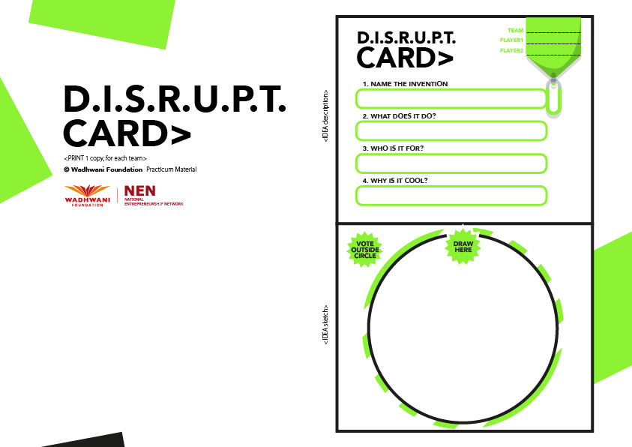

Slide 9
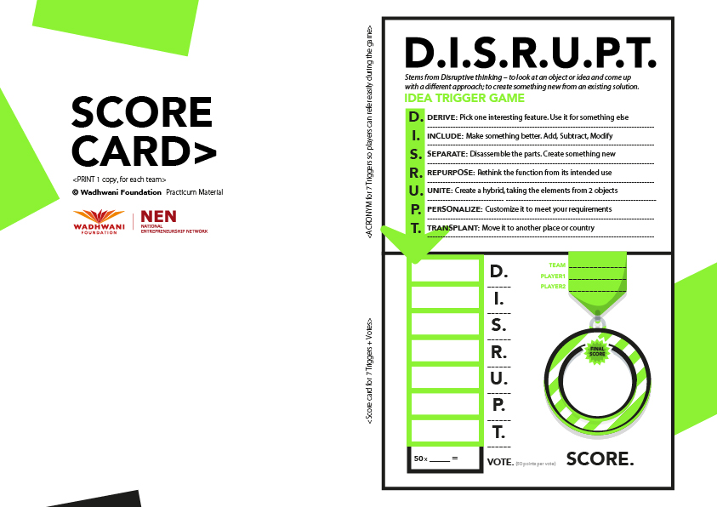

Slide 10
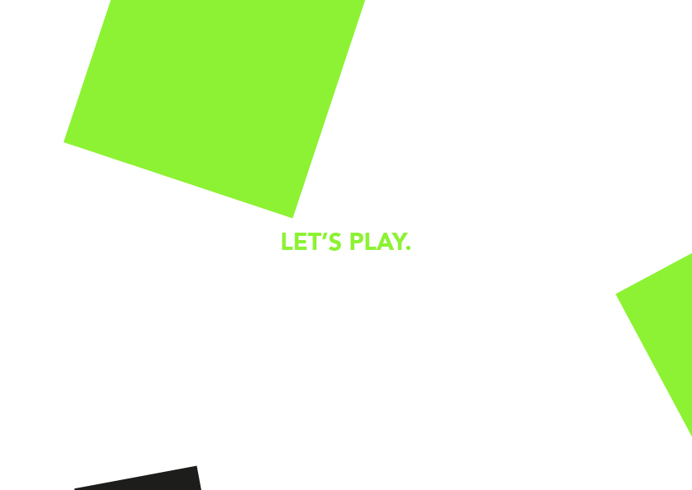

Slide 11


