Slide 1


We-APP
Capstone Project On-
“Weather app using react.JS”
Mentored By –
Ravi Chandran
Presented By –
Nachiketa Prasad
Sonu Raghuwanshi
Yash Kumar Jaiswal

Slide 2
Contents
Objective
Work-Flow
Technology
Engineering Practices
Live Demo
Test Cases
References

Slide 3
Objective
Weather Forecast App
Search specific city weather
Suggestion according to the weather
Add city to the Favorites
Good UI and UX

Slide 4
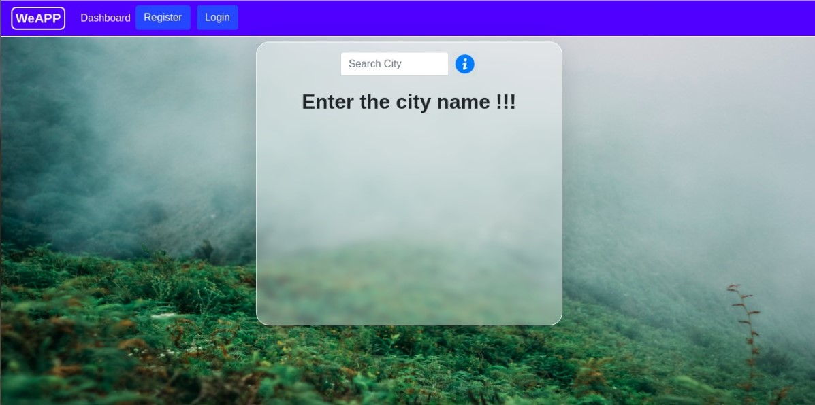
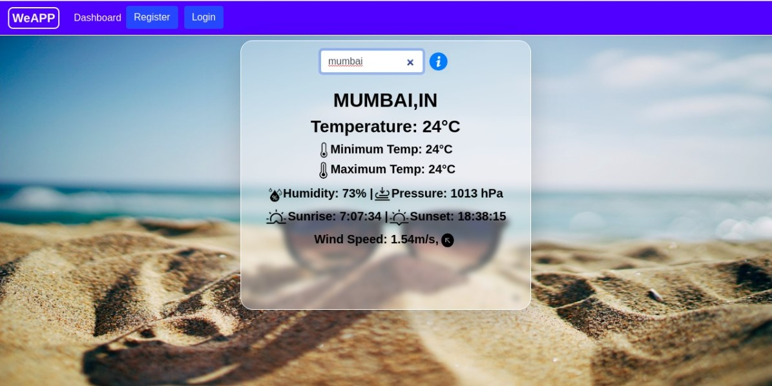

Work-Flow
Request
City=mumbai
Object
of Arrays

Slide 5
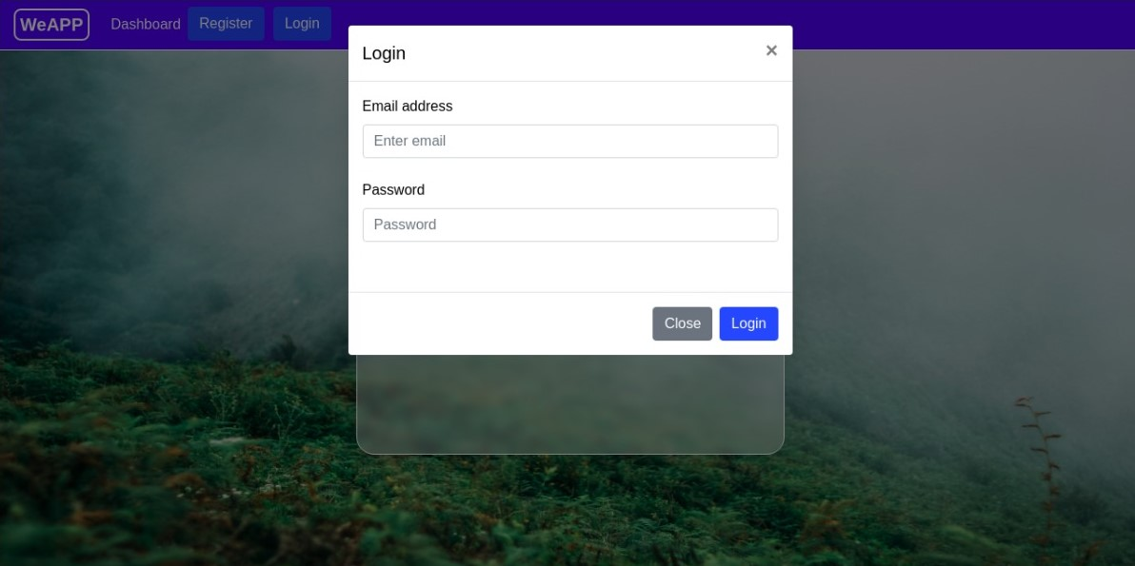
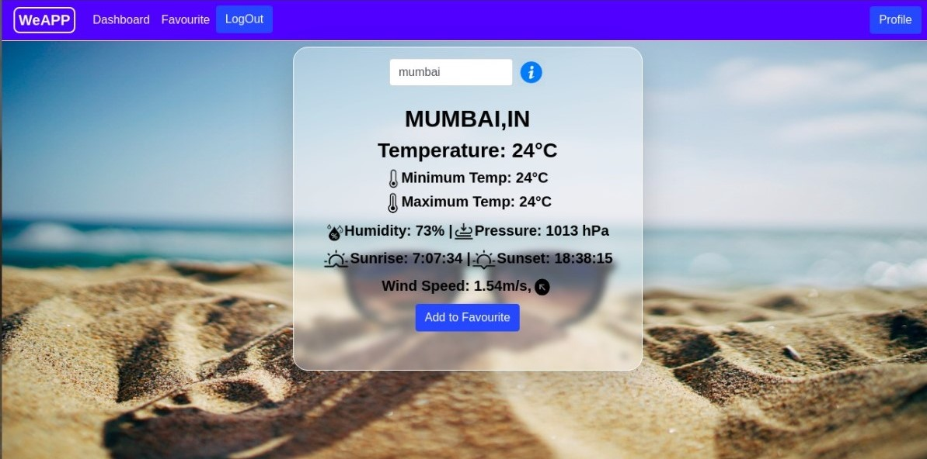

Work-Flow
db.json
demo-mail@gmail.com
Request
Email & Password
*********
Token

Slide 6
Technology
We-APP

Slide 7
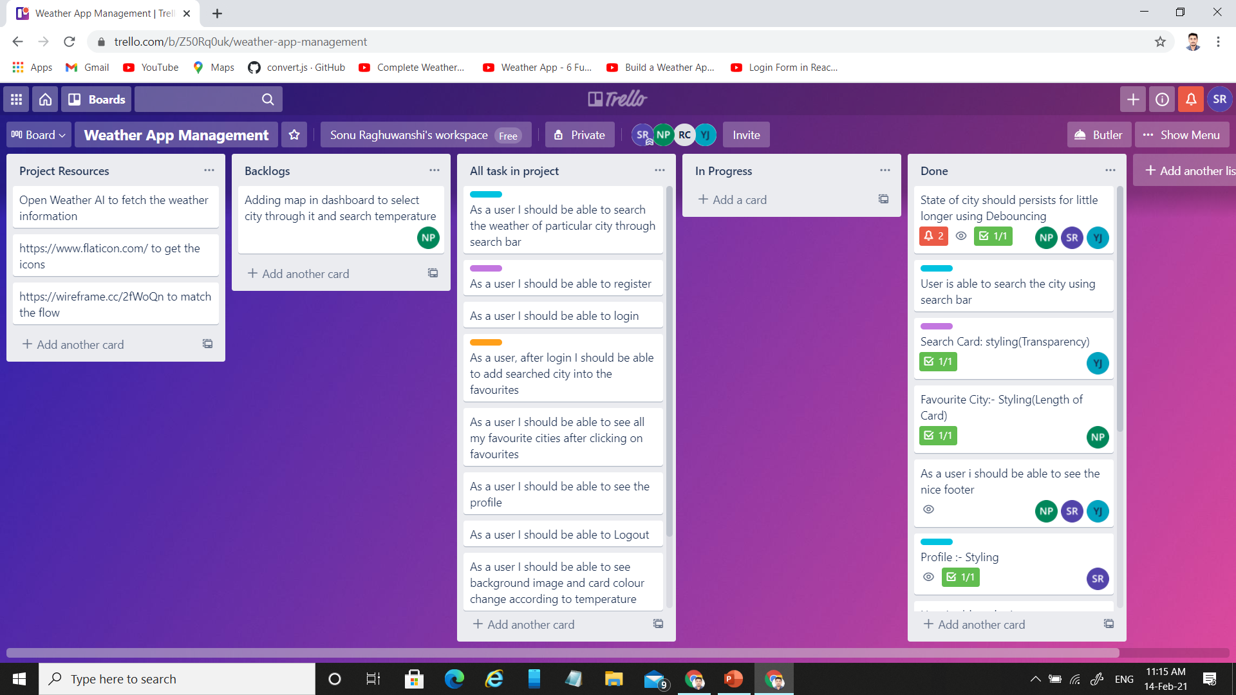
Engineering Practices
Agile : involve discovering requirements and developing solutions through the collaborative effort of self-organizing and cross-functional teams and their customer/end user.
Trello

Slide 8
Live Demo

Slide 9
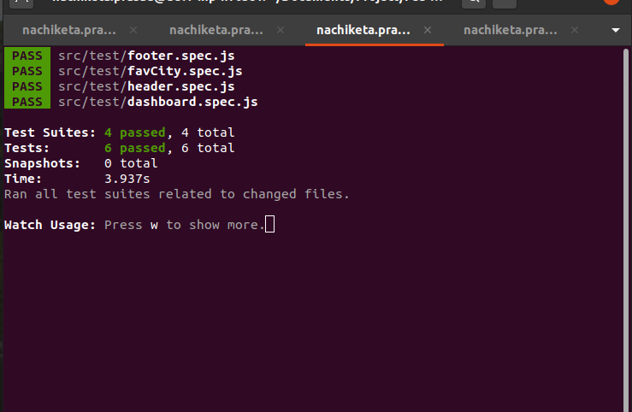
Test Cases

Slide 10
Reference
https://openweathermap.org/api
https://www.flaticon.com/free-icons/fat
https://stackoverflow.com/questions/tagged/reactjs
https://getbootstrap.com/
https://wireframe.cc/
https://trello.com/
https://reactjs.org/

Slide 11


