Slide 1
Decentralized Token Exchange (DEX)
Building a Web3 Swap Platform on the Ethereum Blockchain

Slide 2
What is Blockchain?
Blockchain is a decentralized digital ledger used to record transactions securely.
It stores data in blocks that are linked together in a chain.
Each block contains transaction data, timestamp, and a cryptographic hash of the previous block.
The data is distributed across many computers (nodes) in a network.
Once information is added, it cannot be easily changed or deleted.
Blockchain provides transparency, security, and trust without a central authority.
It is widely used in cryptocurrencies like Bitcoin and Ethereum.

Slide 3
What is DeFi ?
DeFi (Decentralized Finance) is a financial system built on blockchain technology.
It allows people to use financial services without banks or intermediaries.
Transactions are done using smart contracts on blockchain networks like Ethereum.
Users can lend, borrow, trade, and earn interest directly using cryptocurrency.
DeFi platforms are transparent, open, and accessible to anyone with internet.
It gives users full control over their funds through digital wallets.
Examples
Decentralized Exchanges (DEX)
Crypto Lending and Borrowing
Stablecoins
Yield Farming and Staking

Slide 4
Project
Our project is a Defi Dapp that can be used for token swapping from either CTA to CTB or CTB to CTA.
Beside swapping a user can also see current status of market gainers and losers with their market cap and price.
Here the process of swapping being done through Metamask wallet.
Here we have used sepolia ethererum testnet for deployment

Slide 5

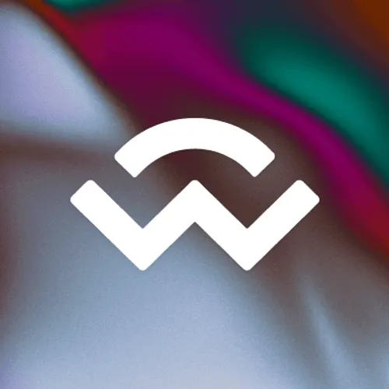
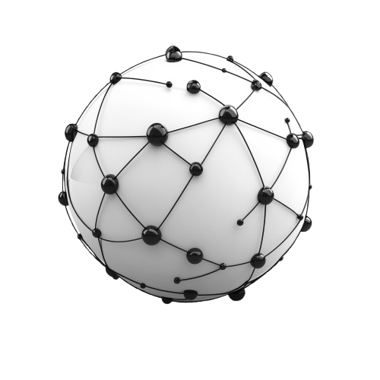

Common terms in project
This is Metamask web3 wallet that is used to store blockchain assets and also allows to interact with Dapps like Uniswap.
Wallet connect - This feature is used to connect or allow our metamask wallet to in
interact with Dapps.
Confirmations nodes - It shows that how many miners of network have confirmed this transaction as valid and trust worthy as per network rules.
Block Explorer - It is a decentralized publically hosted/available database of all the activities occurring with in the network. Whatever transaction or activity which is being made within the network all that can be easily seen on .

Slide 6
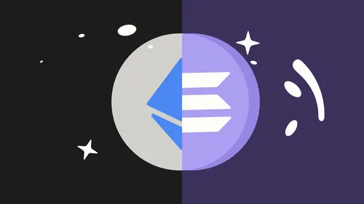
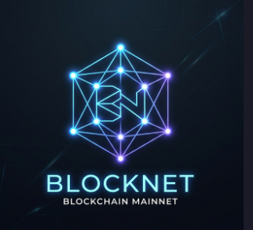
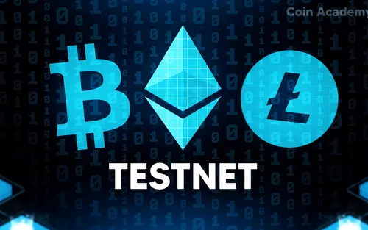
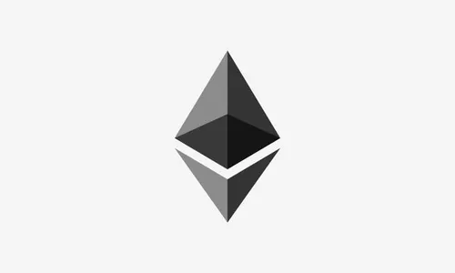
Ethereum and solana are the powerful ecosystem that use to create a new Dapp , token , contract , games , etc on a specific network.
Mainnet is the actual real network of blockchain where real money moves all around.
Testnet is the testing network used for testing purposes of projects with any network.
Crypto is the main coin of network and token is the sub token of the main crypto.

Slide 7
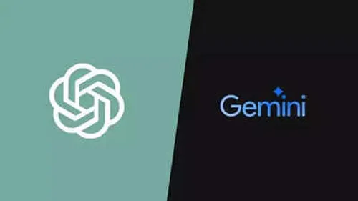
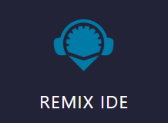
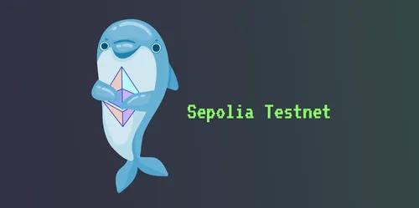
Tools used--
Used for fixing errors and structuring overall code for project.
Remix IDE is the coding environment for Ethereum ecosystem language solidity.
Sepolia network is used in this project for deployment.
Metamask is the web 3 wallet used to store and interact with smart contracts of blockchain.

Slide 8
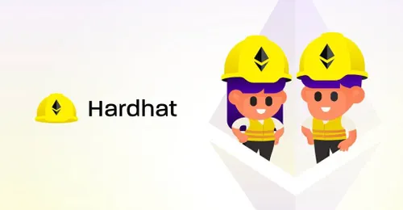


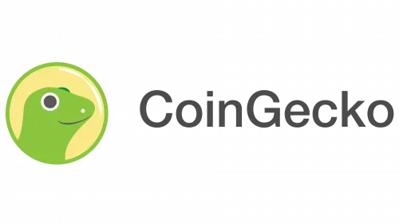
Hardhat in this project is used as central development environment and testing smart contracts. It mainly used for ---
Compiling solidity code
Local testing environment
Testnet & Mainnet deployment script
Quicknode is the RPC node of blockchain that push or pulls data through nodes with vary transactions. It also provides API for swapping rates .
Github here is used to store and host the project as fully functional website.
CoinGecko is the platform which is used to know current rates and
their cap of market and as well as their swap rates .

Slide 9
Steps to use DefiCollege--
Step 1 : Go to url – https://yashjang1.github.io/defi-web3
Step 2 : Install metamask if not installed
Step 3 : Connect wallet – Now connect metamask with site
Step 3 : Add sepolia in metamask with site https://www.alchemy.com/overviews/how-to-
add-sepolia-to-metamask
Step 4 : Import token CTA with address –
“0x4edD12C80E4E120991a182526fB3F5Cc71059a9c”
Import token CTB with address –
“0x86cFB3753cffAb8Ba1052940bb8047d9e5c00bef”
use above addresses in deployed account only !
Step 5 : Now a user can use DefiCollege and swap tokens or can track them

Slide 10
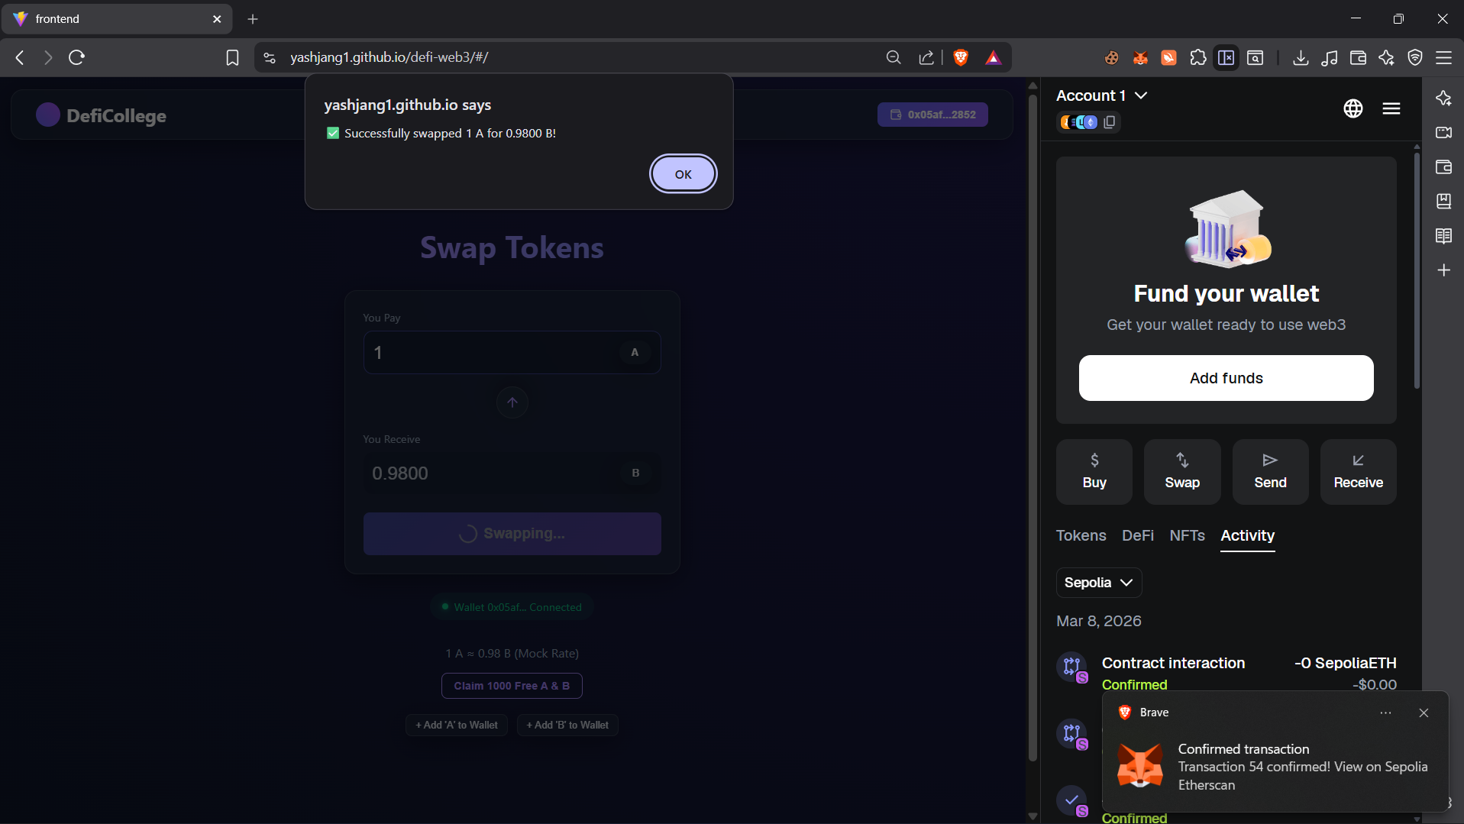

Slide 11
Updates for DefiCollege
Beside swapping we can also implement logic of buy and sell through local currency like upi , card

Slide 12
DefiCollege successfully demonstrates the power of decentralized finance.By bridging javascript and Solidity, html, css it abstracts complex blockchain mechanics into a seamless, user-friendly interface.
Conclusion

