Slide 1
Software-Based load balancer
Presented by:
Yashvi Joshipura
Abdur Rahman shaik

Slide 2
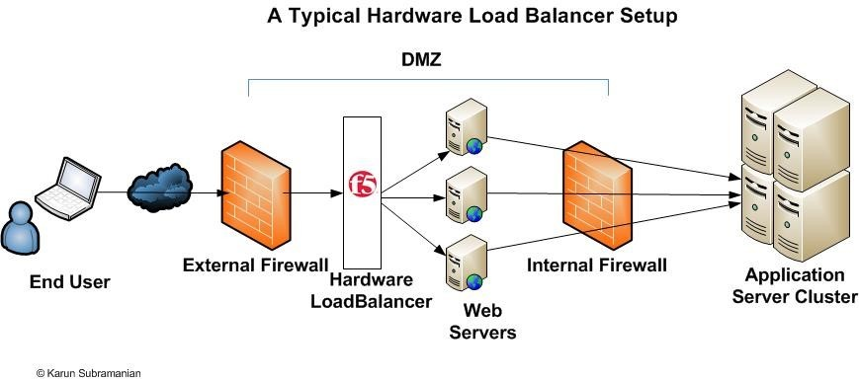
Motivation
Exponential growth in data traffic causes server overload, downtime, and poor user experience.
Traditional hardware load balancers are expensive and inflexible for modern cloud environments.
Need for a cost-efficient, scalable, and reliable software-based solution for traffic management

Slide 3
Problem statement
As demand grows, servers face the risk of becoming overloaded.
Overloaded servers lead to potential downtimes, slower response times, and a subpar user experience.
Traditional hardware load balancers are expensive.
Hardware solutions may lack the flexibility required for rapid scaling in cloud-native environments.
This project aims to create a flexible and cost-effective software load balancer.
The software load balancer is designed to adapt to real-time traffic variations.

Slide 4
Techniques used
Load Balancing Algorithm:
Round-Robin Algorithm: The algorithm spreads incoming requests in sequence across available servers, thus ensuring uniform traffic distribution.
Health Monitoring:
Round-the-clock monitoring of the health of servers to detect non-responding servers. Traffic automatically gets rerouted when the detection of a failure occurs in an operational server.

Slide 5
Techniques used
Incremental Development:
Implemented in an incremental fashion: first a simple skeleton of the load balancer was implemented, with a gradual implementation and testing of algorithms.
Testing and Evaluation:
The performance of the system was measured under low, medium, and peak conditions using simulated traffic workloads. The metrics included efficiency of traffic distribution.

Slide 6
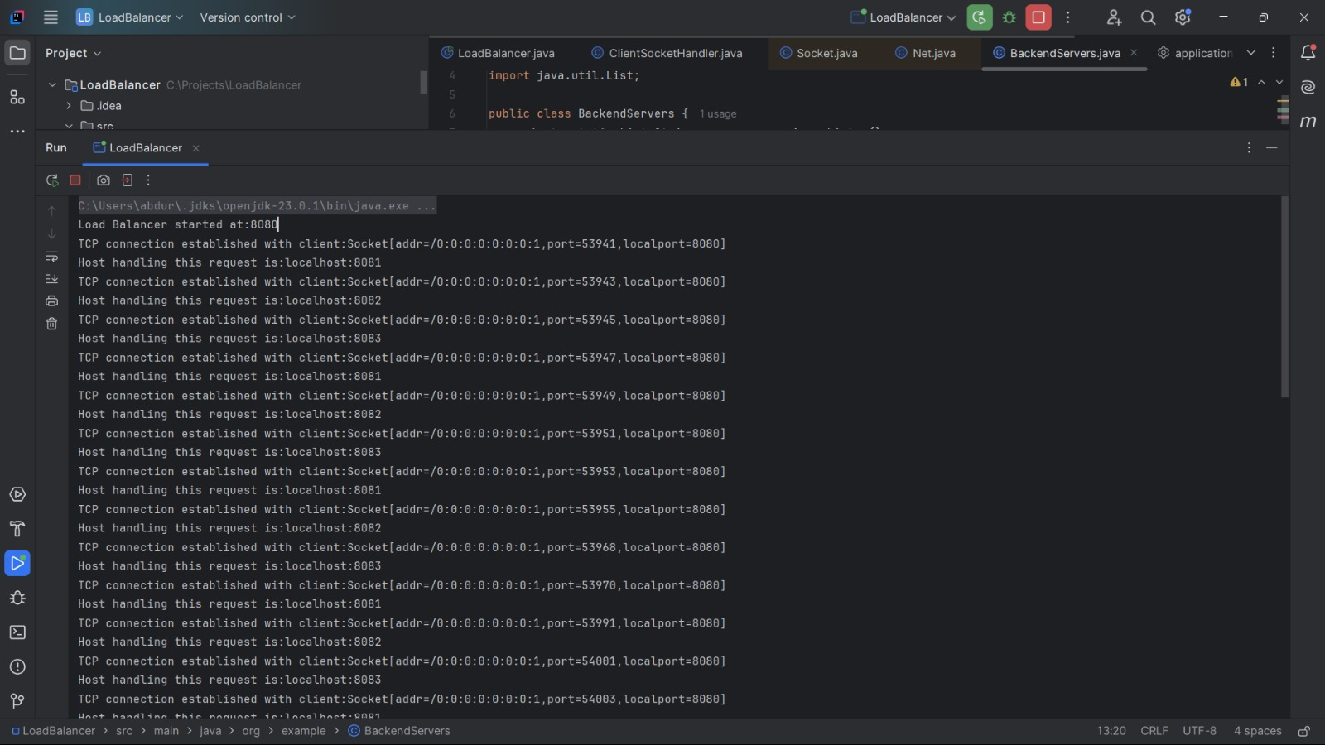
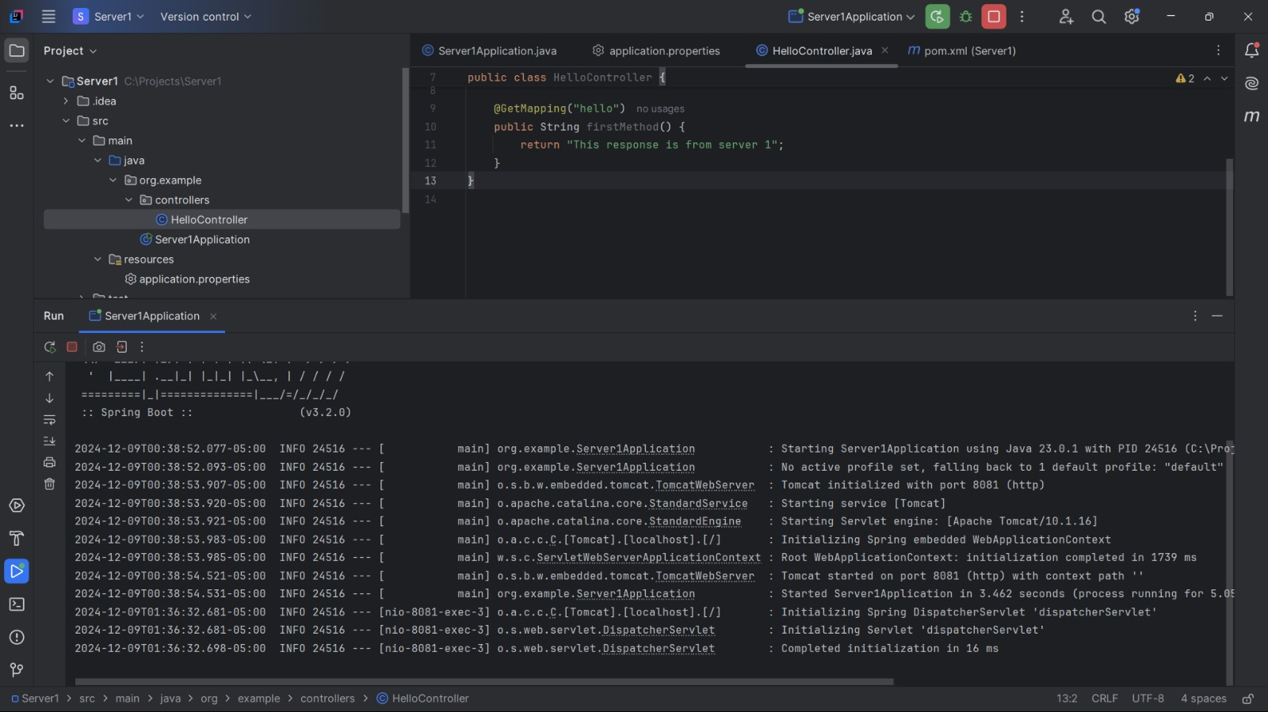
implementation
Figure: Load Balancer Initiation
Figure: Server 1 Initiation

Slide 7
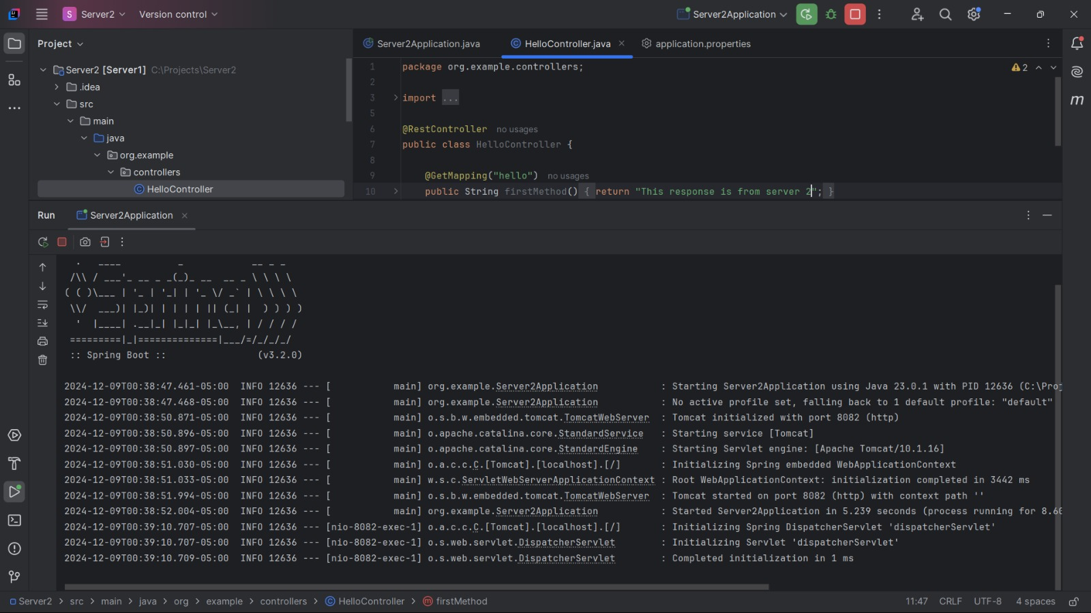
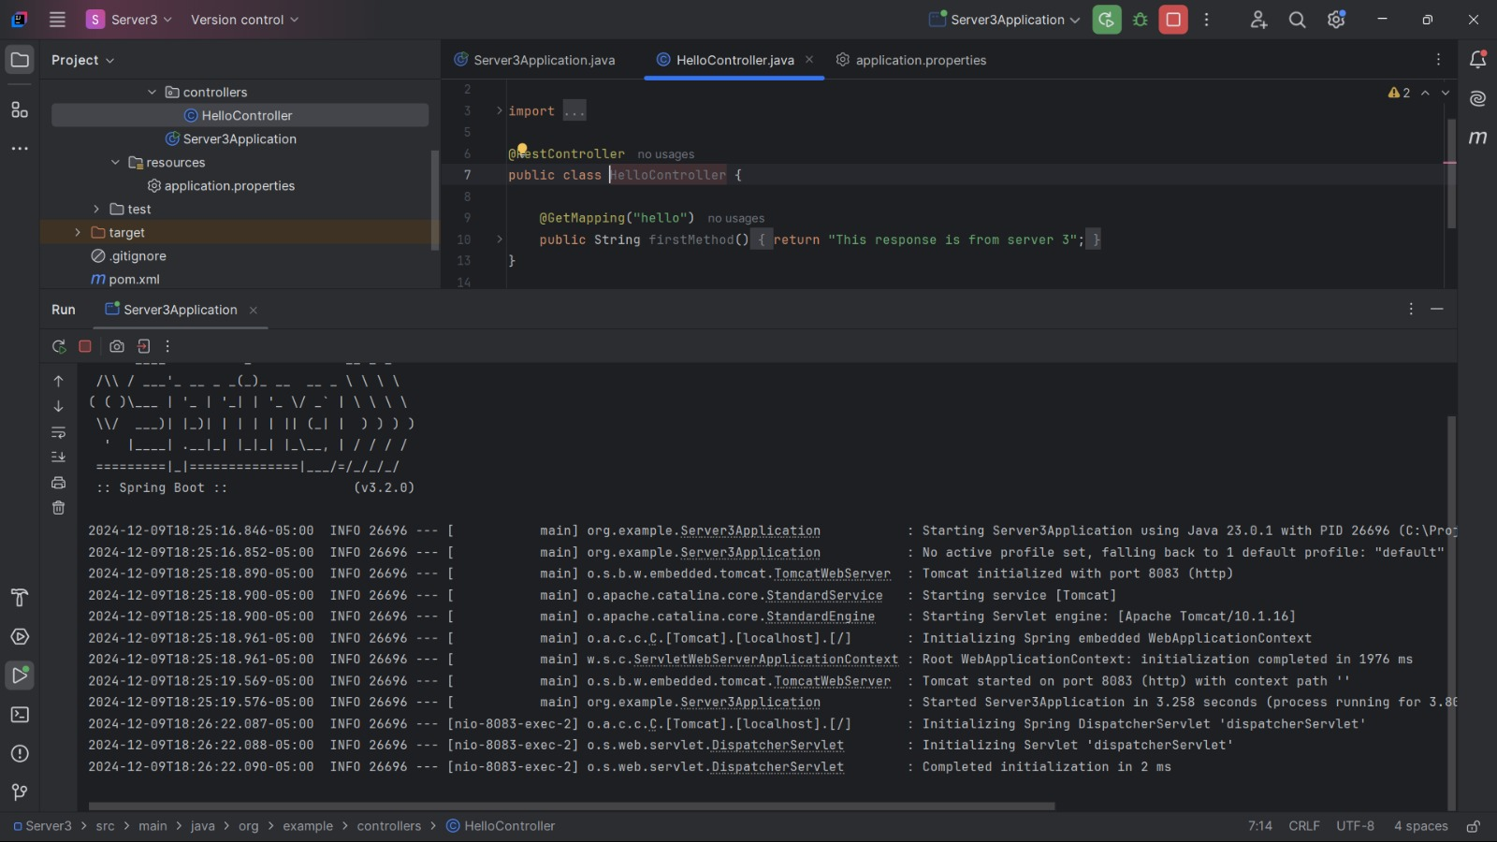
implementation
Figure: Server 2 Initiation
Figure: Server 3 Initiation

Slide 8
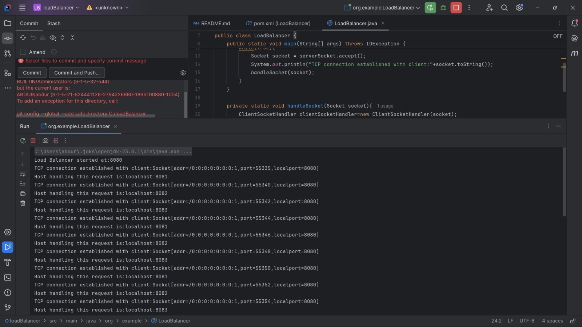
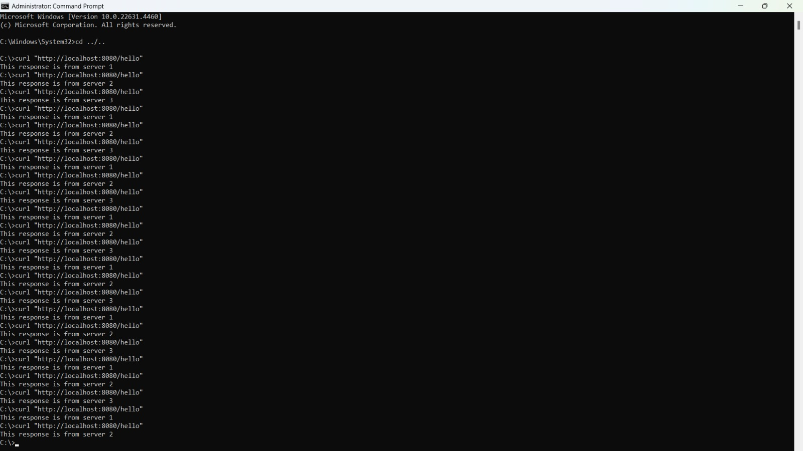
Evaluation
Figure: TCP Connection Established with Client
Figure: Load Balancer
Output

Slide 9
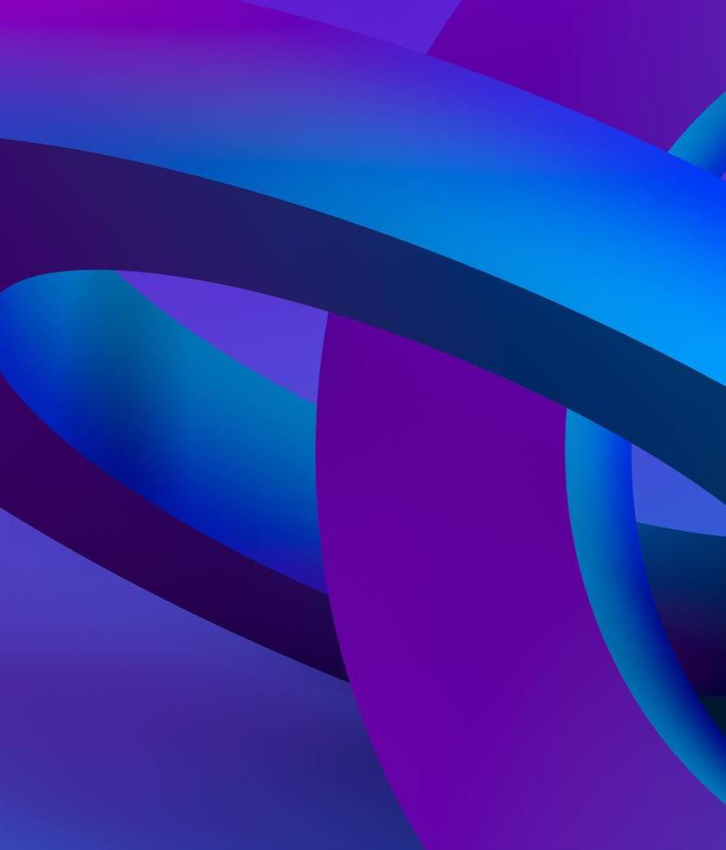
Future Work
Measurement of different metrics like response time and fault tolerance with and without using Load Balancer.
Implementation of Least-Connections Algorithm and comparing it with Round-Robin Algorithm.

Slide 10
THANK YOU!

