Slide 1

IMDB Movie
Analysis

Slide 2

TOOL USED
MS- EXCEL

Slide 3
Problem Statement:-
Based on the massive movie information, it would be interesting to understand, what are the important factors that make a movie more successful than others? So, we would like to analyse what kind of movies are more successful, in other words, get higher IMDB score.
In this project, we take IMDB scores as response variable and focus on operating predictions by analysing the rest of variables in the IMDB movie dataset. The results can help film companies to understand the secret of generating a commercial success movie.
Please Note:-
Since some of the solutions cannot be shown fully because of size and quality constraint of the screenshot therefore the drive link for the excel sheet is pasted here for full solution and reference.
The drive link:-https://docs.google.com/spreadsheets/d/1LRMMixIPoC2Ol3CnJmAbiqKGQe6dnRTN/edit?usp=sharing&ouid=107932508938240092754&rtpof=true&sd=true

Slide 4
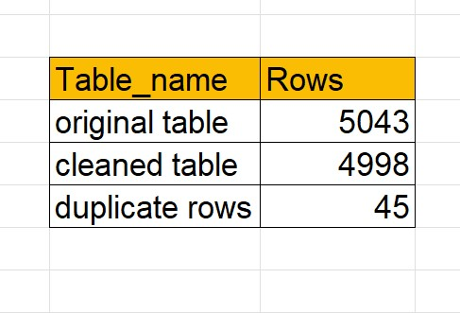
1.Cleaning the data:-this is one of the most important step to perform before moving forward with the analysis. Use your knowledge learned till now to do this. (Dropping columns, removing null values, etc.) Task: clean the data
Please Note:-
Under categorical columns the blank cell is replaced by null and under numerical column it is replace by 0 (zero)

Slide 5

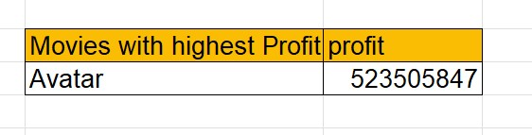
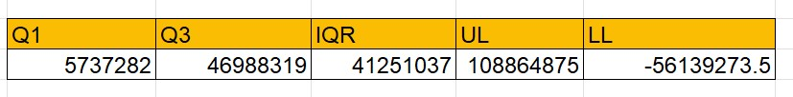
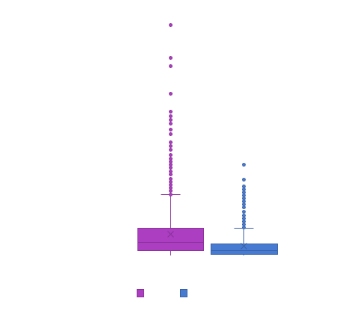
2.Movies with highest profit: create a new column called profit which contains the difference of the two columns: gross and budget. Sort the column using the profit column as reference. Plot profit (y-axis) vs budget (x- axis) and observe the outliers using the appropriate chart type. Task: find the movies with the highest profit?
Box plot shows the outliers which is calculated based on the limits shown in the above table The points can be referred to the table to get the movie Name which is shown in the next slide where True means outlier for full table follow the sheet.

Slide 6
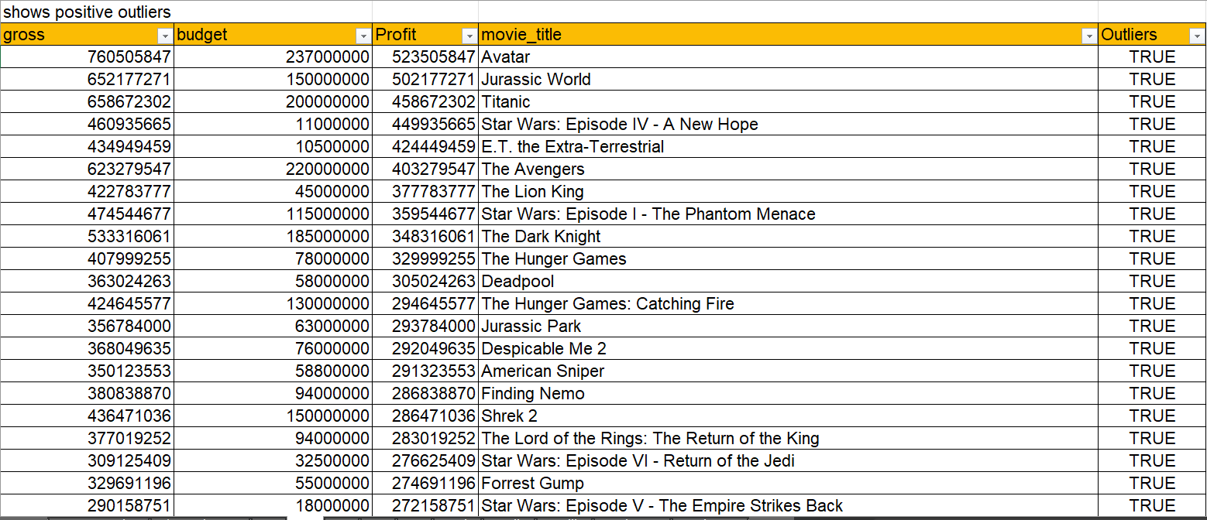

Slide 7
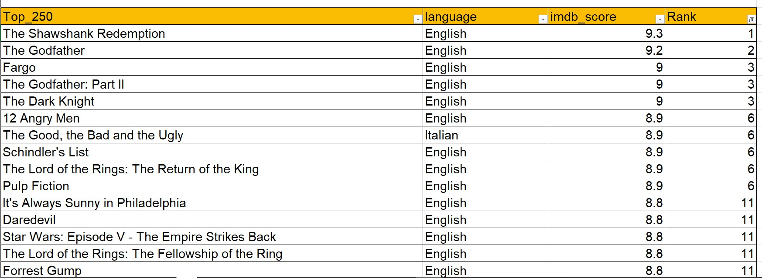
3.Top 250: create a new column imdb_top_250 and store the top 250 movies with the highest imdb rating (corresponding to the column: imdb_score). Also make sure that for all of these movies, the num_voted_users is greater than 25,000. Also add a rank column containing the values 1 to 250 indicating the ranks of the corresponding films. Extract all the movies in the imdb_top_250 column which are not in the english language and store them in a new column named top_foreign_lang_film. You can use your own imagination also! Task: find IMDB top 250
Language→ English

Slide 8
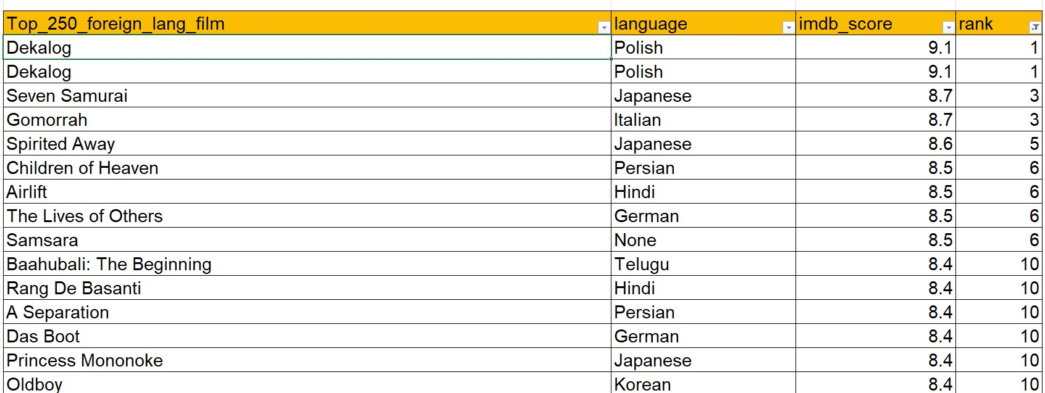
Language→ foreign (other than english)

Slide 9

4.Best directors: group the column using the director_name column. Find out the top 10 directors for whom the mean of imdb_score is the highest and store them in a new column top10director. In case of a tie in imdb score between two directors, sort them alphabetically. Task: find the best directors

Slide 10
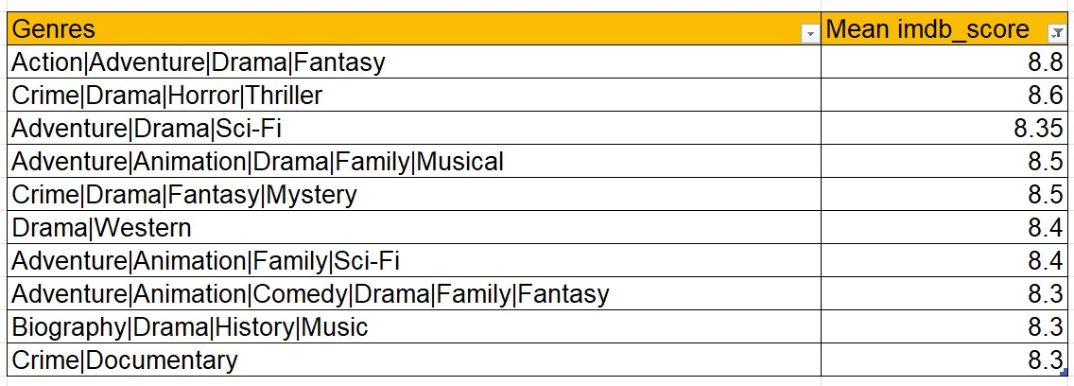
5.Popular genres: perform this step using the knowledge gained while performing previous steps. Task: find popular genres

Slide 11
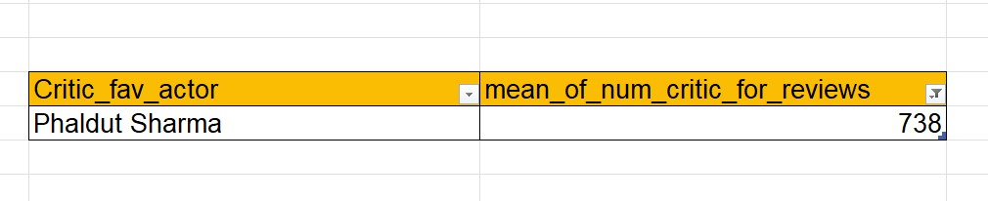
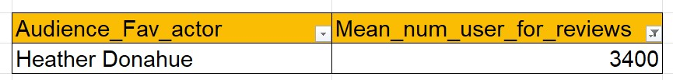


6.Charts: create three new columns namely, meryl_streep, leo_caprio, and brad_pitt which contain the movies in which the actors: 'meryl streep', 'leonardo dicaprio', and 'brad pitt' are the lead actors. Use only the actor_1_name column for extraction. Also, make sure that you use the names 'meryl streep', 'leonardo dicaprio', and 'brad pitt' for the said extraction. Append the rows of all these columns and store them in a new column named combined. Group the combined column using the actor_1_name column. Find the mean of the num_critic_for_reviews and num_users_for_review and identify the actors which have the highest mean. Observe the change in number of voted users over decades using a bar chart. Create a column called decade which represents the decade to which every movie belongs to. For example, the title_year year 1923, 1925 should be stored as 1920s. Sort the column based on the column decade, group it by decade and find the sum of users voted in each decade. Task: find the critic-favorite and audience-favorite actors

Slide 12
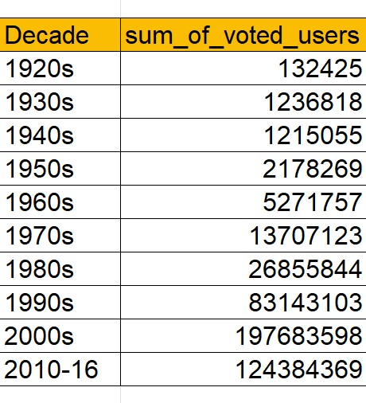
Sum of users voted in each decade→

Slide 13
Learnings:-
Statistics approach to find the outliers.
Application of boxplot
Replace all the blank cell with a value because if the a blank cell is present it means table ends there and when we use ctrl + shift+ down arrow to select all the rows it will stop at every blank cell and thus we have to keep on pressing ctrl + shift+ down arrow thus to avoid this and have a smooth process we should will blank cell with a appropriate value such as a categorical column with null string and numerical column with 0 so if any numerical calculation is performed error will not be shown.
How consolidation be use to group by with a categorical data and use a aggregate function with it.

Slide 14
Thank you

