Slide 1

Sentiment Analysis
BY YASH KATIYAR

Slide 2
What is Sentiment Analysis?
Sentiment Analysis is the process of determining whether a piece of writing is positive, negative or neutral. A sentiment analysis system for text analysis combines natural language processing (NLP) and machine learning techniques to assign weighted sentiment scores to the entities, topics, themes and categories within a sentence or phrase.
Sentiment analysis helps data analysts within large enterprises gauge public opinion, conduct nuanced market research, monitor brand and product reputation, and understand customer experiences.

Slide 3
Why Sentiment Analysis?
Movie: is this review positive or negative?
Products: what do people think about the new iPhone?
Public sentiment: how is consumer confidence? Is despair increasing?
Politics: what do people think about this candidate or issue?
Prediction: predict election outcomes or market trends from sentiment

Slide 4
Procedure: Baseline Algorithm
• Tokenization
• Feature Extraction
• Classification using different classifiers :
1. Logistic Regression
2. Naïve Bayes
3. MaxEnt
4. SVM (Support Vector Machines)

Slide 5
Algorithm Employed
Language used: python

Slide 6
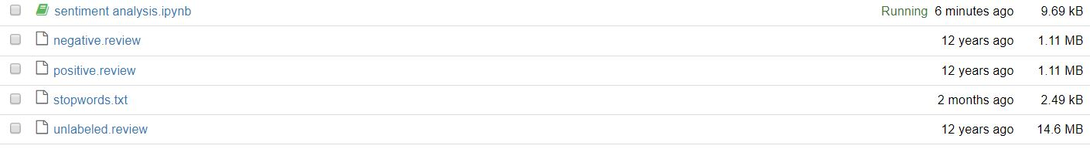
Dataset and other Files
postive.review: xml file containing positive reviews for amazon electronics
negative.review: xml file containing negative reviews for amazon electronics
unlabeled.review: xml file containing unlabeled reviews that are to be predicted
stopwords: txt file containing unimportant words that need to be removed from reviews

Slide 7
Libraries and Tools used
Libraries
NLTK: Natural Language Toolkit (used for natural language processing)
Numpy: used for numerical and matrix calculations and representation
Bs4: Beautiful Soup (used for extracting review text from the xml file)
Tools
WordNetLemmatizer: reduces recurring words with same meaning and same base word
Logistic Regression: Logistic Regression model from sklearn library used as a machine learning model
word_tokenize: tokenizes review into words which can be converted into indicator matrix for later use

Slide 8
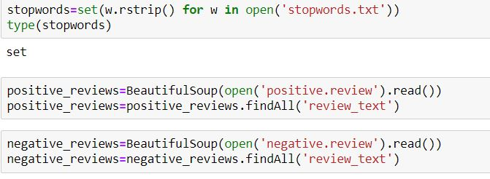
Step 1: Loading Data and Data Extraction
The data is loaded.
The final dataset is created by extracting review text from xml file via BeautifulSoup.

Slide 9
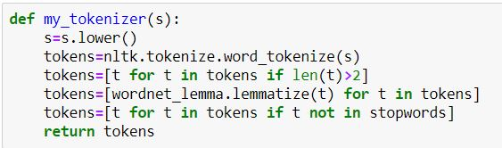
Step 2: Feature Extraction(Tokenization)
The review is tokenized into words
The individual words are then lemmatized
The stopwords are then removed as they are superfluous.

Slide 10
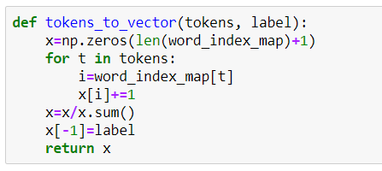
Step 3: Count Vectorization
The tokenized data is then converted into a vector.
Each vector consists of number of occurrence of a word in a review.
Then the vector is finally normalized.

Slide 11
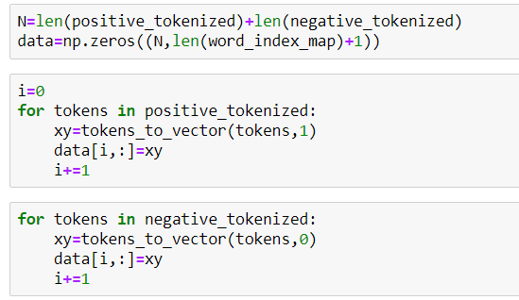
Step 4: Final Data Preparation
Each vector corresponds to a review.
The reviews are stacked together to form a 2-D matrix.
Each row represents a review and each column a word. Last column consists of the label. 0 for negative , 1 for positive.

Slide 12
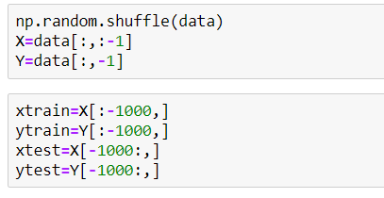
Step 5: Splitting Data
We have a total of 8000 reviews, 4000 each of positive and negative reviews.
We shuffle the data and split it into train and test set.
Train set contains 7000 reviews for training and test set contains 1000 reviews for testing purpose.

Slide 13
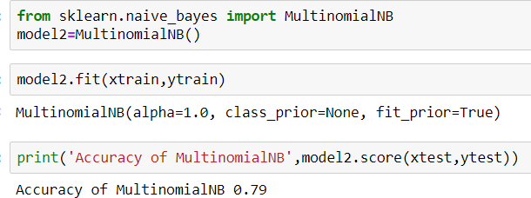
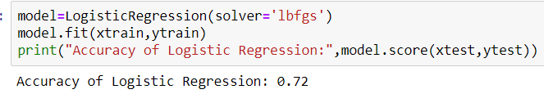
Step 6: Classifying Data
The data is passed to various classifiers as follows

Slide 14
Evaluation and Conclusion

Slide 15
Evaluation
The Multinomial Naïve Bayes classifier was the fastest to train and the most accurate giving around 80% accuracy.
The Logistic Regression was marginally slower than Multinomial Naïve Bayes and gave a pretty good accuracy of about 70%.
The Support Vector Machine was the slowest and the least accurate. It took about half an hour to train.

Slide 16
Conclusion
As it is observed these days, that many individuals’ posts surveys with respect to any item, movie, game or occasion via web-based networking media stages. For this, it is essential for the organizations to define particular sentiments of such surveys keeping in mind the end goal to realize that what individuals think about the item. The projected method utilizes one such stage called twitter to play out the sentiment categorization. The info is taken as tweets in the wake of verifying the client. The current framework has utilized Naive Bayes and Logistic Regression classifiers to classify the sentiments. For highlighting features Logistic Regression is used and for defining labels Effective score of a word is utilized.

Slide 17
Future Possibilities
A lot of experience was gained by this internship on the topic of Sentiment Analysis and Text Mining. Both are kind of analogous with respect to this report. The enthusiasm to learn something new motivated me to learn new things in the field of machine learning and natural language processing. I learned how with the help of a handful of data one can change the world. As a complete project, I wish to take this project further. I wish to employ newer, faster and more accurate techniques to improve upon the project. I would also make a finished product out of it in the form of a user-interface where one can just copy paste a review and know the sentiment of it without reading whole of it. This can also be developed further to give a star rating out of 5 to a review to help the customers more. Currently I am working on LSTM(Long Short-Term Memory) algorithm for the sentiment analysis which is a much better model for the same.

