Slide 1

PROCUREMIND NEXUS
Autonomous Multi-Agent Procurement Intelligence Network
Team: AutoPilot AI
Live Demo: https://procuremind-nexus.onrender.com
AGENT-TO-AGENT COMMERCE
EU AI ACT COMPLIANT
AI AGENT OLYMPICS 2026 — MILAN AI WEEK

Slide 2


THE PROBLEM
The $5.5 Trillion Procurement Crisis
60–70% of buyer time
$500K–$2M lost annually
Wasted on transactional tasks — chasing approvals, reconciling invoices, reformatting proposals
Savings evaporate from slow, manual RFx cycles that drag on for weeks
5–12% maverick spend
Off-contract leakage with $200K–$1M per compliance violation incident
Traditional RPA handles structured clicks. Procurement is messy — AI agents reason, adapt, and learn.

Slide 3




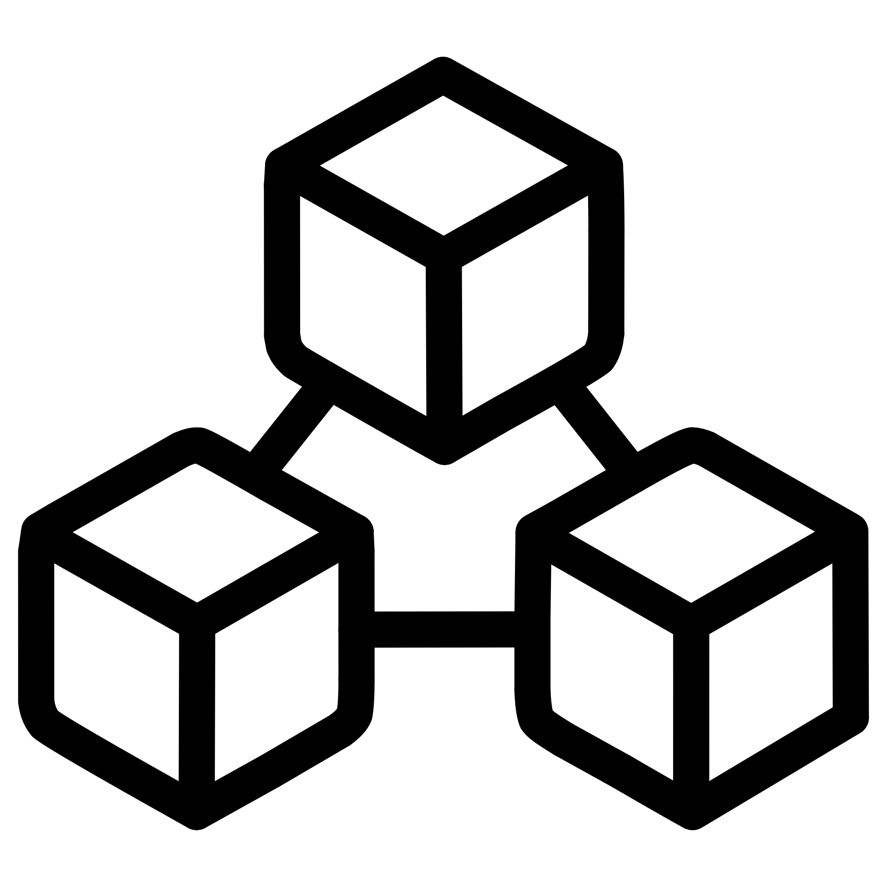
THE SOLUTION
5 Agents. 1 Orchestrator. Zero Chaos.
A central LangGraph orchestrator coordinates a 7-step pipeline — Parse → Comply → Scout → Analyze → Negotiate → Pay → Audit — with full state persistence and autonomous error recovery.
Scout Agent
Analyst Agent
Negotiator Agent
Discovers qualified suppliers across Europe in under 2 hours via web search, internal DB, and x402 credit reports
Reads 100-page contracts in 30 seconds — multimodal PDF analysis with 0–100 risk scoring
Drafts RFQs, scores bids, generates counter-offers, maintains context across negotiation rounds
Compliance Guardian
Payment Executor
Enforces EU AI Act Article 14 human-in-the-loop with hash-chained immutable audit trails
Automated payment processing with budget enforcement and treasury management integration

Slide 4






LIVE DEMO
From Request to Settlement in 2.3 Days
Voice-First Input
Works in English and Italian — "Trova fornitori CNC" — via Speechmatics real-time transcription
Autonomous Decision
Auto-approved under €10K threshold. 10 suppliers discovered in 90 seconds. Risk score flagged at 68/100
Request
Agent
Negotiate
Settle
Instant Settlement
Automated payment processing with full transaction tracking and audit trails
14 days → 2.3 days | €400/order → €25/order | 100% traceable

Slide 5






ARCHITECTURE
Technology Stack
AI Engine
Gemini 2.5 Pro (1M context, multimodal) + Flash for fast tasks. Structured JSON inter-agent communication
Backend
Python 3.11 + FastAPI (16+ async endpoints), LangGraph orchestrator, SQLite + pgvector with hash-chained audit
Integrations
Integrations: Speechmatics voice · Kraken treasury management · Render deployment (https://procuremind-nexus.onrender.com)
Frontend
Zero-build HTML5/CSS3/JS SPA — glassmorphism dark theme, real-time SSE, 5 pages
Code Footprint: Backend 1,500+ lines · Frontend 1,200+ lines · 8 DB tables · 16+ API endpoints

Slide 6
BUSINESS IMPACT
Before vs. After: The Numbers Don't Lie
Before — Manual Procurement
After — ProcureMind Nexus
RFx Cycle Time
14–21 days
RFx Cycle Time
2–3 days ↓60%
Invoice Exceptions
15–25%
Invoice Exceptions
<2% ↓90%
Maverick Spend
5–12%
Maverick Spend
<1% ↓95%
Cost per Order
€150–400
Cost per Order
<€25 ↓90%
Compliance Audit
2–3 weeks prep
Compliance Audit
Real-time, always current
Human Approvals
100% of orders
Human Approvals
5–10% strategic only
"Procurement operates like it's 2025, not 2005." — Marco B., Procurement Manager
€5M+
90%
Annual Savings
Cost Reduction
For a 200-person company
Per procurement order
<5s
100%
Settlement Time
Audit Coverage
automated processing
Immutable, real-time

Slide 7
COMPETITIVE ADVANTAGE
Why ProcureMind Nexus Wins
ProcureMind Nexus redefines procurement with agentic AI, outpacing traditional systems and legacy cloud platforms in speed, cost-efficiency, and compliance.
Traditional RPA
Legacy Cloud (Coupa, Ariba)
ProcureMind Nexus
Handles clicks, not reasoning
Cloud-based, expensive
Agentic AI, real-time reasoning
Slow, manual exceptions
Slow to customize (14 days)
Rapid deployment (2.3 days)
Manual compliance audits
Human approvals 100% of orders
EU AI Act native & blockchain
Rigid, inflexible automation
High cost per order (€400+)
Voice-first, automated payments, multimodal

