Slide 1
FIND THE INTEREST AMOUNT FOR CURRENT YEAR-EMI CALCULATOR
TEAM
2068167- Yash Kakade
2068168-Ganesh Katiyar
2068545- Darshini .A
2069666-Sneha Haldar
2068452-Shakra Shamim

Slide 2
DESCRIPTION
1. Find the EMI for Car with price of 15 Lac, Interest rate of 9.5% & Tenure 1 year; Display the interest amount & principal amount for one month.
2. From Menu, pick Home Loan EMI Calculator, fill relevant details & extract all the data from year on year table & store in excel.
3. From Menu, pick Loan Calculator and under EMI calculator, do all UI check for text box & scales; change the Loan tenure for year & month, check the change in scale; Re-use the same validation for Loan Amount Calculator & Loan Tenure Calculator.

Slide 3
KEY AUTOMATION SCOPE
Validation of transactions & do calculations;
Extract table values & store in excel
Filling data in screen & multiple UI validations
Navigation from Menus
Reusable methods
Scrolling down in web page

Slide 4





PRE REQUISITES
IDE: Eclipse Integrated environment
JAVA: High level programming language
SELENIUM: Selenium is a free (open-source) automated testing framework used to validate web applications across different browsers and platforms.
APACHE MAVEN : software project management and comprehension tool.
TESTNG: TestNG is an automation testing framework

Slide 5
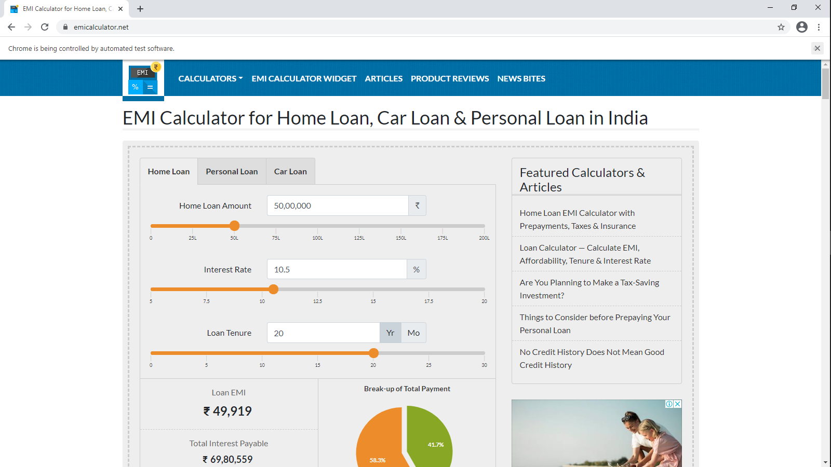
TEST URL

Slide 6
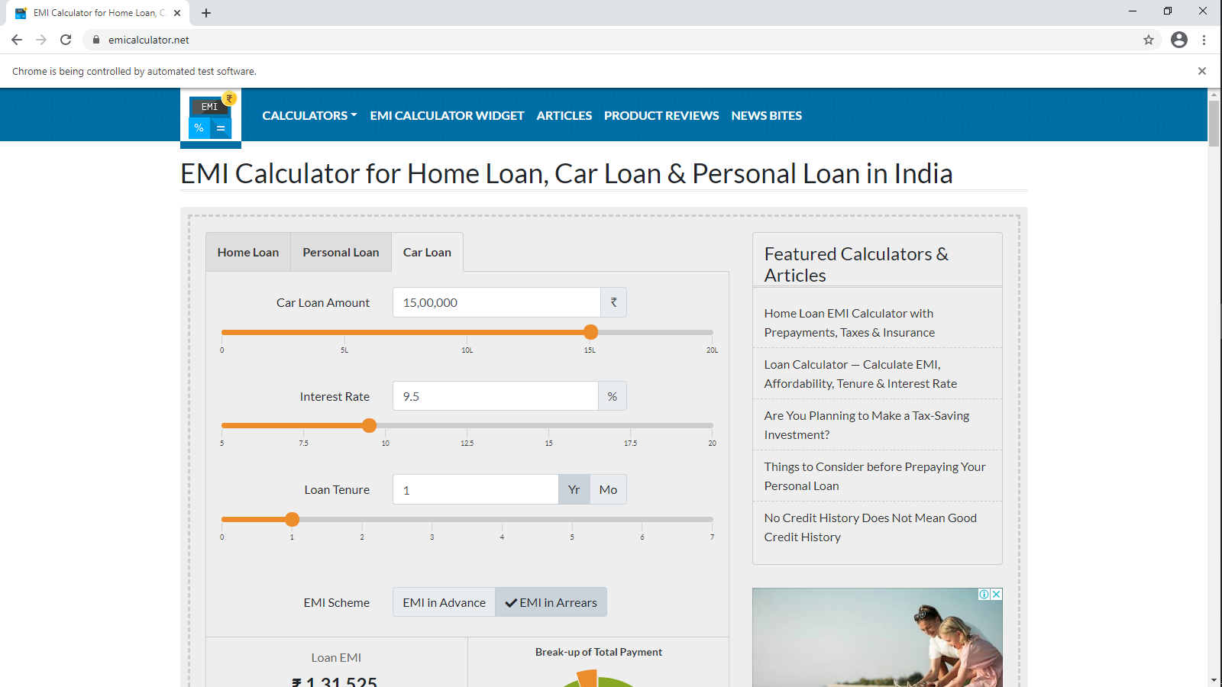
CAR LOAN EMI CALCULATOR

Slide 7
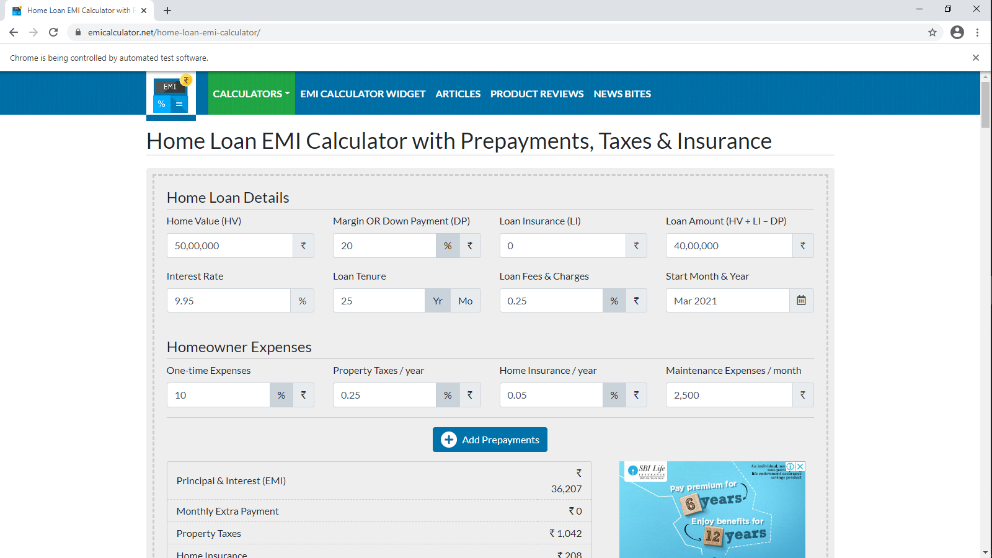
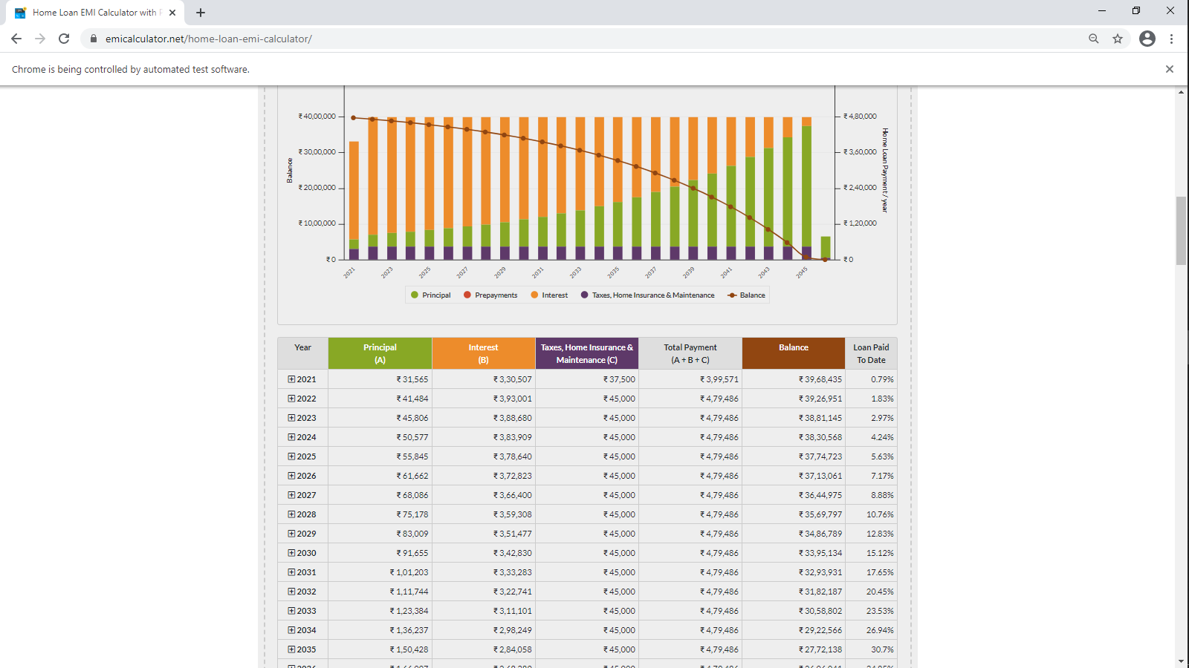
HOME LOAN EMI CALCULATOR

Slide 8
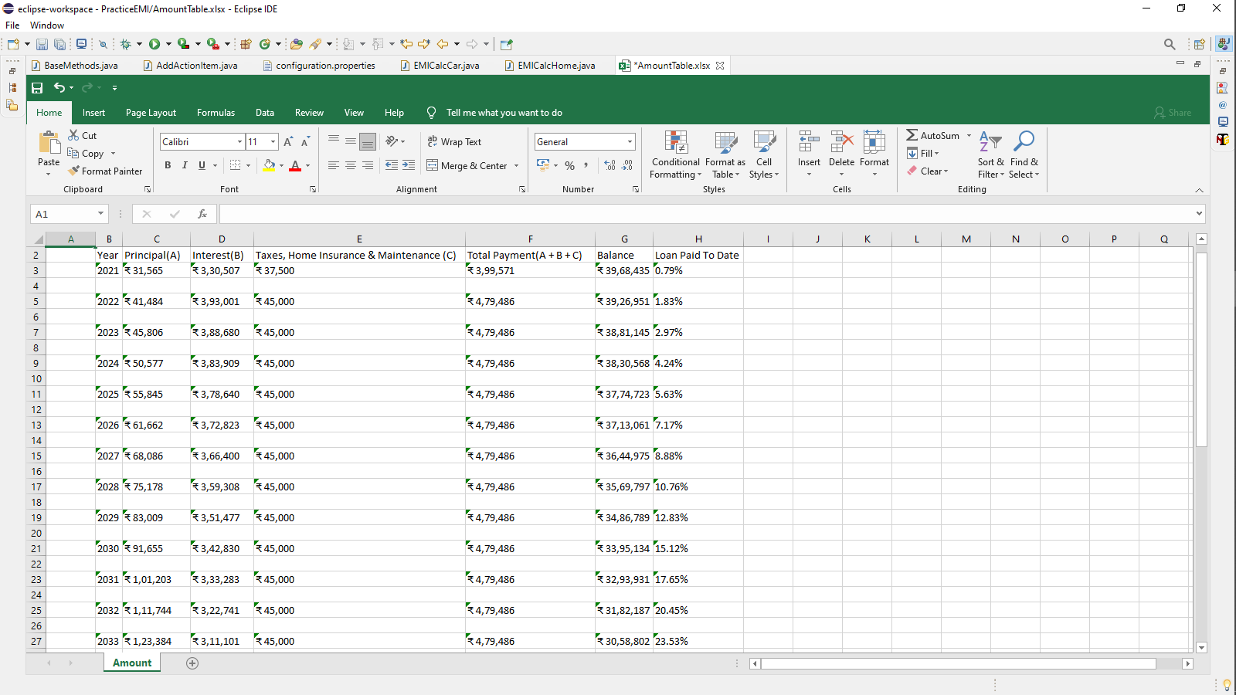
WRITING HOME LOAN DATA INTO EXCEL FILE

Slide 9
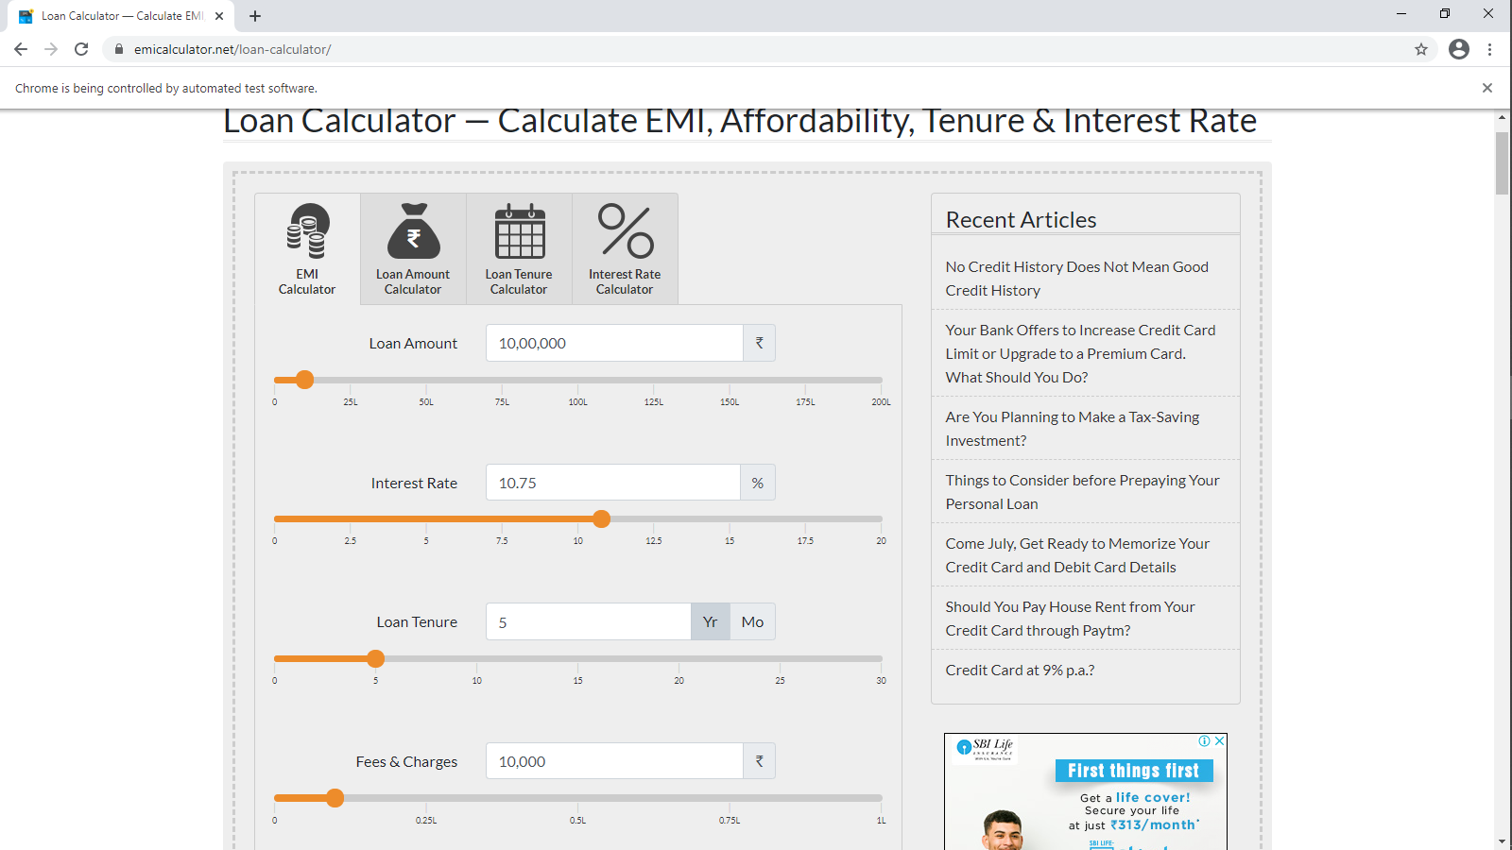
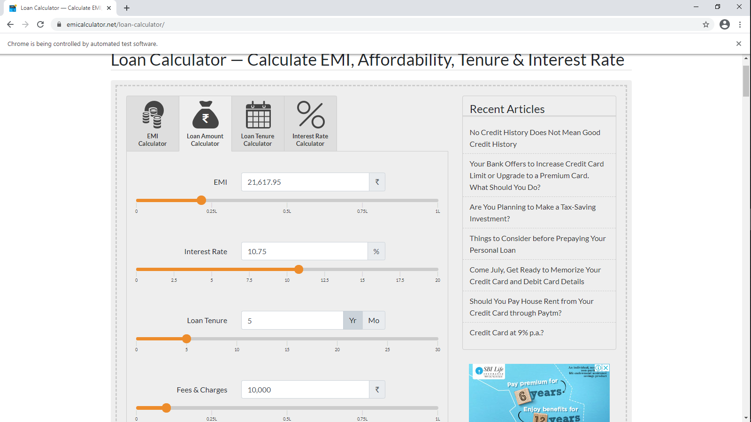
LOAN CALCULATORS

Slide 10
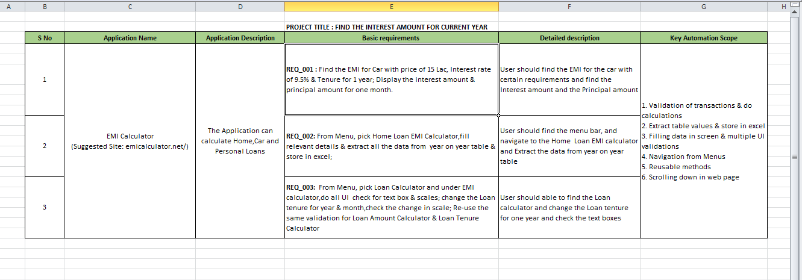
TESTING REQUIREMENTS

Slide 11
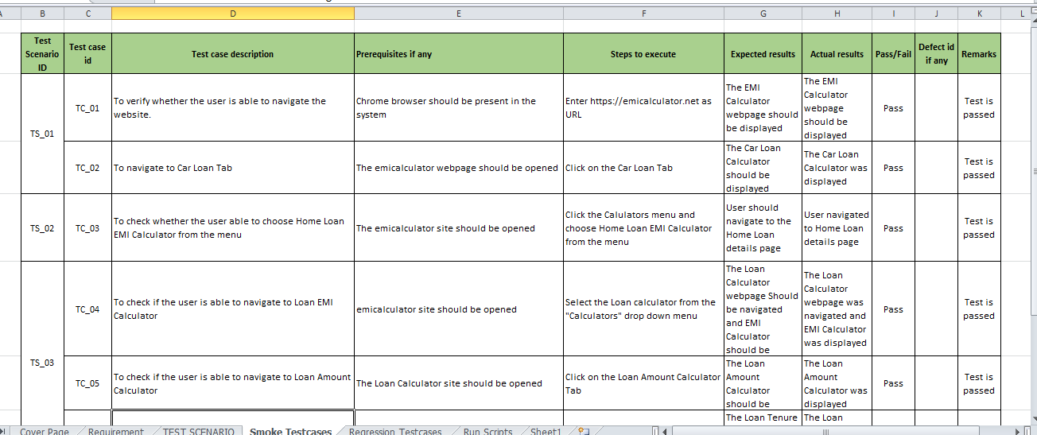
SMOKE TESTING

Slide 12
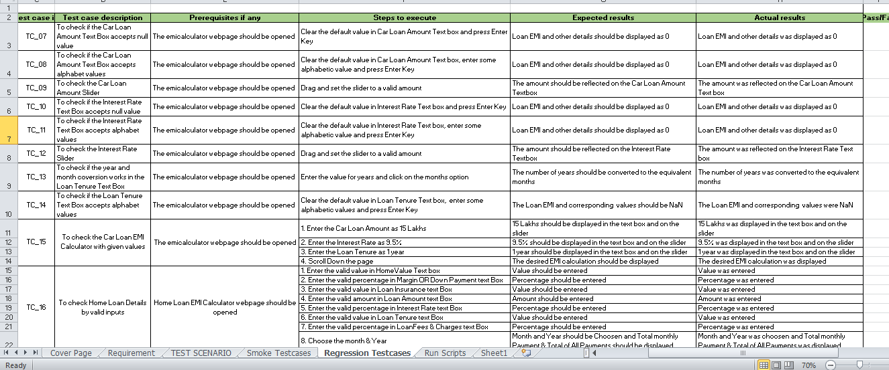
REGRESSION TESTING

Slide 13
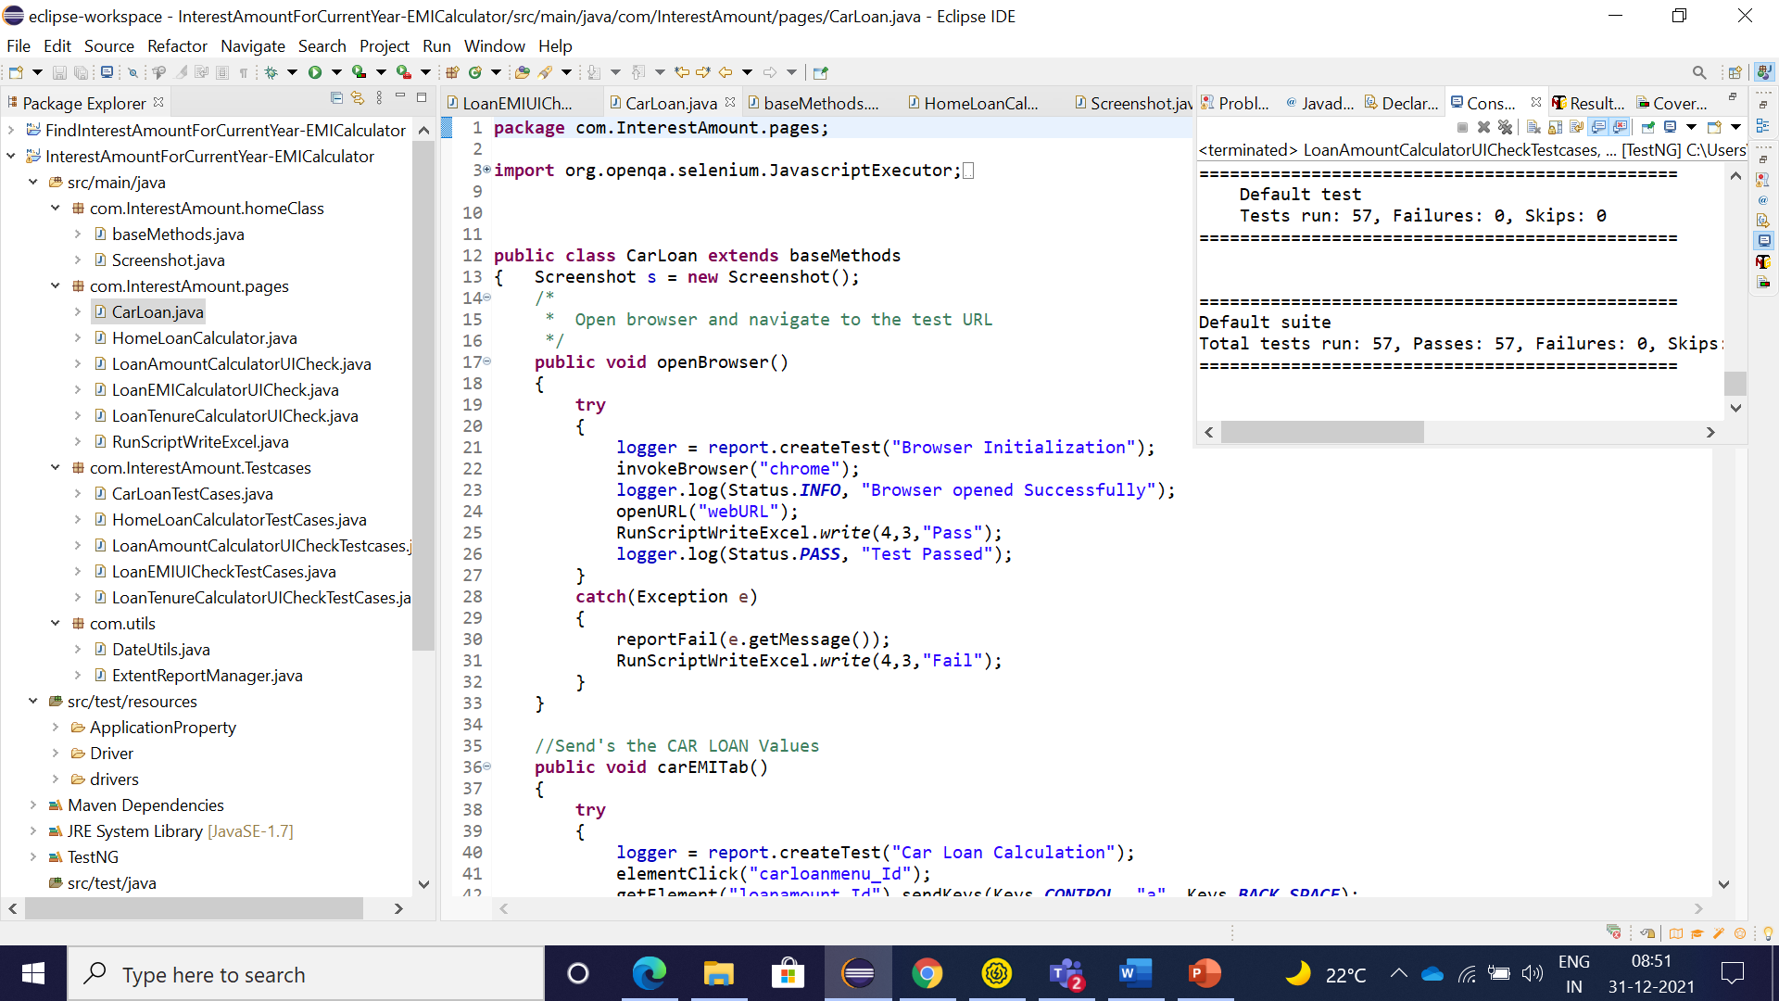
AUTOMATION SCRIPTS

Slide 14
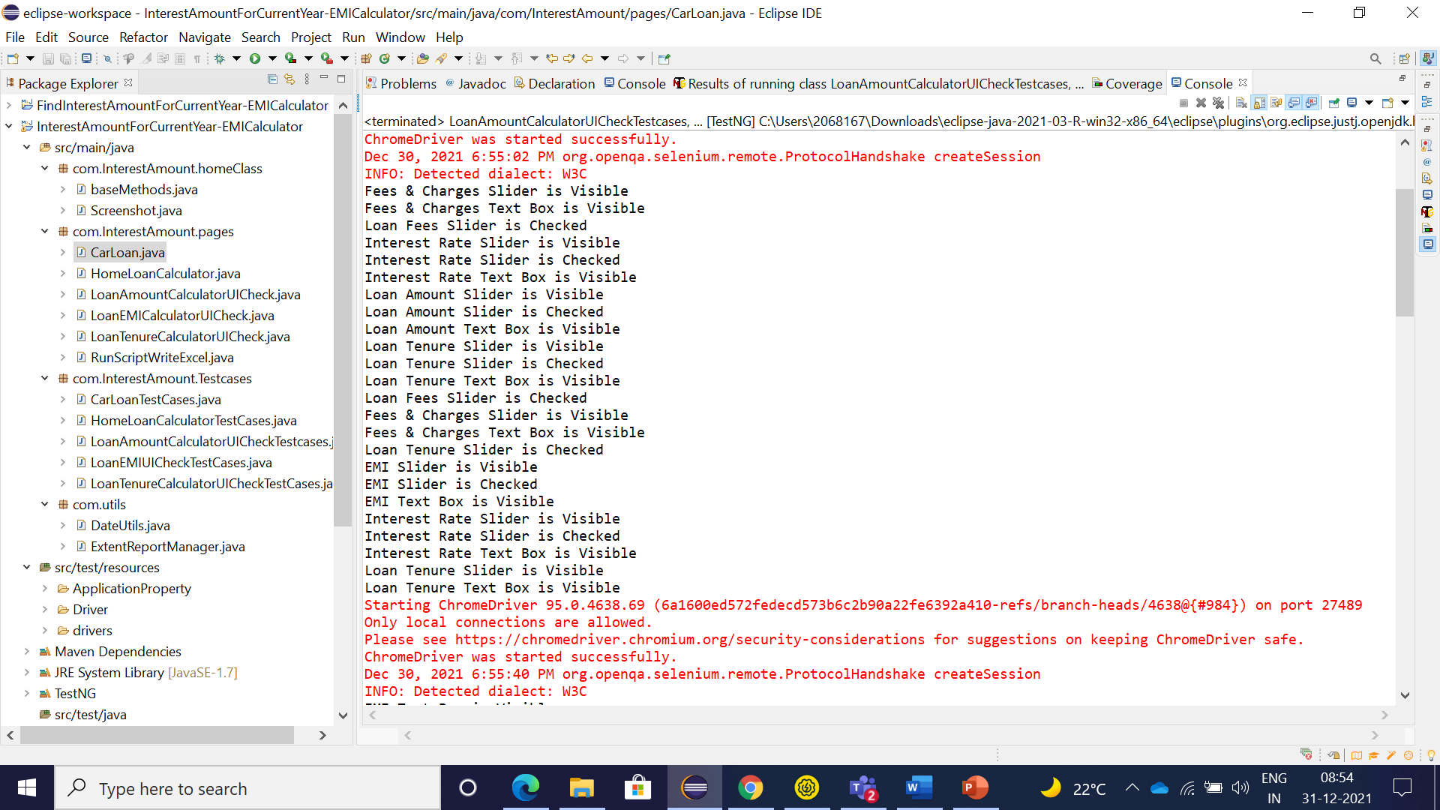
CONSOLE OUTPUT

Slide 15


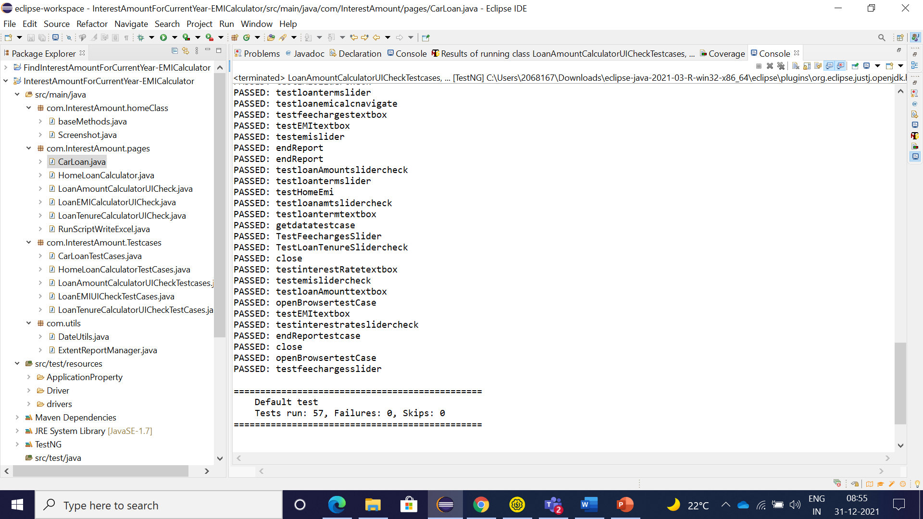
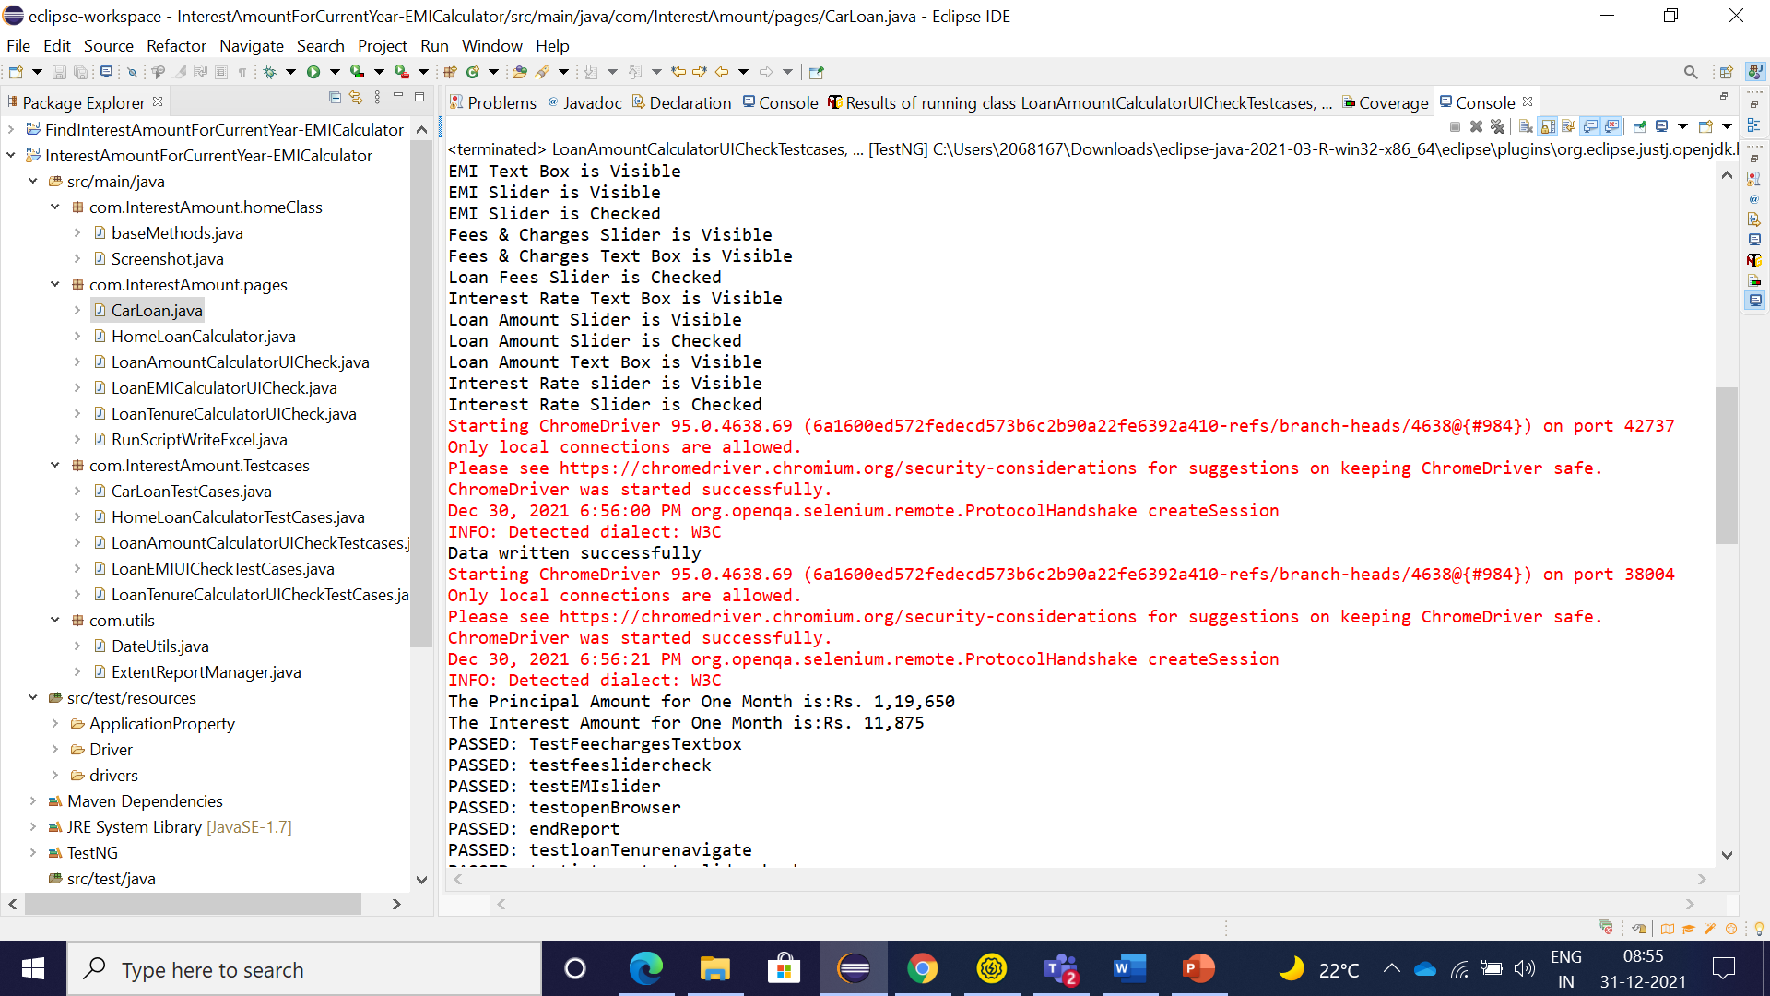

Slide 16
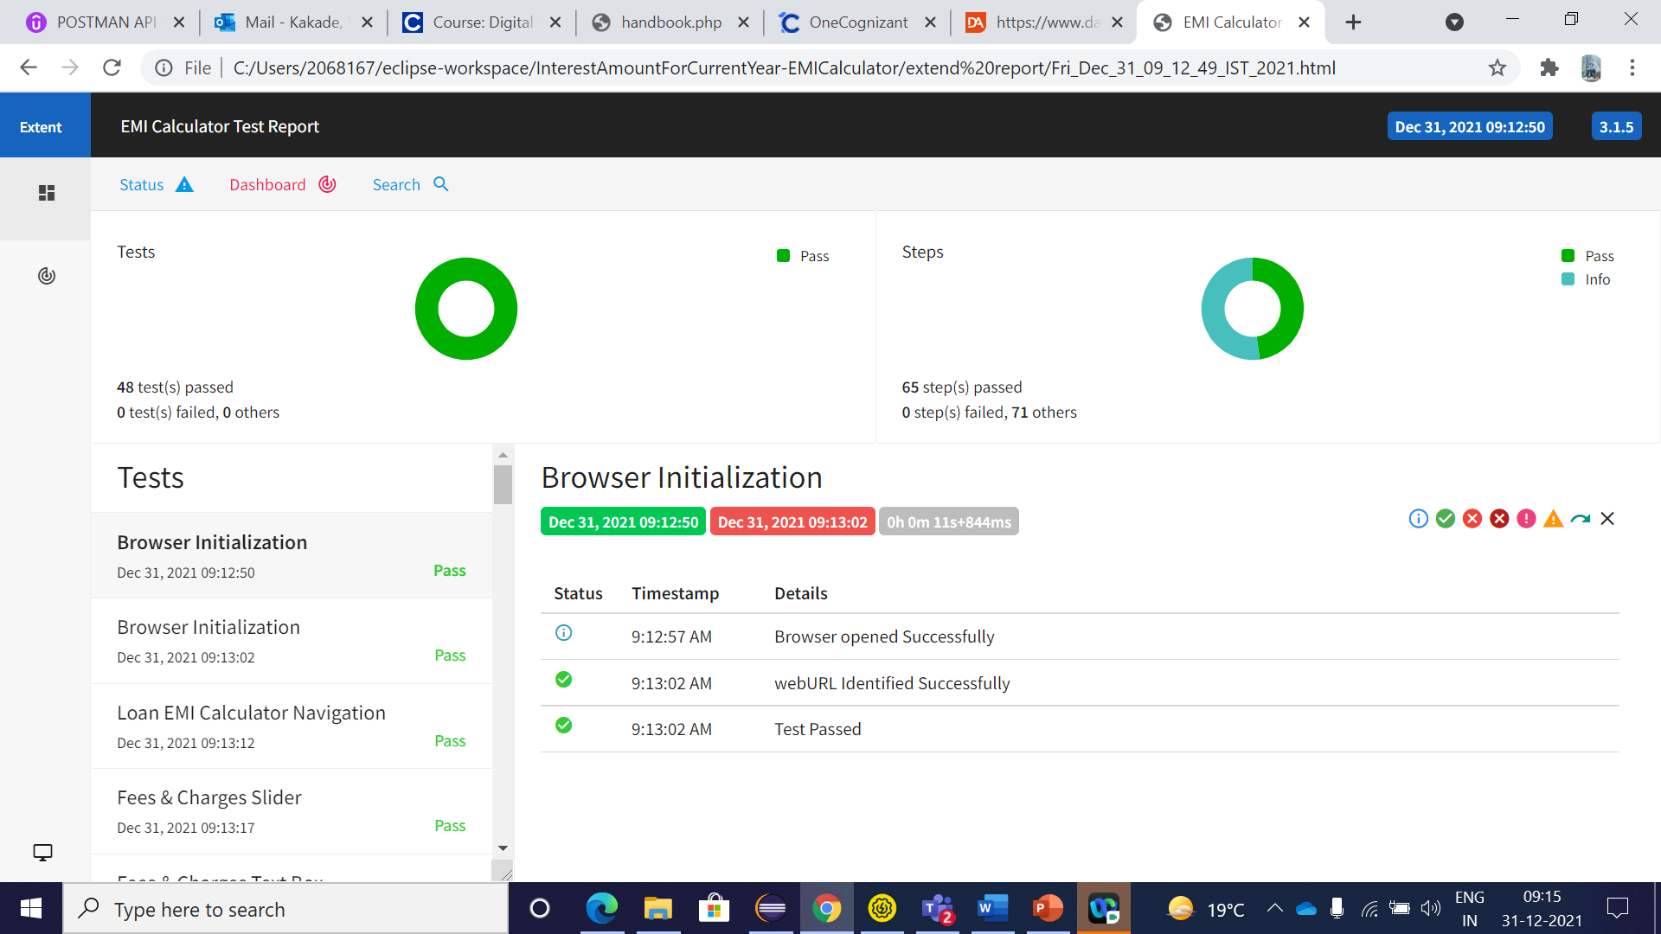
EXTEnd REPORT

Slide 17
THANK YOU

