Slide 1

Class C 106
NATURAL LANGUAGE PROCESSING

Slide 2

INDEX
What is Natural Language Processing
Uses of Natural Language Processing
What is Web speech UPI
Uses of Web speech UPI
Examples of web speech UPI
What is speech recognition
Uses of Speech recognition
How to access webcam using code
What is AI
Uses and Examples of AI

Slide 3

What is Natural Language Processing
Natural language processing (NLP) refers to the branch of computer science and
more specifically, the branch of artificial intelligence or AI—concerned with giving
computers the ability to understand text and spoken words in muchthe same way
human beings can.
NLP combines computational linguistics—rule-based modeling of human language
—with statistical, machine learning, and deep learning models. Together, these
technologies enable computers to process human language in the form of text or
voice data and to ‘understand’ its full meaning, complete with the speaker or
writer’s intent and sentiment.

Slide 4

Uses of Natural Language Processing
Chat bots are a form of artificial intelligence that are programmed to interact with humans in such a way that they sound like humans themselves.
Have you noticed that search engines tend to guess what you are typing and automatically complete your sentences? For example, On typing “game” in Google, you may get further suggestions for “game of thrones
These days voice assistants are all the rage! Whether its Siri, Alexa, or Google Assistant, almost everyone uses one of these to make calls, place reminders, schedule meetings, set alarms, surf the internet, etc.
Want to translate a text from English to Hindi but don’t know Hindi? Well, Google Translate is the tool for you! While it’s not exactly 100% accurate, it is still a great tool to convert text from one language to another.

Slide 5

What is Web speech UPI
The Web Speech API aims to enable web developers to provide, in a web browser,
speech-input and text-to-speech output features that are typically not available
when using standard speech-recognition or screen-reader software.
The API itself is agnostic of the underlying speech recognition and synthesis
implementation and can support both server-based and client-based/embedded
recognition and synthesis. The API is designed to enable both brief (one-shot) speech
input and continuous speech input. Speech recognition results are provided to the
web continuous speech input. Speech recognition results are provided to the web
page as a list of hypotheses, along with other relevant information for each
hypothesis.

Slide 6

Uses of Web speech UPI
Voice Web Search
Speech Command Interface
Domain Specific Grammars Contingent on Earlier Inputs
Continuous Recognition of Open Dialog
Domain Specific Grammars Filling Multiple Input Fields
Speech UI present when no visible UI need be present
Voice Activity Detection
Temporal Structure of Synthesis to Provide Visual Feedback
Hello World
Speech Translation
Speech Enabled Email Client
Dialog Systems
Multimodal Interaction

Slide 7

Examples of web speech UPI
Examples of Web Speech UPI-
The Web Speech API enables you to incorporate voice data into
web apps. The Web Speech API has two parts:
SpeechSynthesis (Text-to-Speech), and SpeechRecognition
(Asynchronous SpeechRecognition.)

Slide 8

What is Speech Recognition
Speech recognition is the ability of a machine or program to receive
and interpret dictation or to understand and perform spoken commands
Speech recognition has gained prominence and use with the rise of
Artificial intelligence (AI) \ and intelligent assistants, such as Amazon's
Alexa and Apple's Siri. Speech recognition systems let consumers
interact with technology simply by speaking to it, enabling hands-free
requests , reminders and other simple tasks.

Slide 9
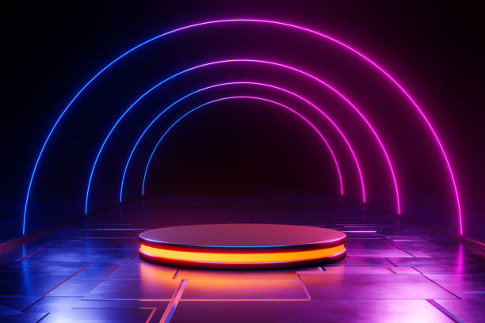
Uses of Speech recognition
Speech recognition software can translate spoken words into text using
closed captions to enable a person with hearing loss to understand
what others are saying. Speech recognition can also enable those with
limited use of their hands to work with computers, using voice comma-
nds instead of typing.

Slide 10

How to access webcam using code
The following code to get a webcam:-
var video = document. getElementById('video');
if(navigator. mediaDevices && navigator. mediaDevices. getUserMedia) {
navigator. mediaDevices. getUserMedia({ video: true }). then(function(stream) {
video. src = window. URL. createObjectURL(stream);

Slide 11

What is AI
Artificial intelligence is the science of making machines that can think
like humans. It can do things that are considered "smart.“AI technology
can process large amounts of data in ways, unlike humans. The goal for AI
is to be able to do things such as recognize patterns, make decisions,
and judge like humans.

Slide 12

Examples of AI
Examples of AI in everyday life :-
Face recognition. Most people use the face recognition feature in their Android or iPhone as it is
one of the best safety features available on your device. ...
Smart cars. ...
Digital assistants. ...
Entertainment and social apps. ...
Banking. ...
Google predictive search algorithm. ...
E-commerce.

