Slide 1
DESIRE 101
Increase the probability of survival for the side project

Slide 2
Ideate
Problems
Target users
Value-add
User POV
Blog
Success criteria
Measurement
Team Valuation
Evaluation of players using custom KPIs
Performance monitoring

Slide 3
Streamlit features
It is important that the data is interpreted correctly but also displayed in a way that makes sense to whoever is viewing it.
Easy-adjust final scores that allow for different weightings to be applied by end users i.e. increasing 1v1 defending weighting for full backs
User registration and authentication
Search filters, Strengths, Weaknesses, Metrics
Page flows: {Search -> Player details -> Compare players}
Private player reports integration, File uploads/downloads
Advanced: Themes, Caching, Stateful apps, Widgets

Slide 4
Prototype
Rely on no code solutions
Write only front-end codes
Serverless deployment for back-end
Value-add to users
Provide channels for user feedback
Takes less than a month

Slide 5
Market
Use Reddit and Twitter for community outreach
SEO for direct users
Self-growth property
Rewards for invitation
Establish a chat group
Long-term updates
Continuous improvement

Slide 6
Monetize
Setup psychological expectation
Polish according to early feedback to accumulate seed users
Test of time and volume
Fixate on a pricing method and republish
Stripe setup on Substack
Basic functions are for free while premium features are only for paid users
Patreon link

Slide 7
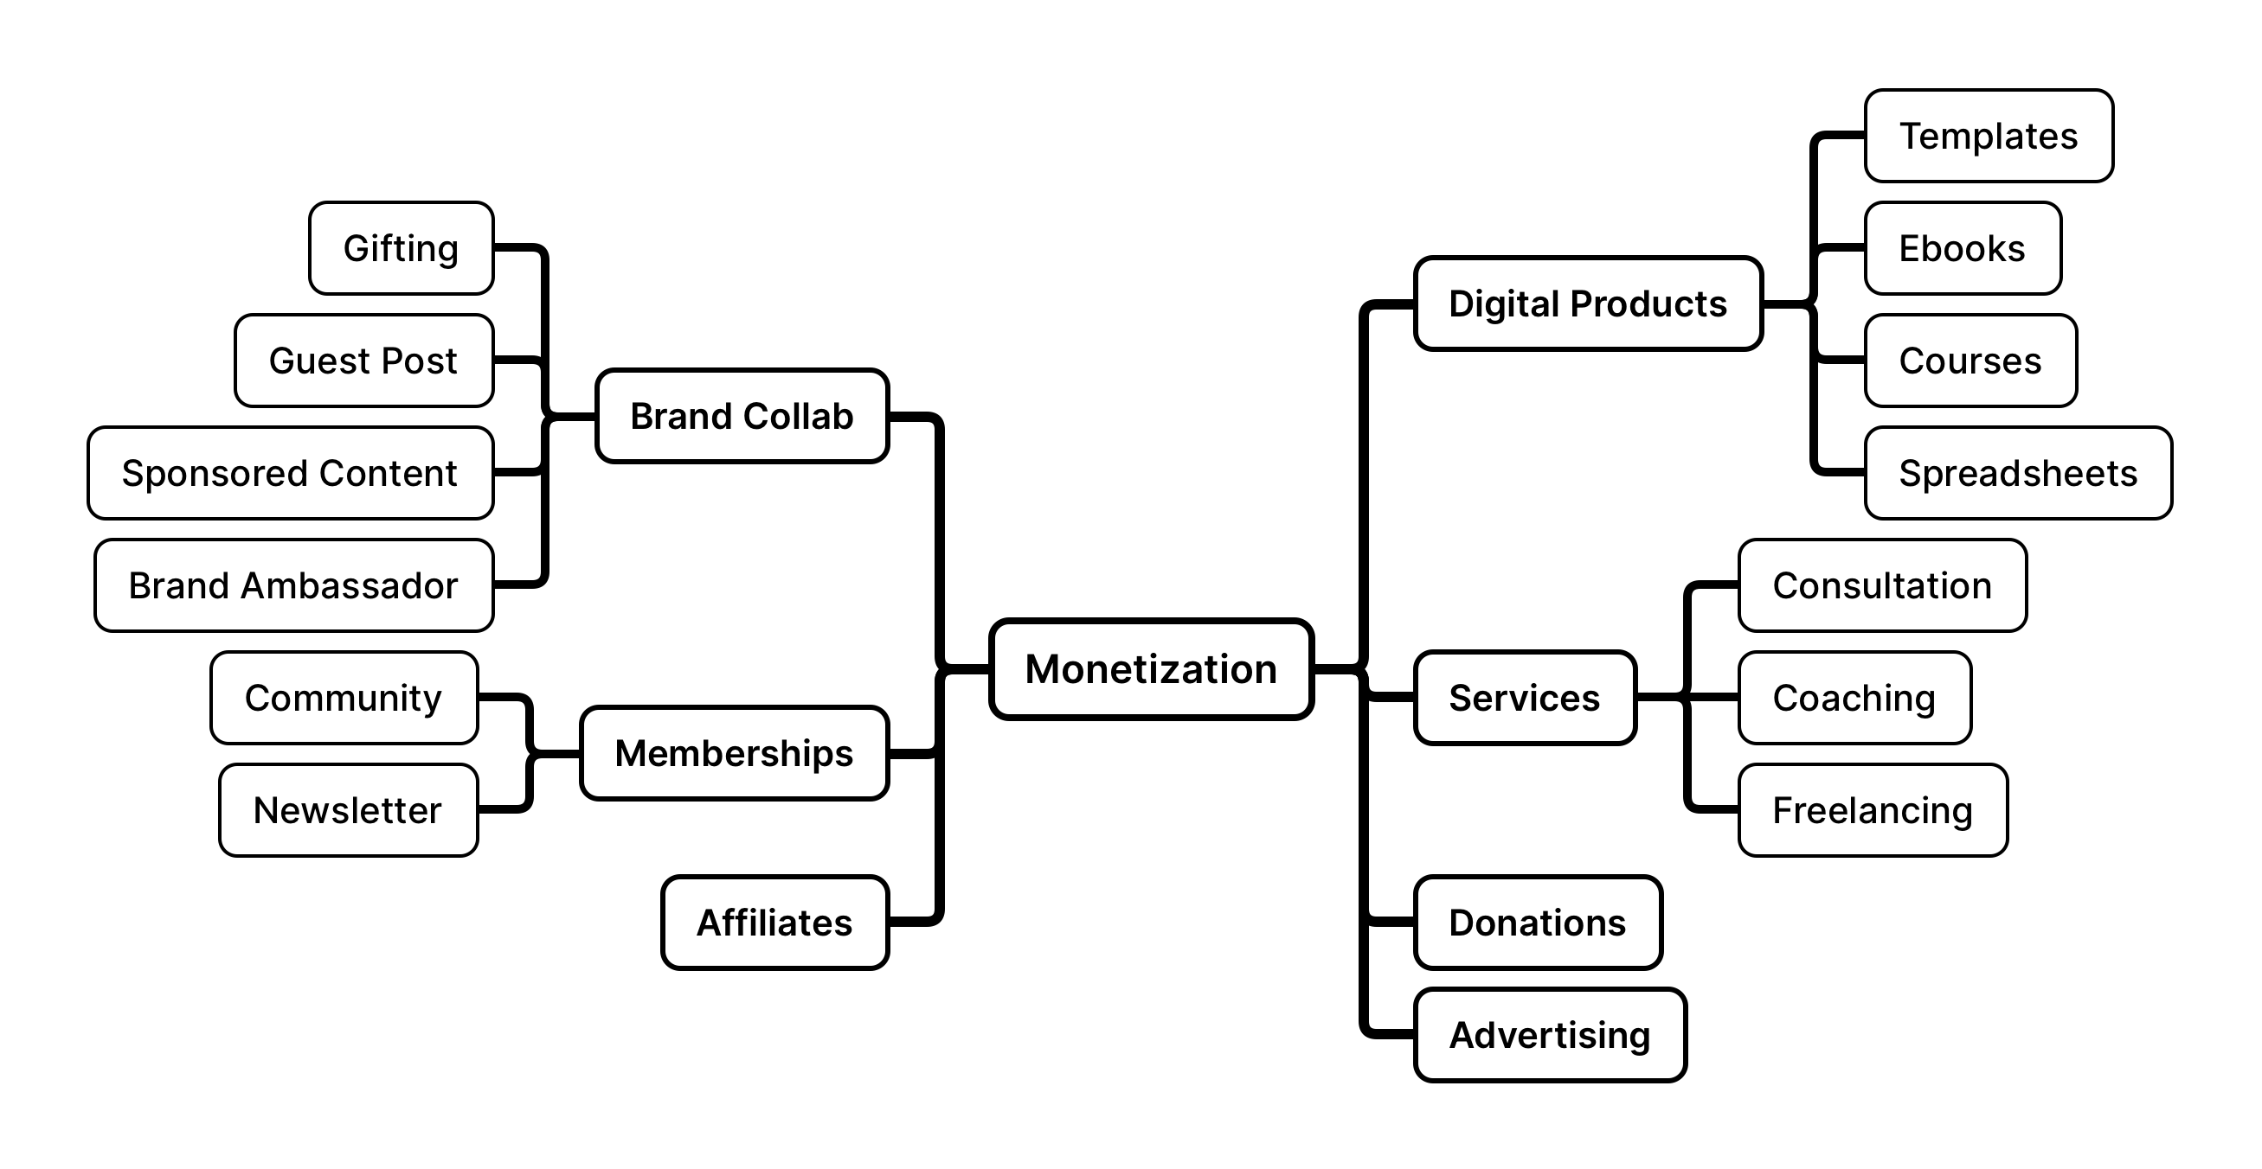
Online brand

