Slide 1
Evaluating players
Defensive metrics for Central Midfielders
Yash Karle

Slide 2
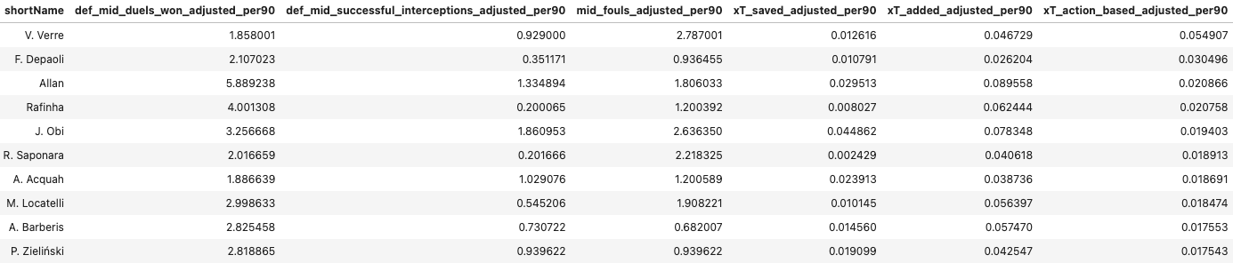
Metric
Action-based Expected Threat for successful defensive duels in isolated possession chains
Xgboost model trained for Bundesliga possession chains and scored on Serie A midfielders
Filtered down to ‘Ground defending duel’ actions only as the model was skewed towards tall forwards
Normalized to reflect per 90 stats scaled down for opposition possession %

Slide 3
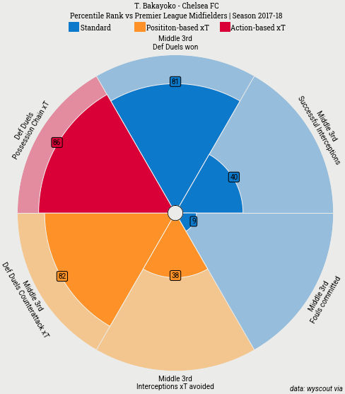
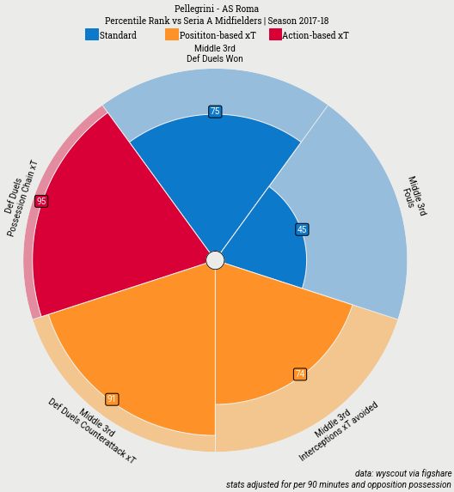
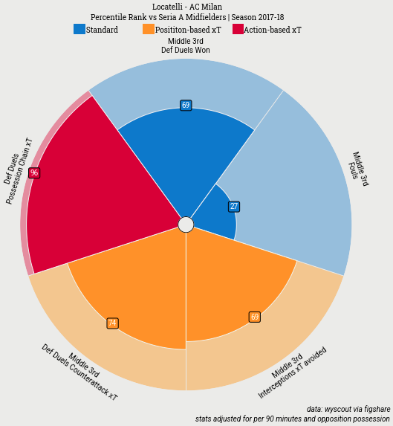
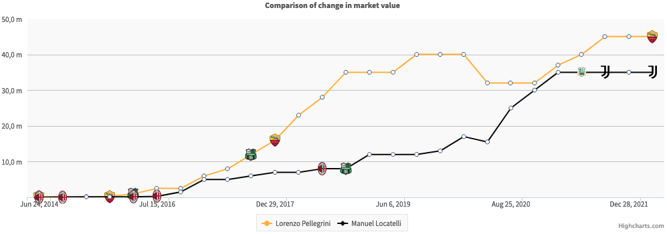
Recommendation
Factors
Age
Minutes played
Club & manager
Playing style
Contract
Market value

Slide 4
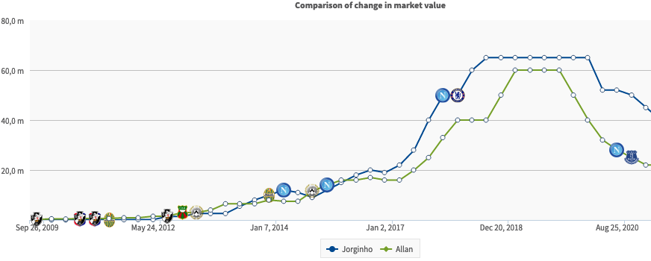
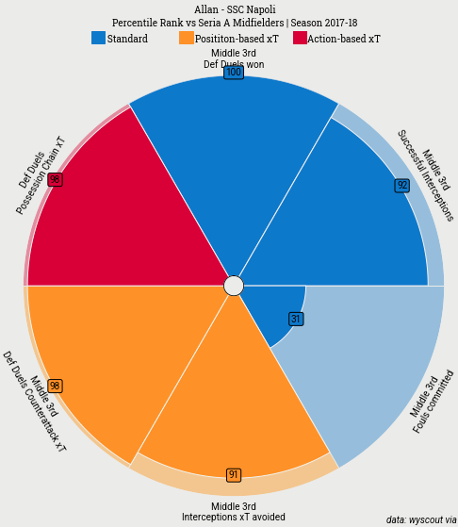
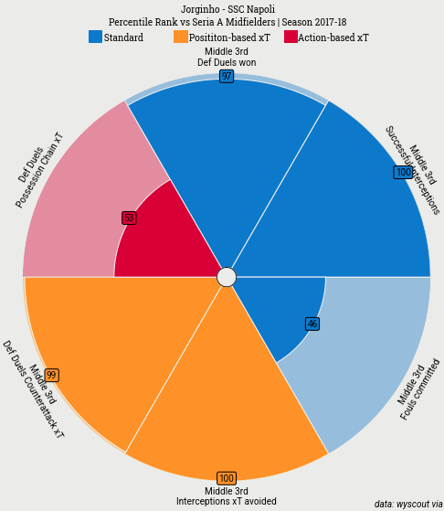

Slide 5
