Slide 1
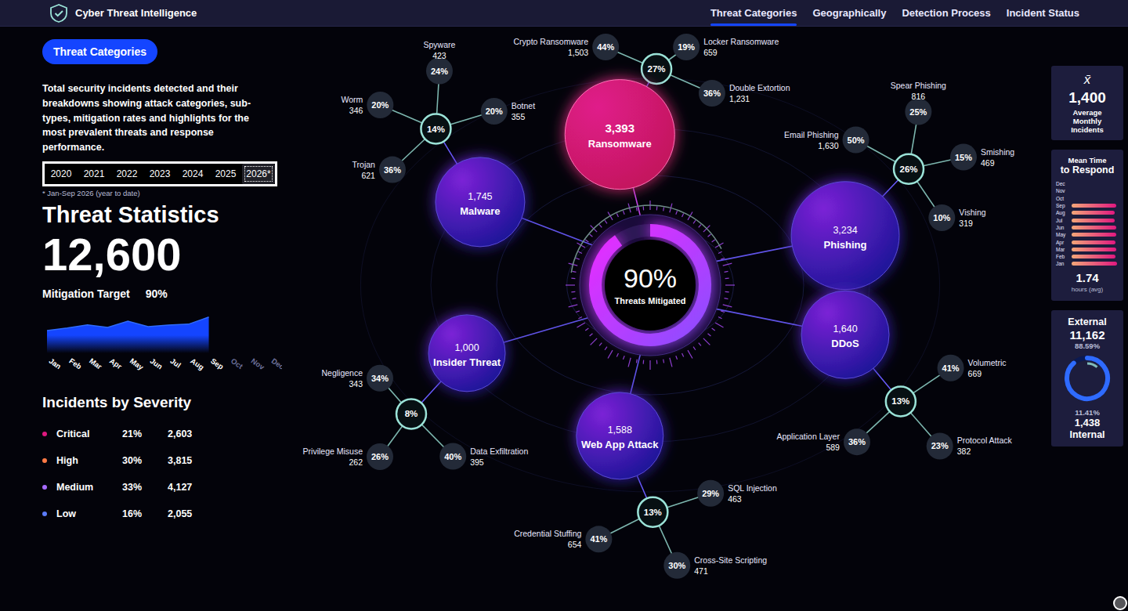
Cybersecurity Threat Intelligence Dashboard
ADSF | DATA VISUALIZATION PROJECT
80,200 security incidents, 2020 to Sep 2026
Python
SQL
Excel
HTML / SVG
+122%
27%
-46%
90.2%
more incidents
ransomware share, 2026
time to respond
mitigation rate, 2026 YTD
7,200 in 2020 to 16,000 in 2025
up from 12% of all incidents in 2020
mean response 3.21 to 1.74 hours
first year to reach the 90% target
Notes:
Introduce the project: an interactive dashboard giving security leadership one view of 80,200 incidents from 2020 to September 2026. The four numbers along the bottom are the whole story: volume has more than doubled, ransomware is the fastest-growing category and is now the largest, response is much faster, and the mitigation rate has reached the 90% target for the first time in 2026 year to date. 2026 covers January to September only.

Slide 2




From four questions to 80,200 clean records
Questions leadership asks
Raw export to analysis-ready data
Are attacks increasing?
81,403
-1,203
80,200
Yearly and monthly volume
YEAR SELECTOR + SPARKLINE
raw rows
duplicates
clean records
Which attacks matter most?
Other issues found and fixed (rows)
6 categories, 19 sub-types, mitigation rate
THREAT CATEGORIES TAB
Where do they come from?
12 source countries, 8 target industries
GEOGRAPHICALLY TAB
Are we responding fast enough?
Funnel, time to respond, SLA compliance
DETECTION PROCESS TAB
Synthetic data from seeded Python scripts (seeds 2026 and 2027), built to resemble public threat-report patterns. No real organisations or people.
Notes:
Frame the dashboard as answering four management questions, each mapped to a part of the dashboard. The raw file was deliberately messy: 1,203 duplicates dropped, inconsistent labels such as PHISING and DDOS mapped to six standard names, mixed date formats and dollar-sign text parsed, impossible response times replaced with the category and severity median, missing country and industry labelled Unknown and kept out of the charts. The 2025 and 2026 records were added in a second batch with the same cleaning rules; the 2020 to 2024 figures are unchanged. The data is synthetic.

Slide 3
How to read the dashboard
Reading the main view
1
Bubble = category
Size shows count; pink is the largest.
2
Hub = share of total
Small nodes are sub-types, as % of category.
3
Centre ring = mitigation
90% in 2026 YTD vs a 90% target
Four tabs
Threat Categories: mix, sub-types
Geographically: countries, industries
Detection Process: funnel, tools, SLA
Incident Status: status by month, severity
Left panel: year selector, headline count, monthly sparkline and severity split.
Right panel: average monthly incidents, monthly time to respond, and external vs internal (89% vs 11% in 2026 YTD).
Notes:
Walk through how to read the main view: bubbles are categories sized by count, hubs show each category's share, small nodes are sub-types and the centre ring is the mitigation rate. The year buttons (2020 to 2026) update every visual and hovering shows tooltips. 2026 is marked with an asterisk because it covers January to September only.

Slide 4
Volume more than doubled; ransomware leads
Incidents detected per year
Share of incidents by category (%)
+122%
2.8x
12% → 27%
26%
more incidents
Critical incidents
ransomware share
phishing, now #2
7,200 to 16,000 (2025); average month 600 to 1,333
1,157 to 3,221 (2025); 16% to 20% of volume
887 to 3,964 incidents (4.5x) by 2025; 27% in 2026 YTD
#1 every year to 2025; ransomware leads in 2026 YTD
Notes:
Volume grows every full year, from 7,200 in 2020 to 16,000 in 2025, and Critical incidents grow faster than the total. 2026 covers January to September: 12,600 incidents, about 9% above the same nine months of 2025. The category mix keeps shifting: ransomware goes from 12% to 27% while malware's share falls from 24% to 14%. In 2026 year to date ransomware (27%) overtakes phishing (26%) as the largest single category.

Slide 5
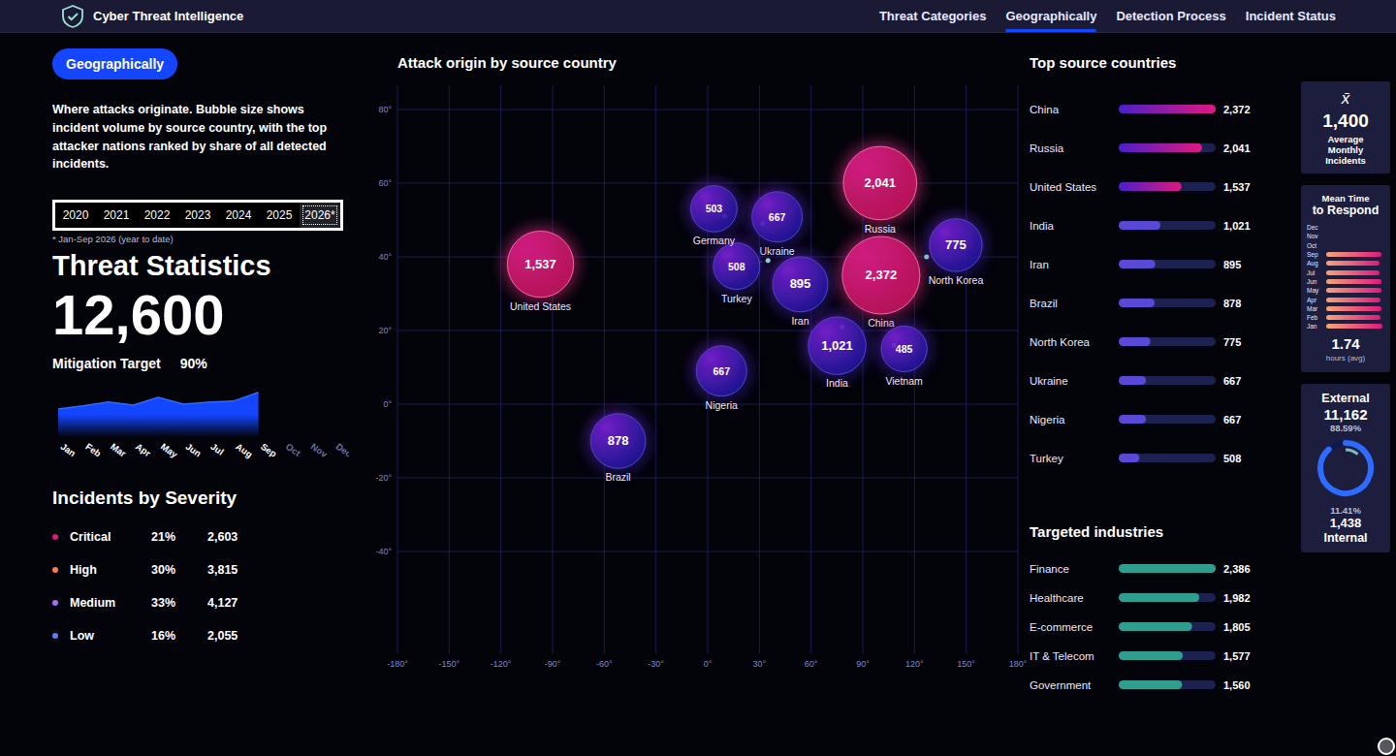
Ransomware dominates cost; origin is concentrated
Estimated impact by category, 2020 to 2026 YTD ($M)
Geographic view, 2026 YTD
$6.7B
from ransomware: 64% of the $10.4B total. Malware is next at $951M.
35%
Finance
China + Russia
top target industry
Impact is the dataset's per-incident estimate.
14,882 and 13,162 incidents; the top two source countries
15,148 incidents, ahead of Healthcare at 12,705
Notes:
Ransomware accounts for about $6.7B of the $10.4B estimated impact from 2020 to September 2026, even though phishing has had more incidents over the period. Attack origin is concentrated: China and Russia together account for 35% of incidents. Finance and Healthcare are the most targeted industries. Rows with unknown country or industry are excluded.

Slide 6
Response got faster; two tools do most detecting
Mean time to respond (hrs)
Answered within SLA (%)
Share by detection source (%)
3.21 → 1.74
65% → 91%
54% SIEM + EDR
2026 YTD response funnel
12,600
Detected 100%
12,421
Triaged 98.6%
11,979
Contained 95.1%
11,367
Mitigated 90.2%
Average detection time 34 min | SLA met 91.1% | SLA targets: Critical 60 min, High 120, Medium 240, Low 480
Notes:
Both response measures improve every year: mean time to respond fell 46% (3.21 to 1.74 hours) and SLA compliance rose from 65% to 91%. SIEM and EDR together detect 54% of incidents, so detection leans on two tools. In 2026 year to date, 98.6% of incidents are triaged, 95.1% contained and 90.2% mitigated.

Slide 7




What to do next
Ransomware readiness
Staff for the peak
Close the backlog
Keep phishing controls
Tested offline backups, EDR coverage and an incident playbook.
Add analysts or SOAR automation before the autumn peak.
Review open Critical and High incidents every week to hold the 90% target.
Awareness training and email filtering still pay off.
64% OF TOTAL IMPACT
DECEMBER RUNS 14% ABOVE AVERAGE
179 OPEN; 90.2% VS 90% TARGET
26% OF 2026 YTD INCIDENTS
Threats keep rising, response keeps improving, and the 90% target is finally within reach.
IN THE SUBMISSION ZIP
Dashboard (HTML)
Workbook (Excel)
Data is synthetic: results demonstrate the method, not real-world rates.
SQL (13 queries)
Report (PDF)
Notes:
Four actions, each tied to a finding. Ransomware readiness first because it is the fastest-growing, now the largest, and highest-impact category. Staff before the autumn peak to protect response times; December has run about 14% above an average month. A weekly backlog review is how the 2026 mitigation rate of 90.2% is held at or above target. Keep phishing controls because phishing is still close behind ransomware. Close on the one-line message and point to the four deliverables in the submission zip; repeat that the data is synthetic and that 2026 covers January to September.

