Slide 1
Project Problem :
Strategic Cost Reduction & Risk Mitigation in Packaging Procurement for ABInBev.
Vyas Bhumit Vishnugopal
Yash Keswani

Slide 2
Index
1. Introduction & Market Landscape
2. Unit Costs & Packaging Problem
3. Aluminum Problem & Proposed Solution
4. Detailed Analysis & AI Integration
5. A peek into AI Model
6. Glass bottle Dynamics
7. Business aspect in Glass Bottle Dyanmics
8. Journey of Used Glass Bottle
9. Issues in Return Journey of Glass Bottle
10. Solution for Reuse of Glass Bottle

Slide 3
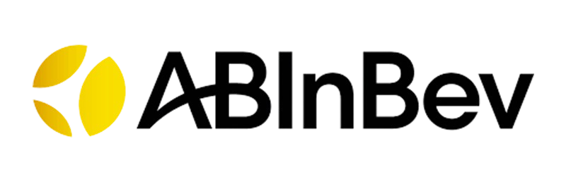
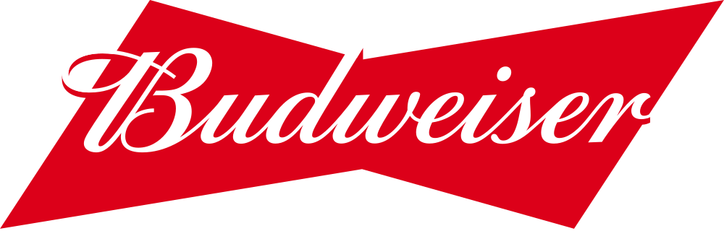

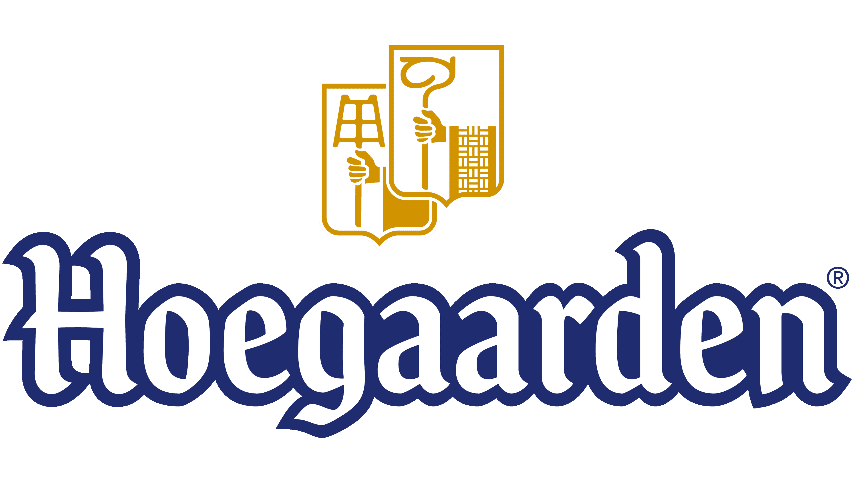
Industry Challenges
₹ 444 B+
Market Size of Beer Industry in India
Changing Consumer Preferences
Regulatory Issues
Procurement
Distribution
Gen-Z and newer generations are consuming less alcohol and more inclination towards white liquor and craft beers
India has a complex web of varying state-level policies, high and inconsistent taxation, and restrictions on distribution and advertising.
High volatility in Packaging material
(Aluminum, Glass) prices as well as High Import costs of malt
and hops.
Inadequate cold chain infrastructure coupled with fragmented distribution systems (government-controlled, open market, and hybrid) across makes beer distribution highly challenging
6.72%
CAGR of the Beer Industry in India
Company’s focus
Beer Brands with high market presence and Brand Image
Organic growth
The company’s main area of focus has shifted from acquisitions to having organic growth rather than acquiring
It includes Budweiser classic(lager) with low ABV , Budweiser Magnum with high ABV(strong lager) ,Budweiser 0.0(non-alcoholic) ,Budweiser Beats(Energy Drink) and newly introduced Budweiser magnum double barrel whisky these are key products in the umbrella of Budweiser .Persona varies from strong bold Indian taste to classic Budweiser experience without alcohol and also introduces parent brand in new Indian single malts corn whisky market
Increase Profit Margins
The company's approach to increasing its profit margin is centered on disciplined cost management and strategic revenue growth.
Seen as a “lifestyle beer” associated with beaches, vacations, and international culture. In India, often marketed as the beer “you have with lime,” which differentiates it from other lagers. Popular in restaurants, pubs, nightclubs, and premium hotels, rather than mass retail.
Sustainability
Company’s sustainability goals aim for Water Stewardship , Circular Packaging and decreasing carbon footprints from value chain
Consumers who find lagers too bitter or heavy often shift to Hoegaarden for its citrusy, smooth, and refreshing taste. It’s often recommended by bartenders as a “premium international wheat beer.”

Slide 4
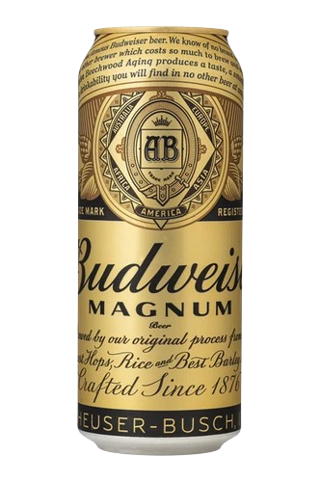
The Packaging Problem
Unit costs of a Beer Bottle
Packaging Costs
Major Chunk of cost is from cans made up of Aluminum & bottles of Glass
Distribution Costs Includes transportation, cold chain, storage
20 %
45 %
Operating Costs Includes brewing and overhead costs such as electricity, steam, labor, maintenance, quality control
20 %
Raw Material Costs Includes Malt, Hops, Water & Yeast
15 %
Aluminum Issue
Price Volatility
Regulatory Gridlock
Import Dependency
Surging Demand
The market’s unpredictable demand can lead to supply shocks especially in states like Uttar Pradesh, where cans can account for 75-80% of sales for major brewers.
India has limited domestic can manufacturing abilities which are owned by International giants Canpack and Ball, compounding these issues the aluminum required for manufacturing of specific gauge is imported.
New mandate requiring BIS (Bureau of Indian Standards) for cans has become a major impediment, slower process has caused significant delays in shipments from international suppliers
Aluminum had a 22% volatility in 2024 and 19% in 2023 exposed company’s equity of 408 million USD in 2024 and 337 million USD in 2023, AB InBev has largest commodity exposure of 1,841 million USD hedged for year 2024, fluctuations in price represent the most significant commodity risk for AB InBev.

Slide 5
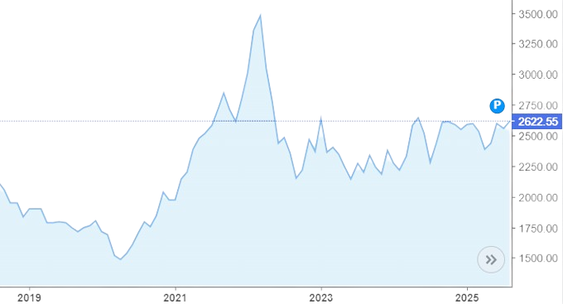
AB InBev’s cost of sales rose sharply in 2022 as commodity inflation and currency effects pushed up packaging inputs
18.4% increase in cost of sales & 15.8 % rise per hectoliter
In India, aluminum supply is materially import‑linked, with a large share of scrap and primary metal sourced from abroad this makes local can costs sensitive to global aluminum prices and rupee movements.
Solution
Collaboration with Partners
Integrating Risk Management Holistically
Shift sourcing from transactional buys to strategic partnerships across the full aluminum value chain—primary producers, coil/sheet mills, can-makers, and logistics—locking in quality, volumes, and service with multi‑year agreements and shared KPIs
Break silos between procurement, finance, R&D, sustainability, and operations by instituting an enterprise commodity‑risk framework that aligns short‑term hedges, mid‑term contracting, and long‑term design changes into one coherent plan.
Re-engineering light weight cans
Reduce metal per unit by optimizing can body gauge, end diameter, and seaming without compromising performance, cutting permanent material intensity and cost per hectoliter.
Investing in Financial Instruments
Implement a layered hedging program (forwards/swaps/futures and options) to cap upside price risk while preserving downside participation, executed with creditworthy counterparties and monitored by an internal risk committee
Using Recycled Aluminum
Producing aluminum from recycled scrap uses up to about 95% less energy than from virgin bauxite, delivering significant cost and carbon benefits over the long term

Slide 6
Strategic Comparison of Aluminum Procurement Approaches
Feature
Company’s Approach
Compatibility
Viability
Collaboration with Partners
AB InBev works closely with aluminum suppliers, logistics providers, and recycling partners to secure a reliable aluminum supply chain.
Strong – supports supplier relationships and long-term contracts, but may limit flexibility in volatile markets.
High – strengthens supplier ecosystem but offers limited price control.
Using Recycled Aluminum
Heavy investment in post-consumer recycled aluminum to cut costs and reduce carbon footprint.
High – aligns with ESG goals, but dependent on availability and quality of scrap aluminum.
Medium – good for ESG branding but scaling globally is difficult.
Uses futures, options, and hedging contracts to lock in aluminum prices, stabilize procurement costs, and maintain liquidity.
Very High – reduces price volatility risks, frees cash for growth, and offers better long-term predictability.
Investing in Financial Instruments
Very High – mature markets make this highly scalable and profitable.
Innovates in packaging to reduce material use per can, lowering costs and emissions.
High – cost-saving and eco-friendly but requires upfront R&D and retooling investment
Medium – strong future payoff but slow ROI due to capital needs.
Re-engineering light weight cans
Combines supplier diversification, hedging, and ESG targets for a resilient aluminium procurement strategy.
Very High – creates a balanced, future-proof supply chain that mitigates both financial and operational risks.
High – supports long-term resilience but needs strong execution and systems.
Integrating Risk Management Holistically
Investing in financial instruments (hedging, futures, and options) emerges as the most viable choice, offering immediate price stability, global scalability, and stronger cash flow management. Hedging will not just a defensive move but a strategic enabler, aligning with AB InBev’s size and financial maturity.
AI-driven forecasting can turn financial hedging into a competitive advantage.
Combining financial instruments with advanced AI models creates a resilient, cost-efficient aluminum procurement system, giving AB InBev a competitive edge in both financial performance and supply security.

Slide 7

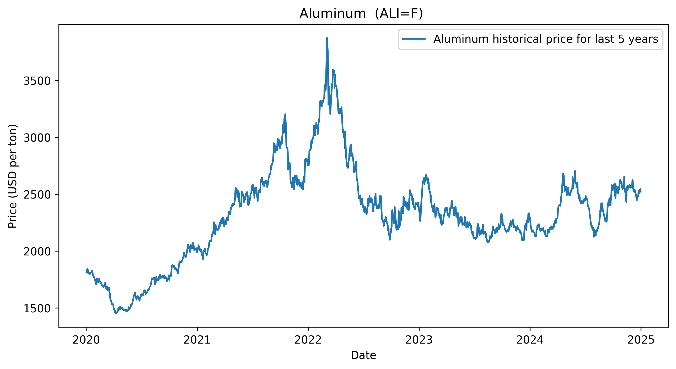
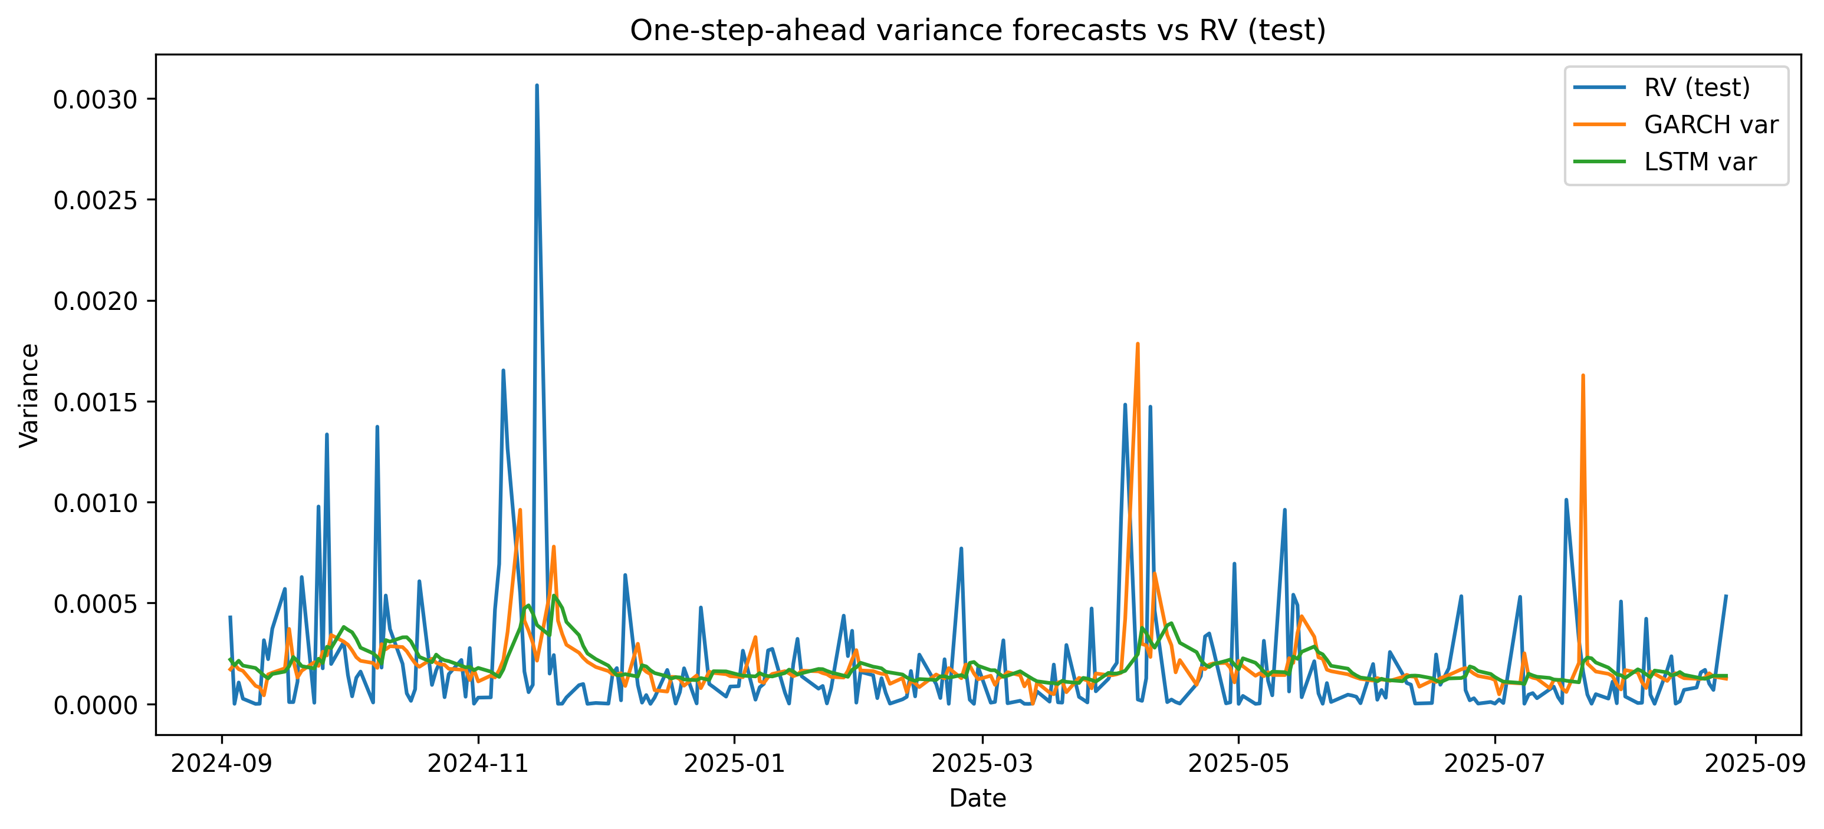
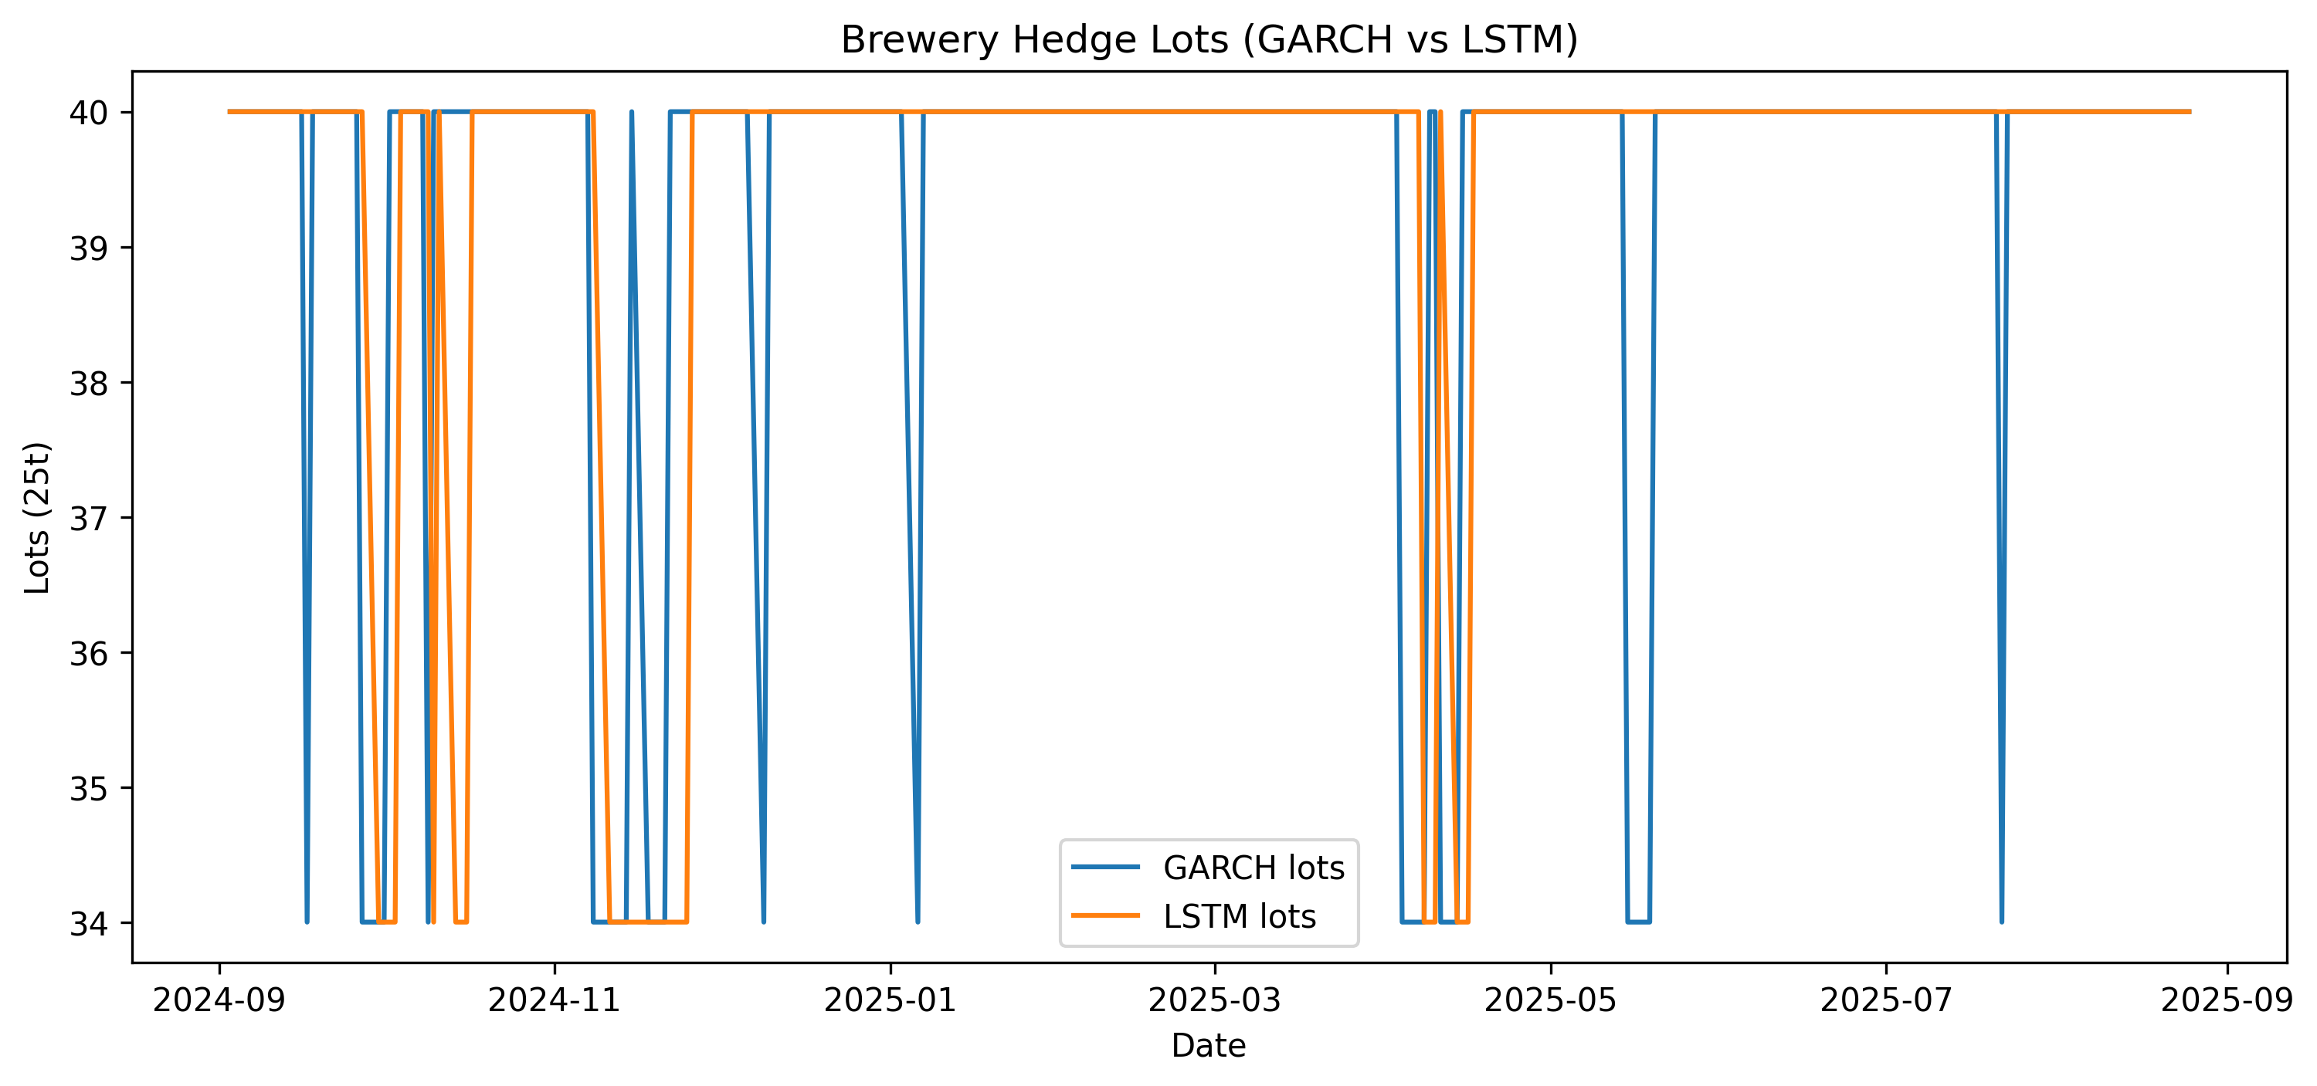
Scan to view interactive model
Aluminum prices have shown sharp swings in recent years (COVID, energy shocks, supply chain disruptions).
For breweries, this creates packaging cost uncertainty since cans are aluminum-intensive.
Traditional procurement strategy is reactive due to cost spikes, unpredictable cash flows.
GARCH model → reacts strongly to spikes, sometimes overshoots → conservative, higher hedging costs.
LSTM model → smoother forecasts, avoids overreaction → cost-efficient but may under-protect in sudden jumps
Together, they give a balanced view of short-term risk vs stability
Both models suggest hedging ~34–40 lots (~850–1000 tons).
GARCH hedging = frequent adjustments → tighter protection, higher transaction costs.
LSTM hedging = steadier → lower costs, but slightly higher exposure risk.
A hybrid strategy balances cost-efficiency and risk resilience.
This approach transforms procurement of aluminum from reactive buying to a predictive, data-driven risk management strategy

Slide 8
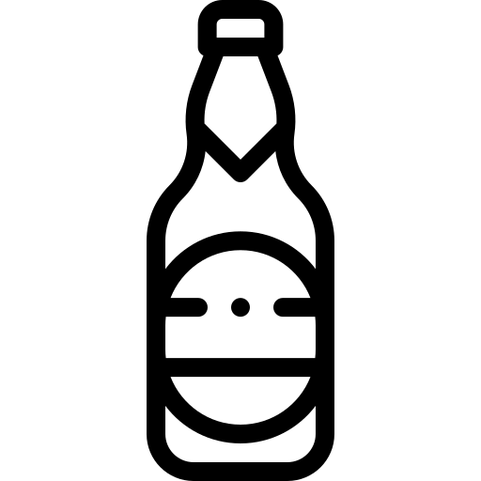
Why Glass Bottle??
Globally, glass bottles account for approximately 31% to 51% of total beer packaging, reflecting their continued dominance despite the rising popularity of cans.
Glass bottles remain vital to the beer industry due to their flavor stability, reusability, sustainability advantages, and premium consumer perception, making them the preferred choice for many brewers and drinkers worldwide
In India, glass bottles are the dominant packaging format for beer, accounting for an estimated 65% of the total volume sold due to consumer perceptions of quality and tradition.
Bottle Packaging Types
330ml
Business Impact
17%
500ml
3%
3B+ L
750M+ L
650ml
80%
India’s beer consumption
Fulfilled by ABInbev
330ml
650ml
500ml
Liters made in 650ml bottle:
750M * 0.65*0.8 = 390M
390M/0.65 = 600M
650ml bottles :
750M * 0.65*0.2 = 97.5M
97.5M/0.33 = 295M
Liters made in 330ml bottle:
330ml bottles :
Estimated no. of bottles required by ABInbev annually
600M + 295M = 895M

Slide 9

Cost Dynamics
RGB can be reused for around 6 - 7 times
57 %
of glass bottles come back to the ABInbev
Cost of new bottle(650ml) :
₹ 12.94
₹ 16.94
Cost of new bottle(330ml) :
Cost of reused bottle(650ml) :
₹ 6.46
₹ 4.82
Cost of reused bottle(330ml) :
Savings per bottle(650ml) :
₹ 10.48
Savings per bottle(330ml) :
₹ 8.12
61.9 % & 62.8 %
of direct savings on procurement of packaging material i.e. Glass Bottles of 650ml and 330 ml each
70 %
Why 70% target??
Target :
Target 70% returns to beat the 57% status quo, cut cost and CO₂ with 6–7 reuse cycles, and neutralize losses from breakage and leakage through smarter incentives and logistics.
13 %
Increase :
0.13*700M = 91M
91M * ₹ 10.48 = ₹ 953.68M
₹ 953.68M is the potential savings
RGB = Returnable Glass Bottle

Slide 10
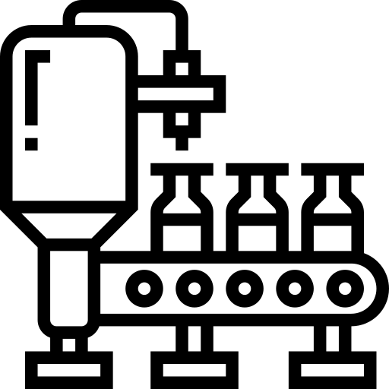
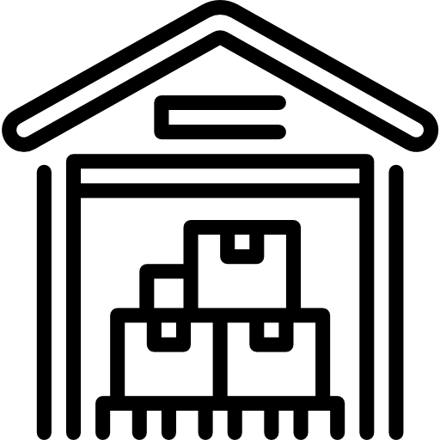
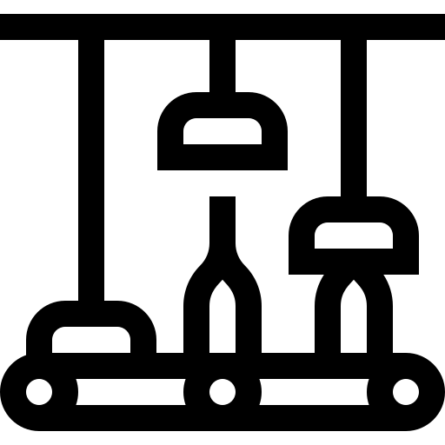
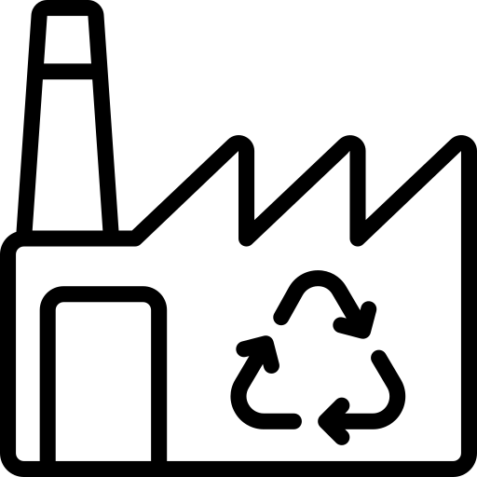



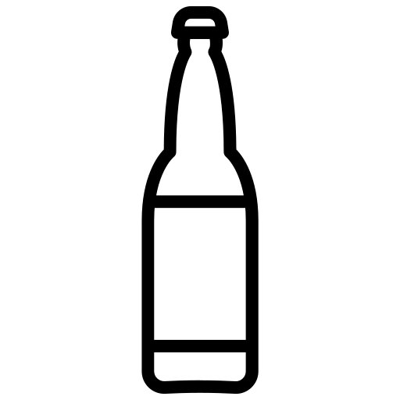
Journey of used glass bottle
Mixed, partly crushed bottles are sorted again to push quality on the higher side. The clean glass is crushed into uniform cullet, blended with sand, soda ash, and limestone, melted in a furnace, and formed into new bottles that will go back to beverage fillers this includes different beverages along with breweries
Breweries often partners with recycling units to save energy and Co2 emissions.
Alcobev bottles are now sorted in 2 phases
Phase 1: In phase 1 alcobev bottles are sorted according to their types like rum, whisky, beer and etc.
Phase 2: In this phase beer bottles are sorted according to their brands.
After both phases these bottles are go to breweries where they are inspected and washed and then bottled
Brewery
Wholesaler
Bottles once sorted from scrape shop
Here bottles are of all types according to their usage such as cold drink bottles, shake bottles and alcobev bottles all these bottles are now separated accordingly .
Recycling Unit
Regional
dealer
Scrape Shop
Receives bottles from Kabadiwalas and smaller collection points. They perform a more robust initial sort, removing non-glass items and separating glass by color (clear, brown, green) if possible. They might also crush bottles into cullet for easier transport.
Often acts as the initial ground force, collecting various types of waste, including glass bottles, directly from homes and small establishments. They play a vital role in areas where formal recycling infrastructure might be less developed.
Kabadiwala
The consumer throws bottle after consuming the beer this doesn’t include number of bottles that are thrown at Bars & restaurants.
Consumer

Slide 11
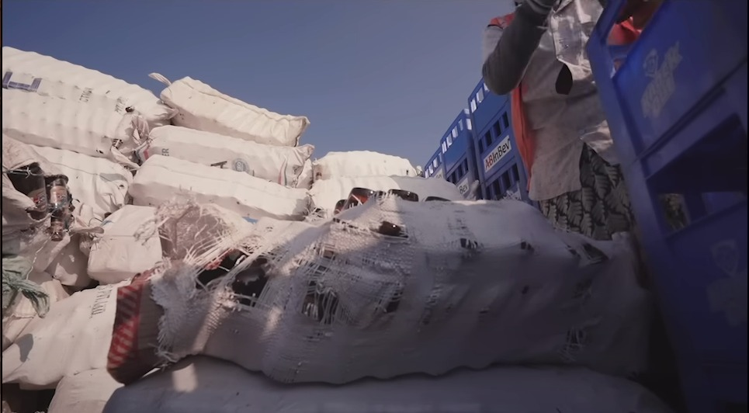
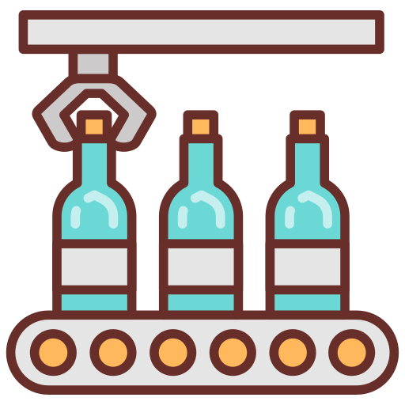
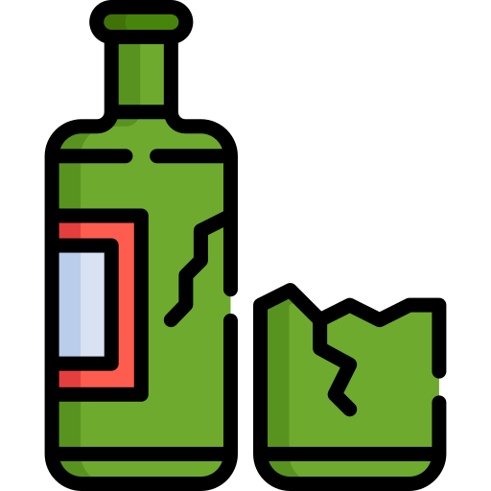
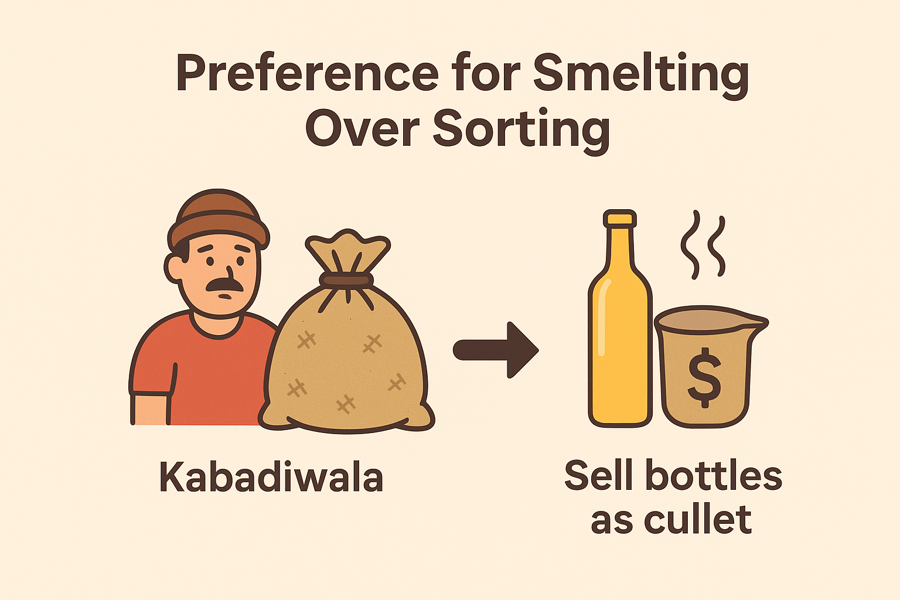

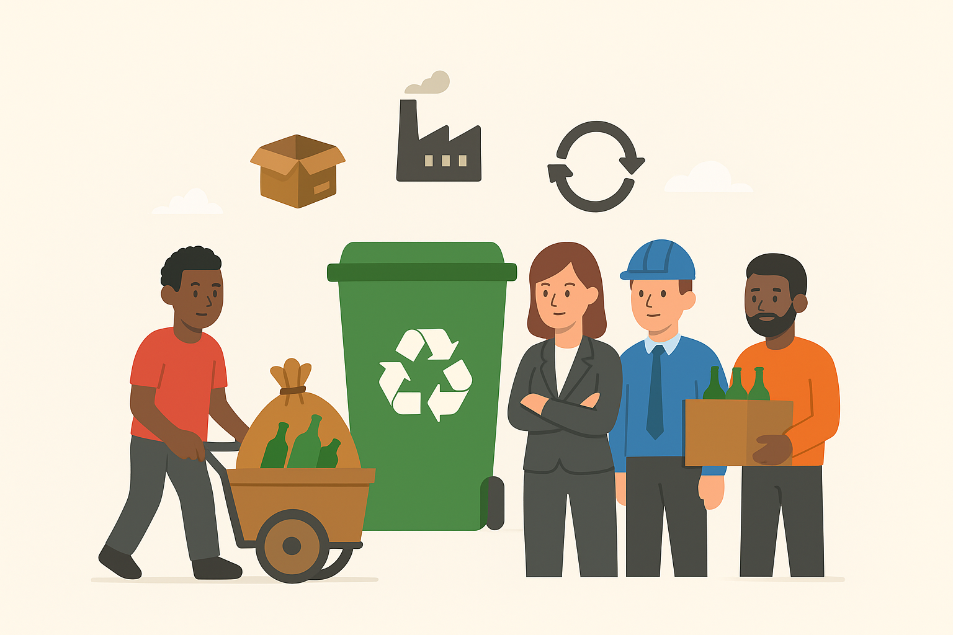
o reuse.
Gaps in Circular Glass Packaging
High breakage also discourages informal collectors (kabadiwalas), as shattered glass is less profitable and harder to process.
Inadequate degassing can lead to off-flavors, oxidation, and reduced product quality when bottles are reused.
Use of gunny bags for transportation is common, which causes significant bottle breakage due to lack of cushioning and stacking pressure.
Weak collaboration among manufacturers, distributors, and recyclers creates major inefficiencies in circular glass packaging.
Low public awareness of glass recycling benefits and lack of incentives (e.g., deposit-return schemes) reduce bottle recovery rates.
Scrapers often sell collected glass directly to smelters because it’s faster, easier, and offers immediate cash returns. Sorting, cleaning, and transporting bottles for reuse requires more labor and coordination, reducing their motivation to support circular packaging systems.
Glass bottle recycling in the alcobev industry struggles with fragile reverse logistics, where the use of gunny bags, poor handling, and high breakage rates make collection unprofitable and discourage scrappers from supporting circular packaging. Operational inefficiencies like inadequate degassing, weak sorting infrastructure, and a preference for smelting over reuse worsen the challenge, while poor coordination between stakeholders and low consumer incentives create a fragmented ecosystem.
Solving this demands deposit-return schemes, investment in safer collection systems, automated sorting and washing facilities, and stronger manufacturer–collector partnerships.

Slide 12





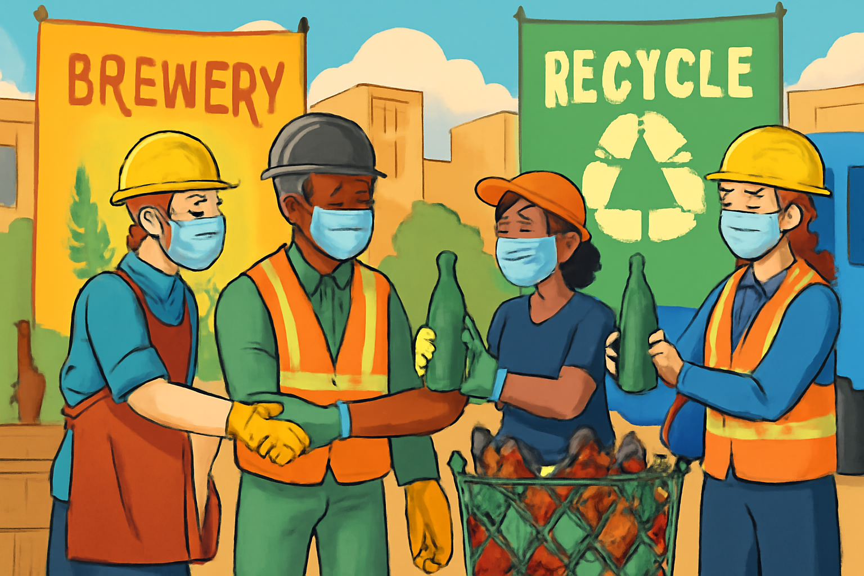
Scalable Solutions for Circular Glass Packaging
Current State
Proposed Future
Advantages/Benefits
Risks/Challenges
More durable and rigid than gunny bags, so bottles break less during moves.
Higher upfront cost is a key drawback.
Protects bottles in transport and handling, reducing losses
They need regular cleaning and maintenance to stay hygienic and reusable
Easy, stable stacking for faster loading and unloading.
Poor management can add to plastic waste and dilute environmental gains
Returned bottles are cleaner and easier to recycle, lowering costs and improving quality
Deposit‑return schemes demand major infrastructure and logistics spend, raising retailer and producer costs
Deposit-return gives a small cash incentive, so people bring bottles back
Low deposits depress returns; design must set the value high enough to motivate behavior
Return rates can reach 90%+ in well-run systems (e.g., Germany about 98%; Norway above 90%).
Poor scheme design can backfire, nudging consumers toward less sustainable packaging choices
Manufacturer–collector partnerships secure a steady, quality supply of recycled glass
Setting up safety, contracts, and payments adds significant upfront cost and oversight needs
They raise collectors’ incomes with fair pay, bonuses, and safety support
Formalizing informal collectors can face resistance and trust gaps, leaving some actors outside the system.
These alliances strengthen brand sustainability and unlock eco‑market opportunities
Partial inclusion fragments value chains and weakens program coordination
Highlight scalable circular‑glass solutions—plastic crates, deposit‑return schemes, and manufacturer–collector partnerships—that boost glass quality, recycling, livelihoods, supply resilience, and brand sustainability while navigating upfront costs, operational complexity, and the need for tight stakeholder collaboration

