Slide 1
Credit eda Case study analysis
Yash khatavkar

Slide 2
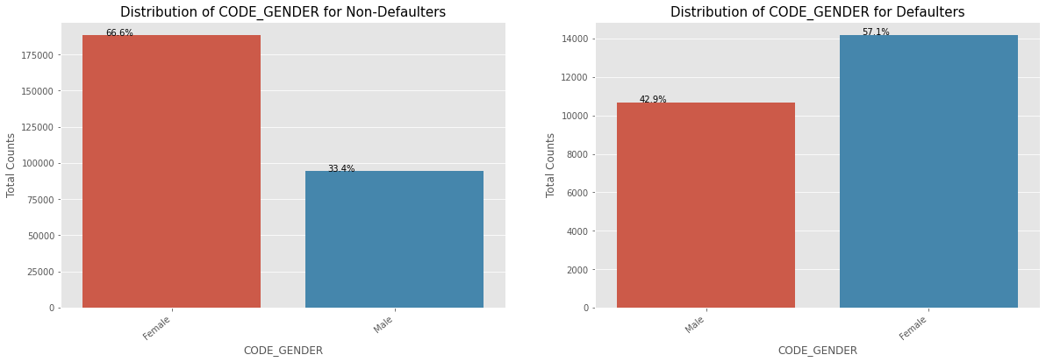
Distribution of Defaulters and Non Defaulter on the basis of Gender
Female contribution is 67% to the non-defaulters and 57% to the defaulters.
We can infer that more females are applying for loans than males and therefor leads to an increase in female defaulters as well.
However the rate at which females default the loans is way less compared to males.

Slide 3
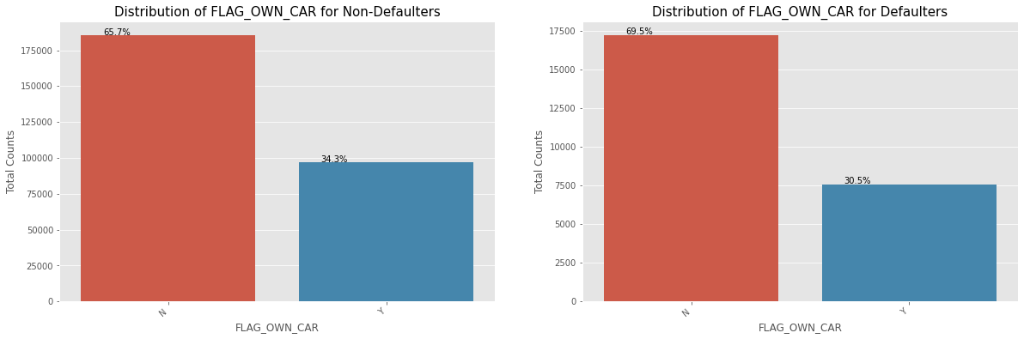
Distribution of Defaulters and Non Defaulter on the basis of ownership of car or not
Loan applicants with cars contribute 65.7% to the non-defaulters and 69.5% to the defaulters.
Therefore we can infer that people who own a car default more often, it might be because there are more people without cars.
Therefore we can conclude that the rate of default of people having car is low compared to people who don't.

Slide 4
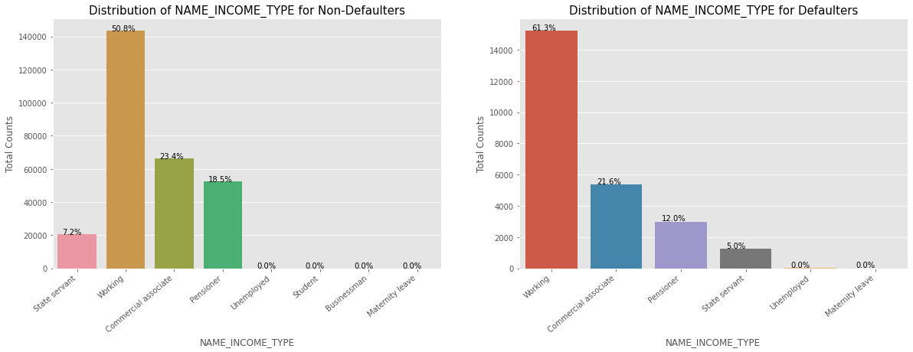
Distribution of Defaulters and Non Defaulter on the basis of Income Type
We can observe that the students don't default. It may be as they are not to repay the loan during the tenure as students.
Business Men never default as they have a strong financial support.
Majority of the loans are disbursed towards working class people.
Working class people contribute ~51% to non defaulters and ~61% of the defaulters.

Slide 5
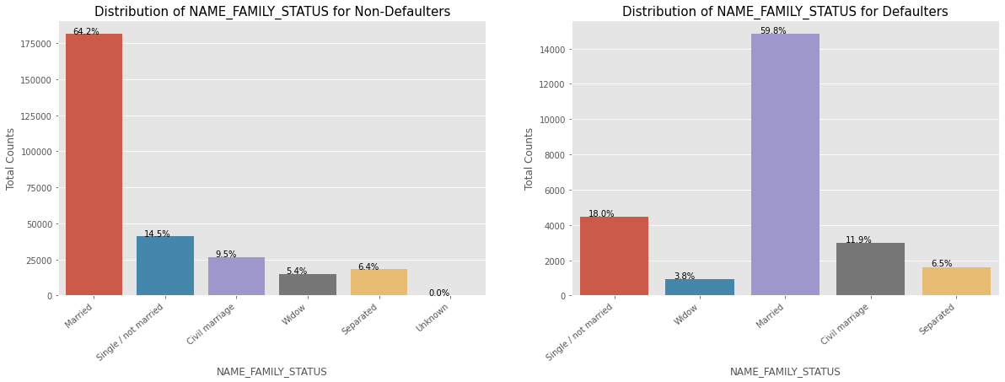
Distribution of Defaulters and Non Defaulter on the basis of Marital Status
From the above bar graph we can infer that married people apply for a majority of the loans.
However we can observe that Single/non Married people contribute 14.5% to Non Defaulters and 18% to the defaulters.

Slide 6
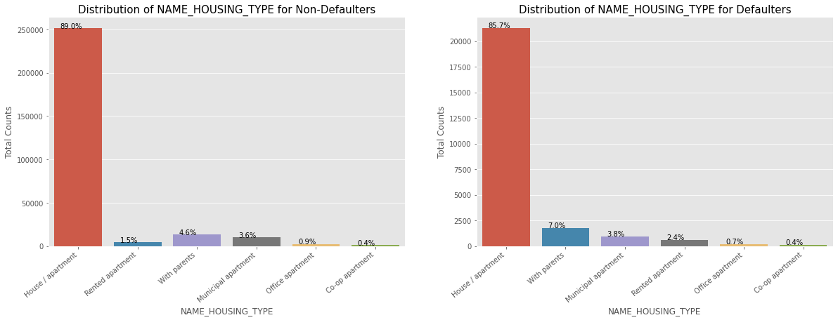
Distribution of Defaulters and Non Defaulter on the basis of Age Group
Applicants who own a House/Apartment, tend to apply for more loans.
Applicants staying with parents a e likely to default more due to high standard of living.

Slide 7
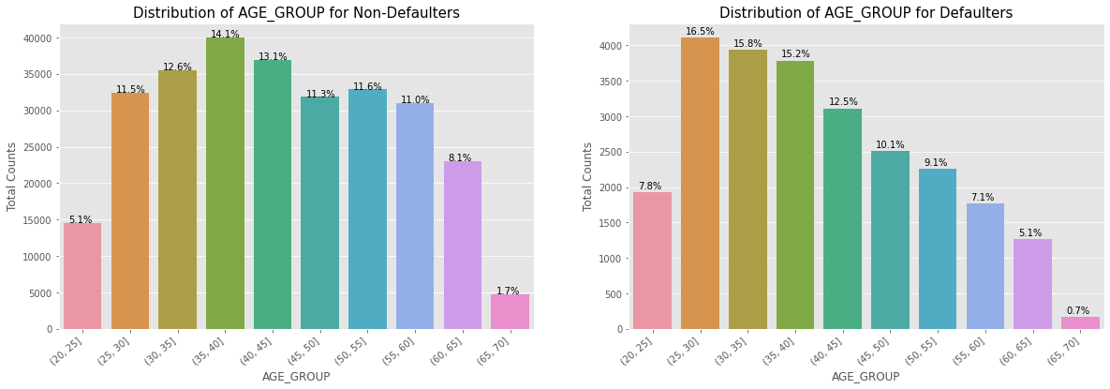
Distribution of Defaulters and Non Defaulter on the basis of Age Group
(25,30] age group riskiest people to loan to as they tend to default more
With rising age group, people tend to default lower above the age of 25.
This may be because they are employed and their salary also increases as their grower older.

Slide 8
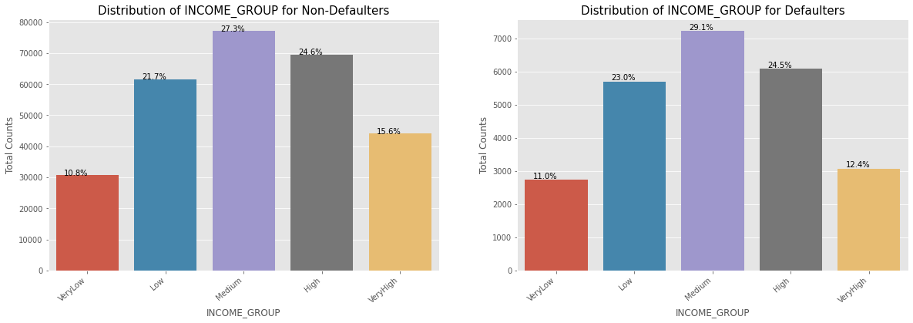
Distribution of Defaulters and Non Defaulter on the basis of Income Group
Very High income group likely to default less often. They contribute 12.4% in Defaulters and 15.6% in Defaulters.

Slide 9
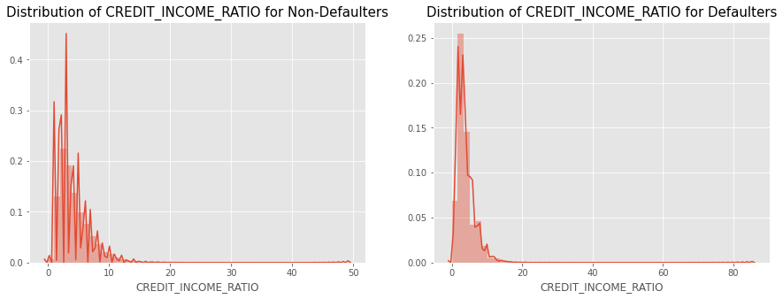
Distribution of Defaulters and Non Defaulter on the basis of Credit and Income Ratio
Highest defaults take place when the credit income ratio is approximately between 2 - 2.5.

Slide 10
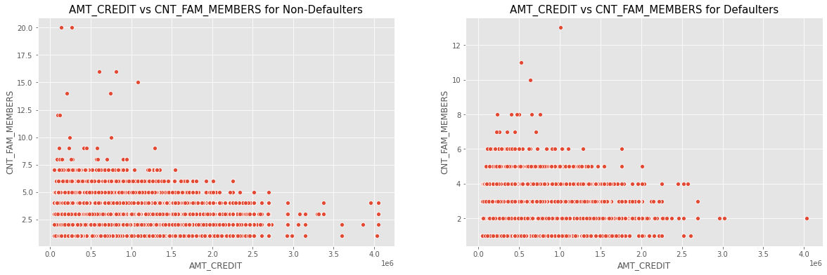
Distribution of Defaulters and Non Defaulter on the basis of no of family members and approved loan amount
We can conclude and evaluate that families with larger member and applicants with a higher credit amount default less often.
At the same time, density in the left corner lower side we can observe that people might be more vulnerable to default if the applicant’s family size is small and the credit amount is low .

Slide 11
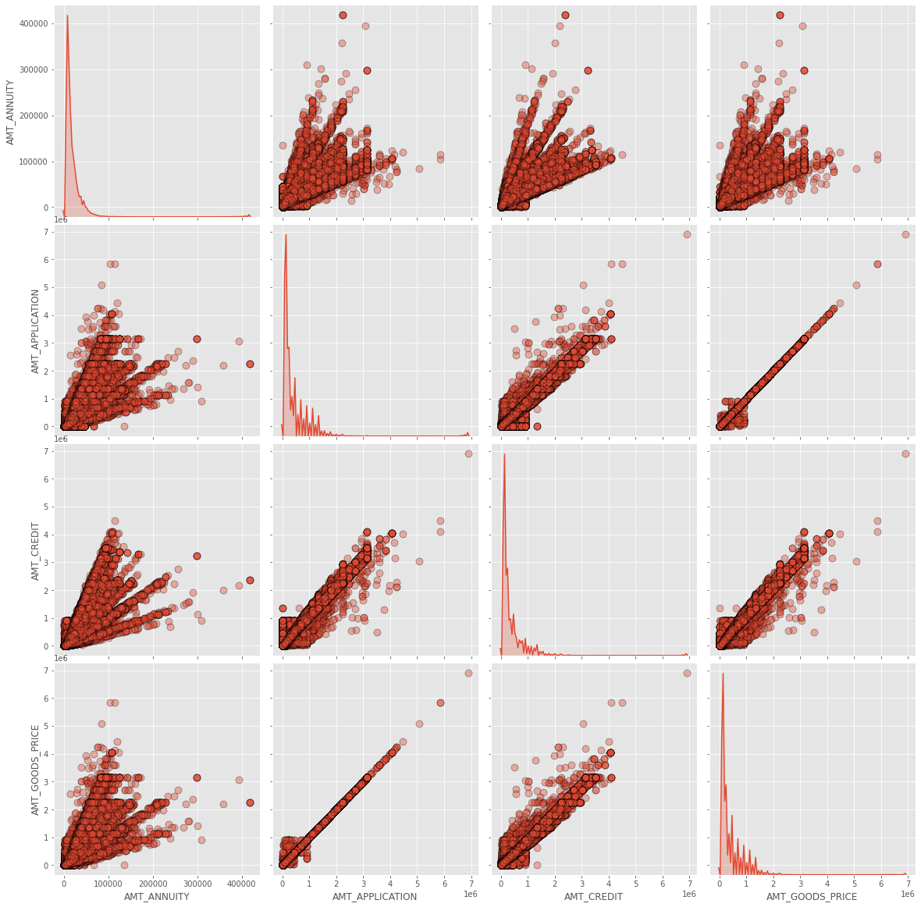
Basis other variables
1. Amount of final credit distributed to the consumer previously is linked to the previous application price and also at the same time amount of the goods that consumer asked for in the previous application.
2. Amount of credit asked by the consumer is highly dependent on the price of the goods in the previous application transaction.
3. Annuity in the previous application is primarily depend on the following elements:
a. Credit amount approved b. Credit amount the client asked for in the application c. Amount of the goods requested by the client.
AMT_CREDIT is highly related to AMT_GOODS_PRICE and AMT_APPLICATION
AMT_CREDIT highly dependent on AMT_GOODS_PRICE
The grant in previous application is based on final credit amount, credit the client requested in the application, price of the goods.

Slide 12
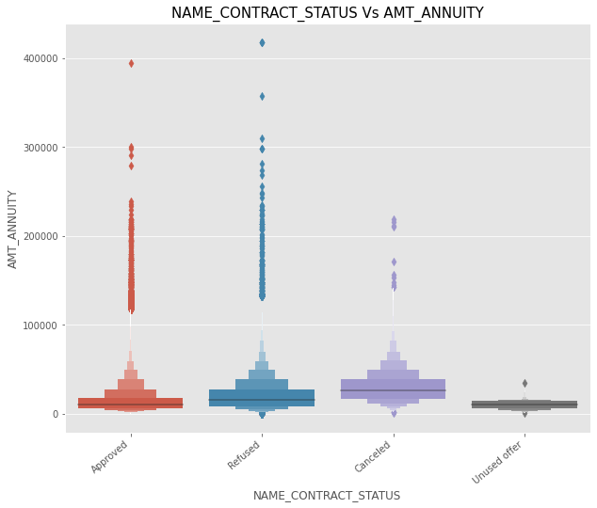
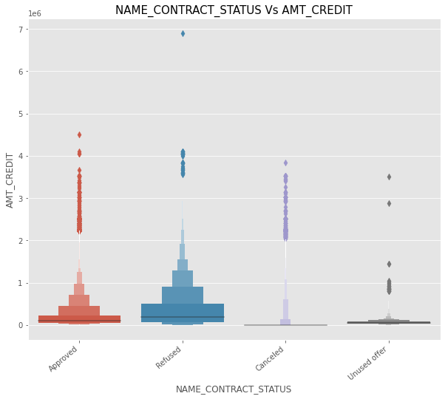
Basis customer’s annuity and various other loan approval status
If annuity amount lower then application will either be unused offer or canceled. In addition, applications with a high annuity amount have higher chances of being refused.
If credit amount is low, then it will not be made use in most of the cases

Slide 13
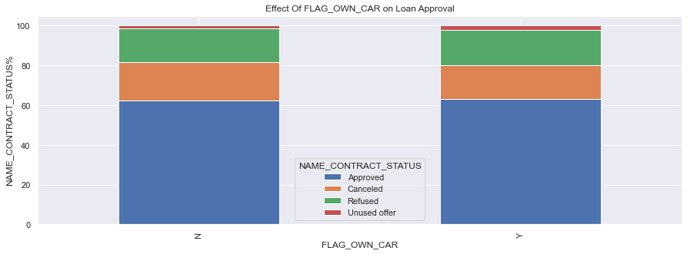
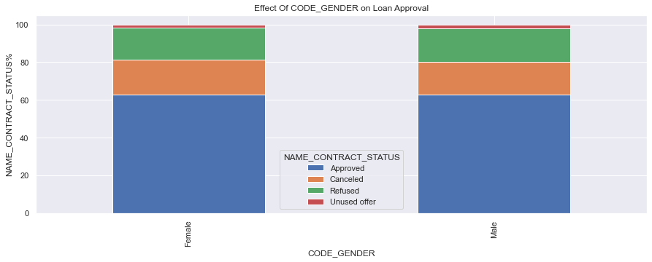
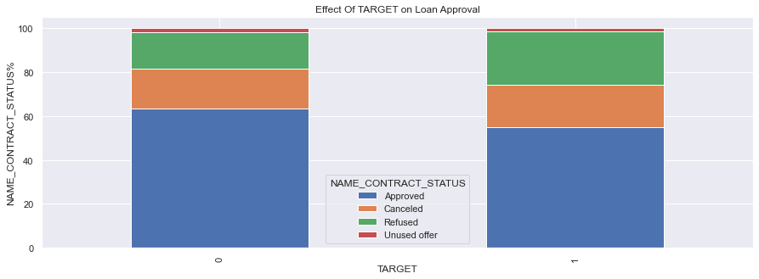
Basis customer’s annuity and various other loan approval status
Gender has no relevenace in decision making process i.e (approval or rejection) of the application
Females have higher chances of not defaulting when we evaluate the data.
The bank can focus more on the female applications in order to increase its topline and bottomline
Applicants who are car owners have a higher probability of not defaulting on their loans than that to applicants not owning a car.
Therefore the bank should focus to car owners when it comes to profit maximization.
People who have been approved previously for a loan have a higher rate of not defaulting on their loans compared to people who were rejected.

Slide 14
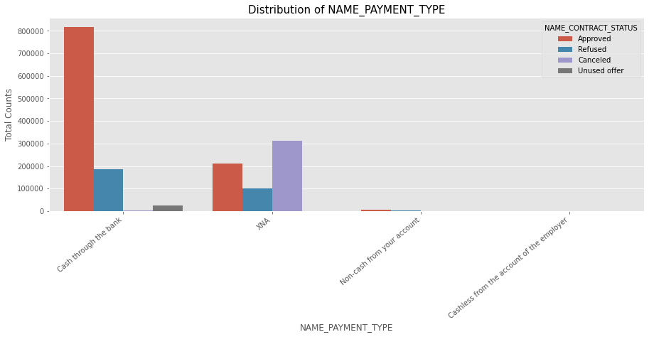
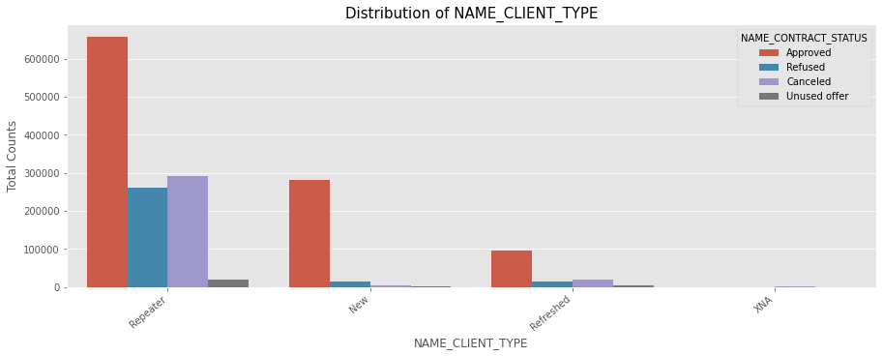
Basis customer’s annuity and various other loan approval status
Majority of the applications are for Consumer and Cash Loans followed by revolving loans.
Majority of refusals are for cash loans
Majority of approvals are for consumer loans
Majority of cancellations are for cash loans
Majority of the applications are Cash through the bank and XNA.
Very minimum no of customers have made use of cashless mode of payment

Slide 15
Summary
The bank should give more importance and preference to the applicant who owns a car while loan approval.
The bank should take into account giving more preference female customers.
Business men are more likely to be better customer as they are less likely to default.
Bank should reject loan applications from the age group (20-25] as they default more often and increase bank’s NPA and affect its profitability drastically.
It should maintain the Credit amount of the loan to Income of the client ratio to less than 2.5 to avoid the risk.
For new loan application, bank should give preference to people who were approved for a loan before from other banks.
Simultaneously bank should approve limited number of loan applications from people who were defaulted the loan last instance as they might again default on the loans.

