Slide 1
ScholarFinder
A simple Python application that gives a list of research scholars by scraping the Elsevier Scopus API

Slide 2
Installation
Simply Extract the zip file and copy it to your desired location

Slide 3
Running the code
Run ‘python3 scopus.py’ in the Command Line
Enter the API key provided by Elsevier developers
If not present then you can use the given key: 7f59af901d2d86f78a1fd60c1bf9426a
Enter G for General Search and A for Advanced Search
Fill the required fields. (For empty fields enter -1)
Enter the file path where you want to install the file (File Path should be complete including the name of the file that you want to install and the extension should be .csv)
The final results containing the list of scholars will be present in the csv file sorted in Descending Order of the Citations Count.

Slide 4
A few limitations of the code
Since the personal data of the scholars is not available, we could not scrape their email addresses. However, we have scraped their current Affiliations and their emails can be found on the official sites of those affiliations.
Due to a lack of GUI, doing an advanced search is quite cumbersome
The keywords are not all available because the loss of full text of some of the authors. We are planning to extract keywords from the abstract for that

Slide 5
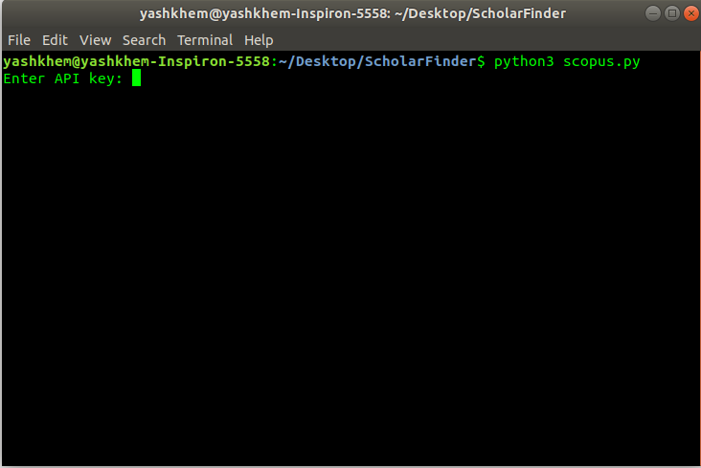
Snippets of the code

Slide 6
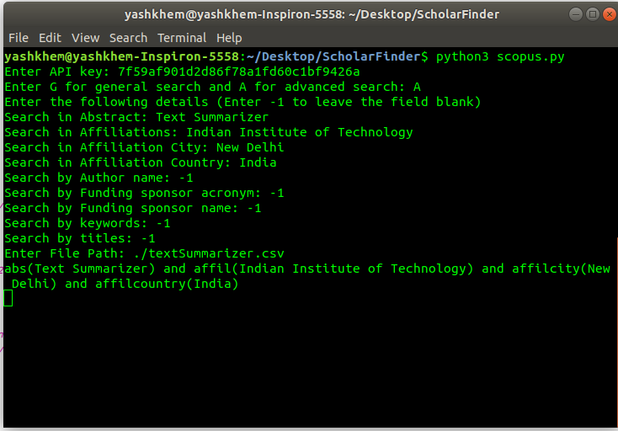

Slide 7
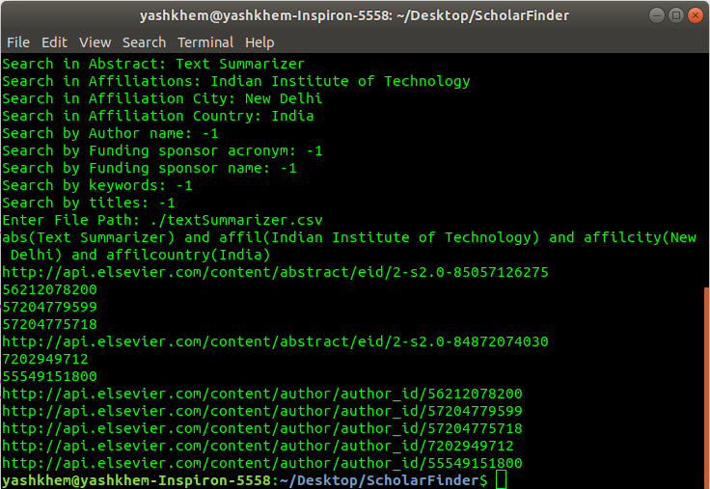

Slide 8
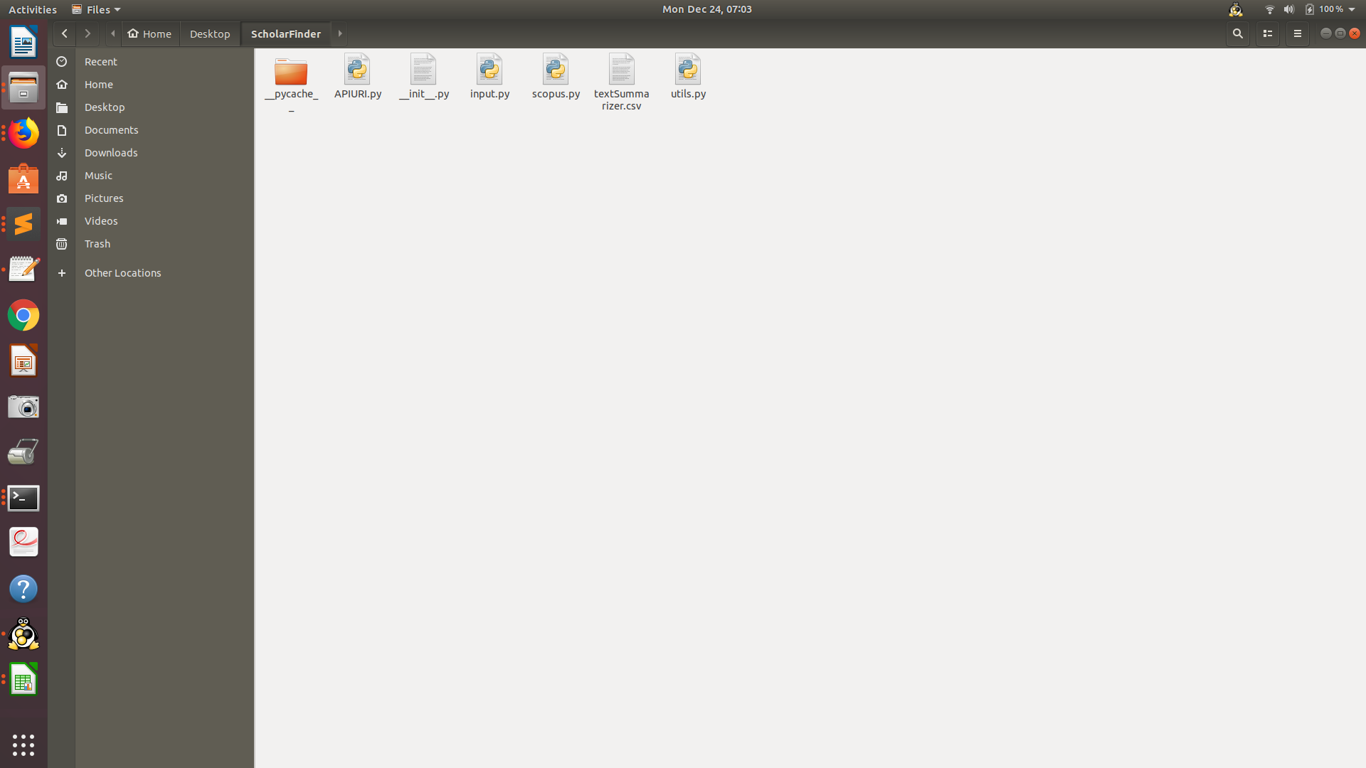

Slide 9
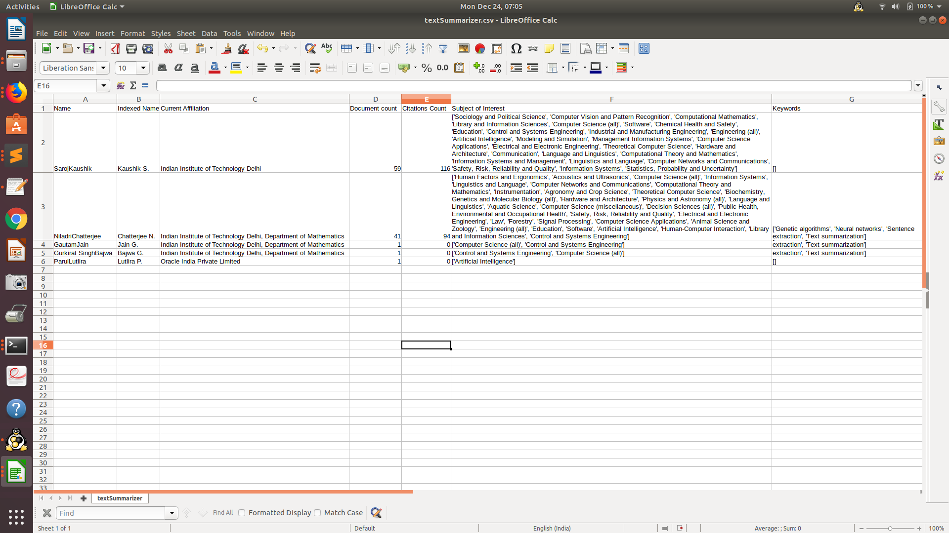

Slide 10
Thank You

