Slide 1
INFO 5100 :Application Engineering Development
FINAL PROJECT
ON
HEALTHCARE MANAGEMENT SYSTEM
Presented by,
Yash Khopkar (NUID:001850102 )
Satvika Shetty (NUID: 001837927)
Shubhi Sharma (NUID: 001856394)

Slide 2
PROBLEM STATEMENT
Healthcare is one of the most important thing in a day to day life of a person. The Healthcare management system is focused to make things easily accessible to the end user.
This application provides the user accessibility to buy vaccines for a particular disease and blood bottles and enrol for blood donation camps .
Vaccines for new diseases will be created by the research lab which will be sent to the CDC for approval. Only the CDC approved vaccines will be available to the user
The NGO (non-governmental organization) admin requests the hospital for a particular number of doctors which is approved by the hospital organization
The hospital admin can request for vaccines from the supplier and the supplier in-turn will send a request to the distributor and the vaccine will be available.

Slide 3
Actors and Use Cases
System Administrator: Responsible to create and alter all the credentials required at the enterprise level
NGO : the NGO Admin is responsible to request the number of doctors from the hospital enterprise and request for fund donations from the sponsors enterprise
Hospital: Responsible to add new doctors to the doctor list and approves or rejects the doctor request sent by the NGO depending on the availability of the doctor. It also creates credentials for the clinic organization.
Sponsors: Responsible to accept or reject the sponsorship request sent by the NGO

Slide 4
Actors and Use Cases contd…
Distributor: Responsible to create credentials for the supplier and the provider
Provider: Requests for vaccines from the supplier
Supplier: Adds the vaccines to its list and also is responsible to approve the vaccine request sent by the provider
Research Lab: it comes up with new vaccines for various diseases
CDC: it approves or rejects the new vaccines created by the Research Lab and then makes it available to the distributor and the end user

Slide 5
Key Roles:
Pharmacy Role: Requests vaccines to the provider
Distributor Role: creates credentials for the supplier and the provider
Provider Role: requests vaccines from the supplier and also displays the list of requested vaccines from the pharmacy and the available vaccines once the requested has be completed by the supplier
Supplier Role: it can add the vaccines and also complete the request sent by the provider if they have enough stock
Hospital Role: it can create credentials for the clinic organization, adds the doctors to the doctor list and also manages the requests sent by the NGO requesting the number of doctors they need

Slide 6
Key Roles contd..
Sponsor Role: Accepts o0r rejects the fund donation request sent by the NGO
CDC Role: it approves or rejects the new vaccines created by the Research Lab and then makes it available to the distributor and the end user
NGO Role: It is responsible to request the number of doctors from the hospital enterprise and request for fund donations from the sponsors enterprise
System Admin: Creates credentials at the enterprise level
Clinic Role: Creates credentials for the pharmacy admin and the clinic admin

Slide 7
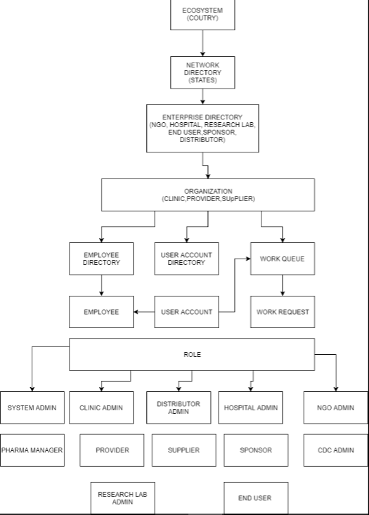
OBJECT MODEL

Slide 8
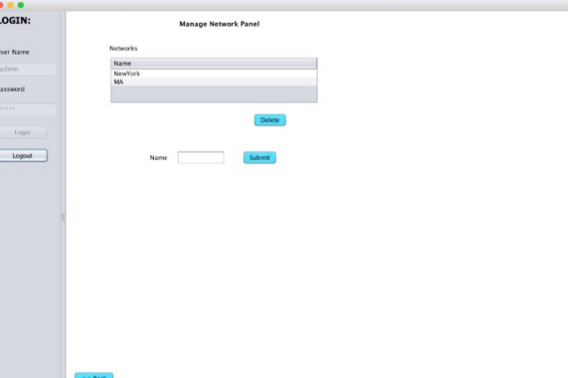
USE CASES (SCREENSHOTS)

Slide 9
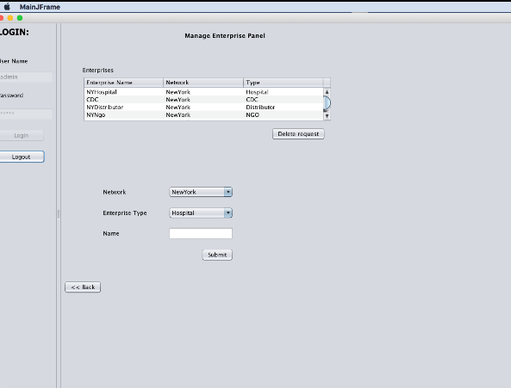
USE CASES (SCREENSHOTS)

Slide 10
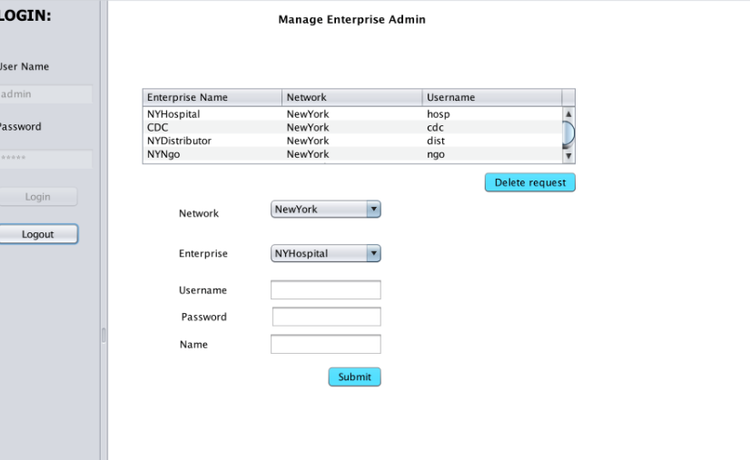
USE CASES (SCREENSHOTS)

Slide 11
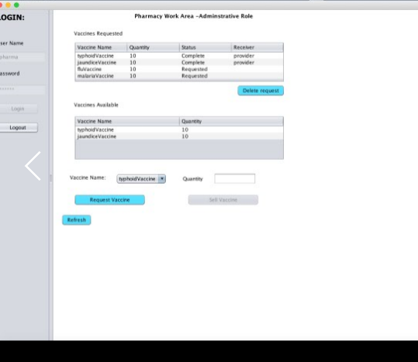
USE CASES (SCREENSHOTS)

Slide 12
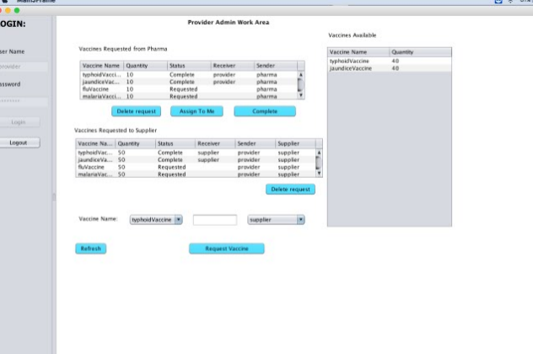
USE CASES (SCREENSHOTS)

Slide 13
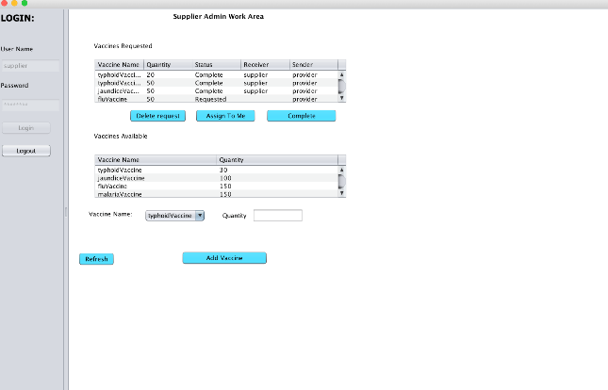
USE CASES (SCREENSHOTS)

Slide 14
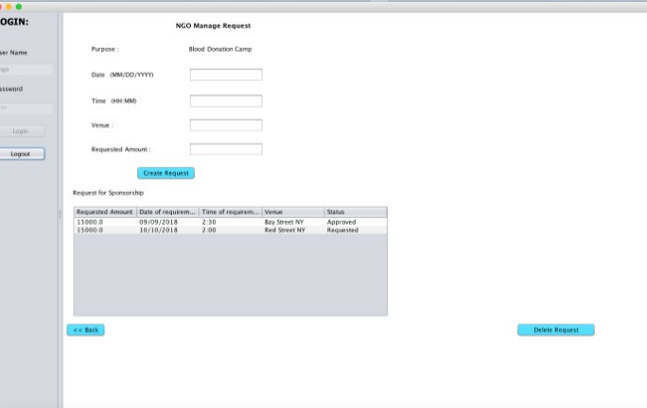
USE CASES (SCREENSHOTS)

Slide 15
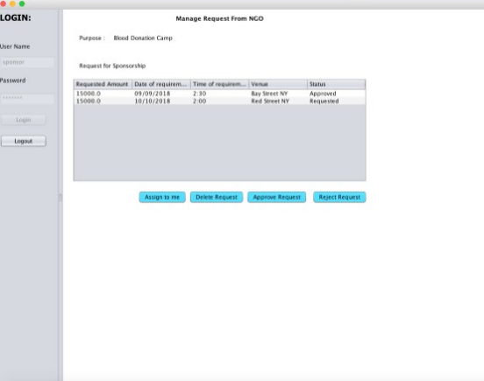
USE CASES (SCREENSHOTS)

Slide 16
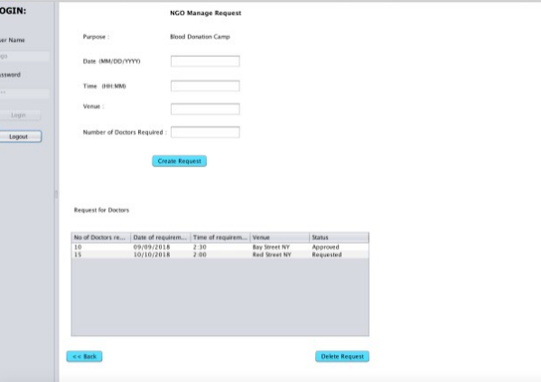
USE CASES (SCREENSHOTS)

Slide 17
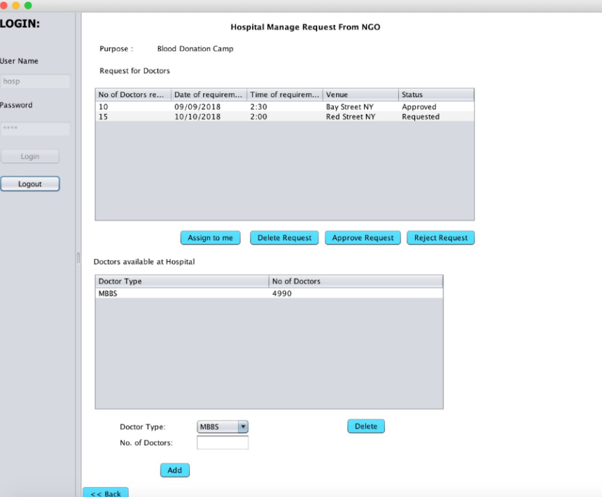
USE CASES (SCREENSHOTS)

Slide 18
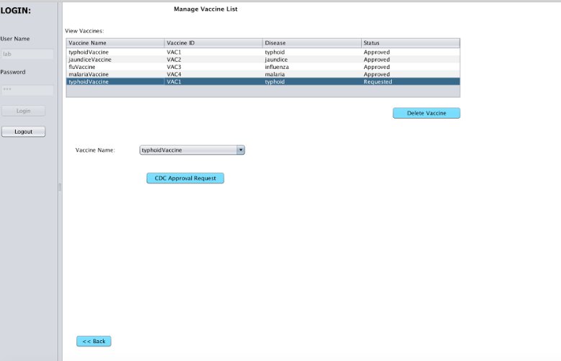
USE CASES (SCREENSHOTS)

Slide 19
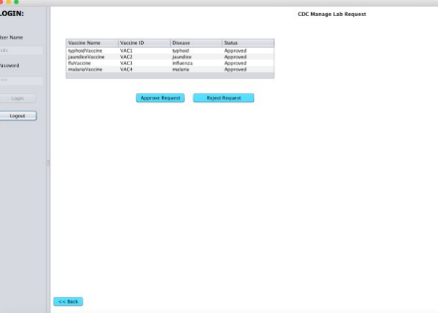
USE CASES (SCREENSHOTS)

Slide 20
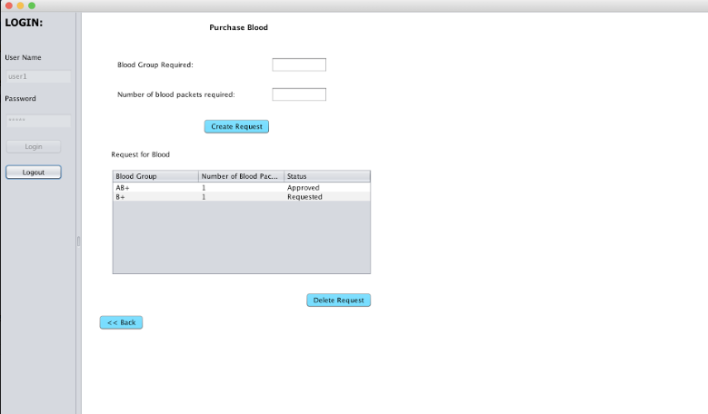
USE CASES (SCREENSHOTS)

Slide 21
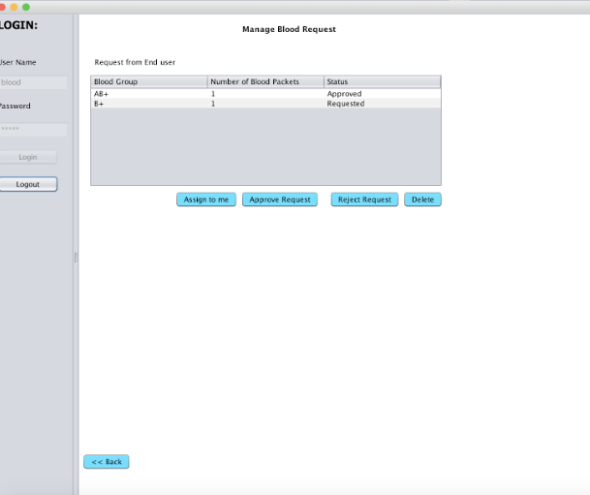
USE CASES (SCREENSHOTS)

Slide 22
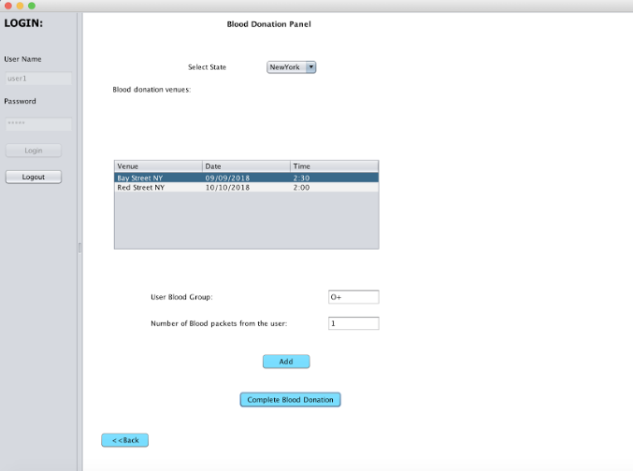
USE CASES (SCREENSHOTS)

Slide 23
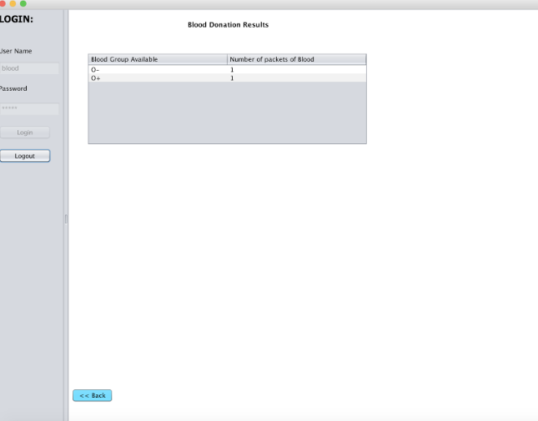
USE CASES (SCREENSHOTS)

Slide 24
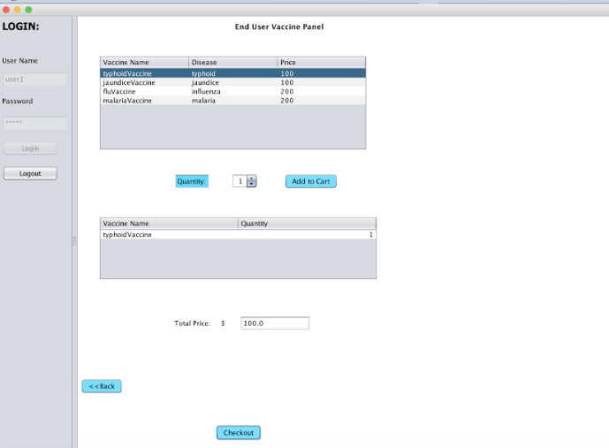
USE CASES (SCREENSHOTS)

Slide 25
THANK YOU
☺

