Slide 1
Τ6.3: Increasing trust of model parameters in cross-domain CTI sharing systems
Konstantinos ZINONOS(8BELLS), bi-weekly telco

Slide 2
Agenda
Recap from last telco
User flow diagram
Latest Architecture
Sequence Diagram (Ongoing)
Next Steps

Slide 3
Timeline (July 2024 – NOV 2025)
June-25
Implementation prep (choose methodology to follow, Fabric Version)
Setup Environment etc
July-25
Start Development Phase
Aug-25
Development Phase
Sep-25
Test Phase
Oct-25
Deploy, Review Phase
Nov-25
Development Phase

Slide 4
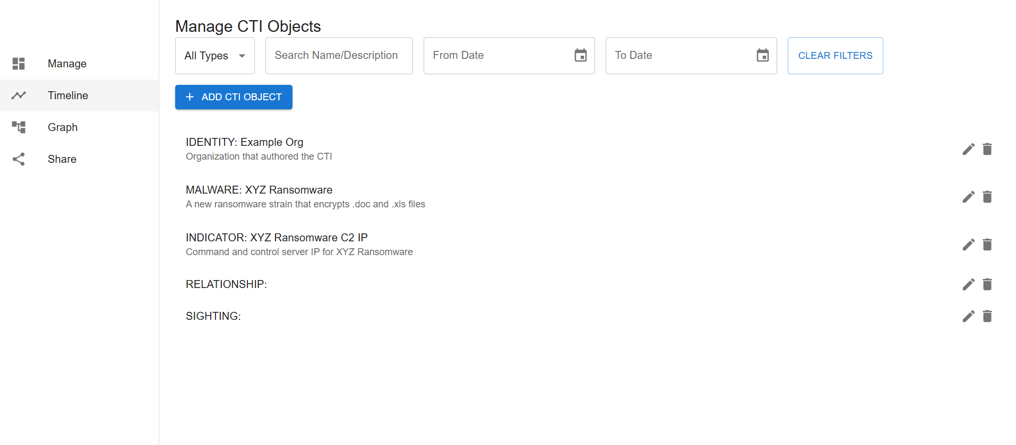
Workstream C

Slide 5
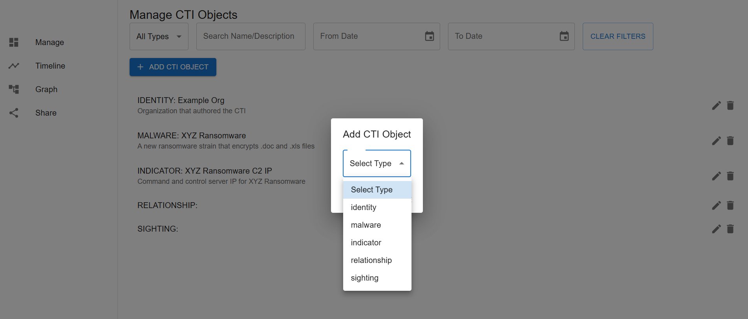
Workstream C

Slide 6
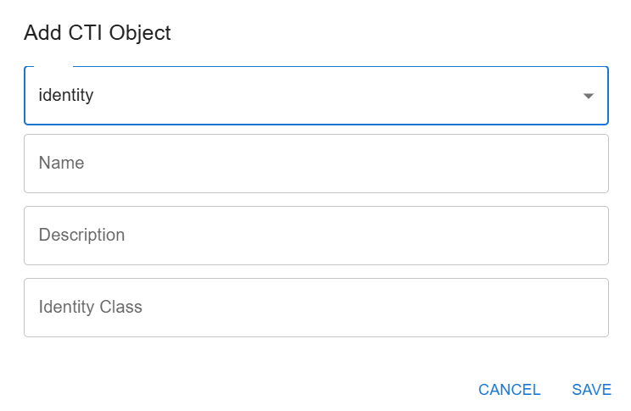
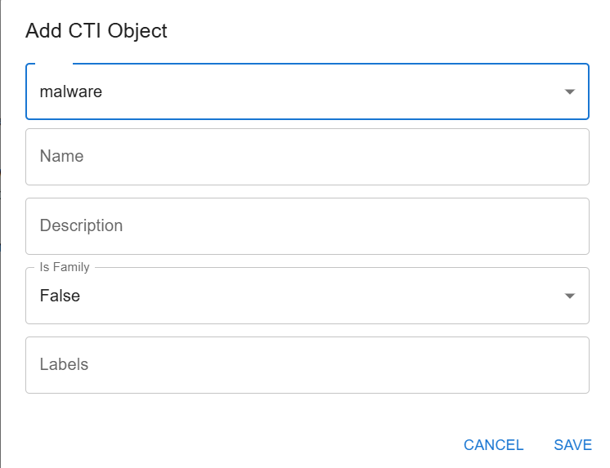
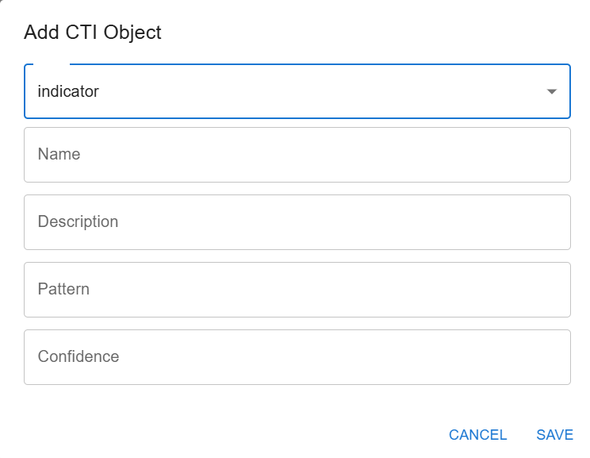
Workstream C

Slide 7
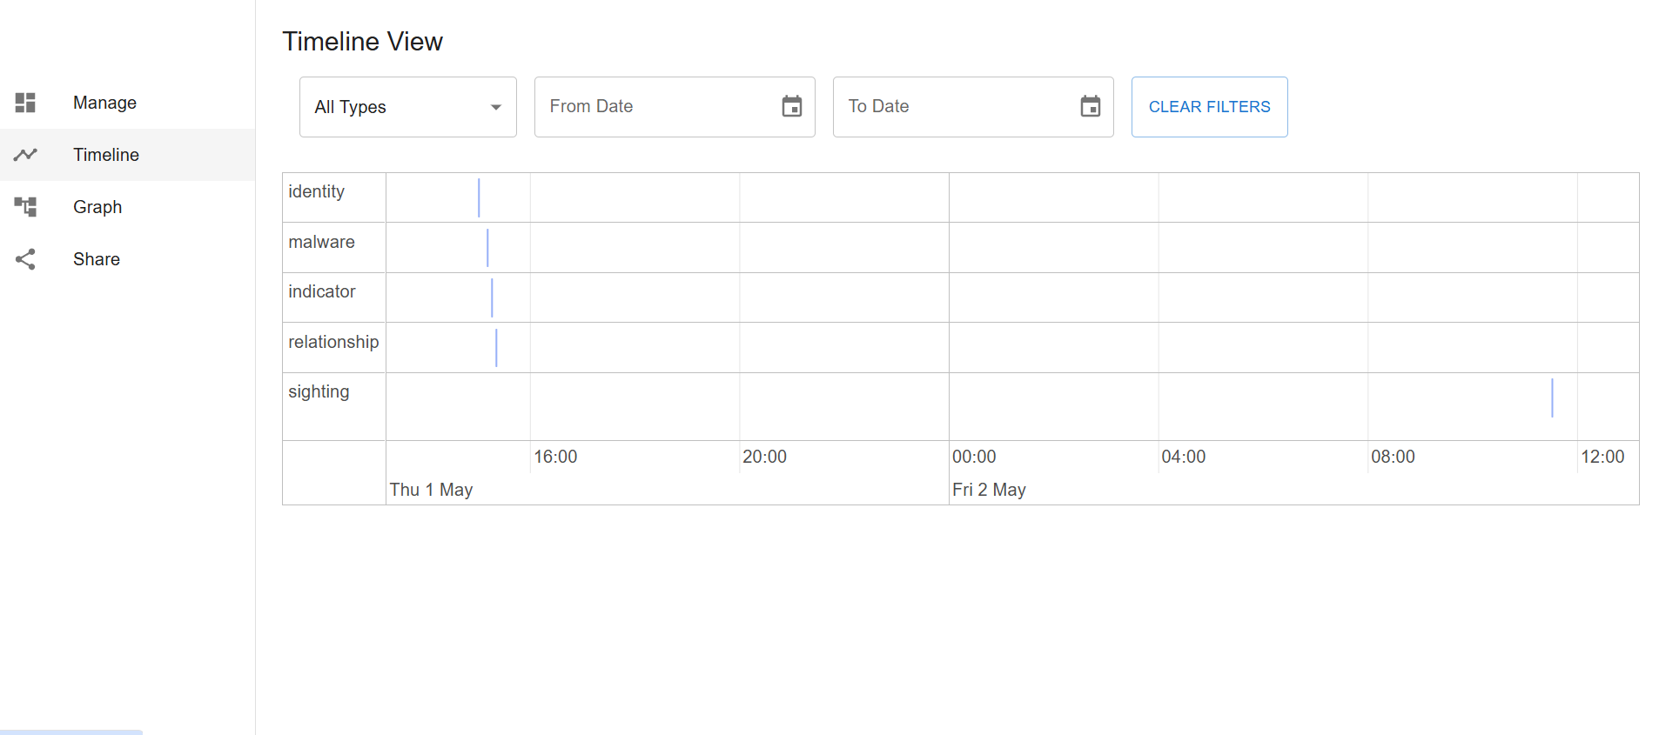
Workstream C

Slide 8
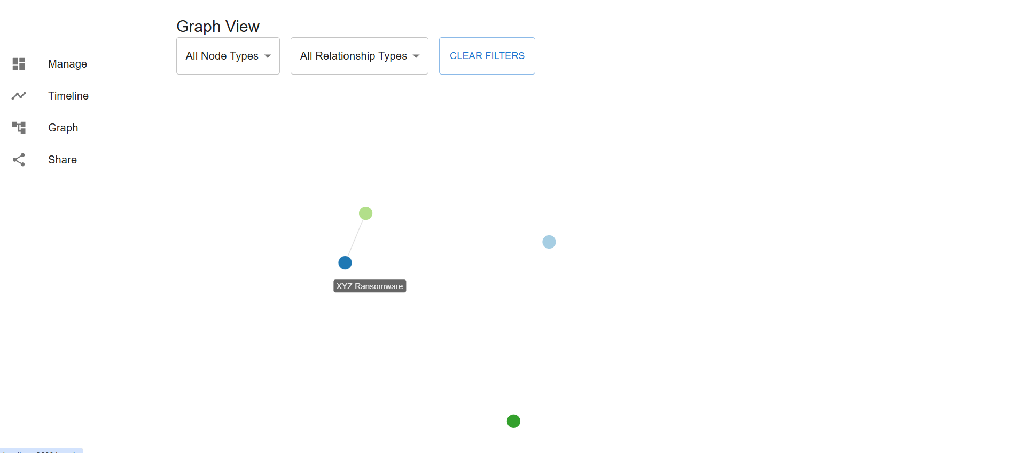
Workstream C

Slide 9
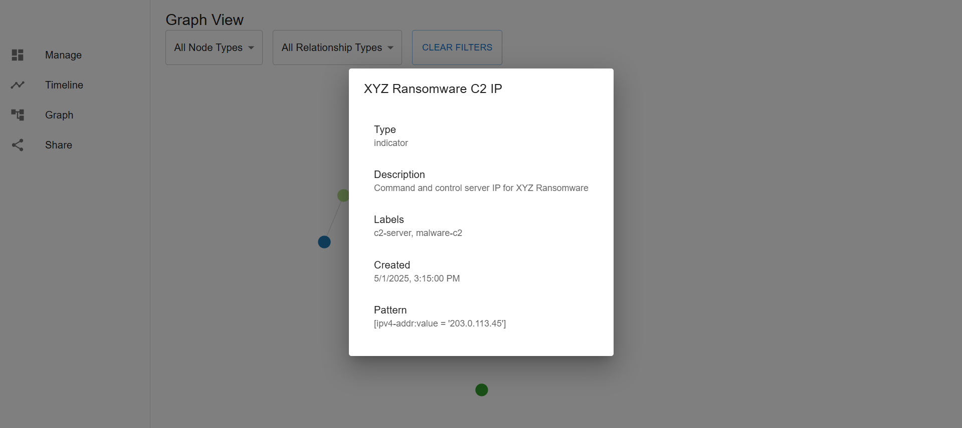
Workstream C

Slide 10
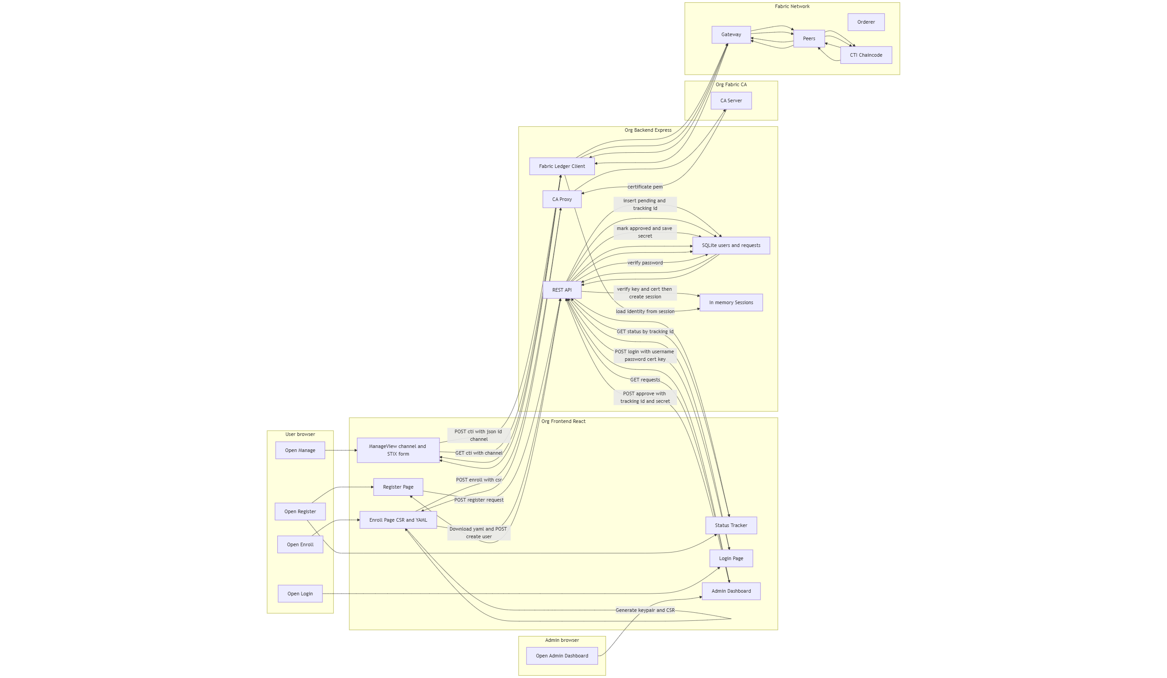
User flow diagram

Slide 11
User flow diagram
A user begins on the Register page in the frontend. Their name, org, and requested role are posted to the backend, which records a PENDING request in the org’s local SQLite database and returns a tracking ID.
The user can revisit a Status/Tracker page that polls the backend for changes to that request.
An admin opens the Admin Dashboard in the same org’s frontend.
The dashboard asks the backend for all pending requests from that org.
After the admin verifies the applicant really belongs to the org and the role is appropriate, the admin clicks Approve.
The backend marks the request APPROVED with an associated enrollment ID and secret (these may have been produced by a separate “register with CA” step).
Because the user’s browser has the tracking ID, the Status page can now reveal the enrollment secret and link to the Enroll page.
On the Enroll page, the user’s browser generates a fresh ECDSA keypair with WebCrypto and builds a CSR (certificate signing request).
The frontend posts the {enrollmentId, secret, csr} to the backend, which simply proxies it to the org’s Fabric CA. The CA returns the user’s certificate (PEM); the backend returns it to the browser.
The browser offers a YAML bundle (cert + private key) for download so the user can keep a local copy, and also creates an application account by sending {username, password, role, cert} to the backend.
The backend stores only the password hash, the public cert, the role, and org info—never the private key.
Notes:
The user flow diagram shows the full, per-organization flow from first contact to signed transactions on Fabric.

Slide 12
User flow diagram
For day-to-day access, the user goes to Login.
They provide username, password, and paste their cert and private key PEMs.
The backend verifies the password against the hash, confirms the key matches the cert (by signing a server-generated nonce), and then creates an in-memory session containing an ephemeral Fabric identity (the cert and key) for that user.
The server sets a session cookie so subsequent API calls can use that identity. Optionally, a short-lived JWT is also returned to let the frontend hide or show UI elements based on role.
Operational work happens in ManageView.
The user selects a channel (for example, main) in the UI and composes a STIX object via a form. When they click submit, the frontend posts {stixJson, id?, channel} to the backend while sending the session cookie.
The backend loads the session’s user identity, connects to Fabric via the Gateway, and sends the proposal to the peers for endorsement on the selected channel, then submits to the orderer for commit. Because the transaction is signed with the user’s certificate, the chaincode can read the role attribute embedded in that cert and enforce your policy (who can create, read, update, or delete).
Updates and deletes are additionally constrained by the creator’s MSP, ensuring only the originating organization can modify its CTI records.
Reads work similarly but use evaluate (query) instead of submit (invoke): the frontend asks for a list or a single CTI on a given channel; the backend evaluates the chaincode with the same user identity and returns results.
Throughout, the private key exists only in the browser and inside the server’s temporary session memory; it is never written to disk or stored persistently. Each organization runs its own copy of this stack (frontend, backend, database) pointing at its own CA and peers, but all participate on the same Fabric network as defined by your connection profile and channel choices in the UI.

Slide 13
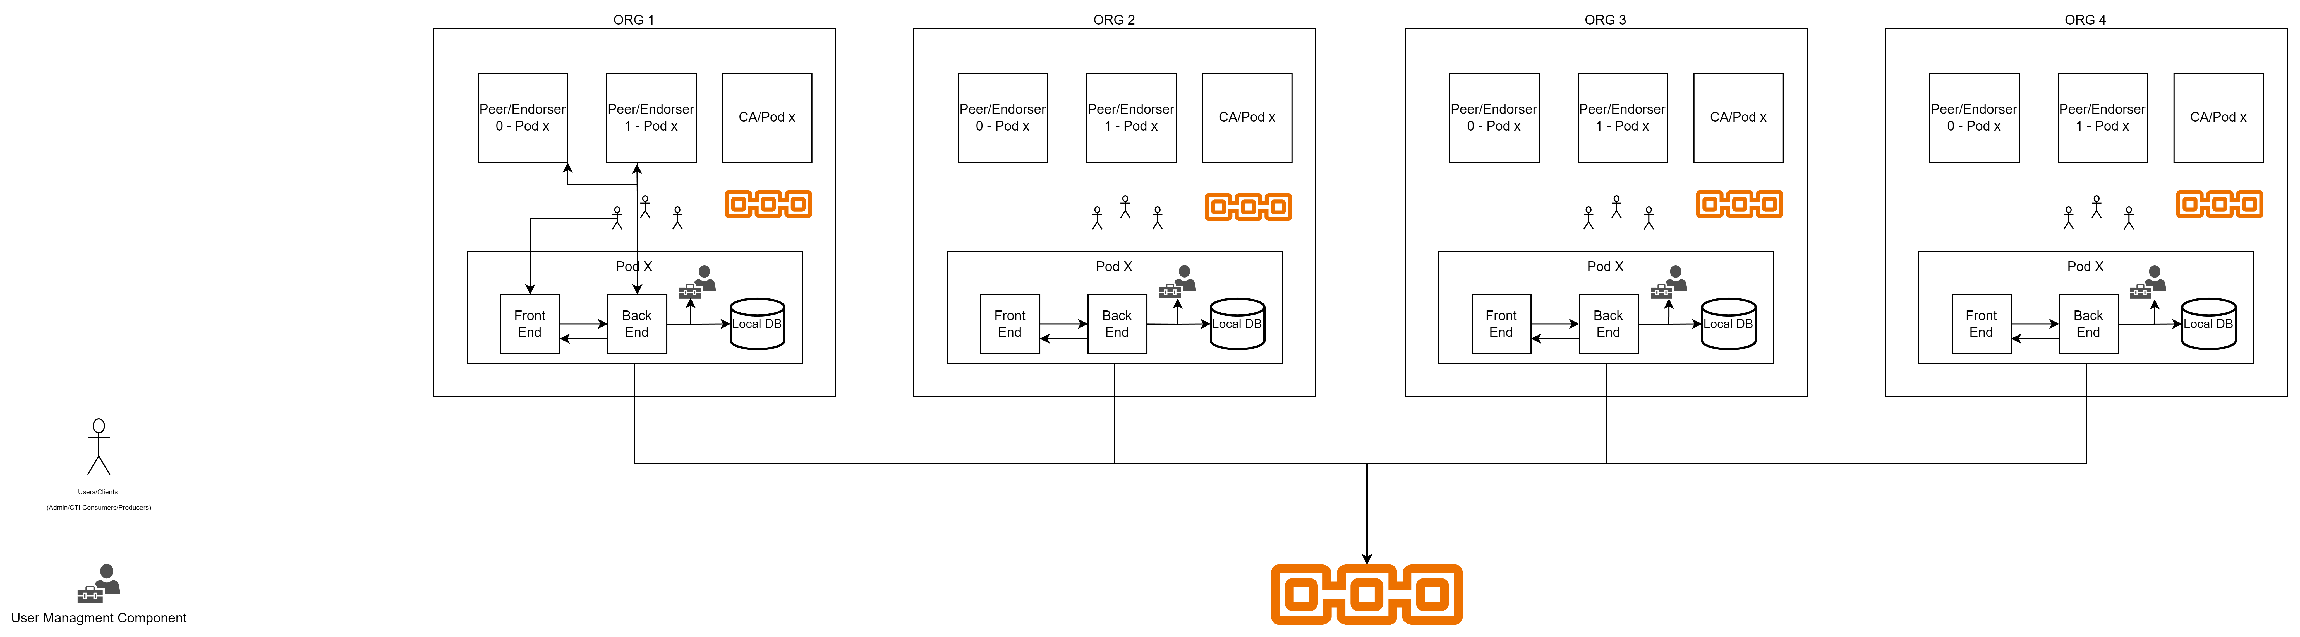
Latest Architecture

Slide 14
Next STEPS
AP1: Access the gitlab repo (t6.3-cti-sharing-ledger)
AP2: Commit F.E code implemented so far
AP3: B.E(Logstail) & Chaincode(NTNU) Partners start with the development phase

