Slide 1
Git Overview yash

Slide 2
1. Git Basics
I. Introduction to git
II. About version control
III. A short history of git
IV. What is git
V. The command line
VI. Installing git
VII. First-Time git Setup
VIII. Getting Help
IX. Getting a Git Repository
X. Recording Changes to the Repository
XI. Viewing the Commit History
XII. Undoing Things
XIII. Working with Remotes
XIV. Tagging
XV. Git Aliases
XVI. Summary

Slide 3
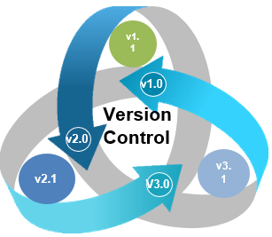
Version Control
Version Control is a system that documents changes made to a file or a set of files. It allows multiple users to manage multiple revisions of the same unit of information.
It is a snapshot of your project over time.

Slide 4

I. Introduction
Introduction to git
Version control is essential for collaborative software development.
git is a distributed version control system widely used for tracking changes in source code.
Why Version Control?
Collaborative work: Enables multiple developers to work on the same project simultaneously.
History tracking: Keeps a record of changes made to the codebase.
Branching and merging: Facilitates parallel development and code integration.
Notes:
Git is a modern and widely used distributed version control system in the world. It is developed to manage projects with high speed and efficiency. The version control system allows us to monitor and work together with our team members at the same workspace. Git is an open-source distributed version control system. It is designed to handle minor to major projects with high speed and efficiency. It is developed to co-ordinate the work among the developers. The version control allows us to track and work together with our team members at the same workspace. Git is foundation of many services like GitHub and GitLab, but we can use Git without using any other Git services. Git can be used privately and publicly.
Git was created by Linus Torvalds in 2005 to develop Linux Kernel. It is also used as an important distributed version-control tool for the DevOps.
Git is easy to learn, and has fast performance. It is superior to other SCM tools like Subversion, CVS, Perforce, and ClearCase.

Slide 5
II. About Version Control
Types of Version Control Systems
Local VCS: It manages changes to files and directories on a local machine without the need for a central server or network
Centralized VCS: Single repository, requires constant network connection.
Distributed VCS: Multiple local repositories, independent of network.
Git as a Distributed VCS
Each user has a complete copy of the repository.
Changes are tracked independently, allowing offline work.
Notes:
Localized Version Control Systems
The localized version control method is a common approach because of its simplicity. But this approach leads to a higher chance of error. In this approach, you may forget which directory you're in and accidentally write to the wrong file or copy over files you don't want to.
To deal with this issue, programmers developed local VCSs that had a simple database. Such databases kept all the changes to files under revision control. A local version control system keeps local copies of the files.
The major drawback of Local VCS is that it has a single point of failure.
Centralized Version Control System
The developers needed to collaborate with other developers on other systems. The localized version control system failed in this case. To deal with this problem, Centralized Version Control Systems were developed.
These systems have a single server that contains the versioned files, and some clients to check out files from a central place.
Centralized version control systems have many benefits, especially over local VCSs.
Everyone on the system has information about the work what others are doing on the project.
Administrators have control over other developers.
It is easier to deal with a centralized version control system than a localized version control system.
A local version control system facilitates with a server software component which stores and manages the different versions of the files.
Distributed Version Control System
Centralized Version Control System uses a central server to store all the database and team collaboration. But due to single point failure, which means the failure of the central server, developers do not prefer it. Next, the Distributed Version Control System is developed.
In a Distributed Version Control System (such as Git, Mercurial, Bazaar or Darcs), the user has a local copy of a repository. So, the clients don't just check out the latest snapshot of the files even they can fully mirror the repository. The local repository contains all the files and metadata present in the main repository.

Slide 6
III. A Short History of Git
Inception
Created by Linus Torvalds in 2005.
Developed for managing the Linux kernel source code.
Key Milestones
Git becomes widely adopted in open-source projects.
GitHub, GitLab, and Bitbucket provide hosting and collaboration.

Slide 7
IV. What is Git?
Definition
Git is a distributed version control system.
Manages and tracks changes in source code during software development.
Core Concepts
Repository: Storage for project files and version history.
Commit: Snapshot of changes at a specific point in time.
Branch: Independent line of development.

Slide 8
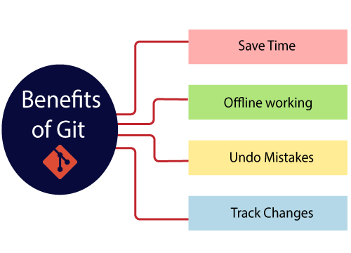
Benefits of git
Notes:
Saves Time Git is lightning fast technology. Each command takes only a few seconds to execute so we can save a lot of time as compared to login to a GitHub account and find out its features.
Offline Working One of the most important benefits of Git is that it supports offline working. If we are facing internet connectivity issues, it will not affect our work. In Git, we can do almost everything locally. Comparatively, other CVS like SVN is limited and prefer the connection with the central repository.
Undo Mistakes One additional benefit of Git is we can Undo mistakes. Sometimes the undo can be a savior option for us. Git provides the undo option for almost everything.
Track the Changes Git facilitates with some exciting features such as Diff, Log, and Status, which allows us to track changes so we can check the status, compare our files or branches.

Slide 9
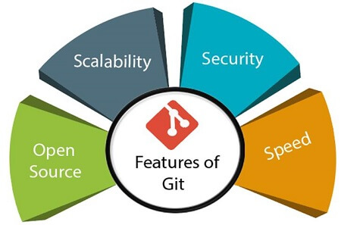
Features of git
Open Source
Scalable
Distributed
Security
Speed
Notes:
Open Source Git is an open-source tool. It is released under the GPL (General Public License) license.
Scalable Git is scalable, which means when the number of users increases, the Git can easily handle such situations.
Distributed One of Git's great features is that it is distributed. Distributed means that instead of switching the project to another machine, we can create a "clone" of the entire repository. Also, instead of just having one central repository that you send changes to, every user has their own repository that contains the entire commit history of the project. We do not need to connect to the remote repository; the change is just stored on our local repository. If necessary, we can push these changes to a remote repository.
Security Git is secure. It uses the SHA1 (Secure Hash Function) to name and identify objects within its repository. Files and commits are checked and retrieved by its checksum at the time of checkout. It stores its history in such a way that the ID of particular commits depends upon the complete development history leading up to that commit. Once it is published, one cannot make changes to its old version.
Speed Git is very fast, so it can complete all the tasks in a while. Most of the git operations are done on the local repository, so it provides a huge speed. Also, a centralized version control system continually communicates with a server somewhere. Performance tests conducted by Mozilla showed that it was extremely fast compared to other VCSs. Fetching version history from a locally stored repository is much faster than fetching it from the remote server. The core part of Git is written in C, which ignores runtime overheads associated with other high-level languages. Git was developed to work on the Linux kernel; therefore, it is capable enough to handle large repositories effectively. From the beginning, speed and performance have been Git's primary goals.
Supports non-linear development Git supports seamless branching and merging, which helps in visualizing and navigating a non-linear development. A branch in Git represents a single commit. We can construct the full branch structure with the help of its parental commit.
Branching and Merging Branching and merging are the great features of Git, which makes it different from the other SCM tools. Git allows the creation of multiple branches without affecting each other. We can perform tasks like creation, deletion, and merging on branches, and these tasks take a few seconds only. Below are some features that can be achieved by branching:
We can create a separate branch for a new module of the project, commit and delete it whenever we want.
We can have a production branch, which always has what goes into production and can be merged for testing in the test branch.
We can create a demo branch for the experiment and check if it is working. We can also remove it if needed.
The core benefit of branching is if we want to push something to a remote repository, we do not have to push all of our branches. We can select a few of our branches, or all of them together.
Data Assurance The Git data model ensures the cryptographic integrity of every unit of our project. It provides a unique commit ID to every commit through a SHA algorithm. We can retrieve and update the commit by commit ID. Most of the centralized version control systems do not provide such integrity by default.
Staging Area The Staging area is also a unique functionality of Git. It can be considered as a preview of our next commit, moreover, an intermediate area where commits can be formatted and reviewed before completion. When you make a commit, Git takes changes that are in the staging area and make them as a new commit. We are allowed to add and remove changes from the staging area. The staging area can be considered as a place where Git stores the changes. Although, Git doesn't have a dedicated staging directory where it can store some objects representing file changes (blobs). Instead of this, it uses a file called index.

Slide 10
V. Installing Git
Platforms
Git supports Windows, macOS, and Linux.
Installation instructions available on the official Git website.
https://git-scm.com/
Verification
After installation, verify by running git --version in the command line.

Slide 11
Lab0
Lab 0: Install git on the system
Objective: install git software on your system.
https://github.com/yashkumar0042/python/blob/master/git/labs/lab0.md

Slide 12
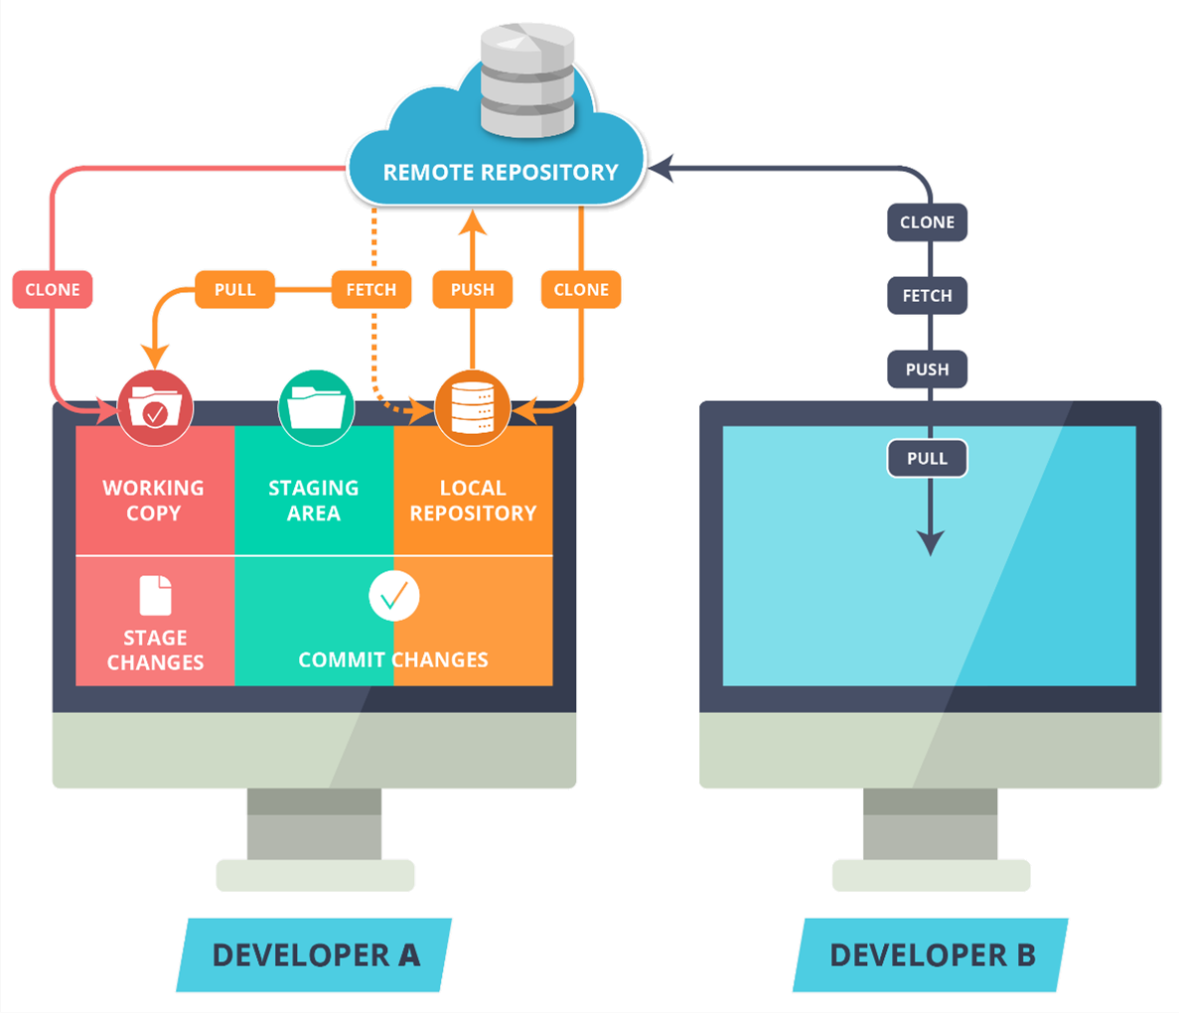

Local Repository
“Local Repository” is user’s copy of the Version Database
The user accesses all the files through local repository and then push the change made to the “Remote Repository”

Slide 13
Remote Repository
The Remote Repository is the server where all the collaborators upload the changes made to the files

Slide 14

Git workspace
“Workspace” is user’s active directory
The user modifies existing files and creates new files in this space. Git tracks these changes compared to your Local Repository

Slide 15

Git Stage
Stage is a place where all the modified files marked to be committed, are placed.

Slide 16
Git stage
Stage is a place where all the modified files marked to be committed, are placed.

Slide 17

Git clone
Clone command creates a copy of an existing Remote Repository inside the Local Repository

Slide 18

Git fetch
Fetch command collects the changes made in the Remote repository and copies them to the Local Repository.
This command doesn’t affect our Workspace.

Slide 19

Git Pull
Pull like Fetch, gets all the changes from the remote repository and copies them to the Local Repository
Pull merges those changes to the current working directory

Slide 20
VI. The Command Line
Basic Commands
git init : Initializes a new Git repository.
git add : Adds changes to the staging area.
git commit : Records changes to the repository.
git push: Pushes the changes to remote repository.
Advanced Commands
git branch : Manages branches.
git merge : Integrates changes from different branches.

Slide 21
VII. First-Time Git Setup
Configuration
Set username and email: git config --global user.name
"Your Name" and git config --global user.email "your@email.com".
Customize Git settings for user preferences.

Slide 22
VIII. Getting Help
Documentation
Official Git documentation available online.
Use git --help for command-specific help.
Community forums and Q&A sites for additional support.

Slide 23
IX. Getting a git Repository
Initializing a Repository
git init: Initializes a new Git repository in the current directory.
Creates a hidden .git directory to store configuration and version history.
Cloning a Repository
git clone <repository URL>: Downloads an existing Git repository to your local machine.
Establishes a connection with the remote repository.

Slide 24
X. Recording Changes to the Repository
Tracking Changes
git status: Shows the status of changes as untracked, modified, or staged.
git add <file>: Adds changes to the staging area.
Committing Changes
git commit -m "Commit message": Records changes in the repository.
Commits create a snapshot in the version history.

Slide 25
XI. Viewing the Commit History
Git Log
git log: Displays a chronological list of commits.
Shows commit hash, author, date, and commit message.
Customizing Log Output
git log --oneline: Condenses commit information to one line.
git log --graph: Visualizes branch history.

Slide 26
XII. Undoing Things
Discarding Changes
git restore <file>: Discards changes in a file.
git restore --source=<commit> <file>: Restores a file to a specific commit.
Amending Commits
git commit --amend: Adds changes to the previous commit.
Useful for fixing mistakes in the last commit.

Slide 27
XII. Working with Remotes
Adding Remotes
git remote add <name> <url>: Links a local repository to a remote repository.
Common remotes include GitHub or GitLab.
Fetching and Pulling
git fetch: Retrieves changes from the remote repository.
git pull: Fetches changes and integrates them into the current branch.

Slide 28
XIV. Tagging
Creating Tags
git tag <tagname>: Marks a specific commit with a tag.
Useful for releasing versions or marking significant points.
Pushing Tags
git push origin <tagname>: Shares tags with the remote repository.

Slide 29
XV. Git Aliases
Creating Aliases
git config --global alias.<alias-name> <git-command>: Sets up custom shorthand for Git commands.
Improves efficiency and reduces typing.

Slide 30
Lab1
Lab 1: Initializing a Repository and Making Commits
Objective: Create a new Git repository, make changes, and commit them.
https://github.com/yashkumar0042/python/blob/master/git/labs/lab1.md

Slide 31
XV. Summary
Git is a distributed version control system.
Essential commands include init, add, and commit.
Understanding branches is crucial for collaborative development.
Explore documentation and seek help when needed.
Git repositories are initialized with git init or cloned with git clone.
Changes are recorded with git add and git commit.
View commit history with git log and customize output.
Undo changes with git restore and amend commits.
Remotes are managed using git remote.
Tags mark important points in history.
Git aliases streamline common commands

Slide 32
Questions & answers
Please ask many questions

Slide 33
Thanks!

