Slide 1

Understanding Git Basics

Slide 2
Git basics
Introduction
Cloning a Repository and Performing Basic Operations
Fetching and Pulling Content
Pushing Code
Git Branching
Git Merging
Git Stash
Git Add Interactive
Git Rebase
Working With Multiple Repositories
Pull Requests
Git Log
Git Hooks

Slide 3
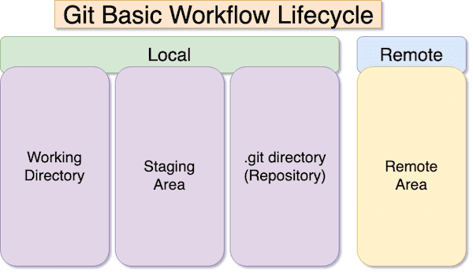
Understanding Git Basics

Slide 4
Introduction
Introduction
Version Control: It is a collaborative system that manages changes to source code over time. It enables tracking modifications, coordinating work among multiple contributors, and maintaining a historical record of project development.
Git: A distributed version control system that allows multiple developers to work on a project simultaneously. It tracks changes in a decentralized manner, providing flexibility and efficiency in collaboration.
Core Concepts
Repository: A repository is a central storage location for project files and their complete version history. It serves as a collaborative space where developers can contribute and access the latest codebase.
Commit: A commit is a snapshot of the project at a specific point in time. It represents a set of changes made to the code, allowing developers to track and manage the development progress.
Branch: A branch is an independent line of development that diverges from the main codebase. It enables developers to work on features or bug fixes separately, promoting parallel development.

Slide 5
Cloning a Repository and Performing Basic Operations
Cloning
git clone <repository URL>: Cloning is the process of copying a repository from a remote source to a local machine. It establishes a connection between the local and remote repositories for collaborative development.
Basic Operations
git init: Initializes a new Git repository in the current directory, creating the necessary data structures for version control.
git add <file>: Adds changes to the staging area, preparing them for the next commit.
git commit -m "Commit message": Records changes in the repository with a descriptive commit message.

Slide 6
Fetching and Pulling
Fetch
git fetch: Retrieves changes from a remote repository without merging them into the local branch. It updates the local repository with the latest changes.
Pull
git pull origin <branch>: Fetches changes from a remote branch and automatically integrates them into the local branch. It combines the fetch and merge operations.
Pushing Code
git push origin <branch>: Pushes local changes to a remote repository, making them accessible to other collaborators. It updates the remote repository with the latest changes.

Slide 7
Git fetch and git pull difference
1. Git Fetch:
Purpose: Fetching is used to retrieve changes from a remote repository without automatically merging them into your local branch.
Workflow: When you run git fetch, Git contacts the remote repository and fetches any new changes, including branches and tags.
It updates the remote-tracking branches in your local repository to reflect the changes in the remote repository.
Example: # Fetch changes from the remote repository (origin)
git fetch origin
Use Case: Useful when you want to see what changes exist in the remote repository before deciding to merge them into your local branch. Allows you to review changes and decide when and how to integrate them.
2. Git Pull:
Purpose: Pulling is a combination of fetching changes and automatically merging them into your current branch.
Workflow: When you run git pull, it performs a git fetch first to retrieve the changes from the remote repository.
Then, it automatically merges the changes into your local branch.
Example: # Pull changes from the remote repository (origin) into the current branch
git pull origin master
Use Case: Convenient when you want to quickly update your local branch with the latest changes from the remote repository.
Automatically merges changes, saving you an additional step compared to git fetch.

Slide 8
Git Branching
Creating a Branch
git branch <branch-name>: Creates a new branch with the specified name, allowing developers to work on separate features or fixes.
git checkout <branch-name>: Switches to the newly created branch for further development.
Merging
git merge <branch>: Integrates changes from one branch into another. It combines the changes made in the specified branch into the current working branch.

Slide 9
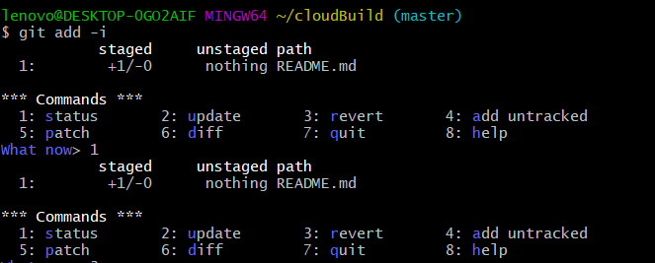
Git Add
Git Add Interactive
git add -i: Interactively stages changes, providing a user interface to choose which changes to include in the next commit.

Slide 10
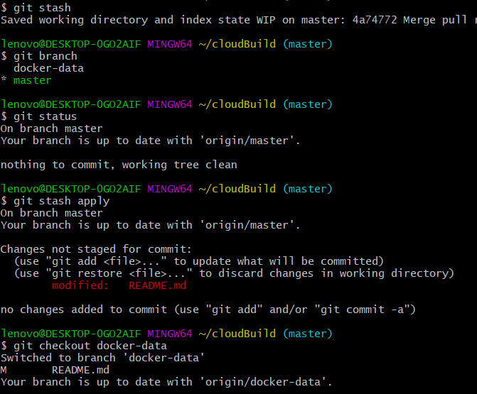
Git Stash
Git Stash
git stash: Temporarily saves changes that are not ready for commit. It allows developers to switch branches without committing incomplete work.

Slide 11
Git Merge
Git Merging
git merge <branch>: Combines changes from different branches, bringing them together into a unified codebase.

Slide 12
Git Rebase, Pull Requests
Git Rebase
git rebase <branch>: Rewrites commit history by moving or combining commits. It helps create a linear and cleaner history.
Working With Multiple Repositories
git remote add <name> <repository URL>: Links a local repository to a remote repository, allowing collaboration between different copies of the codebase.
Pull Requests
A feature in platforms like GitHub, pull requests allow developers to propose changes, discuss modifications, and merge code into the main branch.

Slide 13
Git Log
git log: Displays the commit history of the repository, providing details such as commit messages, authors, and timestamps.
Options: --oneline, --graph, --since.

Slide 14
Git Hooks - Precommit
Custom scripts triggered by Git events. Examples include pre-commit and post-commit hooks.
Example of a pre-commit hook:
#!/bin/bash
echo "Running pre-commit checks..."
# Add custom checks here

Slide 15
Git Hooks – Post Commit
A post-commit hook is a custom script that runs automatically after a commit has been made in a Git repository. It can be used to perform additional actions or tasks based on the successful completion of a commit. Here's an example of a post-commit hook:
#!/bin/bash
# post-commit hook example
echo "Executing post-commit hook..."
# Notify developers or team members about the commit
# This could be done via email, messaging, or any other communication method
echo "Commit successfully made. Notify relevant team members."
# Trigger an automated build or deployment process
# This example assumes the presence of a build script or deployment process
./build_script.sh
# Additional actions or notifications based on your project's requirements
echo "Post-commit hook executed successfully."
In this example, the post-commit hook performs the following actions:

Slide 16
Labs – git tagging
Lab 1:
Create a Git repository named "LabRepo."
Initialize the repository with some files and make a few commits.
Create a lightweight tag called "v1.0" on the latest commit.
Create an annotated tag called "release-v1.1" with a brief description.
List all tags in the repository.

Slide 17
Labs- git alias
Lab 2:
Configure a Git alias named "l" that prints a concise log of the commit history.
Test the alias by running git l in your repository.
Create an alias "s" for "status" and an alias "b" for "branch."
Verify that the aliases work as expected.

Slide 18
Labs – git rebase
Lab 1:
Create a Git repository with two branches, "feature" and "main."
Make changes in both branches, commit them, and ensure there are conflicts.
Use git rebase to reapply the "feature" branch changes onto "main."
Resolve any conflicts during the rebase.
Verify that the commit history is now a linear progression on the "main" branch.

Slide 19
Labs – Answers
https://github.com/yashkumar0042/python/blob/master/git/lab-tag-alias-rebase.md

Slide 20

THANK YOU

