Slide 1

Understanding Git Basics

Slide 2
Git basics
Introduction
Cloning a Repository and Performing Basic Operations
Fetching and Pulling Content
Pushing Code
Git Branching
Git Merging
Git Stash
Git Add Interactive
Git Rebase
Working With Multiple Repositories
Pull Requests
Git Log
Git Hooks

Slide 3
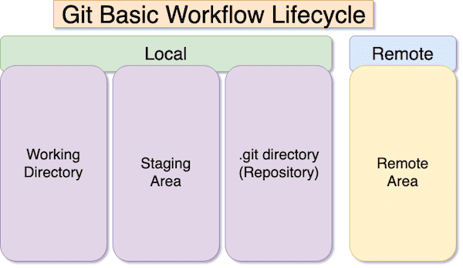
Understanding Git Basics

Slide 4
Introduction
Introduction
Version Control: It is a collaborative system that manages changes to source code over time. It enables tracking modifications, coordinating work among multiple contributors, and maintaining a historical record of project development.
Git: A distributed version control system that allows multiple developers to work on a project simultaneously. It tracks changes in a decentralized manner, providing flexibility and efficiency in collaboration.
Core Concepts
Repository: A repository is a central storage location for project files and their complete version history. It serves as a collaborative space where developers can contribute and access the latest codebase.
Commit: A commit is a snapshot of the project at a specific point in time. It represents a set of changes made to the code, allowing developers to track and manage the development progress.
Branch: A branch is an independent line of development that diverges from the main codebase. It enables developers to work on features or bug fixes separately, promoting parallel development.

Slide 5
Cloning a Repository and Performing Basic Operations
Cloning
git clone <repository URL>: Cloning is the process of copying a repository from a remote source to a local machine. It establishes a connection between the local and remote repositories for collaborative development.
Basic Operations
git init: Initializes a new Git repository in the current directory, creating the necessary data structures for version control.
git add <file>: Adds changes to the staging area, preparing them for the next commit.
git commit -m "Commit message": Records changes in the repository with a descriptive commit message.

Slide 6
Fetching and Pulling
Fetch
git fetch: Retrieves changes from a remote repository without merging them into the local branch. It updates the local repository with the latest changes.
Pull
git pull origin <branch>: Fetches changes from a remote branch and automatically integrates them into the local branch. It combines the fetch and merge operations.
Pushing Code
git push origin <branch>: Pushes local changes to a remote repository, making them accessible to other collaborators. It updates the remote repository with the latest changes.

Slide 7
Git Branching
Creating a Branch
git branch <branch-name>: Creates a new branch with the specified name, allowing developers to work on separate features or fixes.
git checkout <branch-name>: Switches to the newly created branch for further development.
Merging
git merge <branch>: Integrates changes from one branch into another. It combines the changes made in the specified branch into the current working branch.

Slide 8
Git Add
Git Add Interactive
git add -i: Interactively stages changes, providing a user interface to choose which changes to include in the next commit.

Slide 9
Git Stash
Git Stash
git stash: Temporarily saves changes that are not ready for commit. It allows developers to switch branches without committing incomplete work.

Slide 10
Git Merge
Git Merging
git merge <branch>: Combines changes from different branches, bringing them together into a unified codebase.

Slide 11
Git Rebase, Pull Requests
Git Rebase
git rebase <branch>: Rewrites commit history by moving or combining commits. It helps create a linear and cleaner history.
Working With Multiple Repositories
git remote add <name> <repository URL>: Links a local repository to a remote repository, allowing collaboration between different copies of the codebase.
Pull Requests
A feature in platforms like GitHub, pull requests allow developers to propose changes, discuss modifications, and merge code into the main branch.

Slide 12
Git Log
git log: Displays the commit history of the repository, providing details such as commit messages, authors, and timestamps.
Options: --oneline, --graph, --since.

Slide 13
Git Hooks - Precommit
Custom scripts triggered by Git events. Examples include pre-commit and post-commit hooks.
Example of a pre-commit hook:
#!/bin/bash
echo "Running pre-commit checks..."
# Add custom checks here

Slide 14
Git Hooks – Post Commit
A post-commit hook is a custom script that runs automatically after a commit has been made in a Git repository. It can be used to perform additional actions or tasks based on the successful completion of a commit. Here's an example of a post-commit hook:
#!/bin/bash
# post-commit hook example
echo "Executing post-commit hook..."
# Notify developers or team members about the commit
# This could be done via email, messaging, or any other communication method
echo "Commit successfully made. Notify relevant team members."
# Trigger an automated build or deployment process
# This example assumes the presence of a build script or deployment process
./build_script.sh
# Additional actions or notifications based on your project's requirements
echo "Post-commit hook executed successfully."
In this example, the post-commit hook performs the following actions:

Slide 15
Lab4
Lab 4: Remote Repositories
Objective: Work with remote repositories.
https://github.com/yashkumar0042/python/blob/master/git/labs/lab4.md

Slide 16
Lab4
Lab 4: Remote Repositories
Objective: Work with remote repositories.
https://github.com/yashkumar0042/python/blob/master/git/labs/lab4.md

Slide 17

THANK YOU

