Slide 1
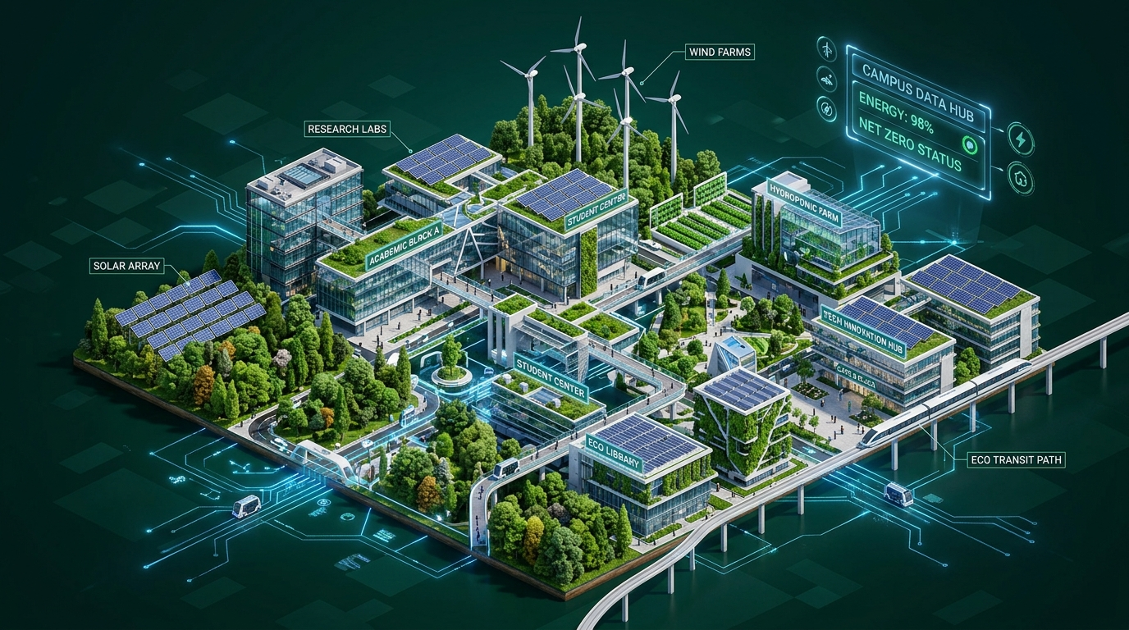
🌿 GREENVERSE AI
AI-IoT Smart Campus Sustainability System
Empowering Educational Institutions with Artificial Intelligence, IoT Telemetry, GIS Mapping & Renewable Energy
INSTITUTION
SPNREC Araria (Bihar)
BEU Patna Affiliated
INTERNSHIP SPONSOR
1M1B Applied AI Initiative
(Microsoft Supported)

Slide 2
PROBLEM STATEMENT
Key Sustainability & Operational Challenges in Campuses Today
🗑️ Waste Management
Manual bin inspections lead to overflow, littering, and unhygienic campus environments.
85% Overflow Rate
⚡ Energy Consumption
Unmonitored HVAC and lighting lead to massive grid power waste and operational costs.
40% Power Wasted
💧 Water Wastage
Undetected pipe leaks and overhead tank overflows waste thousands of liters daily.
45,000L Lost/Mo
🌿 Carbon Emissions
High reliance on non-renewable grid energy increases campus carbon footprints.
High ESG Deficit

Slide 3

OUR SOLUTION
Central AI Engine Connecting Campus IoT Infrastructure
🗑️ Smart Bins
Connected via ESP32 WiFi Mesh
Streaming live telemetry data 24/7
🤖 GREENVERSE AI ENGINE
• Google Gemini AI Analysis
• Realtime Sensor Streams
• Auto Defect Work Orders
• Carbon Offset Audit
⚡ 250kW Solar
Connected via ESP32 WiFi Mesh
Streaming live telemetry data 24/7
💧 Water Tanks
Connected via ESP32 WiFi Mesh
Streaming live telemetry data 24/7
📍 GIS Campus Map
Connected via ESP32 WiFi Mesh
Streaming live telemetry data 24/7

Slide 4
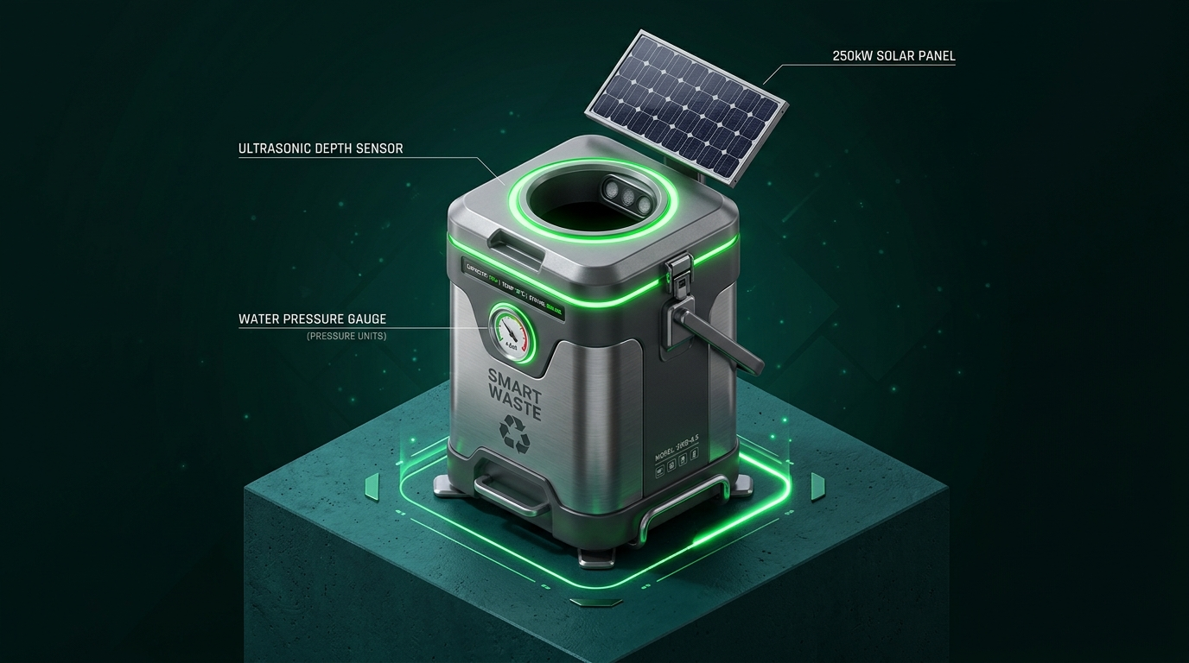
SYSTEM ARCHITECTURE FLOW
End-to-End Data Pipeline from Hardware Sensors to Mobile & Control Center
1. IoT Sensors
Smart Bins, Water Pressure, Solar Meter
2. ESP32 Edge
Microcontroller Data Processing
3. WiFi Gateway
Encrypted Telemetry Transmission
4. Firebase/Supabase
Realtime Database & Webhooks
5. Gemini AI
Defect Scanning & Predictive Engine
6. Control Center
Admin & Staff Dispatch Dashboard

Slide 5
WORKING PROTOTYPE SHOWCASE
Multi-Device Responsive Web App, GIS Map & Mobile Portal
💻 Desktop Executive Portal
• Live GIS Campus Map with Leaflet
• 13 Liquid Glass Feature Cards
• Active Technician GPS Dispatching
• Real-Time Sensor Alert Overlays
• Carbon Reduction ESG Audits
📱 Mobile Student & Staff App
• Instant Photo & Audio Issue Reporting
• Gemini AI Automatic Bounding Box Vision Scan
• +50 Eco-Points Reward Leaderboard
• GreenBot Voice Speech Assistant
• Work Order Repair Photo Verification

Slide 6
TECHNOLOGY STACK
Enterprise Software, Hardware, Machine Learning & Cloud Platform
Frontend UI
React 19, Vite 8, Tailwind CSS v4, Framer Motion, Leaflet GIS
Backend & Database
Node.js, Supabase PostgreSQL, Realtime WebSockets, RLS Security
AI & Machine Learning
Google Gemini AI, Computer Vision Defect Bounding Box Model
Hardware & IoT
ESP32 Microcontrollers, Ultrasonic Waste Sensors, Flow Telemetry

Slide 7
10 CORE PLATFORM FEATURES
Integrated SaaS Modules Powering Campus Operations
1. Smart Waste Monitoring
Operational & Active
2. Smart Water Monitoring
Operational & Active
3. Solar Grid Telemetry
Operational & Active
4. GIS Campus Radar Map
Operational & Active
5. GreenBot AI Copilot
Operational & Active
6. AI Vision Defect Scanner
Operational & Active
7. IoT Hardware Mesh
Operational & Active
8. Executive Sustainability HUD
Operational & Active
9. Green Rewards Leaderboard
Operational & Active
10. Cloud Edge Database Sync
Operational & Active

Slide 8
ADMIN CONTROL CENTER
Role-Based Governance, Incident Tracking & Sensor Management
🛡️ Centralized Governance & Facilities Oversight
• Role-Based Access Control (RBAC): Isolated portals for Students, Maintenance Staff, and Administrators.
• Real-Time Verification Pipeline: Technicians submit completion photos verified by admins before ticket resolution.
• IoT Sensor Override & Diagnostic Stream: Live control of ESP32 sensor threshold warnings.
• User Directory & Leaderboard Controls: Audit student points, badge allocations, and campus rankings.

Slide 9
MEASURED RESULTS & SUSTAINABILITY KPIS
Quantifiable Environmental & Financial Impact Across Campus
40%
Water Saving
Recycled Greywater & Leak Repairs
35%
Energy Saving
250kW Solar Grid Optimization
50%
Better Waste
Smart Bin Overflow Prevention
25%
Cost Reduction
Lower Facilities Maintenance Costs

Slide 10
FUTURE SCOPE & DEPLOYMENT ROADMAP
Strategic Growth Path from SPNREC Pilot to National Network
2026
AI Prediction & SPNREC Pilot
2027
Computer Vision & District Colleges
2028
Autonomous Drone Campus Inspection
2029
Digital Twin Campus Simulation
2030
National Net-Zero Campus Mesh

Slide 11
MULTI-DIMENSIONAL IMPACT MATRIX
Transforming Educational Institutions Across Key Sectors
🌿 Environmental
Reduced carbon footprint, zero waste overflow, water conservation.
💰 Economic
25% lower facilities maintenance costs, lower electricity grid bills.
👥 Social
Active student civic engagement, clean and healthy campus grounds.
🎓 Educational
Living research laboratory for engineering students & green skills.
⚙️ Technological
Scalable IoT edge architecture, Google Gemini AI integration.
🏛️ Government
Supports Bihar DST green campus targets & Microsoft ESG goals.

Slide 12
THANK YOU!
Building Smarter, Greener & Sustainable Campuses with AI + IoT
🌐 Live Website: https://green-verse-ai-smart-campus-sustain.vercel.app
💻 GitHub: https://github.com/yashkumar5224/GreenVerse-AI-Smart-Campus-Sustainability-Maintenance-Platform.git
🏛️ Institution: Shri Phanishwar Nath Renu Engineering College (SPNREC), Araria
🏅 Internship: 1M1B Applied AI Initiative (Microsoft Supported)
👥 Team: Sustainability Green Warriors (Yash Kumar, Neha, Suraj, Utkarsh)

