Slide 1
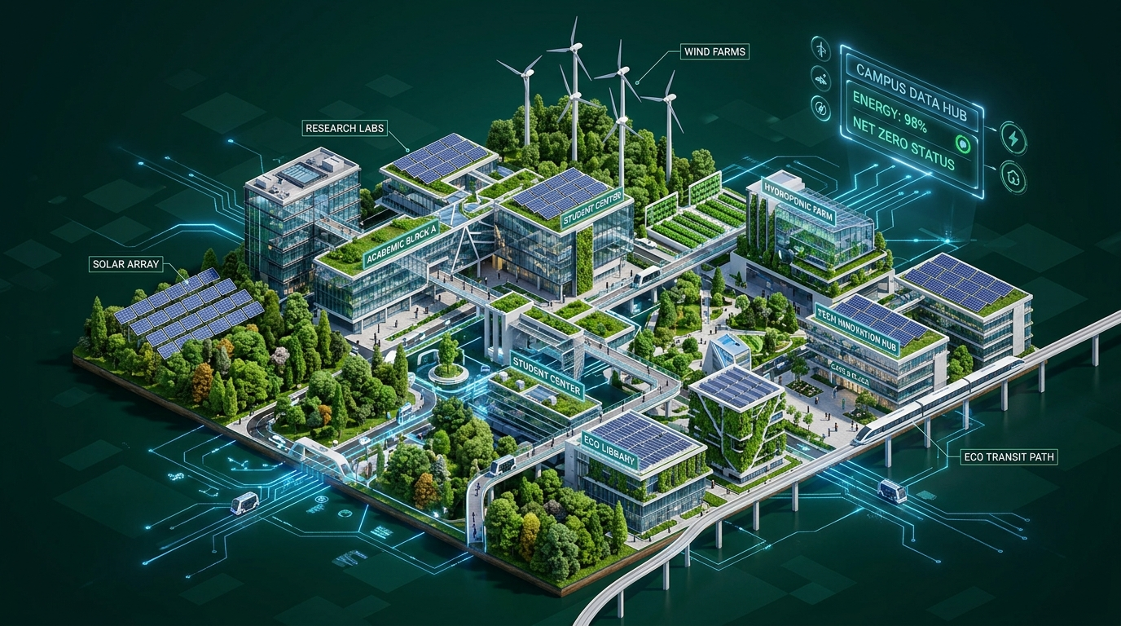
🌿 GREENVERSE AI
AI-IoT Smart Campus Sustainability & Maintenance Platform
Transforming Educational Institutions with Artificial Intelligence, IoT Telemetry, GIS Mapping & Renewable Energy
INSTITUTION
SPNREC Araria (Bihar) BEU Patna Affiliated
INTERNSHIP SPONSOR
1M1B Applied AI Initiative (Microsoft Supported)

Slide 2
Slide 2 | Problem Statement & Solution Overview
Solving Campus Waste, Energy, Water, and Carbon Challenges
🗑️ Waste Management
Manual bin inspections lead to overflow, littering, and unhygienic campus grounds.
85% Overflow
⚡ Energy Consumption
Unmonitored HVAC and lighting lead to massive grid power waste and operational costs.
40% Power Wasted
💧 Water Wastage
Undetected pipe leaks and overhead tank overflows waste thousands of liters daily.
45,000L Lost/Mo
🌿 Carbon Footprint
High reliance on non-renewable grid power increases campus carbon emissions.
High ESG Deficit

Slide 3
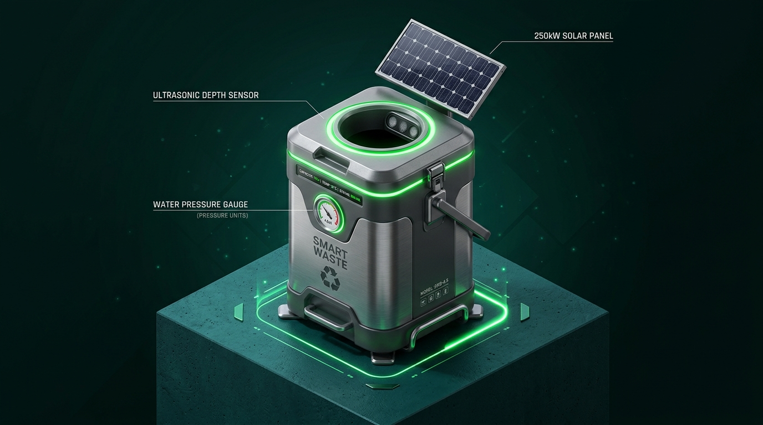
Slide 3 | System Architecture & Data Pipeline
End-to-End IoT Sensors, Supabase Cloud, Gemini AI & Mobile App
1. IoT Sensors
Smart Bins, Water Pressure, Solar Meter
2. ESP32 Edge
Microcontroller Data Processing
3. WiFi Gateway
Encrypted Telemetry Transmission
4. Firebase/Supabase
Realtime Database & Webhooks
5. Gemini AI
Defect Scanning & Predictive Engine
6. Control Center
Admin & Staff Dispatch Dashboard

Slide 4
Slide 4 | Prototype Demonstration
GreenVerse - AI Smart Campus Sustainability & Maintenance Platform
🌐 Website Portal
• Cinematic 3D Eco Hero • Live Telemetry HUD • 13 Feature Cards • Interactive GIS Radar Map
📱 Mobile Student App
• Instant Issue Reporting • Gemini AI Defect Scan • +50 Eco-Points Rewards • GreenBot Voice Assistant
🛡️ Admin Dashboard
• Role-Based Access Control • Technician Dispatch Queue • Photo Repair Verification • Microsoft ESG Audit Log
🔄 Complaint & AI Workflows
User Reports Issue ➔ Complaint Submitted ➔ Assigned to Maintenance ➔ Work in Progress ➔ Verified & Resolved ➔ Eco Points Credited
👥 Role-Based Access Control (RBAC)
• Student: Report issues, track status, earn eco rewards. • Maintenance: Receive tasks, navigate GIS map, upload repair photos. • Admin: Govern users, monitor telemetry, verify completions.

Slide 5
Slide 5 | 10 Core Platform Features
Integrated SaaS Modules Powering Smart Campus Sustainability
1. Smart Waste Monitoring
Operational & Active
2. Smart Water Monitoring
Operational & Active
3. Solar Grid Telemetry
Operational & Active
4. GIS Campus Radar Map
Operational & Active
5. GreenBot AI Copilot
Operational & Active
6. AI Vision Defect Scanner
Operational & Active
7. IoT Hardware Mesh
Operational & Active
8. Executive Sustainability HUD
Operational & Active
9. Green Rewards Leaderboard
Operational & Active
10. Cloud Edge Database Sync
Operational & Active

Slide 6
Slide 6 | Measured Results & Sustainability KPIs
Quantifiable Environmental & Financial Impact Across Campus
40%
Water Saving
Recycled Greywater & Leak Repairs
35%
Energy Saving
250kW Solar Grid Optimization
50%
Better Waste
Smart Bin Overflow Prevention
25%
Cost Reduction
Lower Facilities Maintenance Costs

Slide 7
Slide 7 | Scaling Strategy & Future Roadmap
From SPNREC Pilot to a National Smart Campus Network
1. SPNREC Pilot
Deploy & validate solutions across Araria campus.
2. District Colleges
Expand to nearby Bihar district colleges.
3. Engineering Colleges
Scale to all state engineering institutes.
4. Universities
University-wide deployment & policy integration.
5. National Network
Pan-India data-driven national campus network.
🤝 STRATEGIC PARTNERS & ECOSYSTEM
• Microsoft (Cloud & AI Integration) • Supabase (Database Infrastructure) • Google Gemini AI & Leaflet GIS • MeitY & ISRO (Geospatial Data) • Academic Institutions & Environmental NGOs
🚀 FUTURE EXPANSION MODULES
• Smart Parking: Real-time IoT slot tracking to reduce vehicle emissions. • Carbon Tracking: Live emissions dashboard & Net-Zero targets. • Digital Twin Campus: 3D virtual replica for predictive maintenance simulation.

Slide 8
Slide 8 | Risks, AI Tools & Conclusion
Mitigation Governance, Key Learnings, and Project Accreditation
🛡️ RISKS & MITIGATION
• Data Privacy: End-to-end encryption & RLS isolation. • Hardware Failure: Automated alerts & regular telemetry checks. • Data Inaccuracy: Multi-source verification algorithms. • User Engagement: Gamified Eco-Points & Leaderboards. • System Uptime: Scalable Vercel & Supabase Cloud hosting.
📖 KEY LEARNINGS
• Integrated AI, IoT, GIS & Cloud for real-world impact. • Hands-on full-stack engineering & state management. • Data-driven decision making for smart campus management.
✨ THANK YOU!
Together, let's build smarter, greener & sustainable campuses.
🌐 Live Site: https://green-verse-ai-smart-campus-sustain.vercel.app 💻 GitHub: https://github.com/yashkumar5224/GreenVerse-AI-Smart-Campus-Sustainability-Maintenance-Platform.git 👥 Team: Yash Kumar • Neha Kumari • Suraj Kumar • Utkarsh Raj

