Slide 1
CSE638 — Graduate Systems (GRS) • Winter 2026 • Instructor: Dr. Rinku Shah • IIIT-Delhi
Benchmarking Kubernetes CNI Plugins
A Cross-Environment Performance Study
Kind-Cluster (Intra-Node) vs. Bare-Metal (Multi-Node WiFi)
Team — Group 1
Yash Kumar Vaibhav MT25091
Nishit Jain MT25004
Prakhar Agarwal MT25005
Reehan Sarmah MT25036
Samyak Kr. Sharma MT25039
github.com/yashkumarvaibhav/GrS-CSE638_Project
Group 1 | CSE638 GRS Winter 2026 | Benchmarking Kubernetes CNI Plugins
Slide 1 / 13

Slide 2
Why Benchmark CNI Plugins?
Problem & motivation
• Kubernetes relies on CNI plugins for all pod networking — the choice directly shapes performance.
• Existing benchmarks test either simulated (kind) environments OR production-wired clusters.
• No study compares the same CNIs across fundamentally different environments.
• Edge / WiFi deployments are growing rapidly — performance implications are largely unknown.
• We bridge this gap: same 3 CNIs × same tools × 2 contrasting environments.
“CNI rankings are NOT universal — they depend heavily on the deployment environment.”
Group 1 | CSE638 GRS Winter 2026 | Benchmarking Kubernetes CNI Plugins
Slide 2 / 13

Slide 3
What We Did
Scope & methodology
 | Part A — Kind-Cluster | Part B — Bare-Metal
Hardware | Single 128-core AMD EPYC VM | 3 physical laptops (WiFi)
Network | Docker bridge (intra-node) | 802.11ac/ax shared LAN
Bandwidth | ~60 Gbps bandwidth headroom | ~100–200 Mbps usable
Measures | CNI software efficiency | Real physical-network constraints
CNIs Tested
● Flannel (VXLAN + Host-GW) — lightweight, simple
● Calico (VXLAN + BGP) — iptables-based, policy-rich
● Cilium (VXLAN + Native Routing / Underlay) — eBPF-based, advanced
Tools
Test Topologies
▸ iperf3 — TCP & UDP throughput
▸ netperf — TCP_RR request / response latency
▸ fortio — HTTP load testing, P50 / P99
▸ kubectl top / docker stats — CPU & memory
▸ Kind: Same-node (T1), Cross-node (T2), ClusterIP (T3)
▸ BM: 6 configs = 3 CNIs × 2 modes (overlay + underlay)
▸ Reps: 5 repetitions each (Calico BGP: 4)
▸ Extensions: E1 NetPol, E2 WireGuard, E3 Cilium KPR
Group 1 | CSE638 GRS Winter 2026 | Benchmarking Kubernetes CNI Plugins
Slide 3 / 13

Slide 4
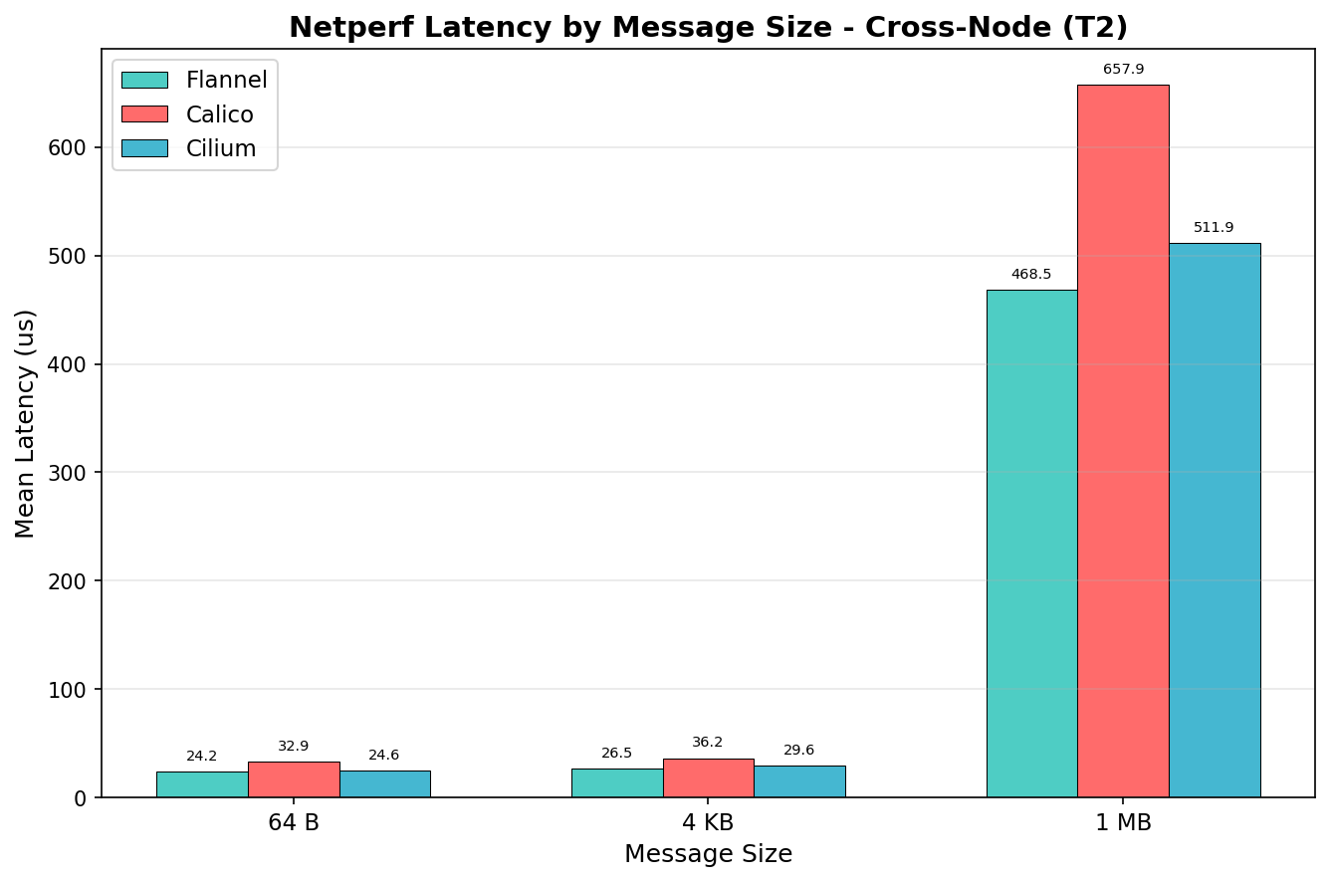
Part A Results — Throughput & Latency
Kind-Cluster (Intra-Node)
TCP Throughput (Gbps, iperf3, 1MB)
Topology | Flannel | Calico | Cilium
Same-Node (T1) | 60.93 | 49.61 | 63.98
Cross-Node (T2) | 30.96 | 23.83 | 27.40
ClusterIP (T3) | 34.13 | 24.11 | 32.42
Cilium leads same-node • Flannel leads cross-node
† Values shown at the concurrency level where each topology peaks.
TCP_RR Latency (T2, 64B, netperf)
Flannel 24.18 µs ≈ Cilium 24.63 µs
Calico 32.91 µs (↑ 36% vs. Flannel)
Group 1 | CSE638 GRS Winter 2026 | Benchmarking Kubernetes CNI Plugins
Slide 4 / 13

Slide 5
Part A — HTTP Performance & Security Extensions
Kind-Cluster (Intra-Node)
HTTP QPS — fortio, 64 B payload, concurrency = 16, topology T2
Cilium
Flannel
Calico
132,836 QPS
81,749 QPS
74,792 QPS
eBPF fast-path
baseline
lowest of three
Extension E2 — WireGuard Encryption Cost
Metric | Calico | Cilium
Throughput loss | −76% | −47%
Latency increase | +537% | +365%
Extension E1 — NetworkPolicy
Calico: throughput −45%
Cilium: throughput +118%†
eBPF handles policy in-kernel, avoiding iptables overhead.
† High CV on Cilium (∼57%) — directional only.
Cilium's eBPF mitigates encryption overhead better.
Plot reference: kind-cluster/plots/1_network_policy_overhead.png
Group 1 | CSE638 GRS Winter 2026 | Benchmarking Kubernetes CNI Plugins
Slide 5 / 13

Slide 6
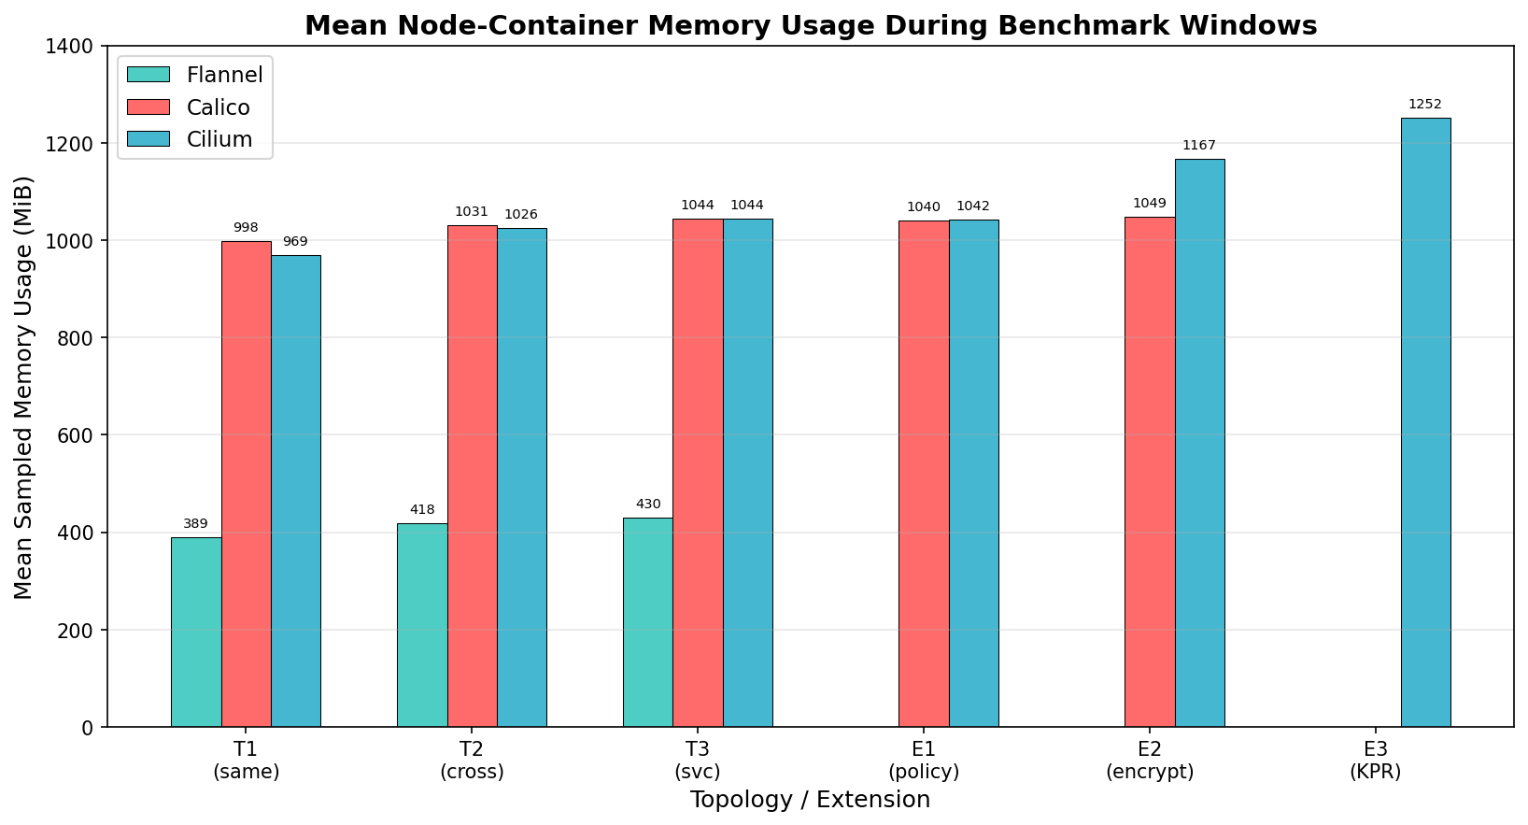
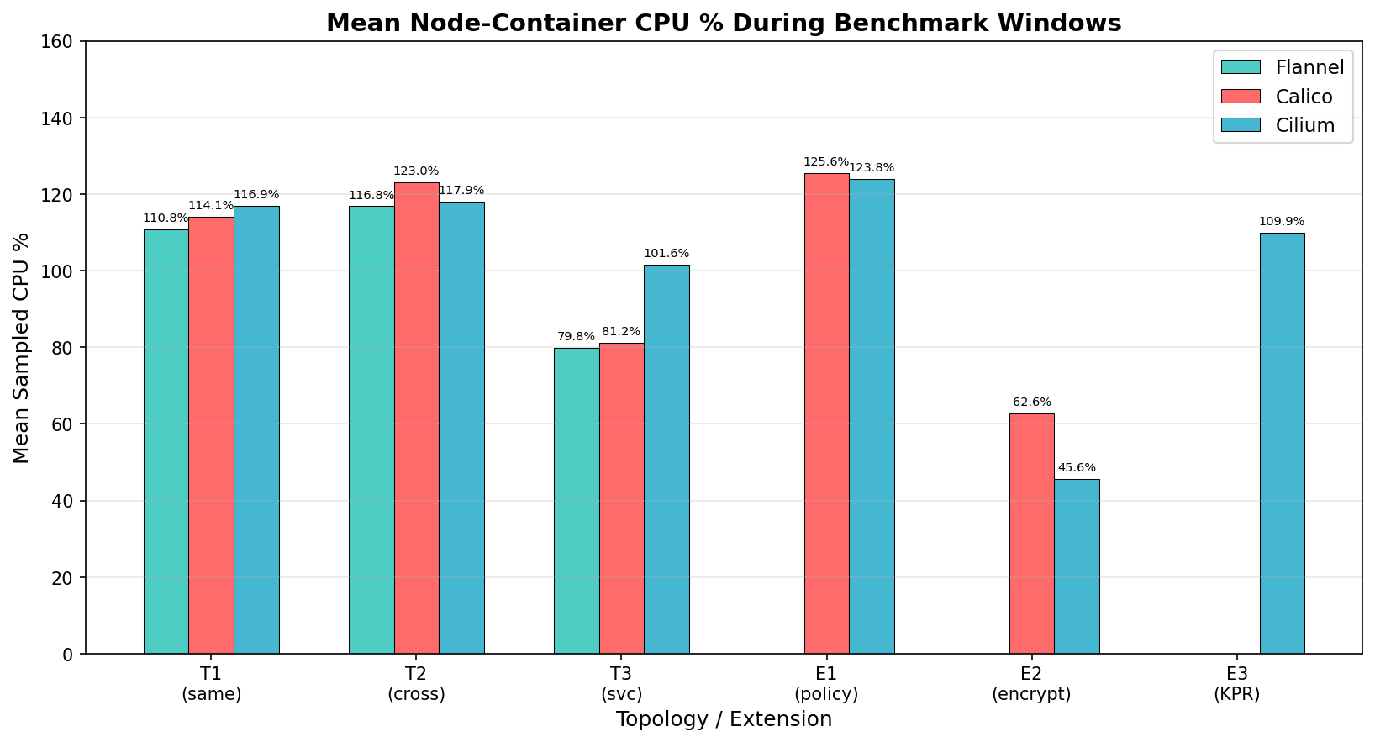
Part A — CPU & Memory Overhead
Kind-Cluster (Intra-Node)
Memory Overhead (MiB)
CPU Overhead (%)
Memory: Flannel 389–430 MiB | Calico & Cilium 969–1,049 MiB (2.4–2.6× more)
CPU baseline: Similar across CNIs (~101–117%)
WireGuard CPU: Drops to 46–63% (encryption throttles; network is the bottleneck, not CPU)
Group 1 | CSE638 GRS Winter 2026 | Benchmarking Kubernetes CNI Plugins
Slide 6 / 13

Slide 7
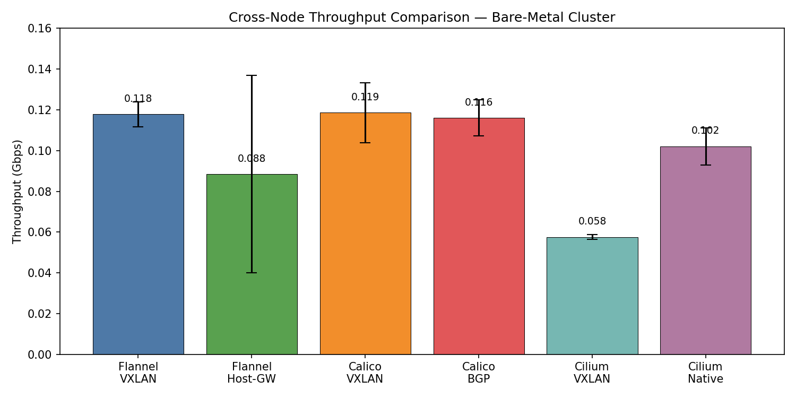
Part B Results — Throughput on WiFi
Bare-Metal Cluster
Key Numbers (Gbps)
Flannel VXLAN
0.118
Calico VXLAN
0.119
virtual tie
Cilium VXLAN
0.058
half the others!
Cilium Underlay
0.102
+77% over its own VXLAN
“WiFi compresses all CNIs into a narrow 0.06–0.12 Gbps band — 262–472× slower than kind-cluster.”
Group 1 | CSE638 GRS Winter 2026 | Benchmarking Kubernetes CNI Plugins
Slide 7 / 13

Slide 8
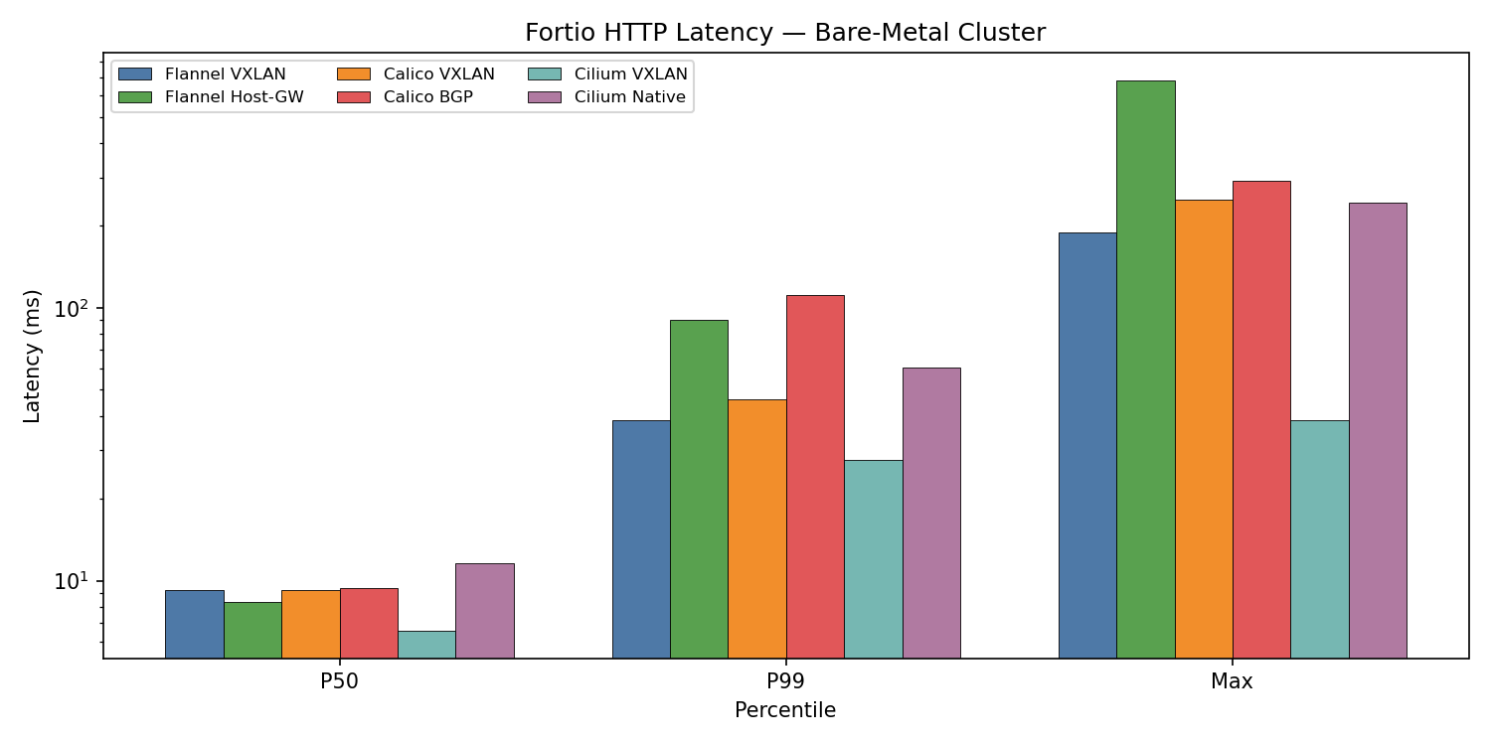
Part B — The Throughput–Latency Inversion
Bare-Metal Cluster
Fortio HTTP Latency — VXLAN mode
Percentile | Cilium VXLAN | Flannel VXLAN | Calico VXLAN
P50 | 6.56 ms | 9.26 | 9.23
P99 | 27.75 ms | 38.77 | 46.21
Max | 38.72 ms | 188.54 | 248.93
Max-latency gap: Cilium 38.72 ms vs. Calico 248.93 ms → Calico 6.4× worse on tail.
Cilium Underlay P50: 11.54 ms (higher than Cilium VXLAN) → underlay ≠ lower latency on WiFi.
⚡ Cilium VXLAN: WORST throughput (0.058 Gbps) but BEST HTTP latency (P50: 6.56 ms)
▸ TCP throughput = sustained bandwidth → per-packet eBPF overhead accumulates.
▸ HTTP latency = individual request–response → eBPF's O(1) connection tracking wins per-request.
Group 1 | CSE638 GRS Winter 2026 | Benchmarking Kubernetes CNI Plugins
Slide 8 / 13

Slide 9
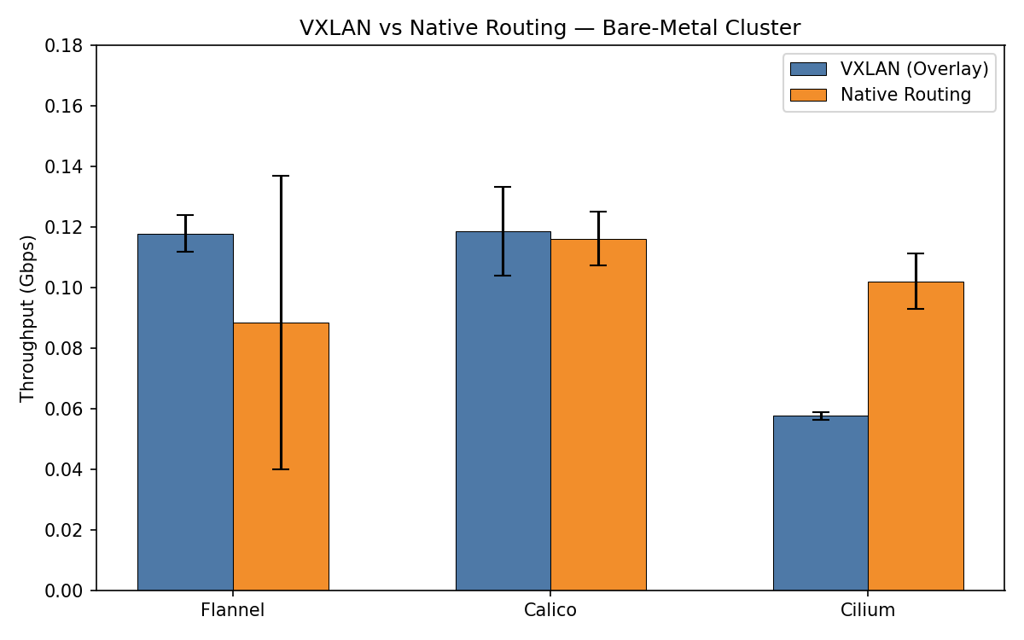
Part B — Routing Modes & UDP Performance
Bare-Metal Cluster
VXLAN → Native Routing / Underlay
CNI | VXLAN | Underlay | Change
Flannel | 0.118 | 0.088† | −25%
Calico | 0.119 | 0.116 | −2% (tie)
Cilium | 0.058 | 0.102 | +77%
† Flannel Host-GW run includes cold-start (CV 55.7%).
Underlay advantage is CNI-specific — not universal.
UDP Highlights (iperf3 UDP, targets 10 / 25 / 50 Mbps)
Calico BGP leads — 11.88 Mbps mean, 38% mean loss across all targets.
At 10 Mbps target: Calico BGP reaches ≤0.15% loss (mean ~0.11%, near-perfect).
At 50 Mbps: WiFi saturates — all CNIs hit 54–82% packet loss.
Group 1 | CSE638 GRS Winter 2026 | Benchmarking Kubernetes CNI Plugins
Slide 9 / 13

Slide 10
Cross-Environment Analysis — Ranking Inversions
Does the winner change with the environment?
Metric | Kind-Cluster Winner | Bare-Metal WiFi Winner | Ranking Inverted?
TCP Throughput | Cilium | Calico ≈ Flannel | ✅ YES
Latency (TCP_RR) | Flannel ≈ Cilium | Flannel | Partial
HTTP Performance | Cilium | Cilium VXLAN | ❌ NO (intrinsic)
CPU Overhead | ~Equal | Flannel (3.9%) | —
Throughput Scaling — Kind T2 vs. Bare-Metal WiFi
CNI | Kind T2 (Gbps) | BM WiFi (Gbps) | Ratio
Flannel | 30.96 | 0.118 | 262×
Calico | 23.83 | 0.119 | 200×
Cilium | 27.40 | 0.058 | 472× ⚠
Cilium's 472× ratio → eBPF per-packet overhead amplifies on slow links.
Group 1 | CSE638 GRS Winter 2026 | Benchmarking Kubernetes CNI Plugins
Slide 10 / 13

Slide 11
Key Insight — The Edge Environment Paradox
Why simplicity beats sophistication on constrained links
“In resource-constrained environments, simplicity outperforms sophistication.”
🔧
⚡
🔀
Flannel's Minimalism
Cilium's eBPF
Cilium Underlay Penalty
Consistent, reliable throughput on WiFi. Low CPU (3.9%). No control plane overhead, no eBPF taxes.
Shines on fast links. On slow links, per-packet hooks dominate and negate the shortcut advantage.
111 trans/sec (Underlay) < 163 trans/sec (VXLAN). Security-identity checks fire on every packet.
Implication → CNI selection MUST be validated on representative hardware. Kind-cluster results do NOT predict edge / WiFi behavior.
Group 1 | CSE638 GRS Winter 2026 | Benchmarking Kubernetes CNI Plugins
Slide 11 / 13

Slide 12
Practical Recommendations
CNI decision matrix by use-case
Use Case | Recommended CNI | Rationale
Constrained / WiFi network | Flannel VXLAN | Lowest CPU (3.9%), consistent throughput
Latency-critical microservices | Cilium VXLAN | Best P99 (27.75 ms), lowest Max (38.72 ms)
High throughput (wired DC)† | Cilium Underlay | +77% over VXLAN on bare-metal (extrapolated)
UDP-heavy workloads | Calico BGP | Best UDP throughput; ≤0.15% loss at 10 Mbps
Security-critical | Cilium | Lower WireGuard overhead (−47% vs. −76%)
Large-scale clusters | Cilium KPR | Bypasses iptables rule explosion
Lowest complexity | Flannel VXLAN | No BGP / eBPF, minimal control plane
† Wired bare-metal validation is Future Work; the +77% figure is measured on WiFi.
Group 1 | CSE638 GRS Winter 2026 | Benchmarking Kubernetes CNI Plugins
Slide 12 / 13

Slide 13
Conclusion
Takeaways, future work, Q&A
Key Takeaways
1. CNI rankings are environment-dependent — Cilium leads on fast links; Flannel leads on WiFi.
2. Throughput–Latency Inversion — Cilium has worst throughput but best HTTP latency on WiFi (eBPF per-request advantage).
3. Overlay vs. Underlay is CNI-specific — no universal winner; Cilium gains +77%, others break even or regress.
4. WireGuard encryption is expensive everywhere (−47% to −76% throughput).
5. WiFi is a valid, underexplored deployment environment for Kubernetes research.
Future Work
▸ Wired bare-metal (1–10 GbE) to complete the environment spectrum
▸ eBPF tracing for per-packet overhead profiling
▸ Production workloads (microservice meshes) beyond synthetic benchmarks
Thank You — Questions?
Group 1 | CSE638 GRS Winter 2026 | Benchmarking Kubernetes CNI Plugins
Slide 13 / 13

