Slide 1
PROOF OF CONCEPT
By prakirti lakhotiya

Slide 2
PROBLEM STATEMENT
The data is for company X which is trying to control attrition. There are two sets of data: "Existing employees" and "Employees who have left". Following attributes are available for every employee.
Satisfaction Level
Last evaluation
Number of projects
Average monthly hours
Time spent at the company
Whether they have had a work accident
Whether they have had a promotion in the last 5 years
Departments (column sales)
Salary
Whether the employee has left
Objective
What type of employees are leaving? Determine which employees are prone to leave next. Present your results in the presentation sheet's presentation area.

Slide 3
BASIC REFORMATTING
At first, the data is splitted into two different sheets.
They have Emp ID as one of the attribute.
For analysing things, this column is not at all required.
So we drop the column Emp ID .
Also, we add a left column to both sheets with left value 1 in ‘existing employee sheet’ and left value 0 in ‘employees who left’ sheet.
After that we merge both the sheets and make them a single dataframe.

Slide 4
Checking null values
Now, we will check to see if any null values are present in the dataset.
We will use dataframe.isnull().any() functions which will return true in front of their column name if null value is present in that column.

Slide 5
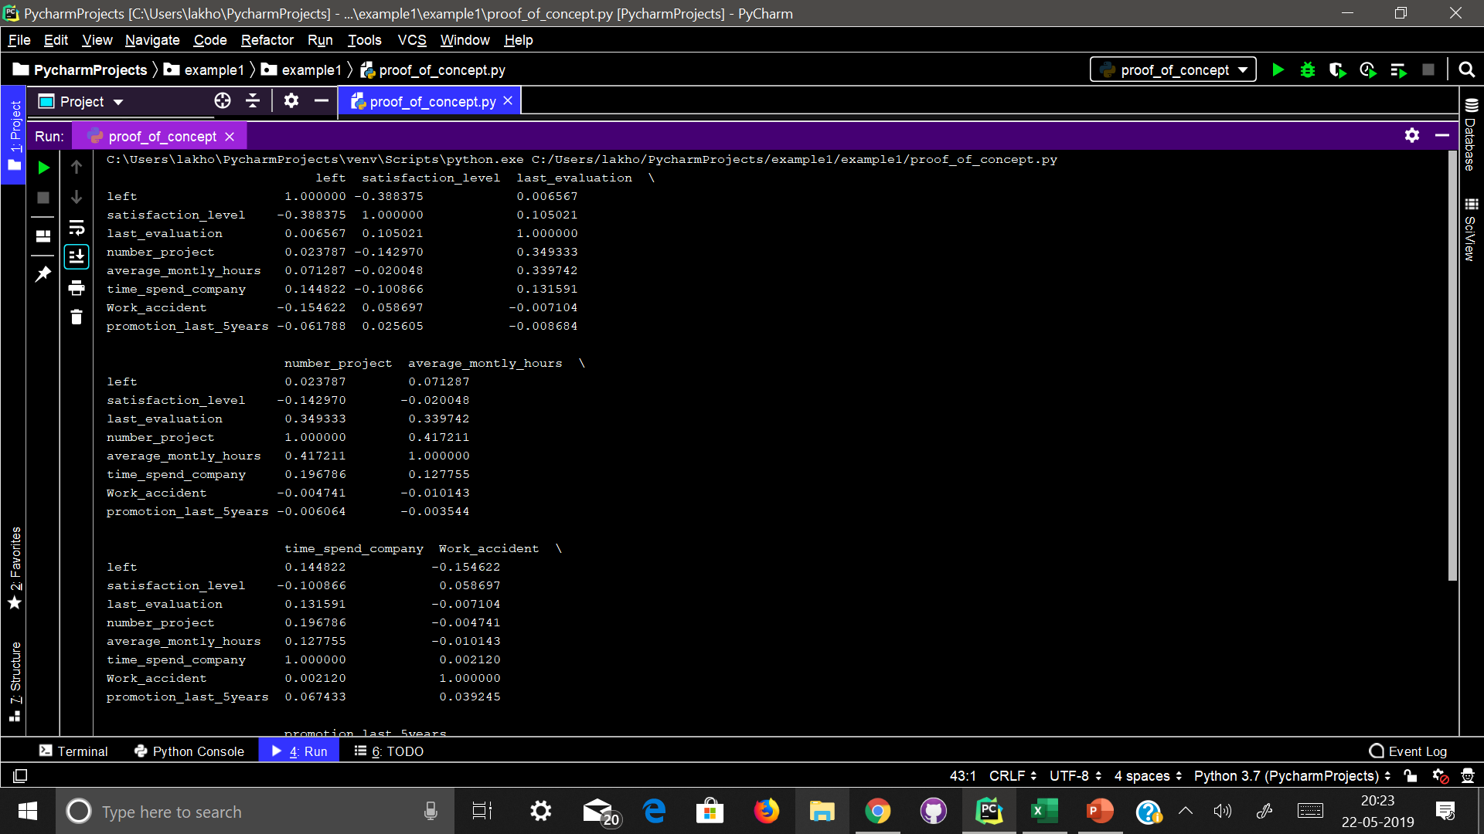
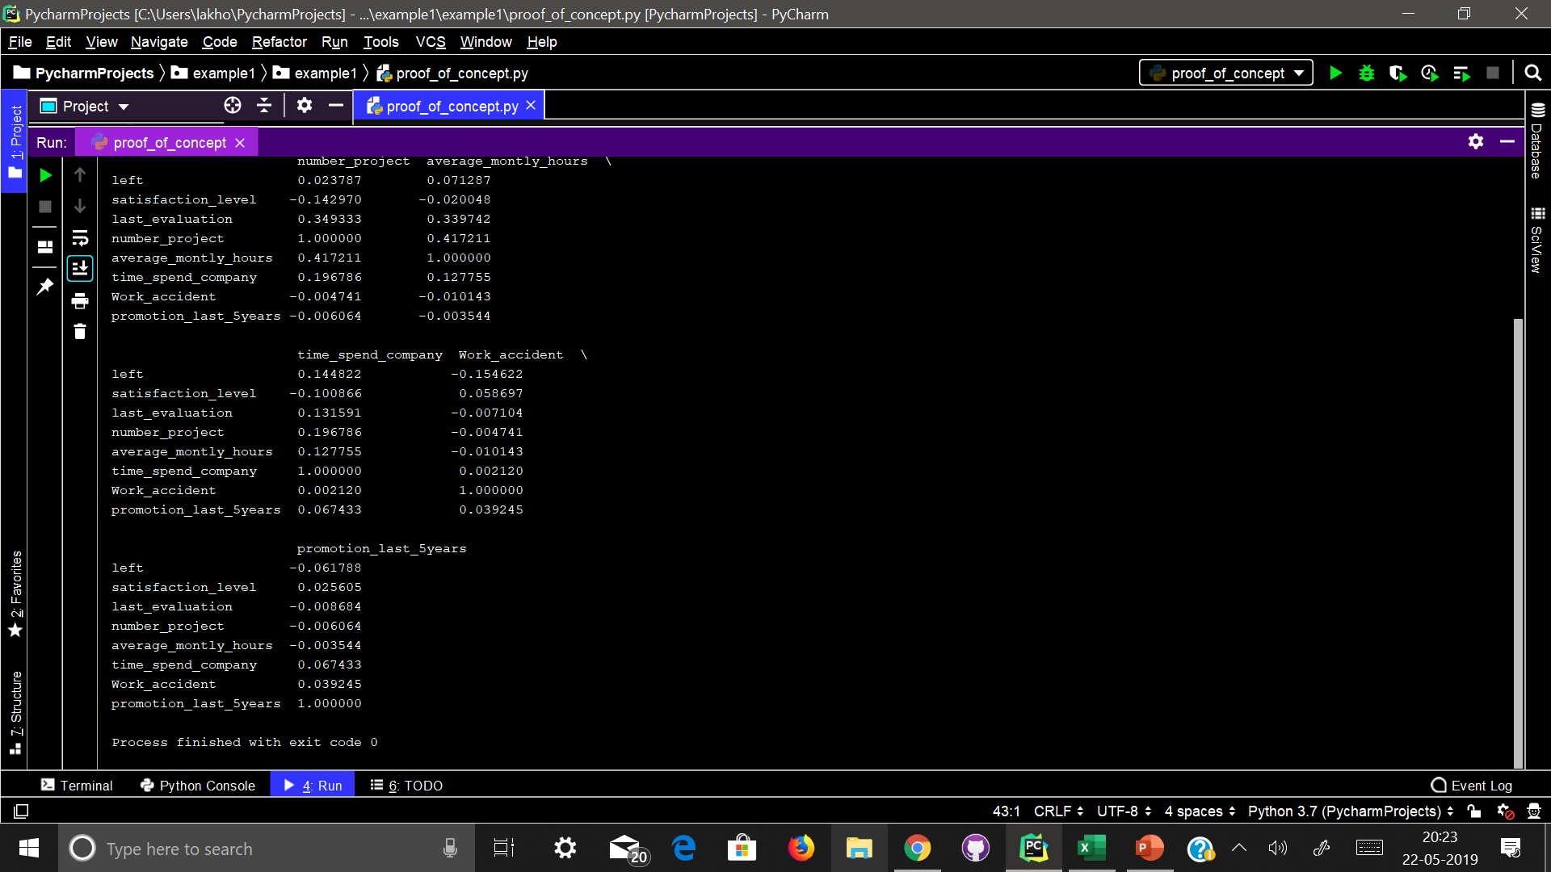
Correlation table
At first, we will get a correlation matrix using dataframe.corr()
This will give positive correlation between projectCount, averageMonthlyHours, and evaluation. Which could mean that the employees who spent more hours and did more projects were evaluated highly.
This also gives negative correlation between turnover and satisfaction

Slide 6
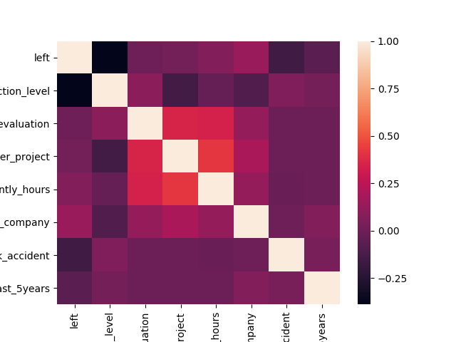
Plotting heatmap of correlation matrix
Positive correlation:
projectCount vs evaluation: 0.349333
projectCount vs averageMonthlyHours: 0.417211
averageMonthlyHours vs evaluation: 0.339742
Negative correlation:
satisfaction vs turnover: -0.388375

Slide 7
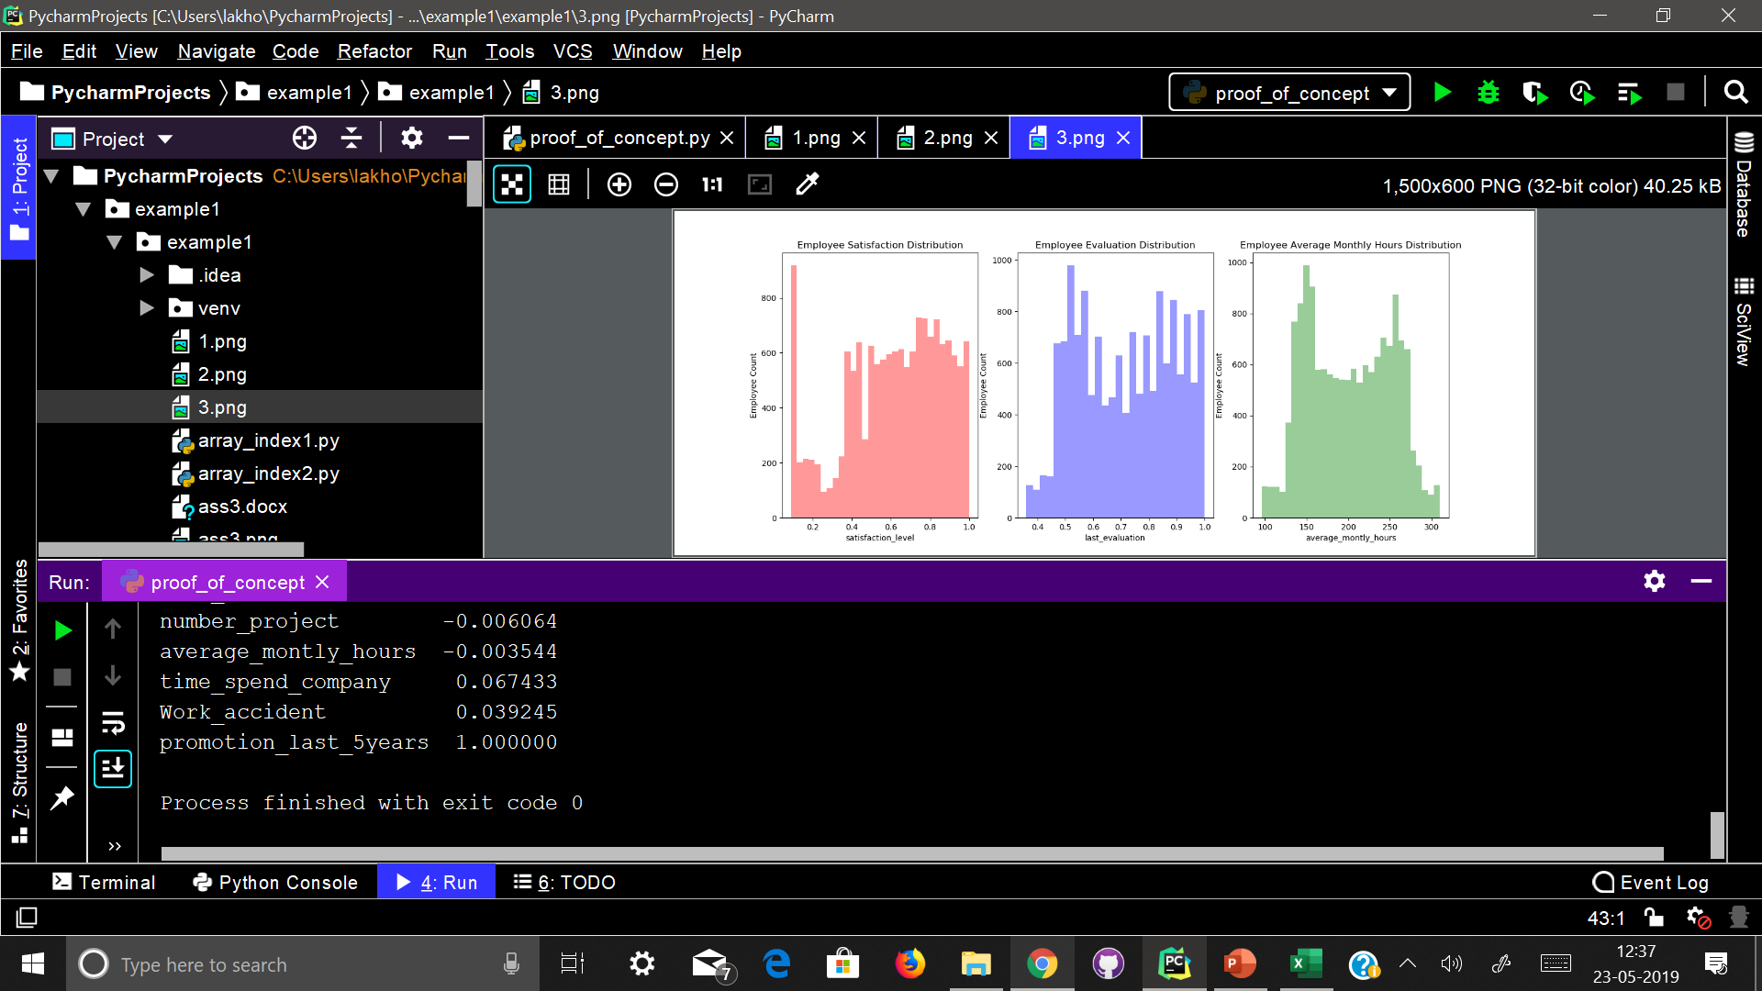
Examining distribution on some features plotting distplots
Satisfaction – A large number of employees are in low and high satisfaction.
Evaluation - There is a bimodal distribution of employees for low evaluations (less than 0.6) and high evaluations (more than 0.8)
Average Monthly Hours - There is another bimodal distribution of employees with lower and higher average monthly hours (less than 150 hours & more than 250 hours)
The evaluation and average monthly hour graphs both share a similar distribution.
Employees with lower average monthly hours were evaluated less and vice versa.
If you look back at the correlation matrix, the high correlation between evaluation and average Monthly Hours does support this finding.

Slide 8
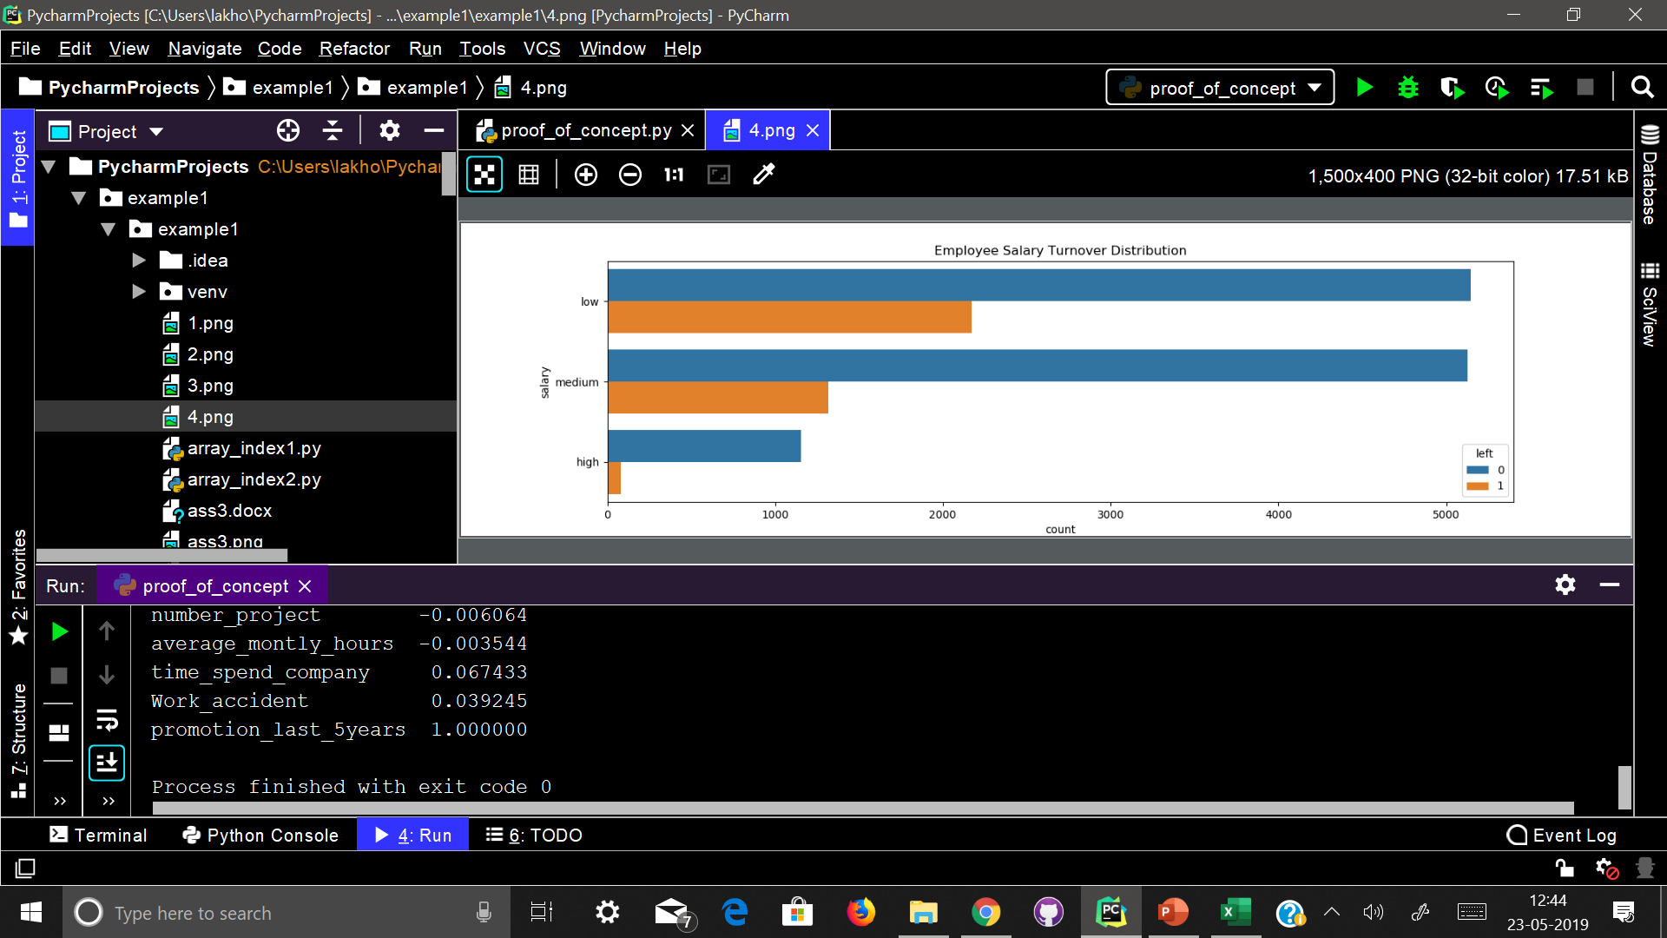
Salary vs left employees
-> Majority of employees who left either had low or medium salary.
Barely any employees left with high salary
-> Employees with low to average salaries tend to leave the company

Slide 9
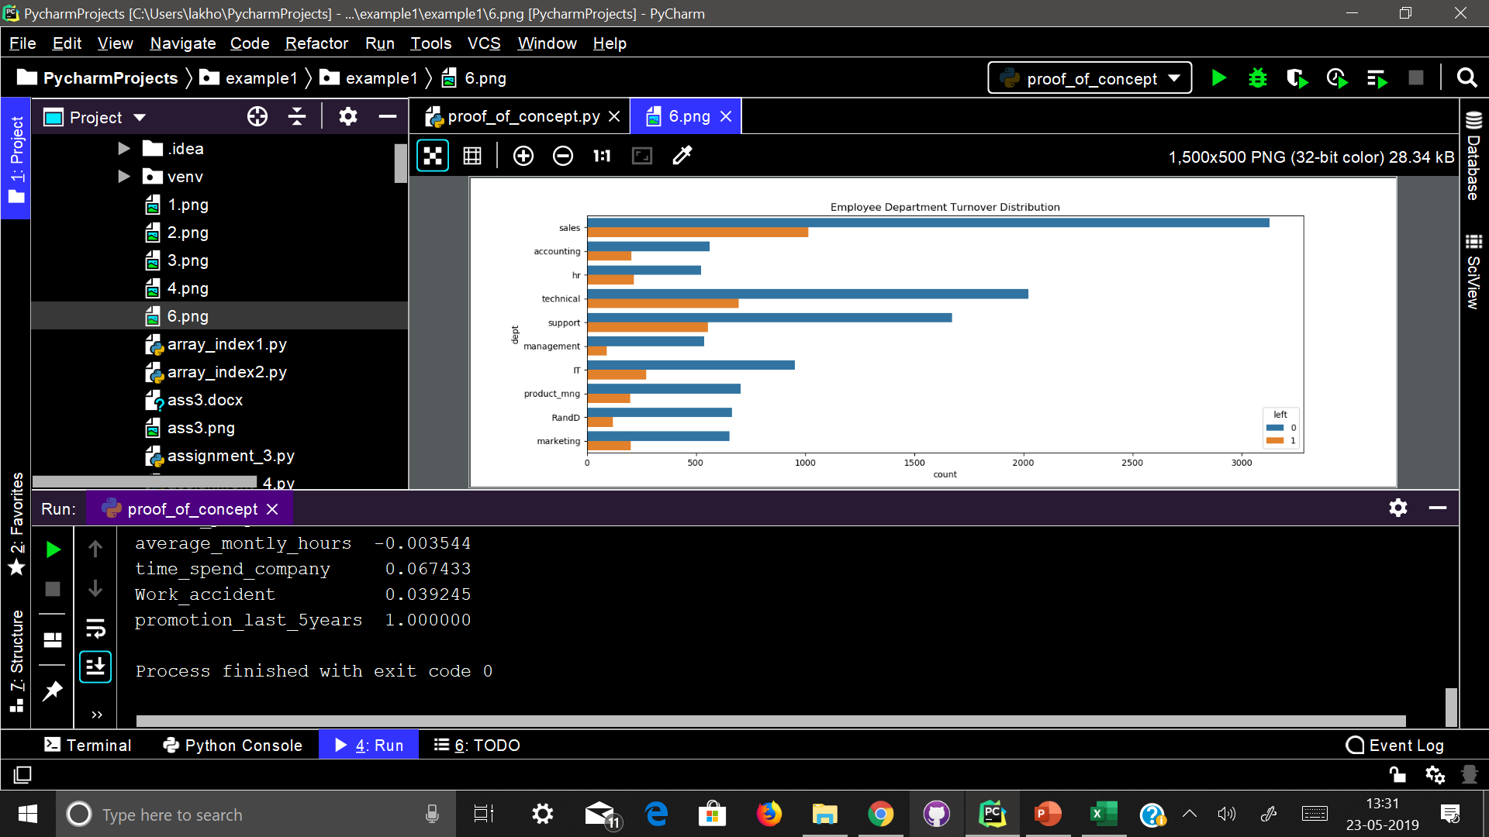
Department vs left employees
-> The sales, technical, and support department were the top 3 departments to have employee turnover
-> The management department had the smallest amount of turnover

Slide 10
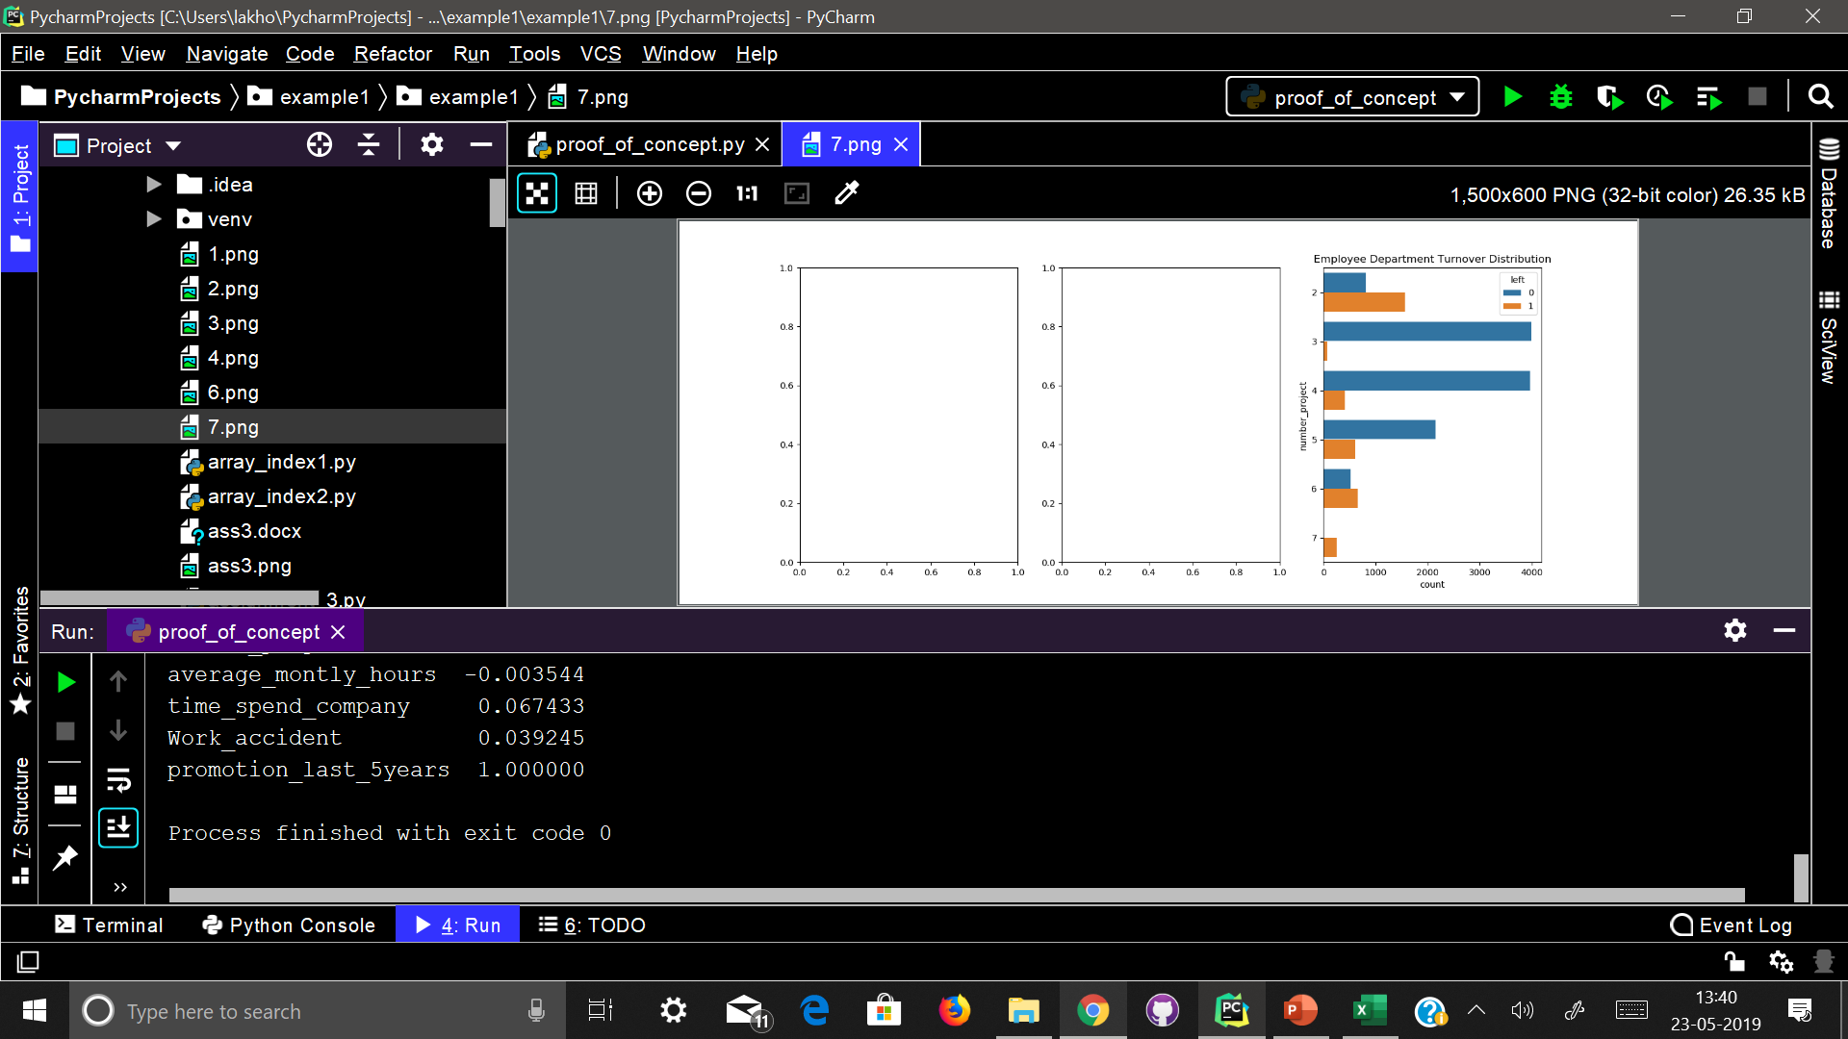
Project count vs left employees
-> More than half of the employees with 2,6, and 7 projects are leaving the company.
-> Majority of the employees who did not leave the company had 3,4, and 5 projects
-> All of the employees with 7 projects left the company
-> There is an increase in employee turnover rate as project count increases

Slide 11
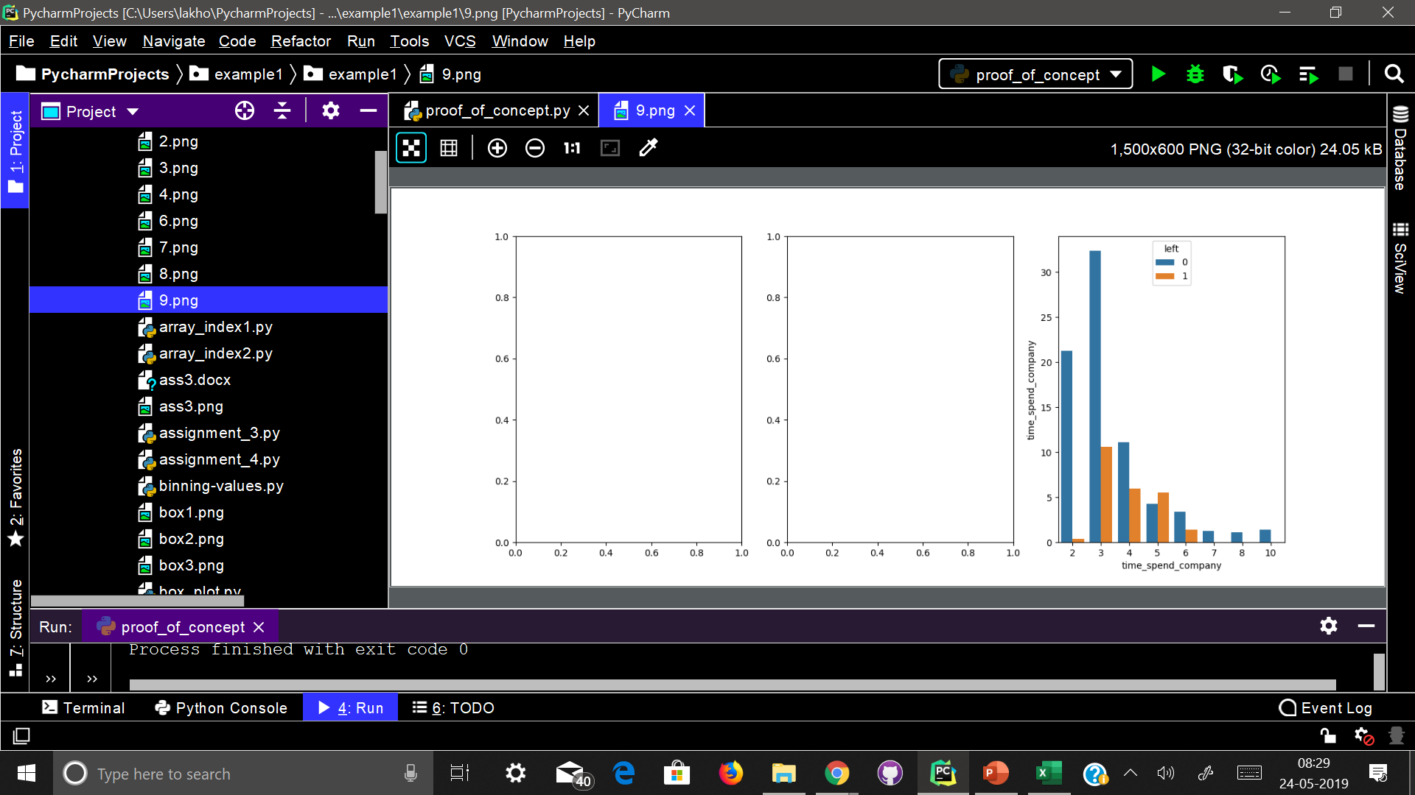
Working years vs left employee
-> More than half of the employees with 4 and 5 years are leaving the company
-> Employees with 5 years should highly be looked into. They are very likely to leave the company.

Slide 12
Analysing the plots (conclusion)
Employees generally leave the company when they are either underworked or overworked.( < 6hr per day or > 10 hr per day).
Employees who have either very low or very high evaluations should be taken into consideration for high leaving rate
Employees having low and medium salary are the bulk of leaving employee.
Employees that had 2,6, or 7 project count was at risk of leaving the company meaning the employee should not have very less or very high workload.
Employee leaving is majorly affected by their satisfaction levels.
Employee that had 4 and 5 years At Company should be taken into consideration for high turnover rate
Employee satisfaction, years At Company, and evaluation were the three biggest factors in determining number of employees leaving the company.

Slide 13
Employees who may leave next
Employees with 5 years of work should highly be looked into.
Employees with number of projects = 6.
The major attributes which are responsible for an employee to leve are satisfaction level, evaluation and their working years in the company.
So if an employee is not satisfied or has less satisfaction level , or not evaluated up to the mark, are more likely to leave the company next.

