Slide 1
Building Coevolution Sites in 16S RNA
Literature Review and Original Results

Slide 2
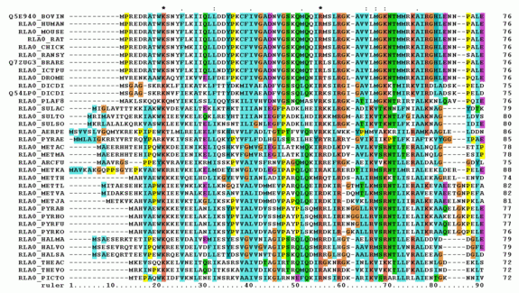
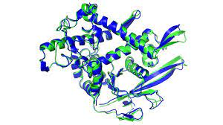
Introduction
Modern day genomics has created a data explosion
Large multiple sequence alignments
Structure determines function
Identification of probabilistic relations
Correspond to functional 2d/3d relations
Mathematical models to extract relationships
Many hierarchical levels of central dogma

Slide 3


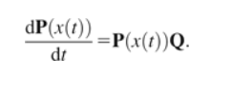
Varying Mathematical Models
Mutual Information
Often with correction terms
Parametric bootstrapping
Physical Models
Generalized Ising Model
Transition State Theory
Neural Networks
Rare, one paper
Markov Models
Probability vectors

Slide 4
Data Types
Studies have been often constrained to protein sequences
Both DNA and RNA
Almost always using amino acid alphabet for probabilistic
Size of interacting sites
Almost always limited solely to pairwise
Even Ising and other models are pairwise

Slide 5
Protein Predictions
Hierarchical Levels
Majority: pairwise contact prediction
Studies of protein domains such as bHLH
Mutation effects
Information gain of amino acid characteristics
Hydropathy
Disulfide bridges
Polarity

Slide 6
Common Problems
Combat sampling bias
Extract information gain from solely structure/function relations
Get rid of phylogenetic information gains
Encompassing epistasis
Spatial proximity can fail

Slide 7
Prior Application in 16S RNA
Yeang et al: 16S with Markov model
Used to predict pairwise interaction partners
Good secondary and tertiary structure validation
Only focuses on binary pairs
Claims to outperform MI

Slide 8
Successes and Failures
Proteins have been explored extensively
RNA is untouched
MI seems to have some potential statistical problems
Sampling bias from small alphabet
Overcome by data size
Isolating information gain from structure/function over phylogeny

Slide 9
Our Algorithm
Calculate nC2 (normalized) MI terms between sites
Rank these sites and join the terms with the maximum MI
Treat the joined term as a new variable
Using join probabilities
Loop until the max MI term reaches a preestablished cutoff

Slide 10
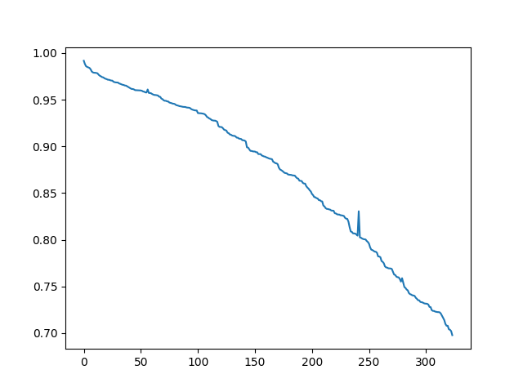
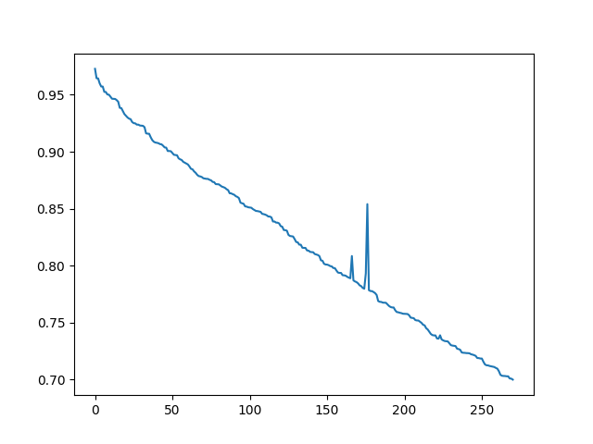
Results: Cyanobacteria and Fusobacteriota
Normalized MI
Epoch Number

Slide 11
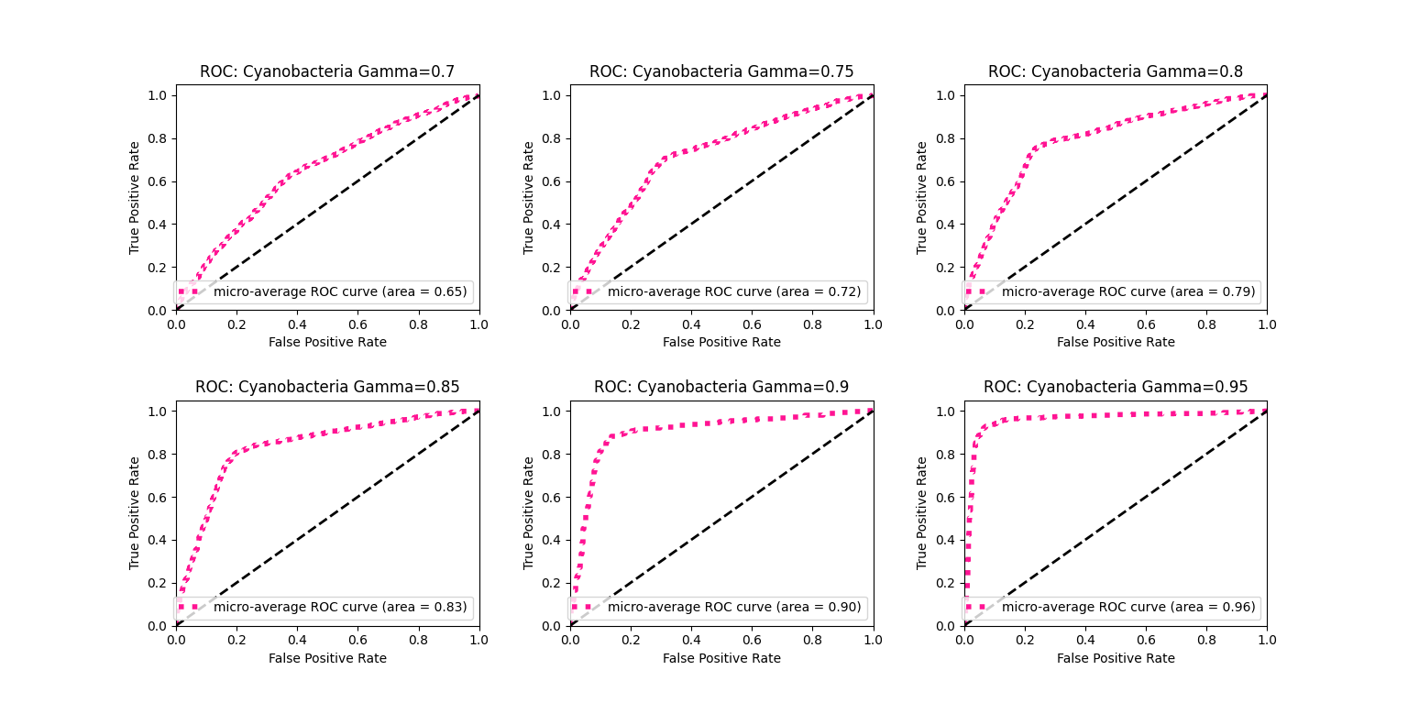
Validation with MFE: Cyanobacteria

Slide 12
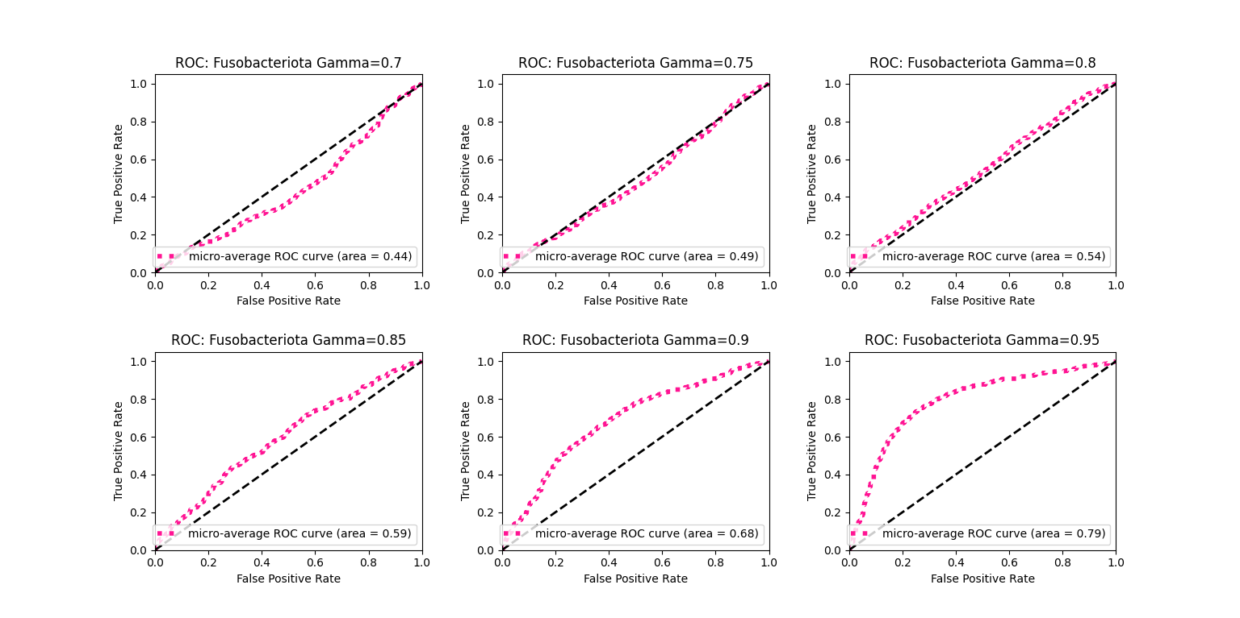
Validation with MFE: Fusobacteriota

Slide 13
Questions and Notes
Can we do tertiary structure validation?
3d distance
Do they align with known tertiary interactions?
How do distance and MFE correlate?
How do we interpret the larger sites that our algorithm builds?
Superadditive correlation
Can we quantify some information gains?
IE using sites over triplets

