Slide 1
Ethereum Price Predictions with LSTM and Backtesting
Yash Murthy
&
Daniel Valverde
August 17, 2022

Slide 2
Research Question
How well do Long Short Term Memory Neural Networks predict the price of Ethereum and how well can we use these predictions to create a trading strategy?

Slide 3
The Purpose and Significance
The purpose of this project is to use Long Short Term Memory, a Recurrent Neural Network, to predict the price of Ethereum, and using those predictions to create trade signals and backtest how the model and strategy performed.
The ability to predict price movement can be quite lucrative. There are an endless number of strategies to attempt and currently, utilizing Recurrent Neural Networks seems to be popular.
We wanted to work on something that we could continue working on once this course was over.

Slide 4
Data
Description: Ethereum is the second largest cryptocurrency and the price is quite volatile. The coingecko API aggregates the price of most cryptocurrencies from various exchanges and makes it possible to see the prices available at each exchange.
Data Source: API from coingecko.com
Date, Price, Total Volume (On a per day basis)
Quantity: 5 years worth of price data (2017 to Present)

Slide 5
Data Pre-Processing
In order to fit the neural network, we reshaped the X-train to be a matrix of shape(length_of_training_set, number_of_features, 1) where 1 signifies we are performing a Univariate forecasting model.
Similar reshaping was done on the X-test set
Did not scale the data for the 3-day Sliding Window LSTM Model
Used a Min-Max Scaler for the 60-day Sliding Window
Before reshaping and scaling, we converted the data into a Sliding Window Dataset

Slide 6
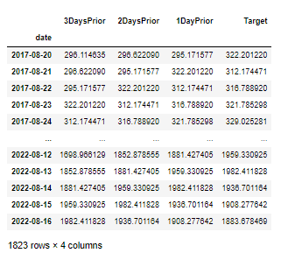
What are Sliding Windows
Sliding window is a way to restructure a time series dataset as a supervised learning problem.
We utilized a 3-day and 60-day sliding window.
To the right you can see the 3-day sliding window that we utilized. The Target Column is the price on the date of its respective row. We are using the prior days prices as the features.
Notes:
https://machinelearningmastery.com/time-series-forecasting-supervised-learning/

Slide 7
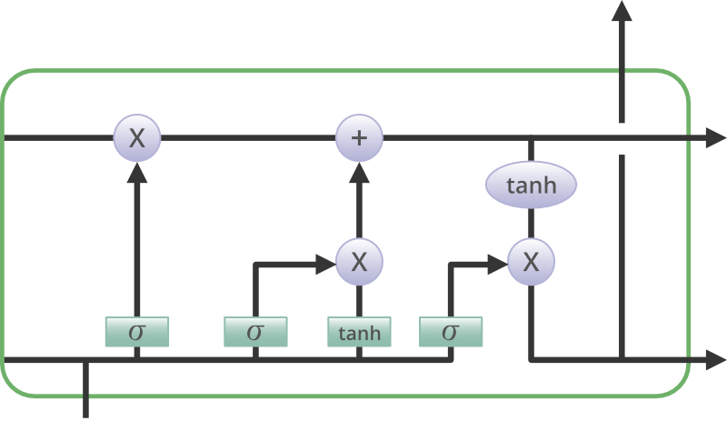
What Is LSTM
Long-Short term memory (LSTM) is a type of recurrent neural network often used in NLP and Time-Series forecasting by utilizing past information for future predictions
Uses 3 ‘gates’ that manipulate memory information and ‘cells’ which store the information
Forget gate - two inputs given, multiplied with weight matrices and bias added, then passes through an activation function which outputs binary result, 0 is forgotten, 1 is retained
Input gate - adds specific info into a vector and converted to a normalized value. Useful into retained
Output gate - another vector is generated and a tanh function is applied. The info is sent to the next cell
Specific examples of LSTM
Image Captioning
Machine Translation
Chatbots
Notes:
https://www.geeksforgeeks.org/deep-learning-introduction-to-long-short-term-memory/

Slide 8
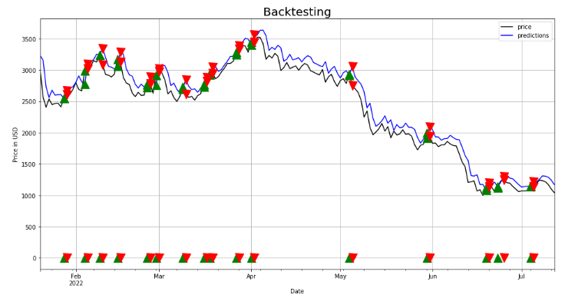

What is Backtesting and Crossover Strategy
Backtesting is a method for seeing how well a strategy or model would have performed using historical data. We performed backtesting in order to simulate when our trading strategy would have performed trades, given the specified trading signals. The strategy we implemented was a crossover strategy between the predicted price and the actual price of ethereum on each day.
Our crossover strategy performs a buy whenever the predicted price crosses the price line at the instant that the predicted price is less than the price. It performs a sell whenever the predicted price crosses back over at the instant the predicted price is greater than the price.

Slide 9
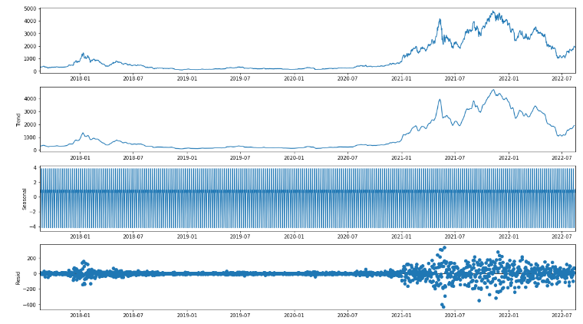
Exploratory Data Analysis

Slide 10
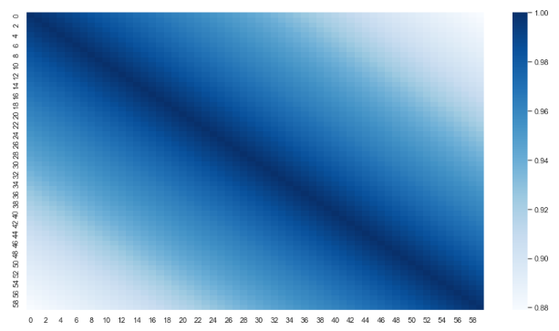
Correlation HeatMap

Slide 11
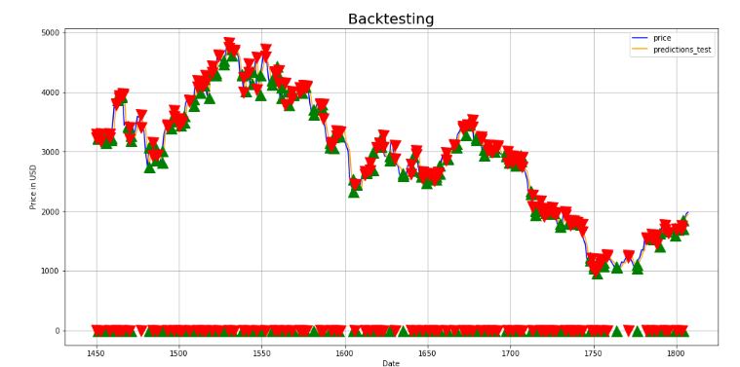
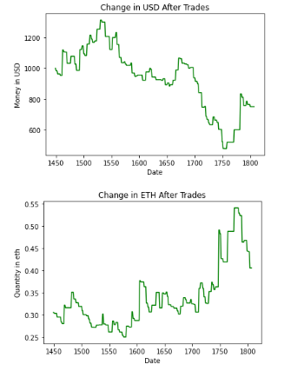
Linear Regression Crossover Strategy
-23.9%
+30.5%

Slide 12
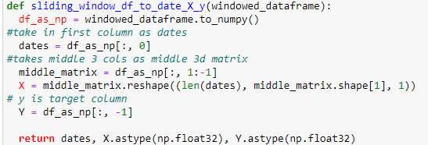
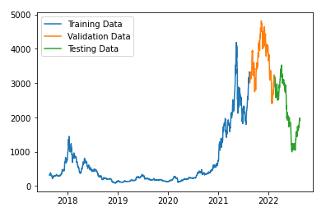
3-Day Sliding Window LSTM Preparation
Created a function to have an initial target date, middle matrix that contains the 3-day sliding window, and the target is the ETH price of that date
The middle matrix is the 3-D matrix that acts as an input in the LSTM model (X)
Target column is the target column in our model (Y)
Training-Validation-Test Split
80-10-10 Split

Slide 13


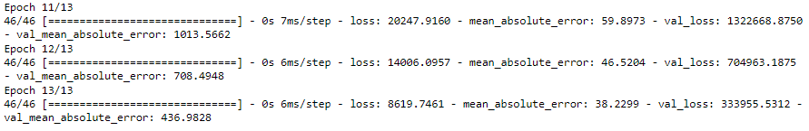
3-Day Sliding Window Model
Created a sequential model
200 neural units in LSTM (larger numbers are more prone to overfitting)
2 stacked dense layers
ReLU activation function is common in NN models as its easy to train and high performing
Final layer is a linear activation function with one output
Compile the Model
Set loss function to minimize as MSE
Utilized the mean absolute error metric
Tells us on average how much are predictions are off from the actual values
Fit the model
13 epochs (runs through the given data 13 times)

Slide 14
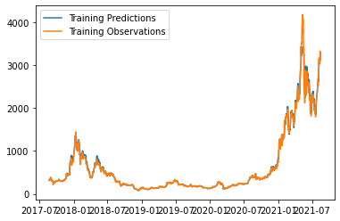
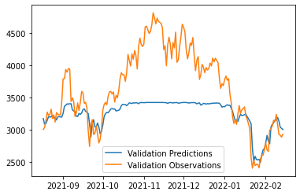
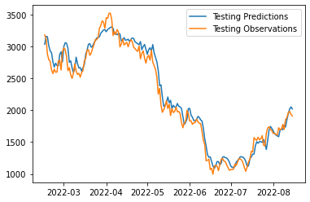
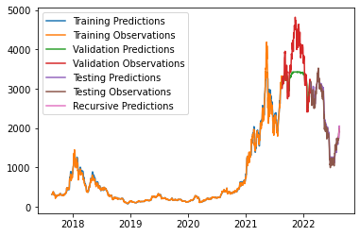
3-day LSTM Sliding Window Results
Recursive Predictions
Uses predicted data to predict prices recursively
Predict 7 most recent prices using the predicted data
Difference is the recursive prediction does not use the price from the last 7 days, it uses our predictions instead
Actual
Recursive Prediction

Slide 15
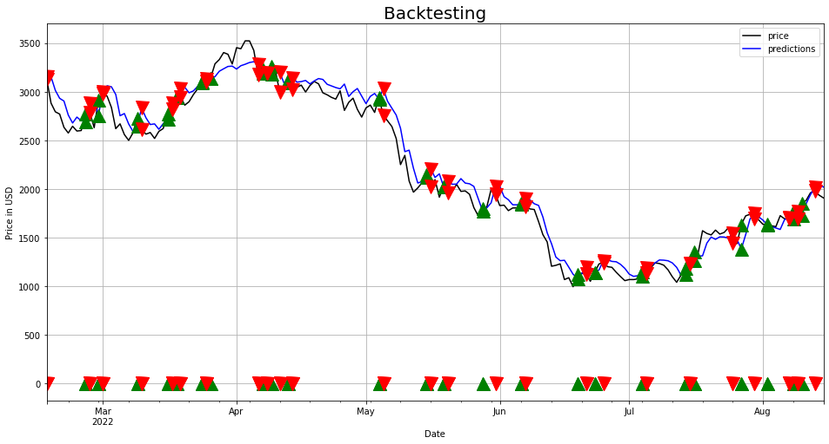
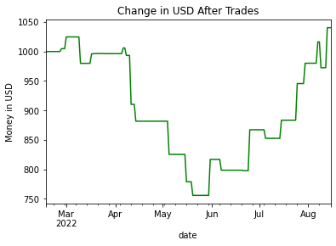
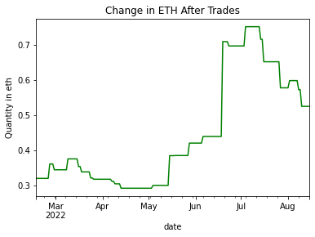
LSTM 3-Day Sliding Window Backtest of Crossover Strategy
+4.05%
+64.21%

Slide 16
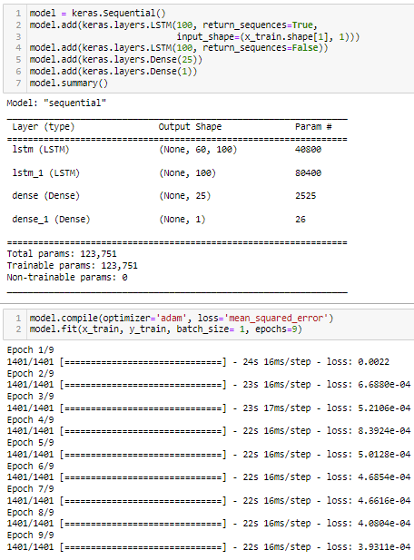
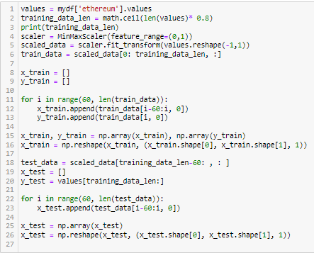
60-Day Sliding Window LSTM Prep

Slide 17
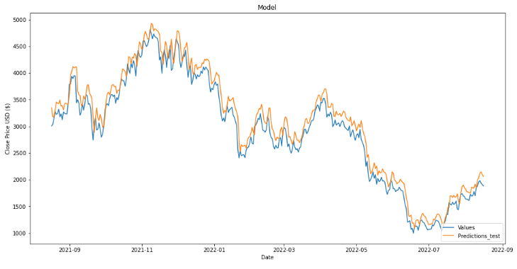
60-Day Sliding Window LSTM

Slide 18
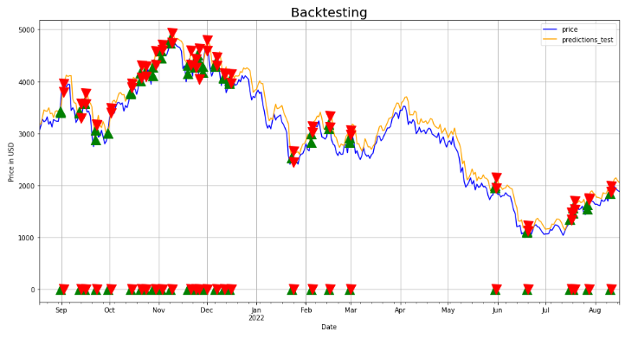
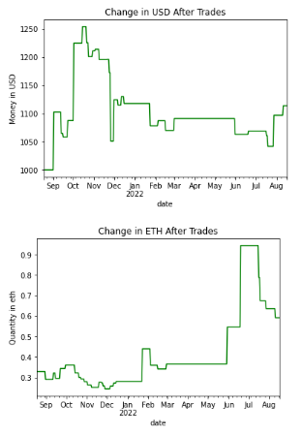
LSTM 60-Day Sliding Window Backtest of Crossover Strategy
+11.37%
+79.79%

Slide 19
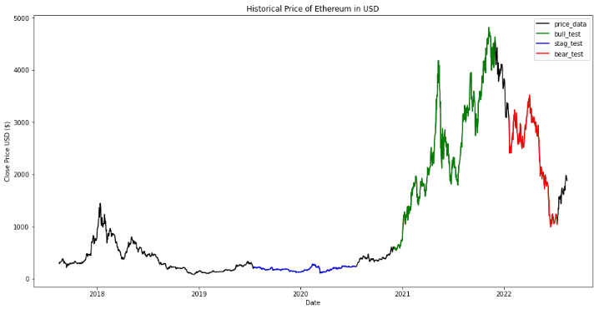
Exploratory LSTM (Bull, Stagnant, Bear)

Slide 20
Summary of Models Performed
 | LSTM 3-Day | LSTM 60-Day | LSTM Bull | LSTM Bear | LSTM Stag | Linear Reg
RMSE_train | 7.10 | 6.79 | 33.275 | 49.46 | 1.31 | 57.95
RMSE_test | 52.23 | 38.77 | 244 | 126.3 | 33.12 | 135.53
R^2_train | 0.9896 | 0.993 | 0.96 | .993 | 0.95 | .994
R^2_test | 0.9698 | 0.978 | 0.914 | .9473 | .14 | .981
Money Change | + 4.05% | +11.37% | +357% | -5% | +1.3% | -23.9%
ETH Change | +64.21% | +79.79% | -30.8% | +152.7% | -13% | +30.5%

Slide 21
Conclusion and Future Considerations
Time Split: 15% Data Preparation, 20% Researching Trading Strategies, 65% Implementing different models and Backtesting them.
We were able to create models that performed very well during periods of price decline. It would be interesting to try and find a model and trading strategy that ideally performs well in all types of periods (bear, bull, and stagnant).
Future Considerations
Using other NN methods such as Transformers for predicting ETH price
Implement a Recursive Prediction function to predict prices of future dates
Using more features other than just Sliding Windows, such as the historic sentiment, bid and ask data
Utilizing other trade signals other than a crossover strategy between prediction and price

