Slide 1
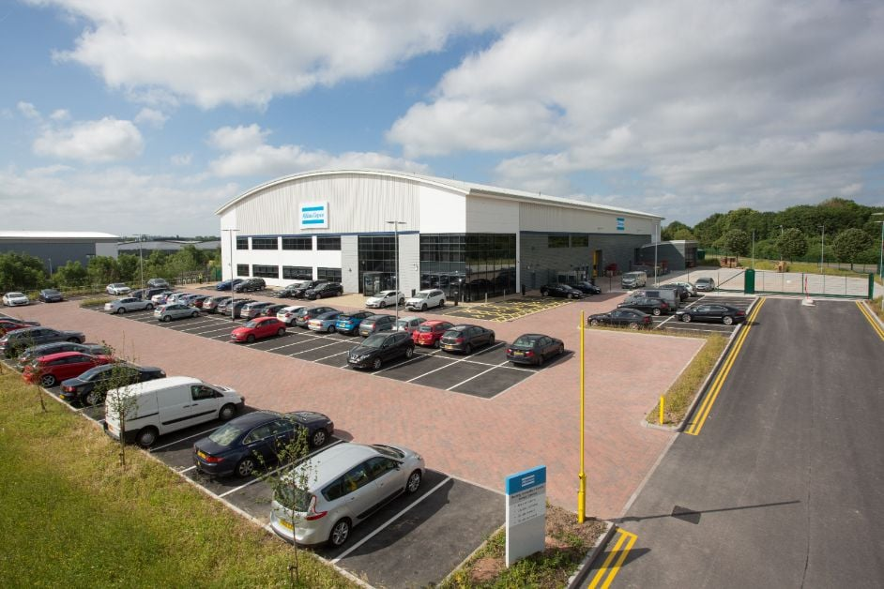

Product Manager Internship at Atlas Copco
Yash Malhotra
BEng Manufacturing Engineering
24 June 2024 – 24 July 2025

Slide 2
My role at a glance
WHERE
Atlas Copco Tools & Industrial Assembly Solutions (ACTIAS), Wolverhampton Customer Centre
WHAT
Product Manager Intern, taking direction from several managers
PRODUCTS
ALTURE: a data-driven service that optimises maintenance. TechCover: a software support contract.
Three starting objectives
Build a clear DDS sales process with case studies and a technical feature pack
1
Raise ALTURE visibility through social media and marketing
2
Deliver market-leading customer demos using every tool available
3

Slide 3
Making ALTURE easier to sell
What I found
What I did
What happened
Customers worried about ALTURE’s IT security
Sales team unclear on what it offered
UK buyers needed face-to-face contact, not just LinkedIn
Interviewed marketing and the Global Product Manager
Pulled scattered material into one sales presentation
Built an awareness strategy and presented it at exhibitions
1 → 7
customers connected to ALTURE by Feb 2025
I also led the ALTURE review meetings and reported progress to the Service Team.

Slide 4
What is ALTURE?
Tightening tools
ALTURE
Insights
Action
Every tightening is recorded
Data-driven maintenance service
Tool health and trends
Fix it before it fails
Less downtime
Full traceability
Security-ready
Maintenance when needed, not by calendar
Results tied to every joint
IT security documentation included

Slide 5
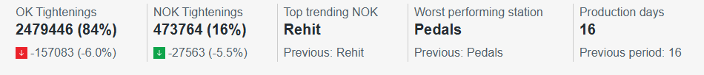
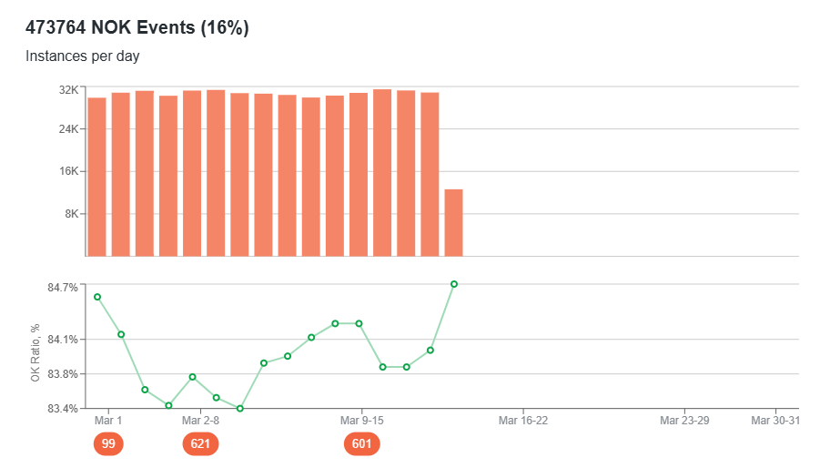
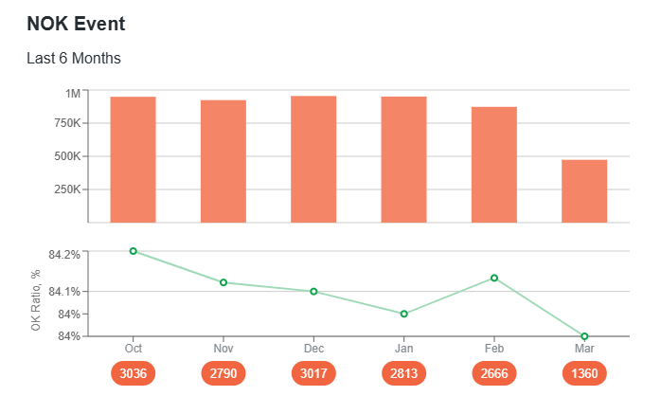
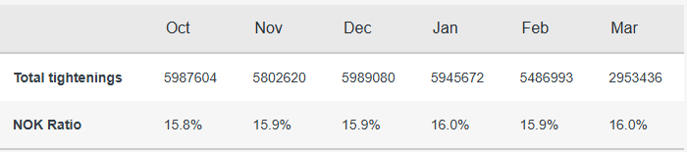
What is ALTURE?

Slide 6
ALTURE in action: aerospace example
CATEGORY A: HIGH RISK
A tool drifts out of tolerance
1
2
ALTURE flags the trend early
Engine casing flange
3
Serviced before rejects hit the build
VDI/VDE 2862 risk categories (A = danger to life and limb)
A
High risk
B
Medium risk
C
Low risk
Illustrative example, not a Rolls-Royce process. The real category would follow the customer’s own standards.

Slide 7
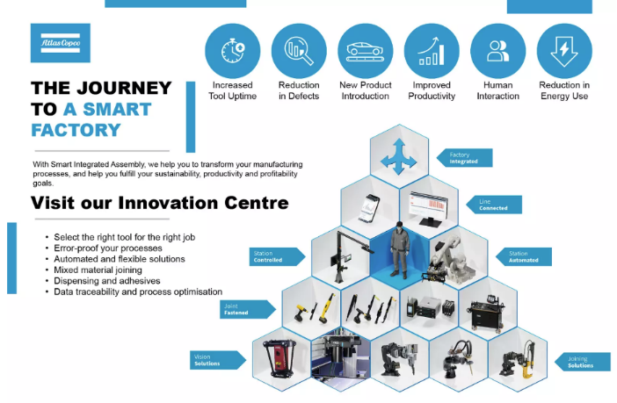
Presenting and representing the business
Sep 2024
Led my first ILS demo at a Milton Keynes exhibition, learning only from watching live demos
2 Oct 2024
Condensed a 4-hour ecosystem demo into 30 minutes for a new distributor
30–31 Oct
Presented ALTURE at Advanced Engineering (NEC) and helped win Best Stand
29 Nov
Gave a 5-minute ALTURE pitch at the York company event and drove the demo kit there
The SMART Factory ecosystem I demonstrated
Best Stand of the Year
Advanced Engineering Exhibition
18 Mar 2025
Ran the ILS demo at University College Birmingham’s VIP event

Slide 8
When things didn’t go to plan
McLaren: a partner not seeing value
UCB: a recurring fault before a VIP event
CHALLENGE
They expected ALTURE to do things it wasn’t designed for.
WHAT I DID
Visited on site, brought in global support and found a recent tightening example for their KPI review.
TAKEAWAY
We’d focused on getting customers connected, not on life after connection.
CHALLENGE
A persistent fault during our SMART Factory install.
WHAT I DID
Researched with global managers, applied a temporary fix, then traced it to the server/ethernet.
TAKEAWAY
The fix held on the day; I learned to troubleshoot under pressure.

Slide 9
Taking on TechCover
1
2
3
4
5
31 Jan
14 Feb
Apr–May
12 Jun
Jul
Joined the team and researched how TechCover works
Presented my research and gathered team feedback
Analysed customer data for those repeatedly helped without a contract
Helped brief Service Sales on TechCover
Simplified the support flowchart and new ways to log enquiries
Same playbook as ALTURE: use customer data to pick targets, then educate the sales team.

Slide 10
What I bring to my next role
Communication
Initiative
Presentation skills noticeably stronger by my six-month review, from nervous to leading demos.
Reached out across teams, led review meetings and took on TechCover alongside ALTURE.
Adaptability
Proactive follow-up
Handled live software faults, late van deliveries and shifting priorities.
Learned to ask for support early and chase colleagues until tasks move.

