Slide 1

BLUESTOCK FINTECH | INTERNSHIP CAPSTONE PROJECT
Mutual Fund Performance Analytics
and Investor Insights
using Python, SQL and Power BI
Prepared By: Yash Mahajan
B.Tech Computer Engineering • PCCOE • Academic Year 2026

Slide 2





INTRODUCTION
Project Overview
Developed an end-to-end Mutual Fund Analytics Platform using Python, SQLite, SQL, Jupyter Notebook and Power BI.
Processed 16 datasets including 10 primary mutual fund datasets and 6 live NAV datasets.
Analysed 46,000 historical NAV records, 32,778 investor transactions and 40 mutual fund schemes.
Automated ETL, database creation, financial analytics and dashboard reporting.
Delivered actionable business insights through interactive dashboards.
WORKFLOW
Raw Data
ETL
Analytics
Dashboard
INSIGHT The project transforms raw financial data into meaningful investment insights through an automated analytics workflow.
Mutual Fund Performance Analytics | Yash Mahajan, PCCOE | 2026
02

Slide 3




METHODOLOGY
Project Workflow
Raw Data
Imported and validated mutual fund datasets.
Cleaned missing values and standardized data.
Stored cleaned data in SQLite.
Performed EDA, Performance Analytics and Advanced Analytics.
Built an interactive Power BI dashboard.
01
ETL
02
SQLite
03
EDA
04
Performance Analytics
05
Advanced Analytics
06
Power BI
07
Mutual Fund Performance Analytics | Yash Mahajan, PCCOE | 2026
03

Slide 4




DATA FOUNDATION
Dataset Description
Fund Master & Scheme Performance Datasets covering 40 mutual fund schemes.
40
Fund Schemes
NAV Records 46,000 NAV records used for return calculations.
46,000
Investor Transactions 32,778 transactions used for behavioural analysis.
NAV Records
Industry Datasets AUM, SIP inflows, category inflows and folios.
32,778
Transactions
Portfolio & Live NAV Portfolio Holdings and Live NAV for portfolio analysis.
16
INSIGHT Combining market data and investor data enables comprehensive financial analysis.
Datasets Used
Mutual Fund Performance Analytics | Yash Mahajan, PCCOE | 2026
04

Slide 5




TOOLS & PLATFORMS
Technology Stack
Python, Pandas and NumPy for ETL and analytics.
SQLite and SQL for structured data storage.
Jupyter Notebook and Matplotlib for analysis.
Power BI for dashboards and visualization.
Git, GitHub and VS Code for development.
Python
SQL / SQLite
Jupyter Notebook
Power BI
Git & GitHub
VS Code
Mutual Fund Performance Analytics | Yash Mahajan, PCCOE | 2026
05

Slide 6



ANALYTICS ENGINE
Performance Analytics
Calculated Daily Returns using 46,000 NAV observations.
Computed CAGR, Alpha and Beta.
Calculated Sharpe Ratio, Sortino Ratio and Maximum Drawdown.
Generated fund_scorecard.csv and alpha_beta.csv.
Compared funds using return and risk metrics.
PERFORMANCE HIGHLIGHTS
23.80%
7.68
Highest 5-Year CAGR
Highest Sharpe Ratio
1.25
-33.50%
Average Alpha
Lowest Max Drawdown
INSIGHT Risk-adjusted return metrics reveal fund quality that raw returns alone cannot capture.
Mutual Fund Performance Analytics | Yash Mahajan, PCCOE | 2026
06

Slide 7




DEEPER ANALYSIS
Advanced Analytics
Historical VaR (95%) and CVaR — Quantifies downside risk exposure for each scheme.
Rolling 90-Day Sharpe Ratio — Tracks risk-adjusted performance stability over time.
Investor Cohort Analysis — Groups investors by behaviour and investment horizon.
SIP Continuity Analysis — Measures consistency of systematic investment plans.
Fund Recommendation & Sector HHI — Suggests funds and measures sector concentration.
INSIGHT Advanced analytics provide deeper understanding of investment risk and investor behaviour.
Mutual Fund Performance Analytics | Yash Mahajan, PCCOE | 2026
07

Slide 8

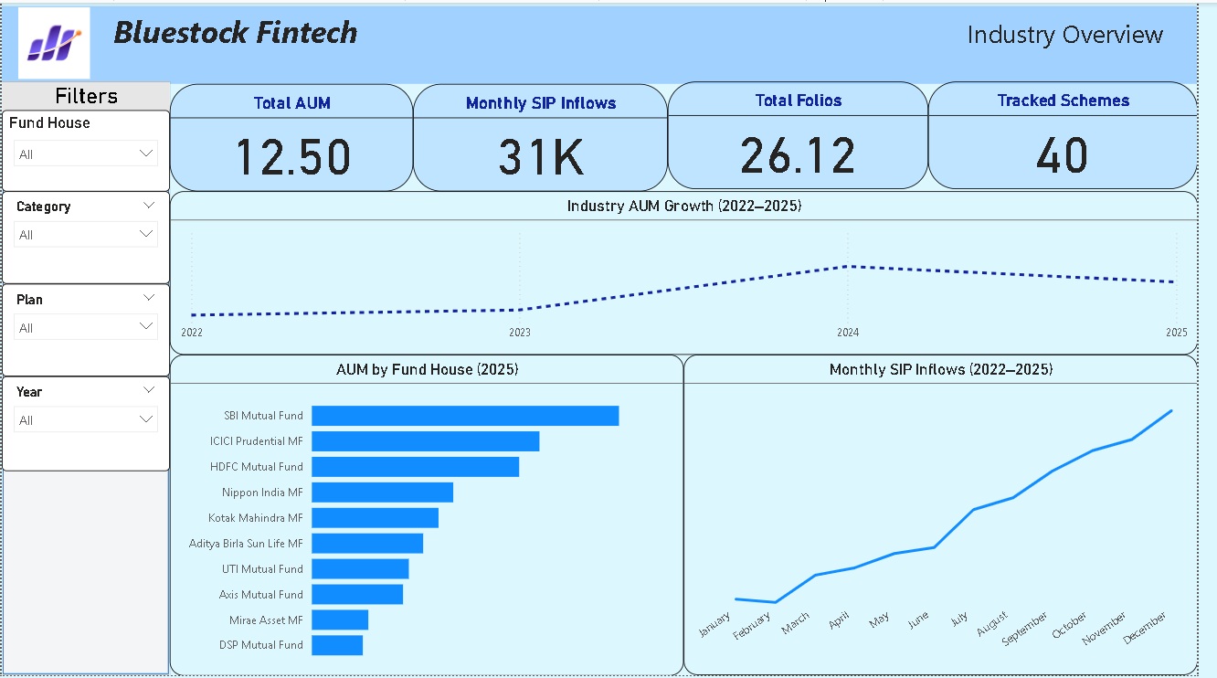
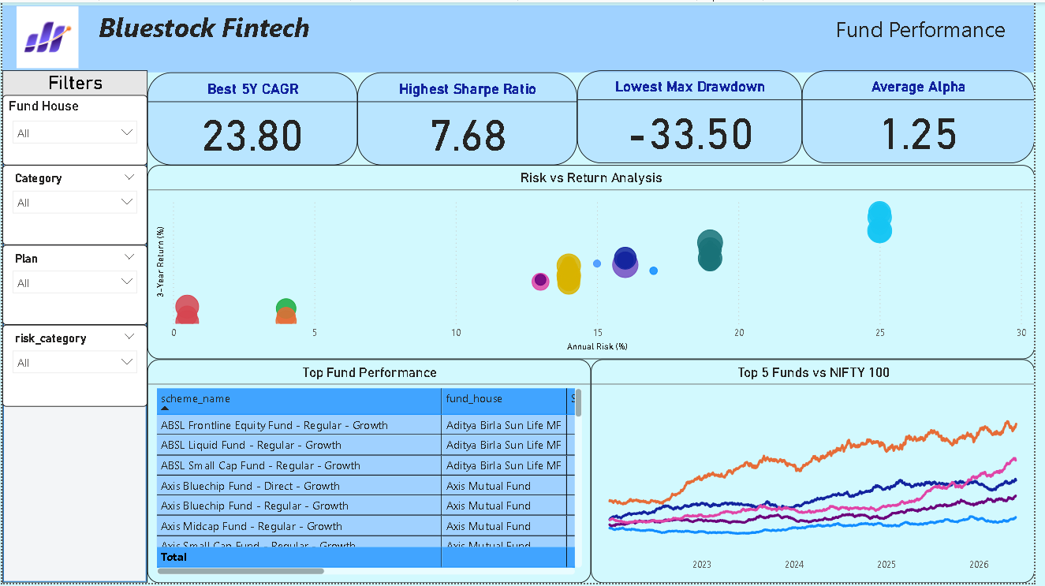
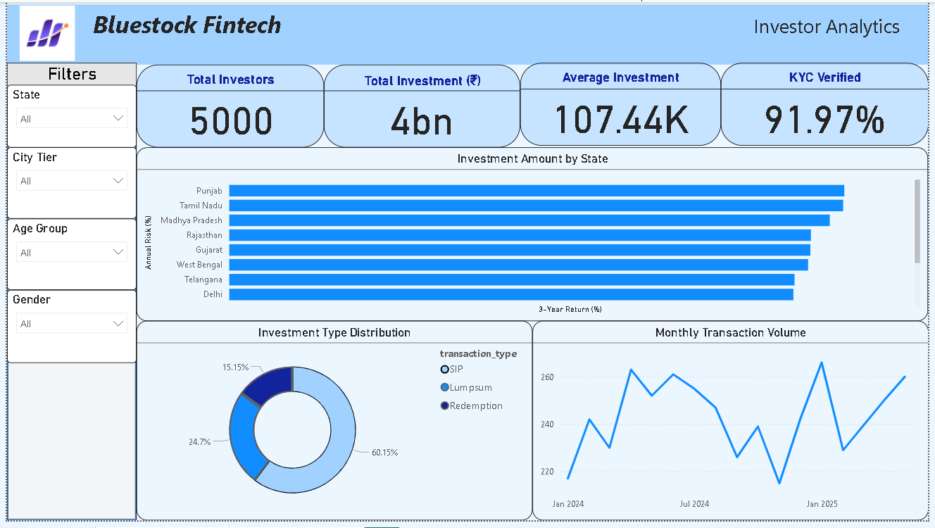
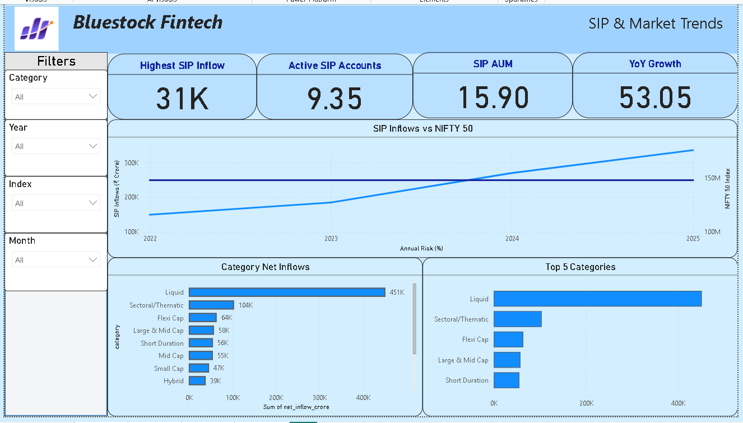
VISUALIZATION LAYER
Power BI Dashboard
Industry Overview
Fund Performance
Investor Analytics
SIP & Market Trends
Interactive Slicers
Industry Overview
Fund Performance
Investor Analytics
SIP & Market Trends
Mutual Fund Performance Analytics | Yash Mahajan, PCCOE | 2026
08

Slide 9
OUTCOMES
Results & Key Findings
46,000
32,778
₹31K Cr
26.12 Cr
NAV Records Processed
Investor Transactions
Monthly SIP Inflows
Industry Folios
Highest 5-Year CAGR: 23.80%
Highest Sharpe Ratio: 7.68
INSIGHT Risk-adjusted metrics provide better fund comparison than returns alone.
INSIGHT Retail participation continues to grow through SIP investments.
Mutual Fund Performance Analytics | Yash Mahajan, PCCOE | 2026
09

Slide 10


PROBLEM SOLVING
Challenges
Challenge
Solution
Multiple datasets with different formats
Standardized schema mapping and automated format converters during ETL.
Missing values and inconsistent records
Applied validation rules and targeted imputation to clean the data.
Financial metric implementation
Built custom Python functions validated against industry-standard formulas.
SQLite integration
Designed a normalized relational schema for efficient, reliable querying.
Dashboard optimization
Optimized DAX measures and used aggregated tables for faster load times.
Mutual Fund Performance Analytics | Yash Mahajan, PCCOE | 2026
10

Slide 11

WHAT'S NEXT
Future Scope
Streamlit Web Application for interactive user access.
Automated ETL pipeline for continuous data refresh.
Real-time NAV updates from live market feeds.
Monte Carlo Simulation for scenario-based forecasting.
Markowitz Portfolio Optimization for allocation strategy.
01
02
03
04
05
Streamlit App
Automated ETL
Real-Time NAV
Monte Carlo
Portfolio Optimization
Mutual Fund Performance Analytics | Yash Mahajan, PCCOE | 2026
11

Slide 12

SUMMARY
Conclusion
Successfully built a complete ETL to SQLite to Analytics to Power BI workflow.
Analysed 46,000 NAV records, 32,778 investor transactions and 40 mutual fund schemes.
Implemented financial metrics and advanced analytics.
Developed an interactive four-page dashboard.
Demonstrated practical application of data engineering and financial analytics.
THANK YOU
Questions? Happy to discuss the methodology, metrics or dashboard in detail.

