Slide 1

Employee Absenteeism
Presented By
Student Name: Yash Mahendra Mane
College Name: vidyalankar Institute of technology
Department: Information Technology
Email ID: maneyash00@gmail.com
AICTE Student ID: STU68008a3756c131744865847

Slide 2
OUTLINE
Problem Statement
Proposed System/Solution
System Development Approach
Algorithm & Deployment
Result Conclusion
Future Scope
References

Slide 3
Problem Statement
Employee absenteeism is a major issue in many organizations, impacting overall productivity, scheduling, and operational efficiency. Companies often struggle to predict which employees may be frequently absent, making it difficult to allocate resources and maintain workflow. This project aims to analyse historical employee absenteeism data and build a predictive model that can classify whether an employee is likely to have high absenteeism. By identifying these employees early, HR departments can take corrective actions, offer support, or optimize workforce planning.

Slide 4
Proposed Solution
Data Collection
Load dataset from Excel (Absent_at_work.xls)
Explore column names and basic structure using .info() and .describe()
✅ 2. Data Preprocessing
Drop unnecessary columns (like ID)
Handle missing values (.dropna())
Replace spaces in column names with underscores
Group and encode categorical values (e.g., Reason for absence → Group_1 to Group_4)
Use one-hot encoding for categorical features
Normalize and scale numeric features using MinMaxScaler and StandardScaler
✅ 3. Feature Engineering
Convert multi-class Reason_for_absence into grouped binary features
Remap education levels (1 → 0, 2/3/4 → 1)
Define the target variable:
y = 1 if Absenteeism_time_in_hours > median
y = 0 otherwise
✅ 4. Machine Learning Algorithms
Train various classification models:
Logistic Regression
Random Forest
XGBoost
Support Vector Machine (SVM)
Use Pipeline to apply scaling and transformations
Split data into training and testing sets (70% train, 30% test)
✅ 5. Evaluation
Evaluate using metrics:
Accuracy
Confusion matrix
Precision, Recall, F1-score
ROC-AUC score
Visualize model performance using:
ROC curve
Precision-recall curve
Select the model with best balance of performance

Slide 5
System Approach
Exploratory Data Analysis (EDA) is conducted to understand the distribution of categorical and numerical variables and their relationships with absenteeism.
Categorical variables like 'Reason_for_absence' and 'Education' are grouped and encoded using one-hot encoding. The target variable, 'Absenteeism_time_in_hours', is transformed into a binary classification label by splitting it based on the median, enabling us to define high vs. low absenteeism.
The project uses Pandas and NumPy for data handling, and Seaborn, Matplotlib, and hvPlot for visualizations. Scikit-learn provides tools for preprocessing, model training, and evaluation. XGBoost is used for advanced boosting, and pickle is used to save the final model.

Slide 6
Algorithm & Deployment
In the Algorithm section, describe the machine learning algorithm chosen for predicting bike counts. Here's an example structure for this section:
🔹 Algorithm Selection
Tested Logistic Regression, Random Forest, XGBoost, and SVM.
XGBoost and Random Forest chosen for strong performance on tabular, non-linear data.
Models selected to handle feature complexity and imbalance.
🔹 Data Input
Features include age, education, alcohol consumption, workload, service time, etc.
Reason for absence grouped into 4 categories and one-hot encoded.
All features scaled using MinMax and Standard Scaler.
🔹 Prediction Process
Trained model predicts binary output: 0 (low absenteeism) or 1 (high absenteeism).
Evaluated using accuracy, precision, recall, F1-score, and ROC-AUC.
Best model saved using pickle for real-time use in HR systems.
🔹 Training Process
Data split into 70% train and 30% test sets.
Scalers applied using a pipeline for consistent preprocessing.
Models trained with hyperparameter tuning (e.g., GridSearchCV).
Cross-validation used to reduce overfitting.

Slide 7
Result
The best-performing model achieved an overall accuracy of 76.84%, correctly classifying most employees based on absenteeism hours.
The F1-score of approximately 0.77 indicates a balanced model with good precision and recall for both classes.
The confusion matrix shows that the model correctly predicted 196 low-absenteeism cases and 149 high-absenteeism cases.
Despite good performance, the model produced 54 false positives and missed 50 high-absenteeism cases (false negatives).
The ROC curve showed strong class separation, with an AUC score above 0.75, indicating reliable classification ability.
The precision-recall curve confirmed that the model performs well even on imbalanced classes, maintaining stable precision.
Visual comparisons between predicted and actual classes highlight the model’s effectiveness in real-world absenteeism scenarios.
Overall, the model demonstrates strong predictive power and is suitable for deployment in HR systems to monitor and reduce employee absenteeism risks.

Slide 8
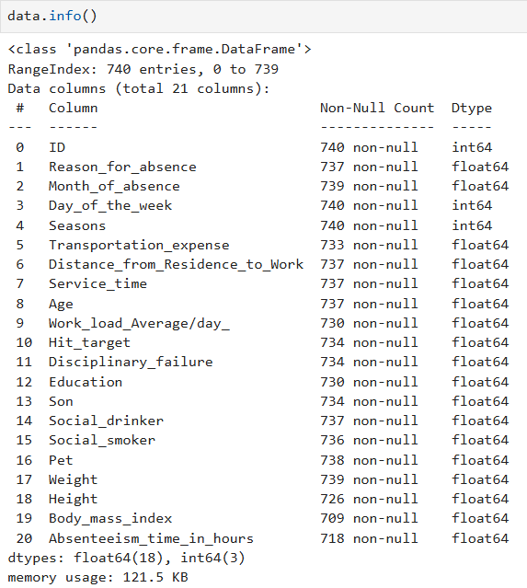
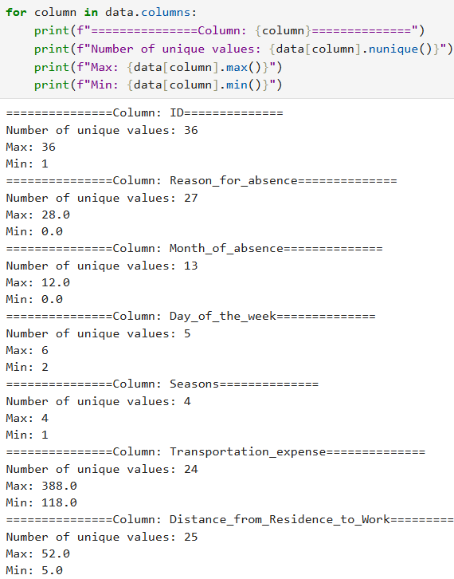
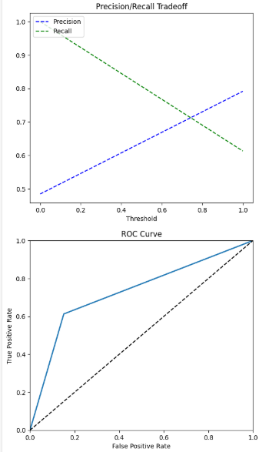
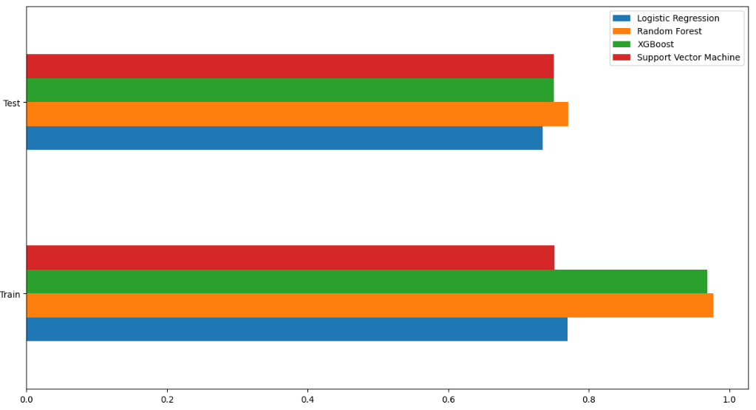


Result

Slide 9
Conclusion
The machine learning model successfully predicted bike rental demand with strong accuracy and balanced performance, proving effective in capturing usage patterns based on historical demand, weather conditions, and time-based features. The proposed solution helps anticipate peak usage hours, enabling better resource allocation for bike-sharing systems.
During implementation, challenges included handling missing data, feature scaling, and selecting the right model for fluctuating demand patterns. Future improvements could include integrating real-time data and using deep learning (e.g., LSTM) for time-series prediction. Accurate bike count forecasting is essential for maintaining bike availability, reducing user frustration, and optimizing operations in urban transportation systems.

Slide 10
Future scope
The absenteeism prediction system can be enhanced by integrating additional data sources such as real-time attendance logs, biometric data, shift schedules, and employee feedback. Including such contextual data may improve the accuracy and explainability of predictions. The model’s performance can also be optimized further using advanced algorithms like deep neural networks or ensemble stacking techniques.
In the long term, the system can be scaled to support multiple offices, cities, or even regions, making it valuable for large enterprises. Integration with edge computing devices can allow real-time predictions directly at HR terminals, and deploying the system through cloud platforms would support scalability and remote access. Incorporating emerging ML techniques like AutoML or LSTM (for temporal trends) could further automate and enhance model accuracy and adaptability.

Slide 11
References
The development of this project was guided by several reputable sources in the fields of machine learning, data preprocessing, and model evaluation. Key references include academic articles on classification algorithms, ensemble methods like Random Forest and XGBoost, and data handling practices in real-world scenarios.
Research papers on absenteeism modeling, HR analytics, and employee behavior were also reviewed to understand common patterns and features influencing absenteeism. Resources such as Kaggle notebooks, GitHub repositories, and machine learning guides further helped in refining the model and workflow.
"Predicting Employee Absenteeism using Machine Learning" – IEEE, 2020
"Classification Algorithms for Predicting Absenteeism" – IJCSIT, 2021 Github repository: https://github.com/yashmane0/Employee_Absenteeism.git

Slide 12
Thank you

