Slide 1
Linking of ATP-binding cassette (ABC) transporters and lipid transfer proteins (LTPs) in Arabidopsis
Yashwanth Manne
CMSE 410

Slide 2
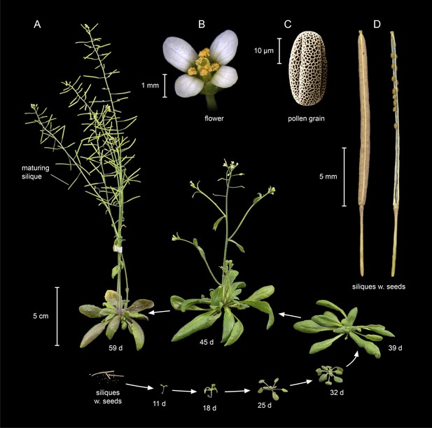
Arabidopsis thaliana
The principal genetic model and standard reference organism in plant and crop science.
Short generation time
Small size
Prolific seed production
Small, genetically tractable genome
Krämer, Ute. “Planting Molecular Functions in an Ecological Context with Arabidopsis Thaliana.” ELife, vol. 4, 25 Mar. 2015, doi:10.7554/elife.06100.
Notes:
https://elifesciences.org/articles/06100Krämer, Ute. “Planting Molecular Functions in an Ecological Context with Arabidopsis Thaliana.” ELife, vol. 4, 25 Mar. 2015, doi:10.7554/elife.06100.
https://seedgenes.org/publications/Koornneef_Meinke_2010.pdf
https://www.nsf.gov/pubs/2002/bio0202/model.htm

Slide 3
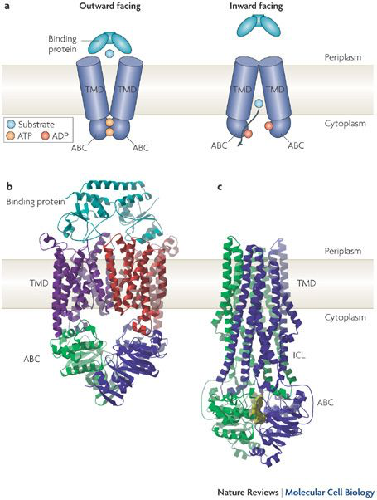
ATP-Binding Cassette (ABC) Transporters
One of largest protein families
2 transmembrane (TMD) and 2 cytosolic domains/nucleotide-binding domains (NBD)
Most eukaryotic ABCs transport the substrate at NBD
Plant ABCs can act in the opposite direction
Notes:
https://www.nature.com/articles/nrm2646

Slide 4
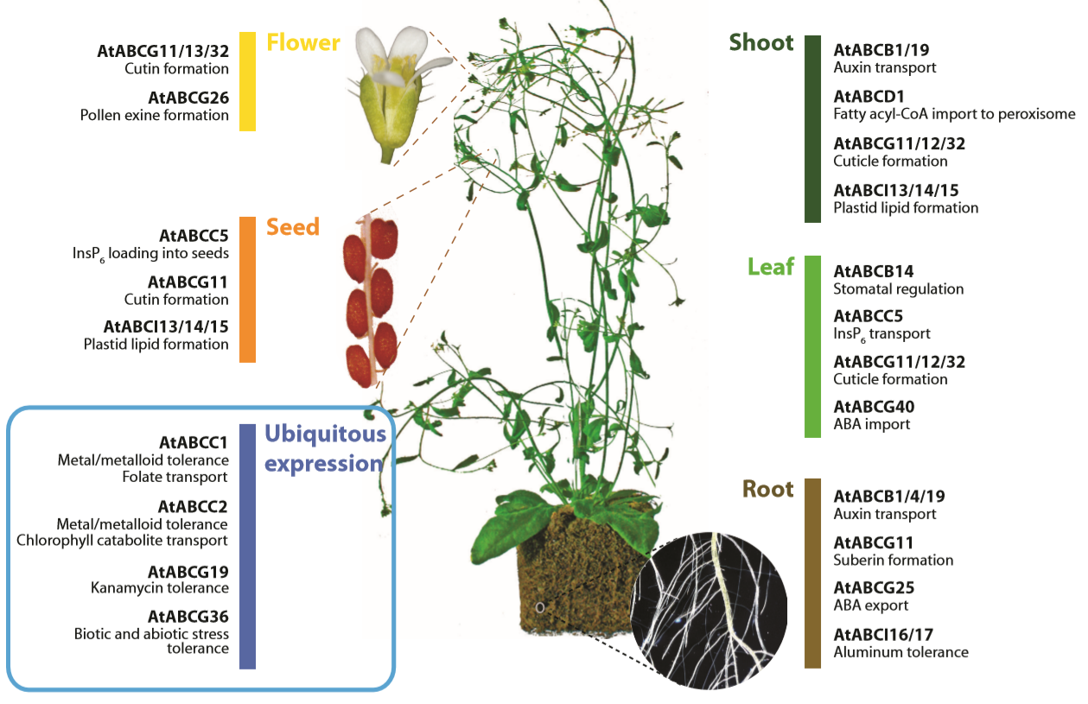
ABC Transporters In Arabidopsis
Localized to plasma, tonoplast, chloroplasts, mitochondria, peroxisomes
Only 22 of 130 have been functionally analyzed
Detoxification
Organ growth
Plant nutrition
Plant development
Abiotic stress response
Pathogen resistance
Plant/environment interaction
Pathogen response
Surface lipid deposition
Phytate accumulation in seeds
Transport of phytohormones auxin and abscisic acid
Kang, Joohyun, et al. “Plant ABC Transporters.” The Arabidopsis Book, vol. 9, 6 Dec. 2011, doi:10.1199/tab.0153.

Slide 5
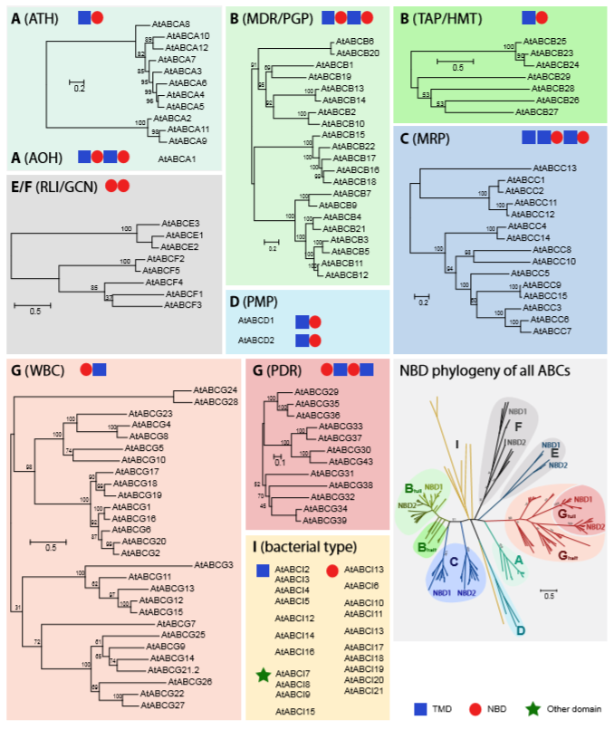
ABC in Arabidopsis
Consensus amino acid sequence:
[LIVMFY]S[SG]GX3[RKA][LIVMYA]X[LIVFM][AG]
Subunit encoding varies:
A: 1 full, 11 half
B: 21 full, 11 half
C: all full
D: 1 full, 1 half
E&F: soluble (lack any TMDs)
G: 15 full, 18 half
I: target chloroplast/mitochondria
2 are from the mitochondrial genome
Kang, Joohyun, et al. “Plant ABC Transporters.” The Arabidopsis Book, vol. 9, 6 Dec. 2011, doi:10.1199/tab.0153.
Notes:
All by individual genes (ABCI subfamily)
2 genes each encoding (one NBD and one TMD) that form heterodimers
1 gene encoding one NBD and one TMD that form homodimers
1 gene encoding all

Slide 6
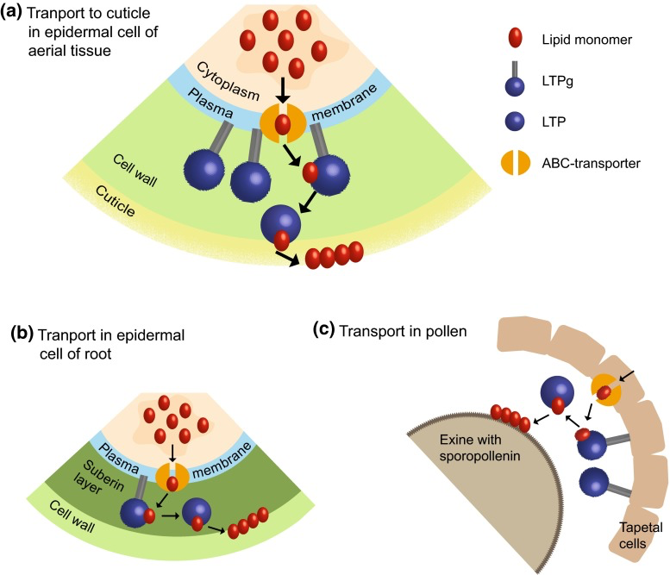
Lipid Transfer Proteins (LTPs)
Edqvist, Johan, et al. “Plant Lipid Transfer Proteins: Are We Finally Closing in on the Roles of These Enigmatic Proteins?” Journal of Lipid Research, vol. 59, no. 8, 19 Mar. 2018, pp. 1374–1382., doi:10.1194/jlr.r083139.
Small, compact proteins folded around tunnel-like hydrophobic cavity
Encoded by large gene families in all land plants but not algae or other organisms
Key for the colonization of land
Abundantly expressed in most plant tissues
Localized to extracellular spaces outside the plasma membrane
Evidence for transfer and deposition of monomers required for:
Assembly of water-proof lipid barriers
Signaling during pathogen attacks
Likely facilitates transfer of barrier materials and adhesion between barriers and extracellular materials.
Salminen, Tiina A., et al. “Lipid Transfer Proteins: Classification, Nomenclature, Structure, and Function.” Planta, vol. 244, no. 5, 25 Aug. 2016, pp. 971–997., doi:10.1007/s00425-016-2585-4.
Notes:
Cavity makes them suitable for binding and transporting various lipids.
https://www.nature.com/articles/s41580-018-0071-5:
Only a minority of lipids achieve their final intracellular distribution through transport by vesicles. Instead, the bulk of lipid traffic is mediated by a large group of lipid transfer proteins (LTPs),
https://www.ncbi.nlm.nih.gov/pmc/articles/PMC5052319/

Slide 7
Problem
ABC transporters often work in parallel with LTPs that "pick up" the compound from the ABC transporters.
Identification of Involved Genes
Branching point for further research of cellular mechanisms of plants
Pull-down assays or knockout studies
Aid in production of high-value plant products
Co-expression data with Pearson coefficient to link genes
Rule out spurious relations by cross-referencing protein-protein interactions
Notes:
ABC transporters often work in parallel with LTPs that "pick up" the compound from the ABC transporters. Through this project, I hope to understand possible genes involved in the transport of small hydrophobic particles and the LTPs’ and ABC transporters’ role in this.

Slide 8
My Goal:
Link ATP-binding cassette (ABC) transporters and lipid transfer proteins (LTPs) in arabidopsis plants.

Slide 9
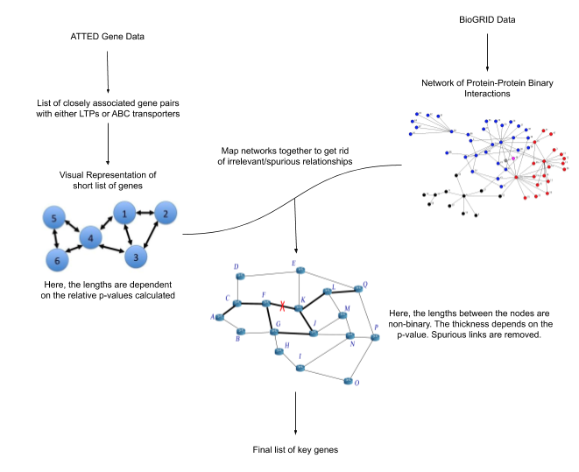
My Approach
Obtain Arabidopsis data from ATTED & BioGRID
Remove excess annotations
Load data using Python’s Jupyter Notebooks and Pandas, OS libraries
Plot preliminary figures using Matplotlib, Numpy, and Networkx libraries
Create weighted graph using Networkx
Use Networkx’s shortest_path algorithm to get all gene interactions less than cutoff
Compare to list of top 50 ABC-LTP gene pairs with lowest MRR from ATTED data
Compare if any pairs have studies done on them
Attempt to recreate with tissue-specificity

Slide 10
Method/Software
Pandas read_csv(‘’,sep =’\’)
I: tab-separated textfile
O: Pandas DataFrame
Networkx shortest_path_length()
I: Graph, source node, target node, weight
O: length of shortest path between source and target
Networkx all_pairs_shortest_path_length()
I: Graph, cutoff
O: dictionary keyed by pairs with shortest path length as key-value
Taxonomy Name/ID Status Report
I: Strings of names/ NCBI taxonomy ID
O: tab-separated text file with ‘code’, ‘taxid’, ‘primary taxid’, and ‘taxname’
Networkx from_pandas_edgelist()
I: DataFrame, source, target
O: Networkx graph

Slide 11
Data
Notes:
BioGRID), which is a curated database of genetic, protein, and chemical interactions as well as post-translational modifications. ATTED-II is a plant coexpression database created from numerous DNA microarray analysis studies.

Slide 12
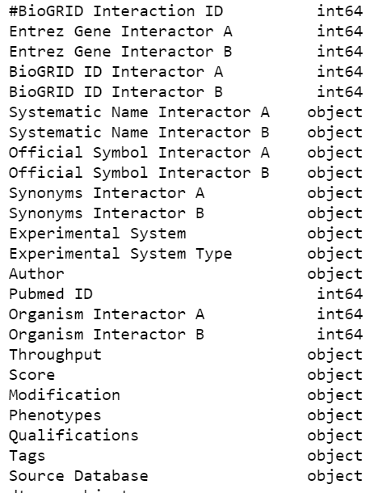
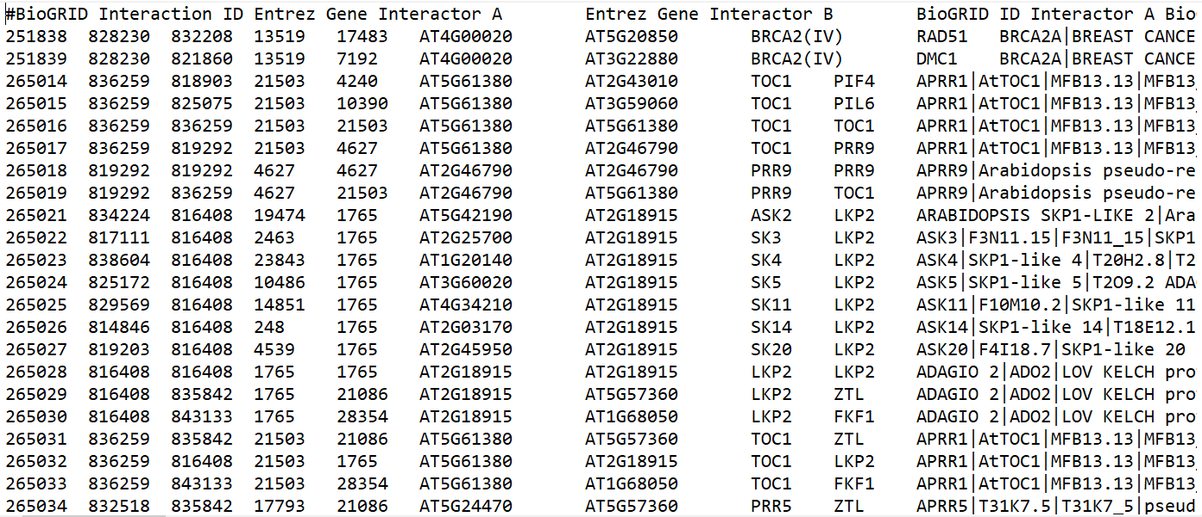
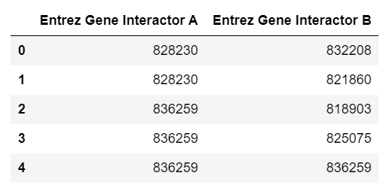
BioGRID Data
“BIOGRID-ORGANISM-Arabidopsis_thaliana_Columbia-3.5.181.tab2”
January 25, 2020
Notes:
BioGRID Interaction ID: A unique identifier for each interaction within the BioGRID database. Can be used to link to BioGRID interaction pages. For example: http://thebiogrid.org/interaction/616539
Entrez Gene ID for Interactor A: The identifier from the Entrez-Gene database that corresponds to Interactor A. If no Entrez Gene ID is available, this will be a “-”.
Entrez Gene ID for Interactor B: Same structure as column 2.
BioGRID ID for Interactor A: The identifier in the BioGRID database that corresponds to Interactor A. These identifiers are best used for creating links to the BioGRID from your own websites or applications. To link to a page within our site, simply append the URL: http://thebiogrid.org/ID/ to each ID. For example, http://thebiogrid.org/31623/.
BioGRID ID for Interactor B: Same structure as column 4.
Systematic name for Interactor A: A plain text systematic name if known for interactor A. Will be a “-” if no name is available.
Systematic name for Interactor B: Same structure as column 6.
Official symbol for Interactor A: A common gene name/official symbol for interactor A. Will be a “-” if no name is available.
Official symbol for Interactor B: Same structure as column 8.
Synonyms/Aliases for Interactor A: A “|” separated list of alternate identifiers for interactor A. Will be “-” if no aliases are available.
Synonyms/Aliases for Interactor B: Same stucture as column 10.
Experimental System Name: One of the many Experimental Evidence Codes supported by the BioGRID.
Experimental System Type: This will be either “physical” or “genetic” as a classification of the Experimental System Name.
Author: First author surname of the publication in which the interaction has been shown, optionally followed by additional indicators, e.g. Stephenson A (2005)
Pubmed ID: Pubmed ID of the publication in which the interaction has been shown.
Organism ID for Interactor A: This is the NCBI Taxonomy ID for Interactor A.
Organism ID for Interactor B: Same structure as 16.
Interaction Throughput: This will be either High Throughput, Low Throughput or Both (separated by “|”).
Quantitative Score: This will be a positive for negative value recorded by the original publication depicting P-Values, Confidence Score, SGA Score, etc. Will be “-” if no score is reported.
Post Translational Modification: For any Biochemical Activity experiments, this field will be filled with the associated post translational modification. Will be “-” if no modification is reported.
Phenotypes: If any phenotype info is recorded, it will be provided here separated by “|”. Each phenotype will be of the format []:. Note that the phenotype types and qualifiers are optional and will only be present where recorded. Phenotypes may also have multiple qualifiers in which case unique qualifiers will be separated by carat (^). If no phenotype information is available, this field will contain “-”.
Qualifications: If additional plain text information was recorded for an interaction, it will be listed with unique qualifiers separated by “|”. If no qualification is available, this field will contain “-”.
Tags: If an interaction has been tagged with additional classifications, they will be provided in this column separated by “|”. If no tag information is available, this field will contain “-”.
Source Database: This field will contain the name of the database in which this interaction was provided.

Slide 13
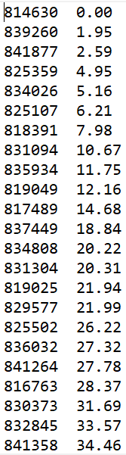
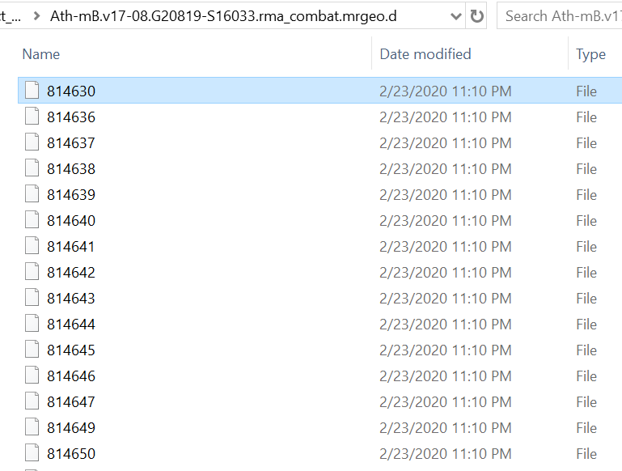
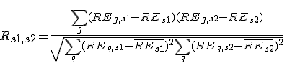






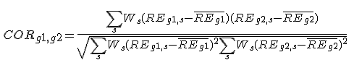
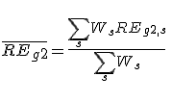

ATTED Data
Contains Entrez Gene ID and Mutual Rank of every gene to a given gene
“Ath-mB.v17-08.G20819-S16033.rma_combat.mrgeo.d”
October 31, 2017
Notes:
http://atted.jp/help/coex_cal.shtml
http://atted.jp/help/mr.shtml

Slide 14
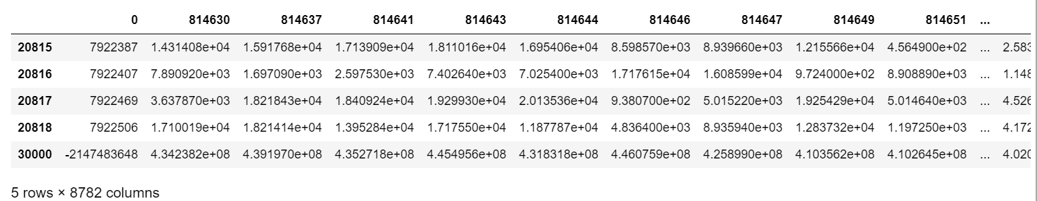
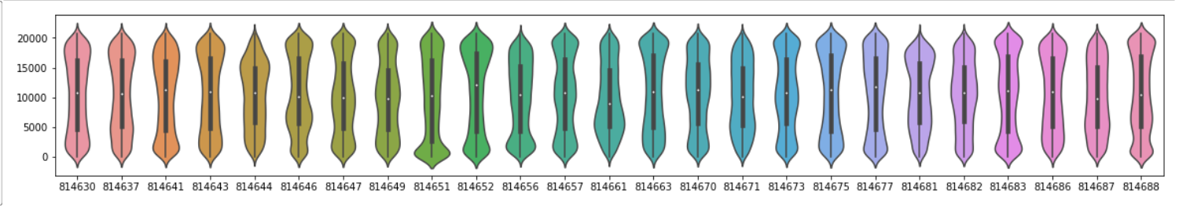
Overlapped Genes’ ATTED Data Compiled
Notes:
Last row shows sum of all MRs

Slide 15
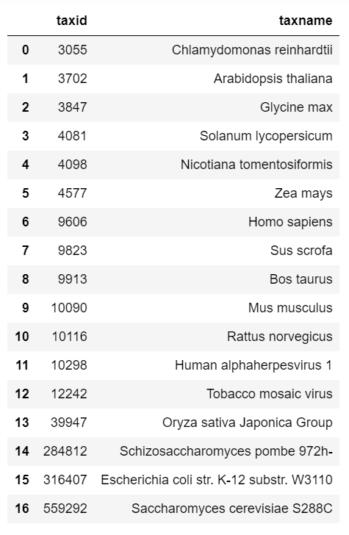
Data Description
Organisms present in BioGRID data (right)
56198 total interactions.
55814 Arabidopsis: Arabidopsis interactions
384 Arabidopsis: Other interactions
0 interactions that don't involve Arabidopsis
10550 unique genes in BioGRID
10367 genes with only Arabidopsis: Arabidopsis
20819 total genes in ATTED
8782 genes that are also present in BioGRID set
Missing Values:
BioGRID: some annotations missing
ATTED: none

Slide 16
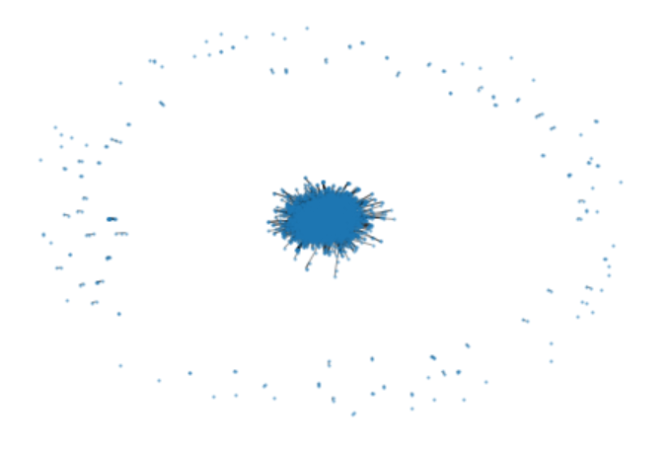
Interactions of BioGRID

Slide 17
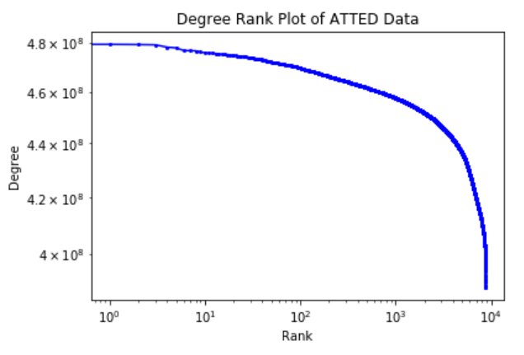

Slide 18
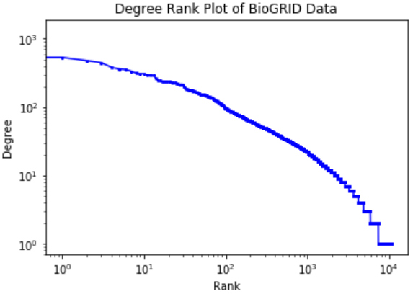

Slide 19
Toy Data
I made sure that anything I tried worked by splitting only the first 100 rows of the bioGRID data and first 100 files of the ATTED data.

Slide 20
Future
Learn some more networkx to try to get the shortest path algorithm to work
Figure out how to use ‘weights’ to map ATTED MR values to bioGRID network

