Slide 1


An Analysis of Nothing
Chandler Ault, Yamina Katariya, Yash Manne, Aditi Shrivastava
Notes:
Yash

Slide 2

Background and Use Case
Project : Web application/Dashboard
Explore and query dialogue snippets
Recommend episodes
Interactive visualization of character appearances, ratings, dialogue, etc.
Use Case: Descriptive Analytic Visualization
User selects episode of interest
Website returns dashboard of descriptive analytics
User filters or toggles fields of interest
Python: Simple web app development that supports interactive visualizations
Notes:
Aditi

Slide 3


Python Packages
Streamlit
Purpose:
Create custom web apps for ML and data science
Focus is on quick development
Authors:
Snowflake
Dash
Purpose:
Built on Plotly.js, React, and Flask
Create and customize ML and data science web apps with UI elements
Authors:
Plotly
Notes:
Aditi

Slide 4
Streamlit
Pros
Almost entirely in Python
Small learning curve + rapid development
Fully open-source
Supports all main Python plotting libraries
Can be deployed on ‘Streamlit Sharing’ platform + other options for free
Cons
Runs slower with larger datasets
Entire source code is re-run
Limited control of application layout
Works directly with script files - not notebooks
Notes:
Yam

Slide 5
Plotly | Dash
Pros
Huge design flexibility
Attributed to HTML and CSS code
Can create plots in other languages (R, Julia)
Scalable for larger datasets
Cons
Requires some knowledge of HTML, Javascript, and CSS
Large learning curve
Works directly with script files - not notebooks
Pushes users to use plotly for visualizations
Notes:
Yam

Slide 6
Streamlit
For project timeline - simplicity and faster development is preferred
Primarily uses Python
Large selection of visualization/plotting tools
Easy integration of ML episode prediction Python scripts
Notes:
Yash

Slide 7
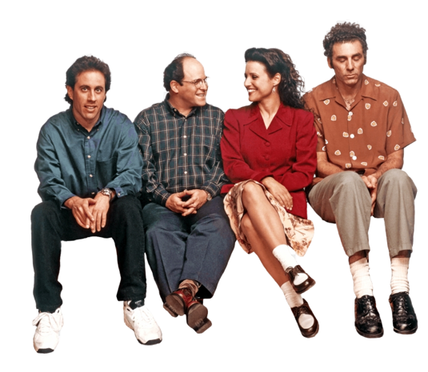
Remaining Concerns
Concerns:
Speed
Large dialogue dataset
Search /query of dialogue might be slow
Potential Workarounds:
Perform operations on subsets of the data
Watch out for:
Aesthetic/customization of application - look into HTML and CSS
Notes:
Chandler

Slide 8
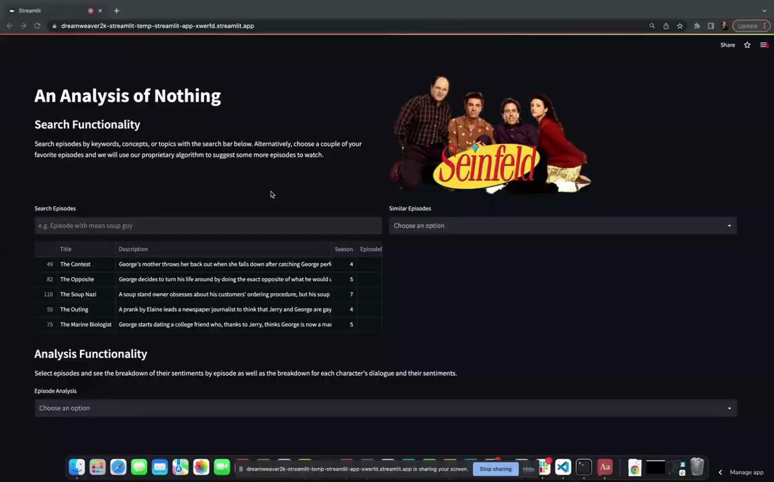
Package Demo
Notes:
Chandler

Slide 9

Package Demo

