Slide 1

A
Project
Presentation on
“Battery Monitoring System Using IoT”
Presented By
Group No. 52
BMHB03 : YASH GAJANAN MARKAD
BMHB04 : TIRTHRAJ HEMRAJ AVASTHI
BMHB16 : TEJAS DILIP KINGE
BMHB39 : DHEERAJ PRAMOD KHODKE
Under the Guidance of -:
Prof. Jitendra.S.Narkhede
Mechanical Engineering Department

Slide 2

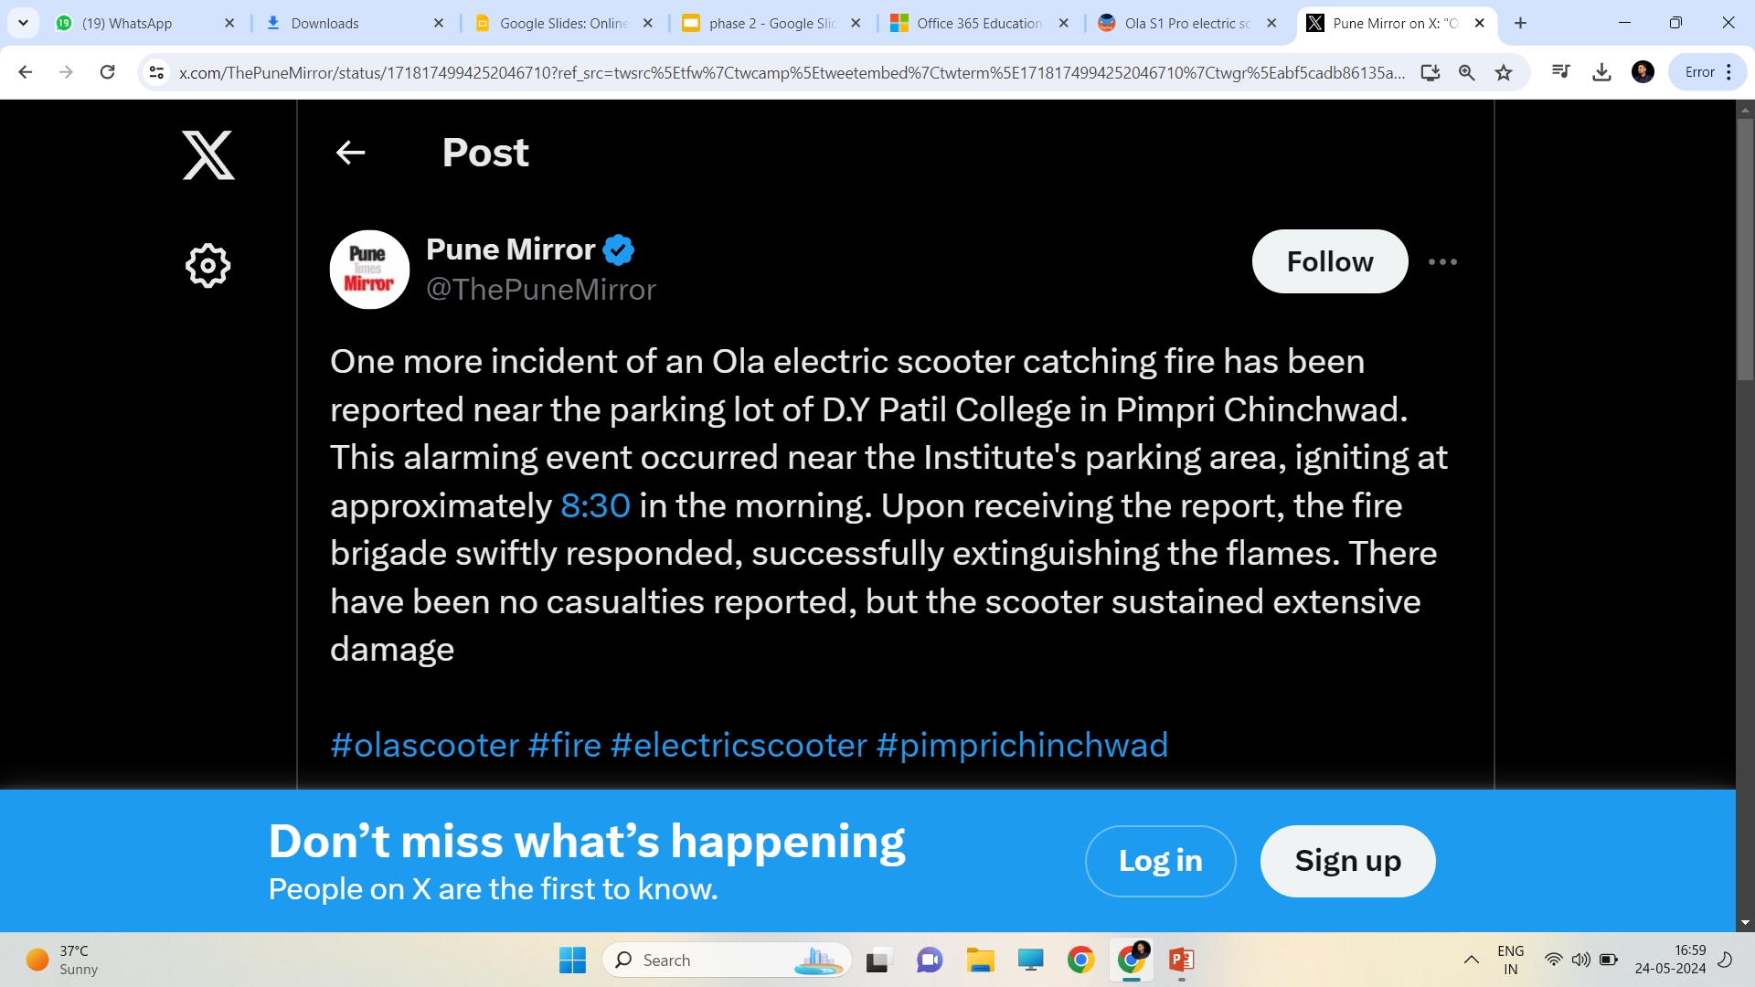

From Ola Electric to Okinawa scooters: Why electric vehicles have been catching fire in India ?

Slide 3
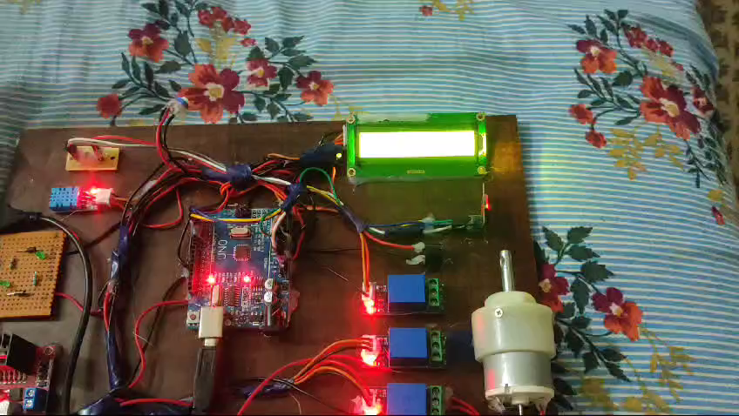
HARDWARE RESULTS

Slide 4
CONTENTS
Introduction
Component list
Block Diagram
Circuit Diagram
Hardware Results
Conclusion

Slide 5
INTRODUCTION
Battery Monitoring System (BMS) forms a crucial system component in various applications like electric vehicles (EV), hybrid electric vehicles (HEV), uninterrupted power supplies (UPS), telecommunications and so on. The accuracy of these systems has always been a point of discussion as they generally give an error of maximum 10% considering all the parameters together. Batteries are the heart of the automation system, and its applications are more in all the fields, where the electrical supply requires.The periodical monitoring/observations are required for battery source to provide continuous power to the load without any interruption.
This system uses IoT technology as a platform for monitoring and controlling automation. Battery voltage, load current, battery temperature level, charging relay status, discharging relay status, and Load ON/OFF status can be monitored wirelessly.

Slide 6
COMPONENT LIST
Atmega 328 smd controller
DHT11 module(Temperature/Humidity sensor)
Voltage Divider Module
10k potentiometer
Lithium-Ion Battery
Battery Cell Holder
BMS Module
LCD 16x2
Buzzer
DC Motor
1-channel Relay
IOT

Slide 7
BLOCK DIAGRAM
DHT11 Sensor
AT328
controller
LCD 16 x 2
Buzzer
10k POT
ESP-01
Voltage Divider
Relay
Motor
Power Supply
BMS
Battery
7

Slide 8
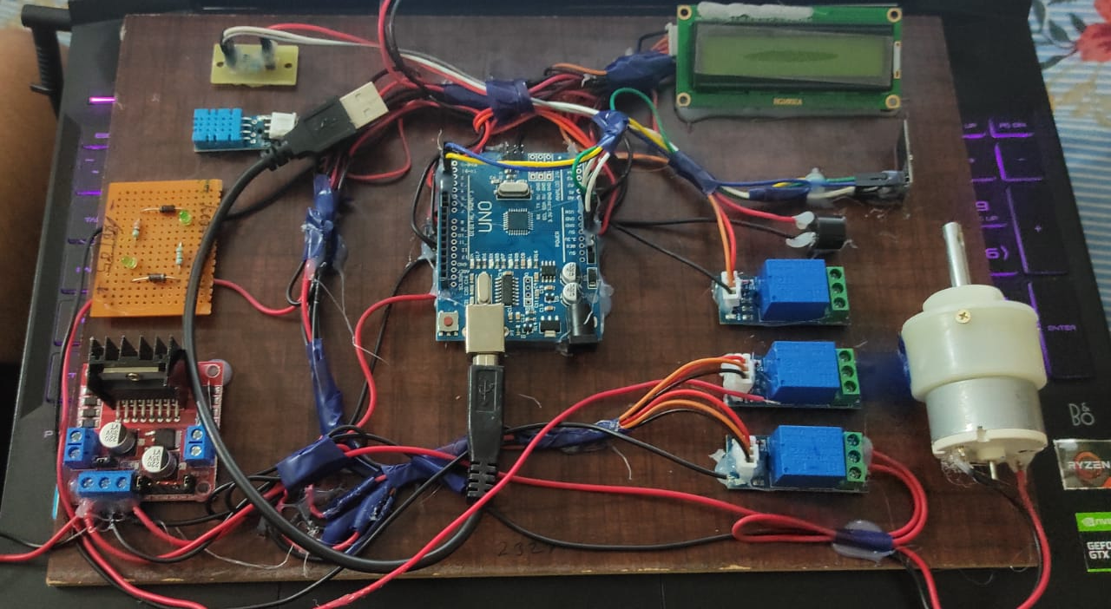
DHT11 module
DC Motor
Resistors
Buzzer
LCD 16x2
Atmega 328 smd controller
1-channel Relay
Motor Voltage divider module

Slide 9
CONCLUSION
Guarantees the security, dependability, and longevity of the battery pack.
Charge monitor and fire prevention.
Enhances the overall efficiency battery.
Deliver more accurate and timely data regarding the charge, health, and function of the battery pack.
In order to improve the features and capabilities of EV BMS more research and development is still possible.

Slide 10
THANK YOU...!!!

