Slide 1

End-to-End Data Pipeline: AdventureWorks Sales and Operations Analytics
Yashmeet Baid - 1RVU23CSE547
Akshata Athreya - 1RVU23CSE035
Tanisha Savitha Naik - 1RVU23CSE500
Kunal K - 1RVU23CSE229
RV University, Bangalore India.

Slide 2
Project Overview
This project implements an end-to-end Azure Data Engineering pipeline for the AdventureWorks dataset, simulating a real-world enterprise data workflow. It integrates multiple Azure services—Azure Data Factory (ADF), Azure Data Lake Storage Gen2, Azure Databricks, Azure Synapse Analytics, and Power BI—to enable seamless data ingestion, transformation, and visualization.
The pipeline automates data extraction from GitHub APIs, performs data cleansing and transformation using Apache Spark in Databricks, and loads the curated data into Azure Synapse Analytics for analytical reporting through Power BI dashboards.
Following the Medallion Architecture (Bronze–Silver–Gold), the system ensures scalability, automation, and maintainability, representing a complete cloud-based ETL/ELT solution aligned with modern data engineering best practices.

Slide 3
Dataset(s) details
Adventure Works Dataset
The Adventure Works dataset, sourced from Kaggle, represents a structured, real-world inspired business database designed for academic and analytical experimentation. It models the operations of a fictional manufacturing and retail company specializing in bicycles and related products. The dataset offers a clean relational structure suitable for research in data analytics, SQL querying, database design, and business intelligence.
Dataset Characteristics:
Total Tables: 10 relational tables
Data Domains Covered:
Customers
Products
Sales and Order Details
Employees
Territories and Geography
Schema Type: Normalized relational schema supporting referential integrity
https://www.kaggle.com/datasets/ukveteran/adventure-works

Slide 4
Literature Survey
Leveraging Azure Data Factory Pipelines For Efficient Data Refreshes In BI Applications: This paper examines how Azure Data Factory (ADF) pipelines can streamline data refresh processes in Business Intelligence (BI) applications by automating ingestion, transformation, and loading of data. It outlines best practices such as scheduling, performance monitoring, error handling, and scalability to support growing data demands. The results show improvements in data accuracy, refresh speed, and user satisfaction. Overall, the study demonstrates that ADF enhances agility and efficiency in BI workflows.
References: Banoth, D. N., Khan, I., Mohana, M., Dandu, K., Goel, P., Jain, A. & Shrivastav, A. (2022) ‘Leveraging Azure Data Factory Pipelines for Efficient Data Refreshes in BI Applications’, International Journal of General Engineering and Technology (IJGET), 11(2), pp. 35-62. Available at: https://www.researchgate.net/publication/390897435_Leveraging_Azure_Data_Factory_Pipelines_For_Efficient_Data_Refreshes_In_BI_Applications

Slide 5
Literature Survey Contd.
Optimizing data pipeline for data analytics:This thesis explores optimizing data pipeline architecture through a lakehouse approach, improving data management and analytics. Using AWS S3, dbt Cloud, and Snowflake, the AdventureWorks dataset is cleaned and preprocessed efficiently. The study examines orchestration, Snowpipe with AWS SNS, and micro-partitioning to boost performance. By integrating raw, historical, and transformed data into fact and dimension tables for Power BI, the pipeline achieves scalability, adaptability, and faster decision-making.
References:
Quang, N. D. P. (2024). Optimizing Data Pipeline for Data Analytics. Available at: https://epub.vgu.edu.vn/handle/dlibvgu/1861 .

Slide 6
Literature Survey Contd.
Active Learning via a Sample Database: The Case of Microsoft's Adventure Works: This paper highlights the use of Microsoft’s Adventure Works (AW) database to teach advanced database skills in a realistic, hands-on environment. It emphasizes active learning as essential for developing robust querying and management skills. Unlike small textbook databases, AW offers a comprehensive, lifelike structure that reflects real business processes. The study demonstrates its value in supporting pedagogical objectives within undergraduate CIS programs.
References:
Mitri, M. (2015) ‘Active Learning via a Sample Database: The Case of Microsoft’s Adventure Works’, Journal of Information Systems Education, 26(3), pp. 177-186. Available at: https://aisel.aisnet.org/jise/vol26/iss3/1 . (aisel.aisnet.org)

Slide 7
System Architecture
Flow:
GitHub API → Azure Data Factory
Data Lake Gen2 (Bronze) – raw storage
Databricks (Silver) – Spark transformation
Synapse Analytics (Gold) – analytical serving
Power BI – dashboarding
Key Principle: Modular, scalable, and automated data flow.
Azure Resource Setup
Resource Group: logical container for all services.
ADLS Gen2: Hierarchical namespace with /bronze/, /silver/, /gold/, /parameters/.
ADF: Orchestration with Author, Monitor, Manage, Learn workspaces.
Linked Services: HTTP (GitHub) + ADLS connections.
Databricks: Cluster for Spark processing.
Synapse + Power BI: For analytics and visualization.

Slide 8
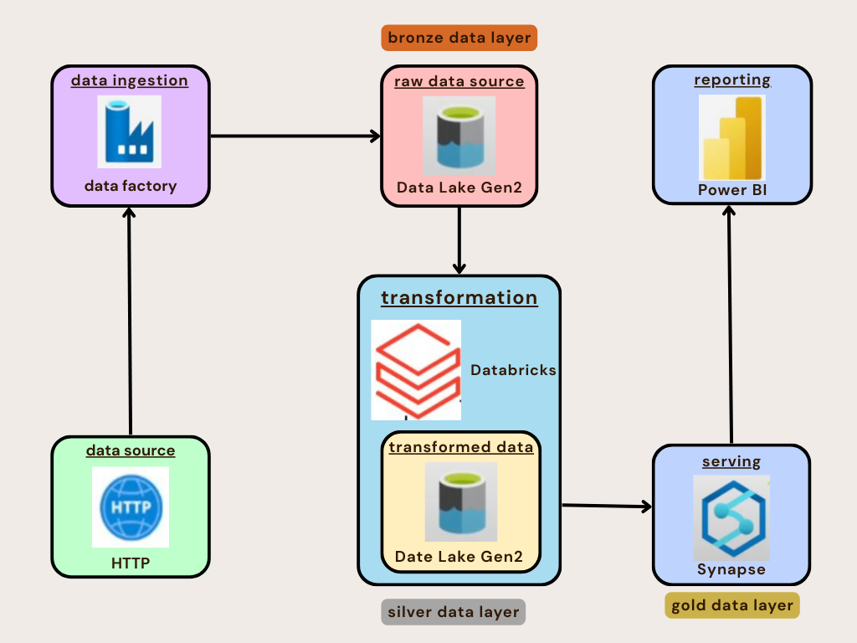
Overview

Slide 9
Key Learnings
1. Dynamic & Metadata-Driven Pipelines:
Using JSON-driven parameterization in Azure Data Factory enabled dynamic ingestion of multiple datasets, improving scalability and reducing maintenance effort.
2.Medallion Architecture:
Clear separation of Bronze (raw), Silver (curated), and Gold (analytical) layers ensured data lineage, modularity, and simplified debugging.
3.Data Quality & Transformation:
Implemented schema validation, deduplication, and standardization in Databricks using Spark — achieving reliable, analytics-ready datasets.
4.Performance Optimization:
Leveraged parallel ForEach execution, Parquet compression, and Serverless Synapse SQL for faster queries and reduced costs.
5.Security & Governance:
Enforced RBAC, Managed Identities, and secure access controls across all Azure components for enterprise-grade protection.
6.Integration & Automation:
Unified ADF, Databricks, Synapse, and Power BI into a seamless pipeline, automating end-to-end data flow from ingestion to visualization.

Slide 10
Layers Overview
Layer | Goal | Features/ work done
Bronze Layer – Data Ingestion | Store raw GitHub CSVs in ADLS without modification. | Built using ForEach + JSON configuration JSON file Source paths, file names, and target destinations Pipeline automatically copies 10 AdventureWorks datasets
Silver Layer – Transformation with Databricks | Clean, standardize, and join data using Apache Spark. | Read raw files from /bronze/. Apply: Schema enforcement Null & duplicate removal Date normalization Joins (Sales + Products + Customers + Territories)
Gold Layer – Analytical Serving | Make data available for BI and analytics. | Synapse Serverless SQL views over Silver Parquet files. Created logical data warehouse via OPENROWSET(). Example Views: gold.sales, gold.customers, gold.products. Optional CTAS (CREATE TABLE AS SELECT) for performance-critical tables.
.

Slide 11
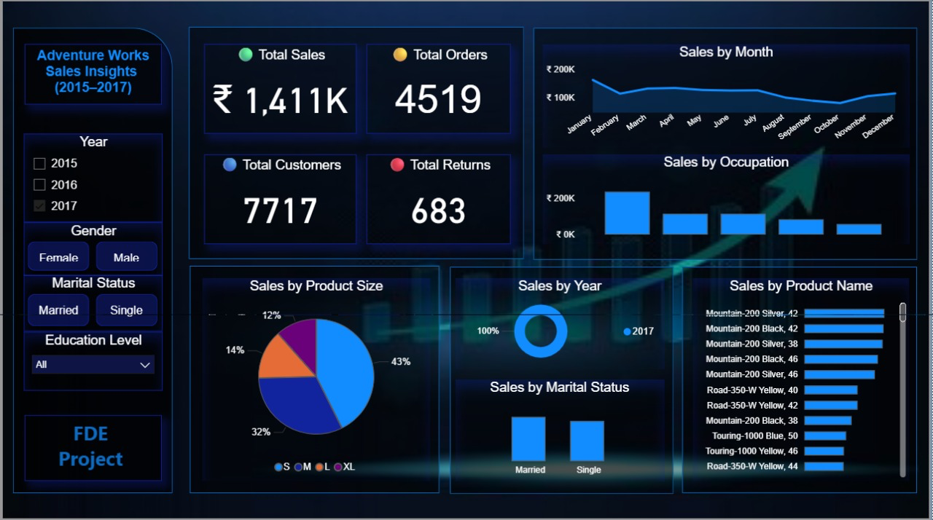
Final Dashboard

Slide 12
Future Enhancements
Adopt Delta Lake:
Enable ACID transactions, time travel, and efficient incremental data updates for greater reliability in the Silver and Gold layers.
Event-Driven Pipelines:
Integrate Azure Data Factory triggers or Logic Apps to automate pipeline runs based on new data arrivals or API events.
Metadata-Driven Automation:
Automate view and table creation in Synapse using metadata-driven SQL scripts to eliminate manual configuration.
CI/CD Integration:
Implement Azure DevOps or GitHub Actions for version-controlled, automated deployment of ADF pipelines and Databricks notebooks.
Advanced Analytics:
Extend Power BI dashboards with predictive insights using Synapse Machine Learning or Azure ML integration.
Cost Optimization:
Incorporate auto-scaling clusters in Databricks and usage monitoring for dynamic cost control.

Slide 13
Thank you

