Slide 1


PROJECT: FORGE AI
THE WORLD’S FIRST HUMAN-CENTRIC CAREER OS
[01] Accelerate Career Growth · [02] Improve Employability · [03] Preserve Authenticity

Slide 2

THE "AI SAMENESS" TRAP
[01] THE PROBLEM
[02] THE IMPACT
Generic AI-generated resumes and LinkedIn posts all look and sound the same to recruiters, leading to instant dismissal.
Low response rates and weak personal branding create a lack of visibility in hyper-competitive technology markets.
[03] THE GAP
[04] THE COST
Current platforms solve isolated problems like resume building or learning, but fail to address the entire career lifecycle.
IT professionals struggle with unclear development paths and inconsistent messaging, resulting in stagnant career growth.

Slide 3

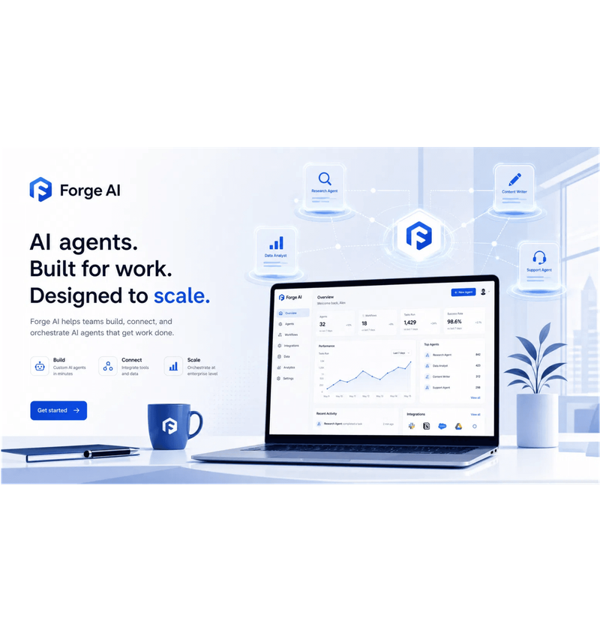
INTRODUCING FORGE AI: A COMPREHENSIVE CAREER OS
[01] TALENT INTELLIGENCE
[02] CAREER READINESS
Intelligent discovery and opportunity scoring for best-fit roles across multiple platforms.
ATS optimization and personalized development roadmaps based on continuous gap analysis.
[03] INTERVIEW SIMULATION
[04] HUMAN AUTHENTICITY
Validating real-world capability through the proprietary FORGE Sim™ scenario-based framework.
Preserving your unique professional voice across all digital assets and outreach.

Slide 4

THE USP: HUMAN AUTHENTICITY ENGINE (HAE)
[01] BEYOND GENERIC
[02] VOICE INTELLIGENCE
Unlike traditional AI systems that generate robotic, template-based content, HAE learns your natural communication style, vocabulary, and professional tone to ensure every output feels uniquely yours.
Our engine builds a deep "Voice Profile" by analyzing your historical LinkedIn posts, technical articles, and past resumes, capturing the nuances that define your professional identity.
[03] AUTHENTIC CONTENT
[04] BRAND CONSISTENCY
Generate LinkedIn posts, long-form articles, and recruiter outreach that bypasses "AI detectors" by mirroring your specific industry expertise and personal storytelling style.
Maintain a unified leadership voice across every touchpoint in the career lifecycle, from initial networking messages to high-stakes executive thought leadership pieces.

Slide 5

INTELLIGENCE LAYERS: DISCOVERY & READINESS
[01] JOB HUNTER AGENT
[02] JD INTELLIGENCE
[03] GAP ANALYSIS
Scours LinkedIn, Indeed, Dice, and company career pages 24/7 to identify high-probability opportunities.
Deep parsing of Job Descriptions to extract hidden skills, certifications, and priority keywords.
Identifies exact skill and experience gaps between your profile and target roles.

Slide 6
FORGE SIM™: VALIDATING REAL-WORLD CAPABILITY
[01] PROPRIETARY FRAMEWORK
[02] INCIDENT RESPONSE
High-stakes simulations for cloud architecture, production failures, and leadership scenarios that move beyond theoretical knowledge.
Real-world exercises that test decision quality under pressure, simulating actual system outages and security breaches.
[03] TECHNICAL DEEP-DIVES
[04] READINESS SCORING
System design challenges and technical interviews tailored to specific roles, ensuring candidates can handle complex engineering tasks.
Quantitative validation of technical competency and leadership capability, providing a data-backed score for recruiter confidence.

Slide 7
VISIBILITY & BRANDING: BUILDING AN UNSTOPPABLE BRAND
[01] CONTENT STRATEGY
[02] THOUGHT LEADERSHIP
Automated management of your LinkedIn content calendar and industry positioning, ensuring a consistent and professional presence without the manual effort.
Humanized articles and research pieces that establish you as a subject matter expert, powered by the Human Authenticity Engine to preserve your unique voice.
[03] RECRUITER OUTREACH
[04] VISIBILITY ANALYTICS
Personalized, high-conversion messaging for referrals and networking, designed to bypass generic filters and land directly in the inbox of key decision-makers.
Real-time tracking of your brand effectiveness and recruiter engagement levels, providing data-driven insights to optimize your professional market positioning.

Slide 8

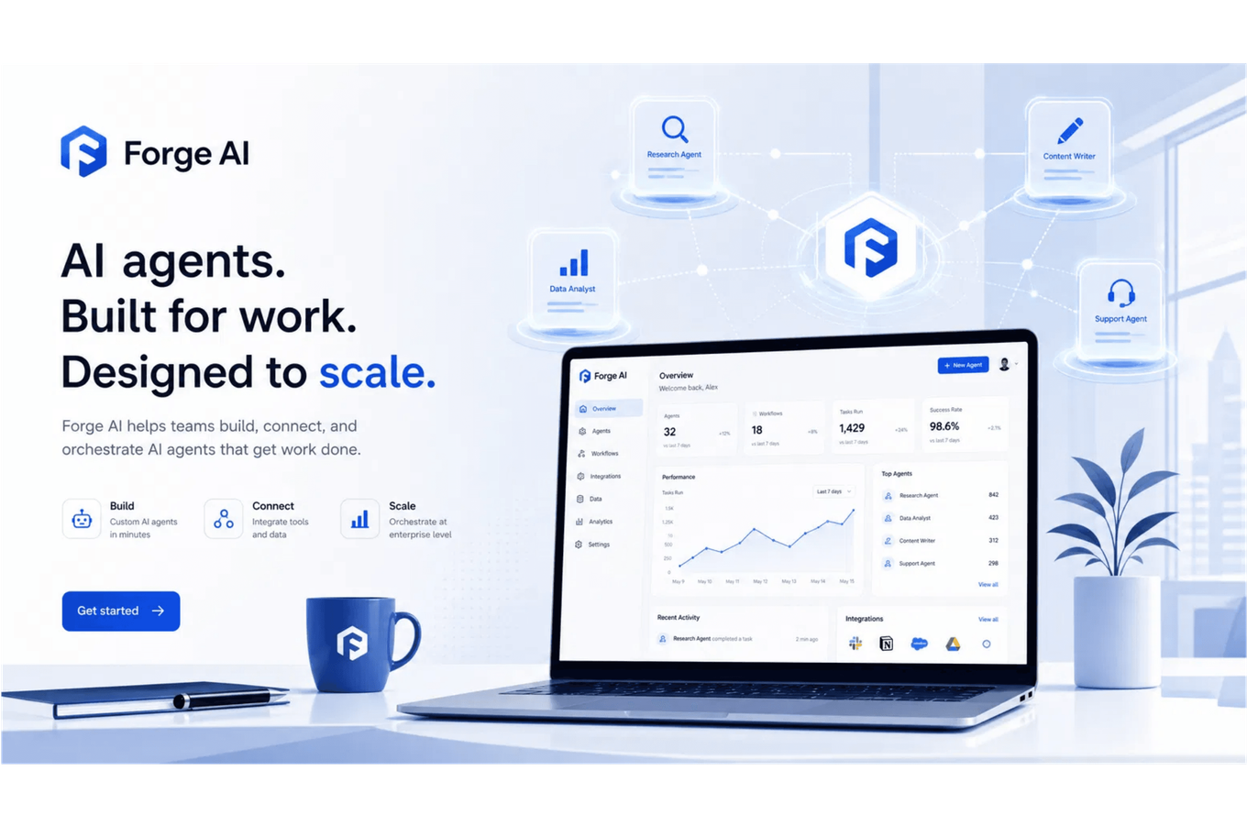
THE ENGINE: 13 SPECIALIZED AI AGENTS
[01] DISCOVERY & MATCHING
Job Hunter, JD Intelligence, and Candidate Matching agents identify and rank the best-fit opportunities 24/7.
[02] READINESS & LEARNING
Resume Intelligence, Gap Analysis, and L&D agents optimize assets and create personalized skill roadmaps.
[03] VALIDATION & SIMULATION
FORGE Simulation and Performance Evaluation agents conduct high-stakes technical and leadership challenges.
[04] BRANDING & OUTREACH
Voice Intelligence, LinkedIn Branding, and Outreach agents amplify your authentic professional identity.

Slide 9

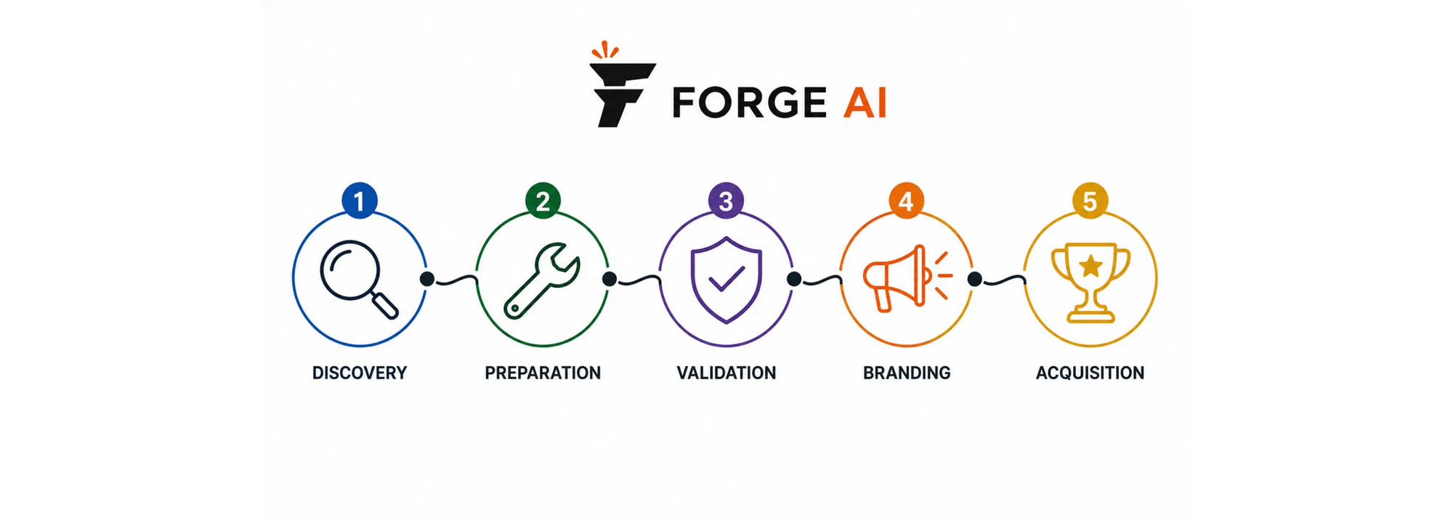
THE WORKFLOW: FROM DISCOVERY TO OFFER
[01] DISCOVERY
[02] PREPARATION
[03] VALIDATION
[04] BRANDING
[05] ACQUISITION
Agents identify best-fit roles across platforms 24/7.
Resume optimization and skill gap bridging.
FORGE Sim™ validates real-world readiness.
HAE-powered visibility and thought leadership.
Success tracking and final offer conversion.

Slide 10
MARKET COMPARISON: WHY FORGE AI WINS
TRADITIONAL PORTALS
RESUME BUILDERS
LEARNING PLATFORMS
FORGE AI (CAREER OS)
[01]
[01]
[01]
[01]
Passive job listings with generic filters.
No discovery features; asset-focused only.
Skill-based discovery, not role-aligned.
24/7 Active Job Hunter & JD Intelligence.
[02]
[02]
[02]
[02]
Zero personalization; one-size-fits-all.
Template-based; robotic AI generation.
Generic curriculum; no voice preservation.
Proprietary Human Authenticity Engine (HAE).
[03]
[03]
[03]
[03]
No validation; relies on self-reporting.
Keyword stuffing; no actual skill check.
Theoretical quizzes; no real-world scenarios.
FORGE Sim™ Real-World Simulations.
[04]
[04]
[04]
[04]
Static profiles; low market visibility.
Static documents; no social presence.
Certification badges; weak personal brand.
Automated Thought Leadership & Outreach.

Slide 11
BUSINESS IMPACT & ROI: ACCELERATING OUTCOMES
[01] FOR INDIVIDUALS
[02] FOR ENTERPRISES
[03] FOR UNIVERSITIES
3X
-60%
95%
Higher response rates from job applications through HAE-powered authentic branding.
Reduction in hiring costs by eliminating skills mismatch through FORGE Sim™ validation.
Employability scores for graduates who complete the Talent Readiness Program.
24/7
40%
100%
Industry-aligned career coaching and simulation access for every student.
Faster career progression and salary growth via continuous readiness validation.
Confidence in candidate quality with data-backed readiness and performance analytics.

Slide 12

FORGE YOUR FUTURE TODAY
[01] Transform your professional identity with HAE.
[02] Validate your readiness through FORGE Sim™.
[03] Dominate your career path with integrated AI.
GET STARTED
exeliqconsulting.com/forge-ai
contact@exeliq.ai

