Slide 1


SMART INDIA HACKATHON 2024
Problem Statement ID – SIH1605
Problem Statement Title- Women Safety Analytics – Protecting Women from safety threats.
Theme- Miscellaneous
PS Category- Software
Team ID-
Team Name - Trishul

Slide 2

Computer Vision and Machine Learning based State-of-the-Art Methodology for Enhancing Women Safety
Trishul
Detailed Explanation
Automated alert and notification system.
Real-Time surveillance system using computer/machine vision.
Data privacy and security Measures (system operates within legal and ethical boundaries)
How It Address The Problem
Novel moving object detection and classification system (Manual monitoring may miss nuanced threats)
Real–Time data driven insights and strategic planning (Lack of Contextual Understanding)
Real-Time Alerts and aid (Assistance with minimum delay)
Innovation And Uniqueness Of The Solution
Integration of Artificial Intelligence (AI) based advanced algorithm (Unified Approach , Holistic Monitoring)
Real-Time gesture and body posture based threat detection and alert system (Immediate Response, Contextual Alerts)
Gesture Analytics for SOS Situations (Distress Signal Detection, Advanced Gesture Recognition)
Privacy-First Design (Ethical Considerations, Compliance and Transparency)
Two-Layer security system (structured approach with iterative development )

Slide 3

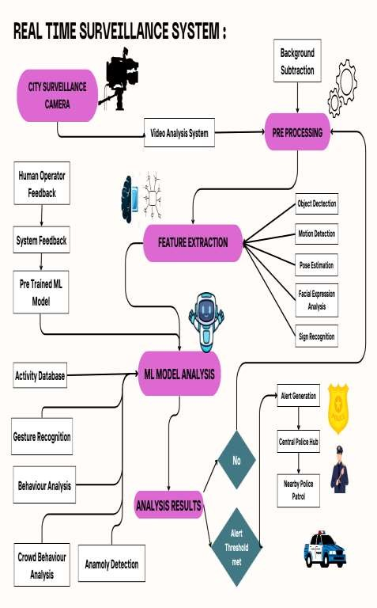
TECHNICAL APPROACH
Trishul
SOFTWARE REQUIREMENT
Python (JUPYTER NB, Google Colab)
Machine Learning & Deep Learning
Libraries Used : cv2, numpy, time, os, matplotlib, mediapipe, sklearn, tensorflow , twilio
Background Subtraction
Threshold (predefined for comparison)
HARDWARE REQUIREMENT
Internet of Things (IOT)
Graphic Processing Unit (GPU)

Slide 4
FEASIBILITY AND VIABILITY
Trishul
Analysis of the Feasibility of the Idea
Technology Availability(Gesture Recognition , Night Vision and Low-light Cameras)
Integration Capabilities(Scalability: Modern cloud-based architectures)
Economic feasibility
Potential Challenges And Risks
Scalability (Data Management , Latency).
Accuracy and Reliability(False Positives/Negatives , Environmental Variability ).
Integration Complexity(Existing Infrastructure , System Interoperability)
Strategies For Overcoming These Challenges
Scalability (Cloud-Based Solutions , Load Balancing)
Accuracy and Reliability(Rigorous Testing and Validation Integration Continuous Improvemet )
Complexity(Standardized Protocols , Modular Architecture)

Slide 5
IMPACT AND BENEFITS
Trishul
Potential Impact On The Target Audience
Impact on Women and society (Increased Safety and Security , Reduced Fear of Crime Improved Awareness)
Impact on Law Enforcement Agencies(Enhanced Operational Efficiency , Reduced Response Times , Informed Decisions)
Impact on Security Personnel( Enhanced Surveillance Capabilities ,Effective Resource
Automated Monitoring)
Benefits Of The Solution (Social, Economic, Environmental, Etc.)
Social Benefits ( Enhanced Personal Safety, Empowerment and Equality , Transparency and Trust)
Economic Benefits(Cost Efficiency , Economic Activity , Operational Savings)
Environmental Benefits(Optimized Resource Use , Informed Urban Design)
Use ,

Slide 6
RESEARCH AND REFERENCES
Trishul
Detailed Explanation: https://docs.google.com/document/d/1mHbjr-
KWeLMUzcoicaaGYHmvT7YY_cIH/edit?usp=drive_link&ouid=117558612120065569 603&rtpof=true&sd=true
Research Paper:
https://drive.google.com/file/d/1hq9oO-T9odiPrrtqZc7xiycdmjr06KWw/view?usp=drive_link
https://drive.google.com/file/d/1Avtk4He4wAbHV-12mFuxKuZ0rwCWmTgt/view?usp=drive_link

