Slide 1

Computer Networks

Slide 2
Syllabus
SUBJECT CODE | SUBJECT TITLE | CORE/ ELECTIVE | CREDITS
 |  |  | L | T | P | C
CSE 223 | Computer Networks | C | 3 | 0 | 2 | 4
Unit I
Overview of the Internet: Protocol, Layering Scenario, TCP/IP Protocol Suite: The OSI Model, Internet history standards and administration; Comparison of the OSI and TCP/IP reference model.
Physical Layer: Guided transmission media, wireless transmission media.
Data Link Layer - design issues, CRC codes, Elementary Data Link Layer Protocols, sliding window protocol
UNIT - II:
Multi Access Protocols - ALOHA, CSMA, Collision free protocols, Ethernet- Physical Layer, Ethernet Mac Sub layer, data link layer switching & use of bridges, learning bridges, spanning tree bridges, repeaters, hubs, bridges, switches, routers and gateways.
UNIT - III:
Network Layer: Network Layer Design issues, store and forward packet switching connection less and connection oriented networks-routing algorithms-optimality principle, shortest path, flooding, Distance Vector Routing, Control to Infinity Problem, Hierarchical Routing, Congestion control algorithms, admission control.

Slide 3
Syllabus
UNIT - IV:
Internetworking: Tunneling, Internetwork Routing, Packet fragmentation, IPv4, IPv6 Protocol, IP addresses, CIDR, IMCP, ARP, RARP, DHCP.
Transport Layer: Services provided to the upper layers elements of transport protocol-addressing connection establishment, connection release, Connection Release, Crash Recovery.
UNIT - V:
The Internet Transport Protocols UDP-RPC, Real Time Transport Protocols, The Internet Transport Protocols- Introduction to TCP, The TCP Service Model, The TCP Segment Header, The Connection Establishment, The TCP Connection Release, The TCP Connection Management Modeling, The TCP Sliding Window, The TCP Congestion Control, The future of TCP.
Application Layer- Introduction, providing services, Applications layer paradigms, Client server model, Standard client-server application-HTTP, FTP, electronic mail, TELNET, DNS, SSH.
Text Books
1. Computer Networks - Andrew S Tanenbaum, 5th Edition, Pearson Education.
2. Data Communications and Networking - Behrouz A. Forouzan, Fifth Edition TMH, 2013.

Slide 4
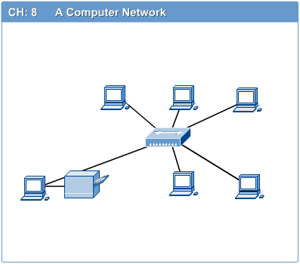
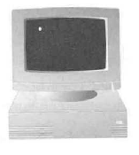
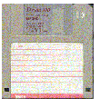
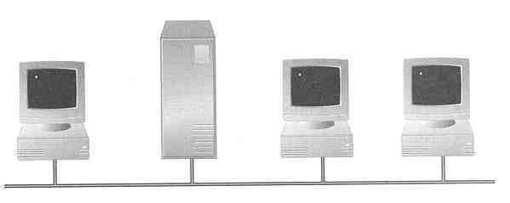
Introduction to Computer Networks
Computer network connects two or more autonomous computers that can be geographically located anywhere.
Why Networking?
  Sharing information — i.e. data communication
  Do you prefer these?
  Or this ?

Slide 5
Uses of Computer Networks
Business Applications
    online buying
Home Applications
  Mail, chat
E-Commerce
Mobile Users
Social Issues

Slide 6
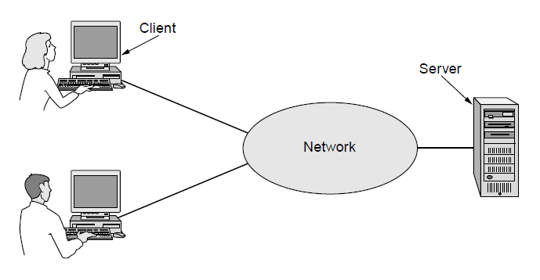
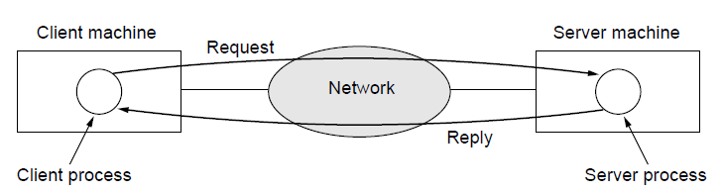
Business Applications
  Check bank account
  Pay bills
  Reserve ticket
A network with two clients and one server
The client-server model involves requests and replies

Slide 7
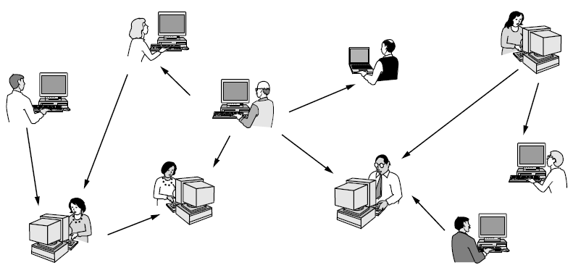
Home Applications
In a peer-to-peer system, there are no fixed clients and servers.
Torrents
Instant messages (Chat box).
Voip Calls (Skype, Google Hangout)

Slide 8
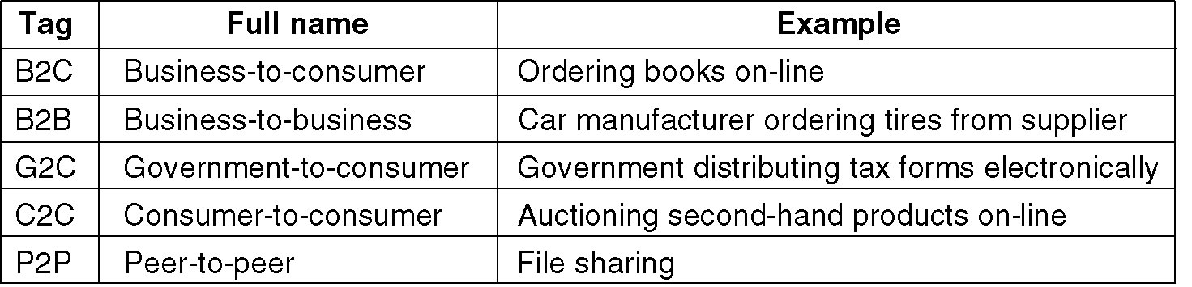
E-Commerce

Slide 9
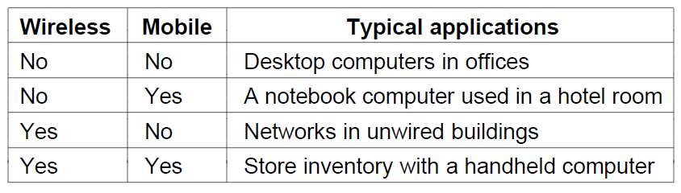
Mobile Users
Combinations of wireless networks and mobile computing

Slide 10
Social Issues
Discussions about
  politics,
  religion,
  …
Hack and robbery

Slide 11
How many kinds of Networks ?
Depending on one’s perspective, we can classify networks in different ways
  Based on network size: LAN and WAN (and MAN)
  Based on transmission media: Wired (UTP, coaxial cables, fiber-optic cables) and Wireless
  Based on management method: Peer-to-peer and Client/Server
  Based on topology (connectivity): Bus, Star, Ring …
  :
  :

Slide 12
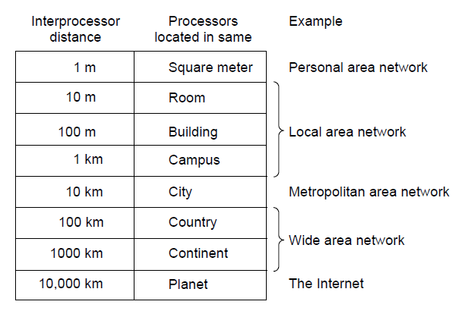
Network Hardware
Personal area networks
Local area networks
Metropolitan area networks
Wide are networks
The internet

Slide 13
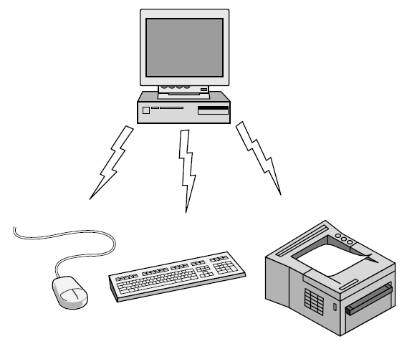
Personal Area Network
Applications :
RFID
Smartcards
Library Books
Bluetooth PAN configuration

Slide 14
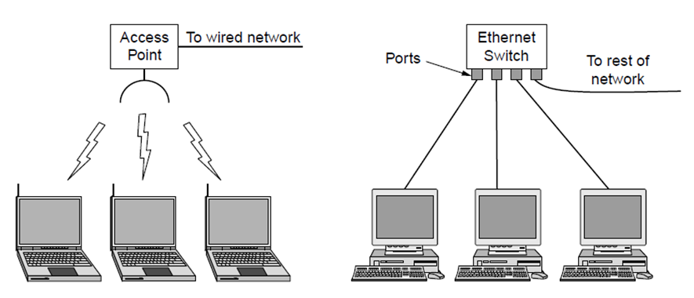
Local Area Network
Wireless and wired LANs. (a) 802.11. (b) Switched Ethernet.
Privately owned Network
Used to connect personal computers, printers and other electronic consumers within home (short range communications).
When LAN is used in companies then it is “Enterprise Networks”.
Wireless LAN(IEEE 802.11) : Radio Signals, Antenna, Radio interface.
Speed of Wireless LAN : 11 Mbps to 100 Mbps
WireLAN : Copper wires or optical cables.
Speed of Wired LAN : 100 Mbps to 1 Gbps.

Slide 15
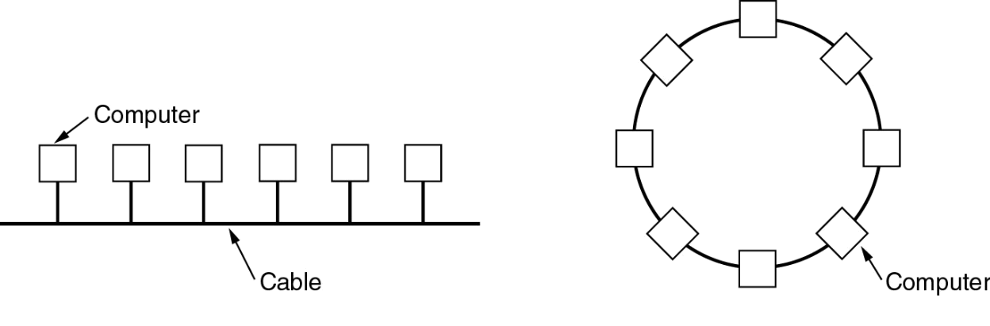
Local Area Networks (2)
Topology …
  Bus
    Ethernet (IEEE 802.3):
      Bus based broadcast network with decentralized control at 10 or 100 Mbps.
  Ring
    Token Ring (IEEE 802.5):
      Ring based broadcast network with token arbitration at 4 or 16 Mbps.
   Low delay. High reliability.
   Requires collision arbitration

Slide 16
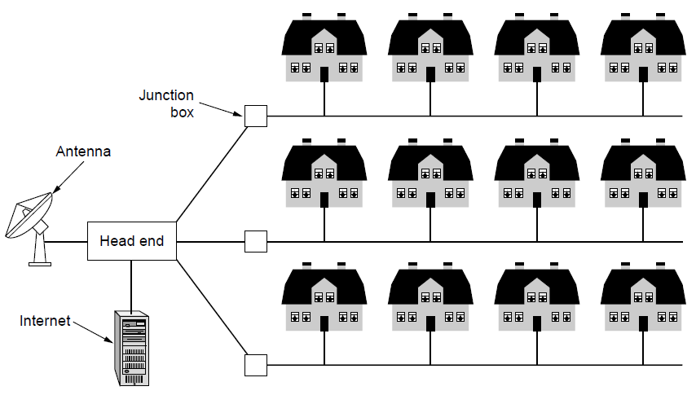
Metropolitan Area Network
Larger version of LAN ("city" wide).
Broadcast – No switches
A metropolitan area network based on cable TV.
WiMAX : Wireless Metropolitan Area Network

Slide 17
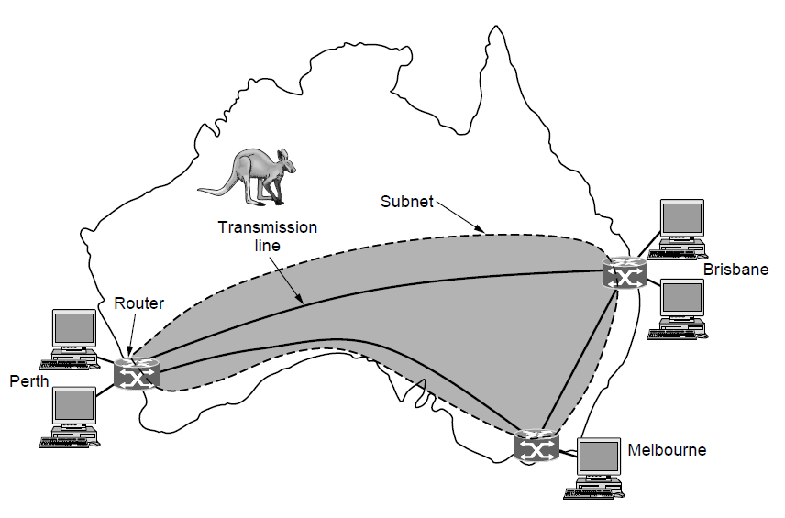
Wide Area Networks
WAN that connects three branch offices in Australia
A network that uses long-range telecommunication links to connect 2 or more LANs/computers housed in different places far apart.
WAN(Collection of multiple LANs) : Hosts, subnets
Subnets : Contain transmission links(copper wires or optical cables) and switching Elements .
Internet : Collection of multiple WANs (or) Network of Networks.

Slide 18
Network Software
Protocol hierarchies
Design issues for the layers
Connection-oriented versus connectionless service
Service primitives
Relationship of services to protocols

Slide 19

Real Time Example
let us consider two friends who communicate through postal mail. The process of sending a letter to a friend has to go through the services from different layers.

Slide 20
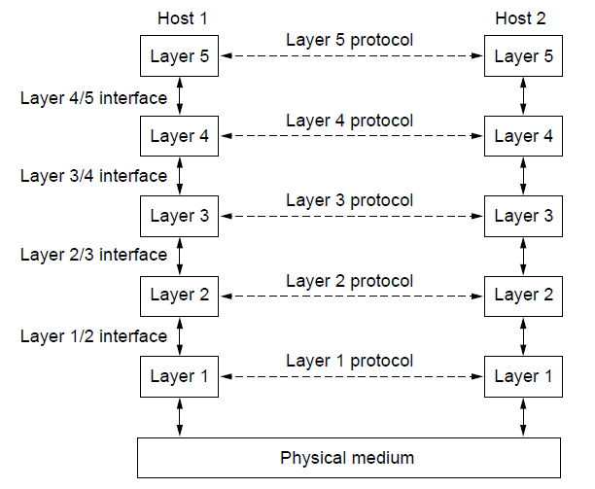
Protocol Hierarchies
Layers, protocols, and interfaces.

Slide 21
OSI
Application
Presentation
Session
Transport
Network
Data Link
Physical
Open Systems Interconnection
Developed by ISO
(International Organization for Standardization)
Contains seven layers
Introduced in 1978 and revised in 1984
Formulates the communication process into structured layers.
There are seven layers in the model, hence the name is 7-Layer model.
The model acts as a frame of reference in the design of communications and networking products.

Slide 22
What happens at the End and Intermediate Nodes ?
Tx
Rx
7
Intermediate Nodes
3
1
1
A
B
C
Q
T
Z

Slide 23

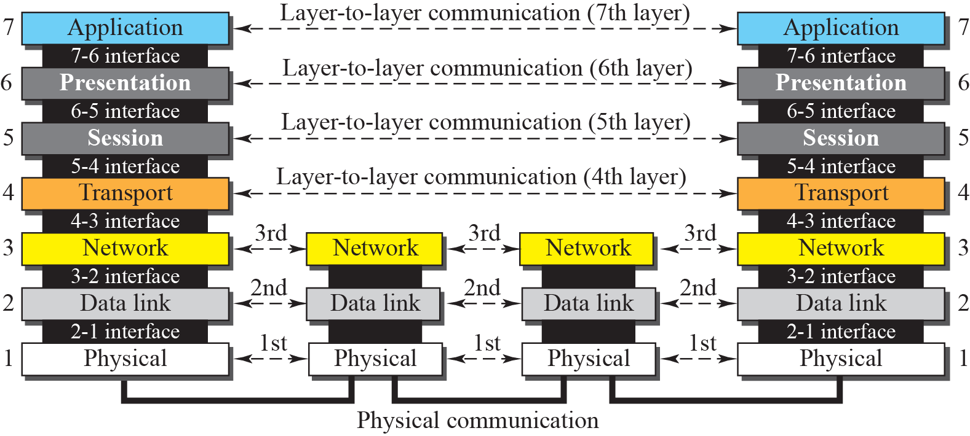
OSI’s Layered Approach
  INTERFACE : between different layers on the same node or stack
  PEER-TO-PEER PROCESSES : between similar layers on different nodes or stacks

Slide 24
OSI Reference Model
Bottom 3 layers
  Bottom 3 layers are responsible for getting the information to the destination
  (Bottom 3 layers): at the lower levels of the model, protocols define the electrical and physical standards
  (Bottom 3 layers) at the lower levels, the bit ordering, the transmission of the bits, and error detecting and correcting are defined
Top 4 layers
at the higher levels of the model, the protocols define the data formatting, message syntax, dialogue management, message sequences and info presentation

Slide 25
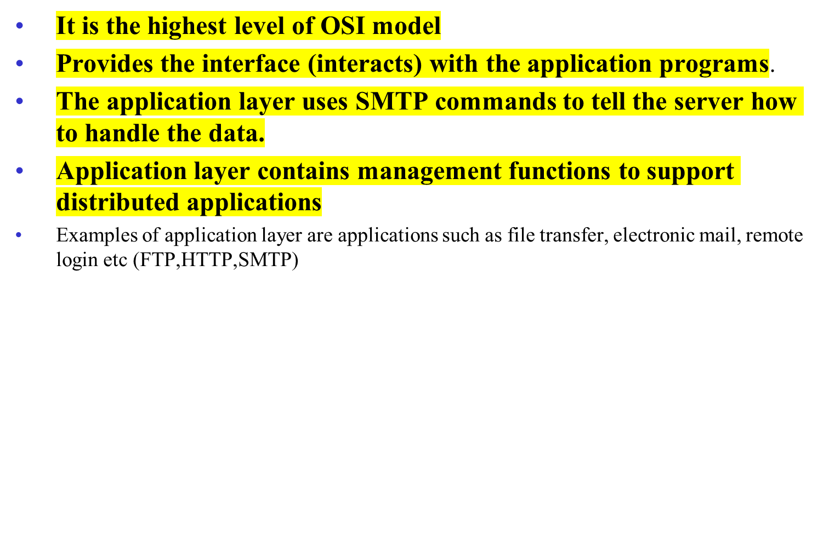

APPLICATION LAYER

Slide 26
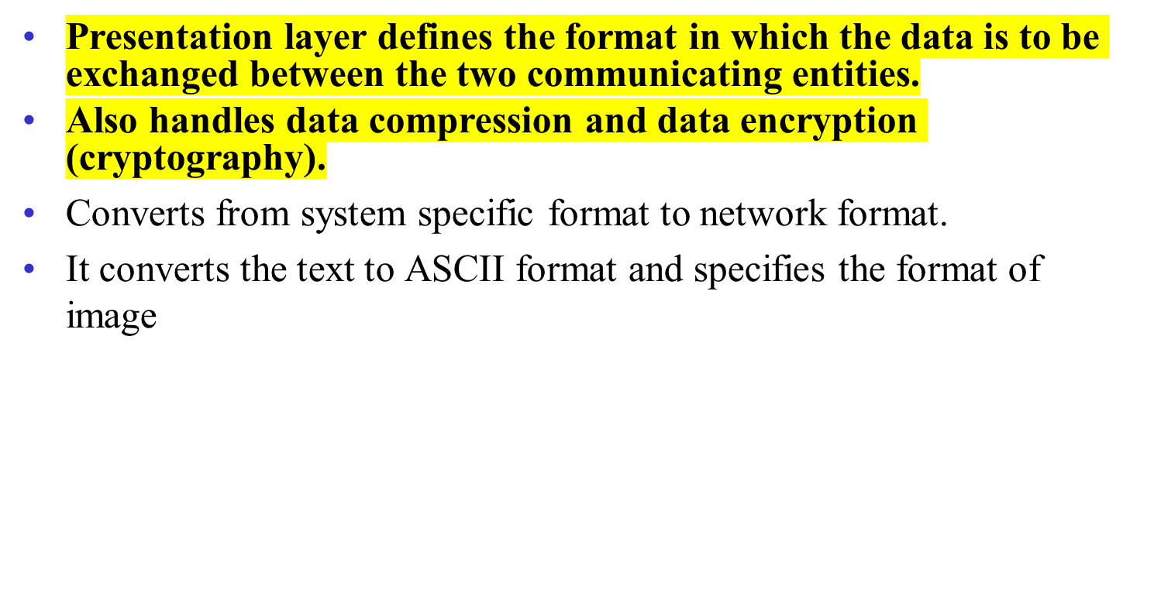

PRESENTATION LAYER

Slide 27
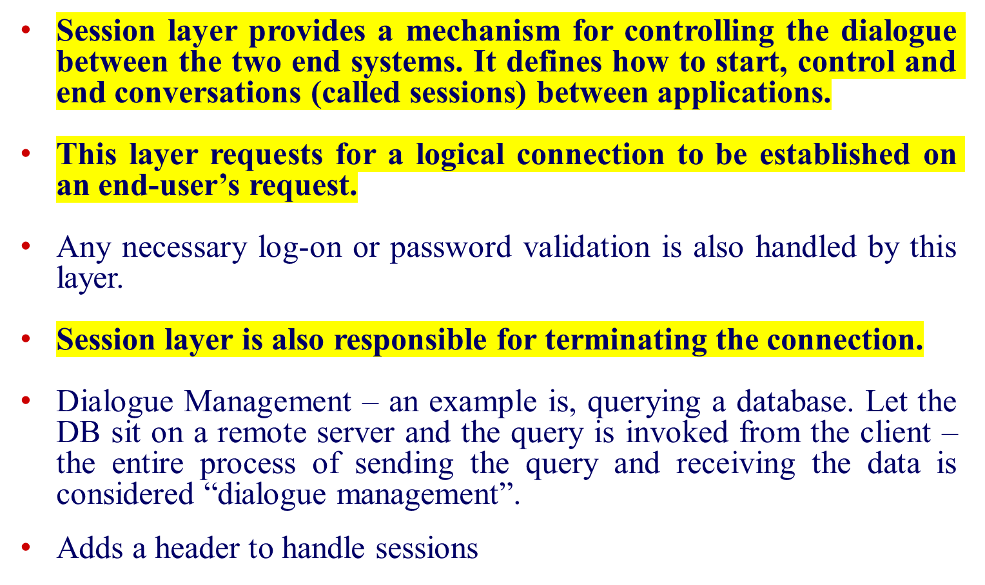
SESSION LAYER

Slide 28
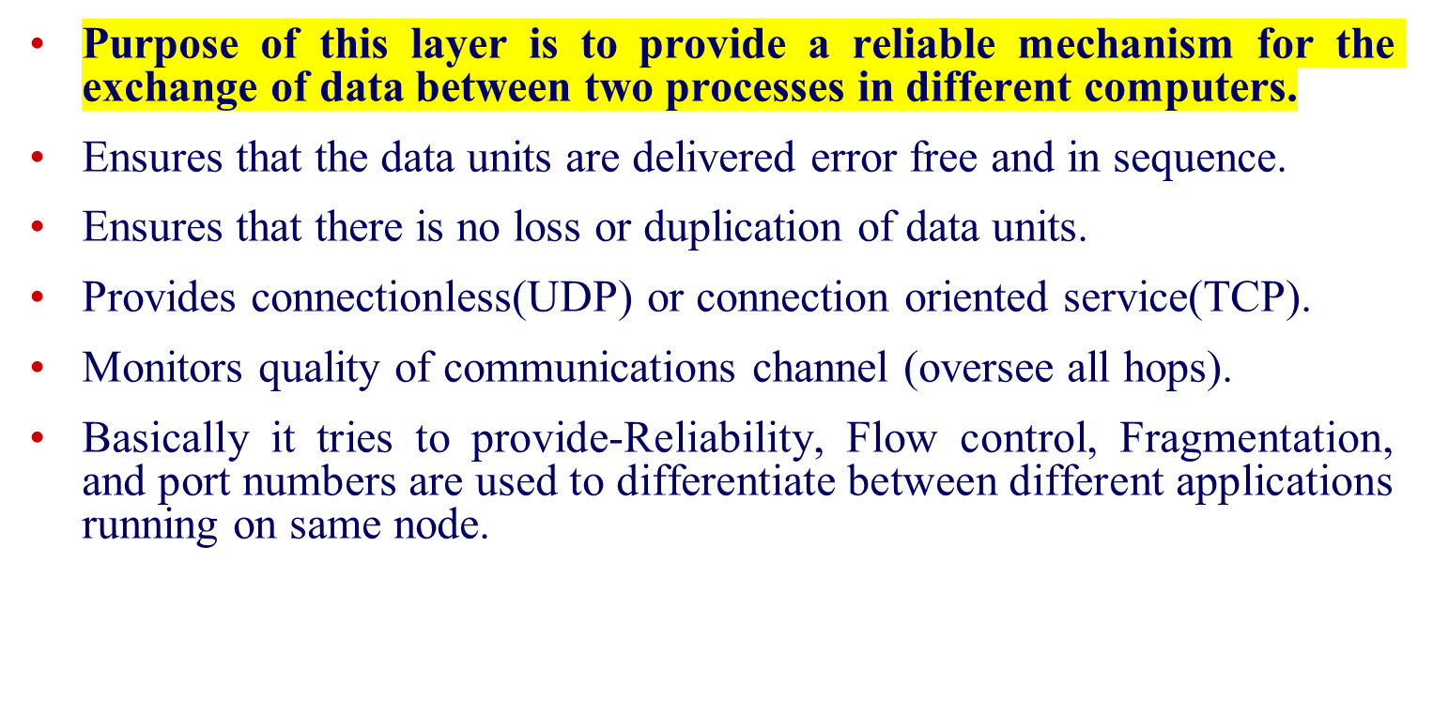

TRANSPORT LAYER

Slide 29
Connection-Oriented and Connectionless Services (1)
Connection oriented service (TCP protocol):
  Like the phone system. The system establishes a connection, uses it, and closes it. Acts like a tube. Data comes out the other end in the same order as it goes in.
        Connection Setup
        Data Transfer
        Connection Termination
Connectionless service(UDP protocol):
  Like the post office. Each message has the entire address on it. Each message may follow a different route to its destination. Ordering not maintained.
        Data Transfer

Slide 30
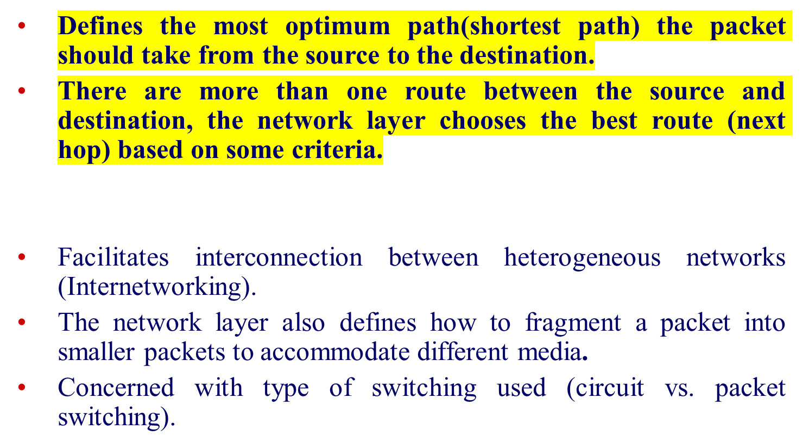

NETWORK LAYER
A
Z

Slide 31
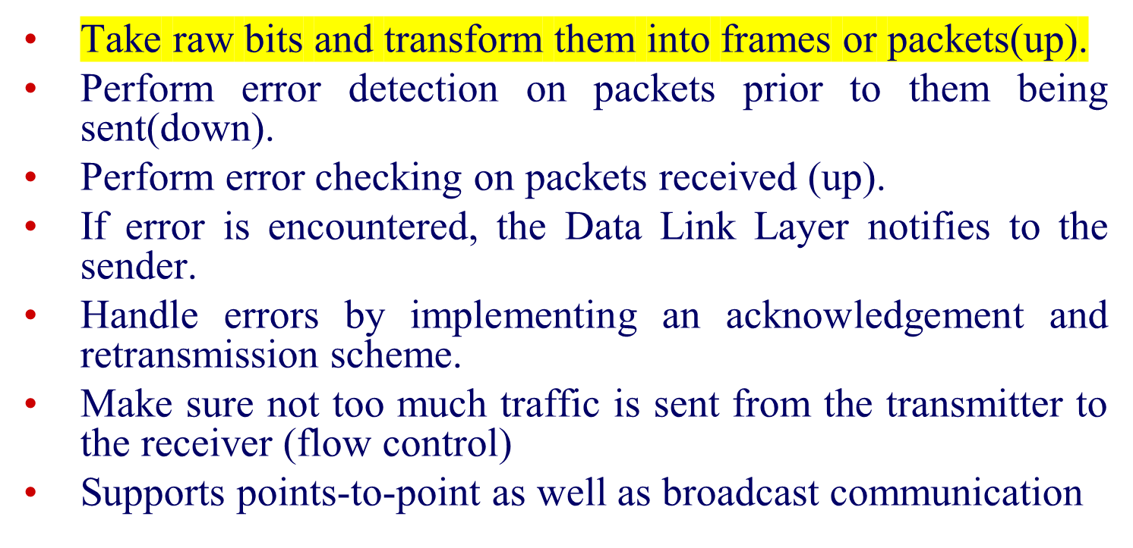

DATA LINK LAYER

Slide 32
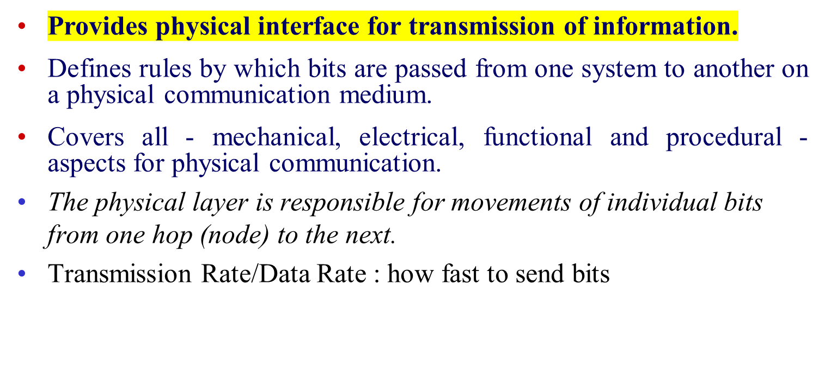

PHYSICAL LAYER

Slide 33

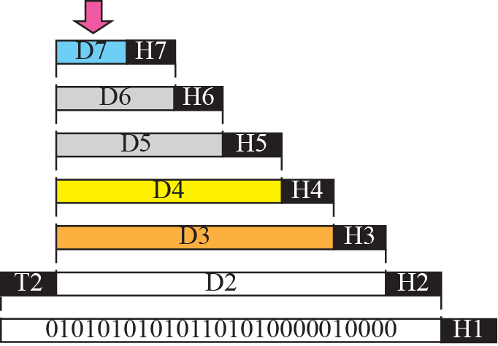


Summary of OSI Model
encapsulation and decapsulation

Slide 34
The TCP/IP Reference Model Layers
Application layer
Transport layer
Internet layer
Link layer

Slide 35

The TCP/IP Reference Model (1)
OSI Model
The TCP/IP reference model

Slide 36
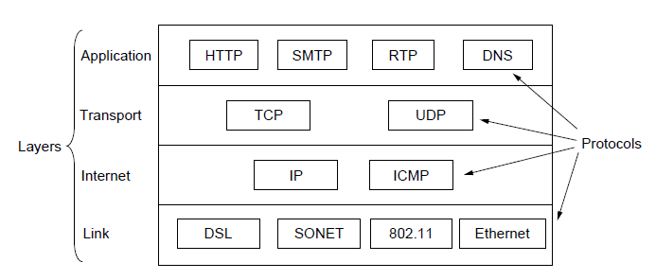
The TCP/IP Reference Model (2)
The TCP/IP reference model with some protocols we will study

Slide 37
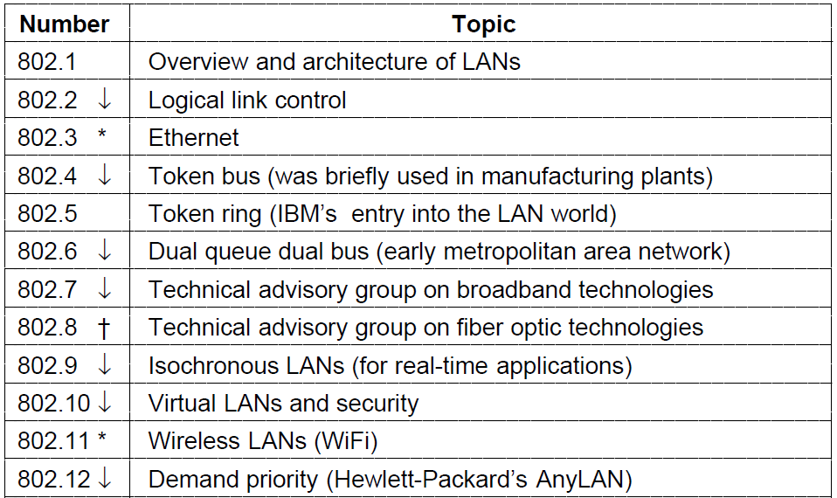
International Standards (1)
The 802 working groups. The important ones are marked with *.
The ones marked with ↓ are hibernating. The one marked with † gave up and disbanded itself.

Slide 38
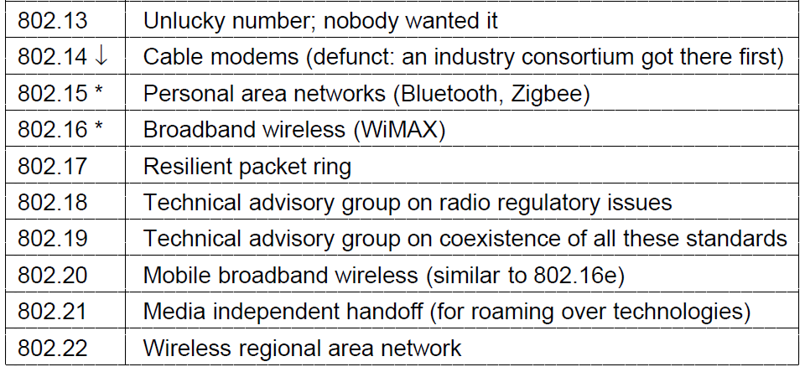
International Standards (2)
The 802 working groups. The important ones are marked with *.
The ones marked with ↓ are hibernating. The one marked with † gave up and disbanded itself.

Slide 39
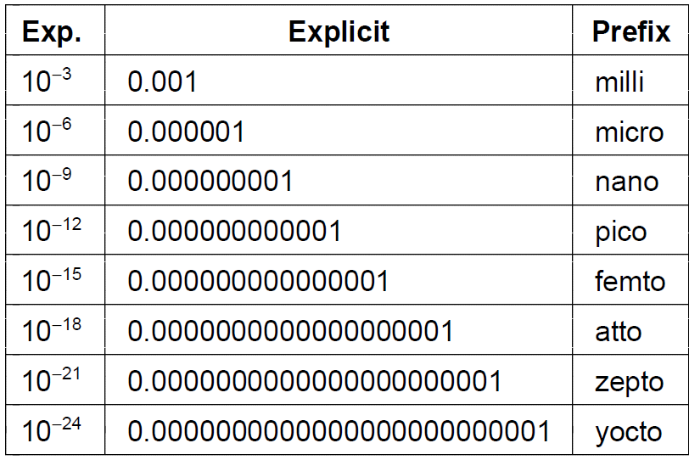
Metric Units (1)
The principal metric prefixes

Slide 40
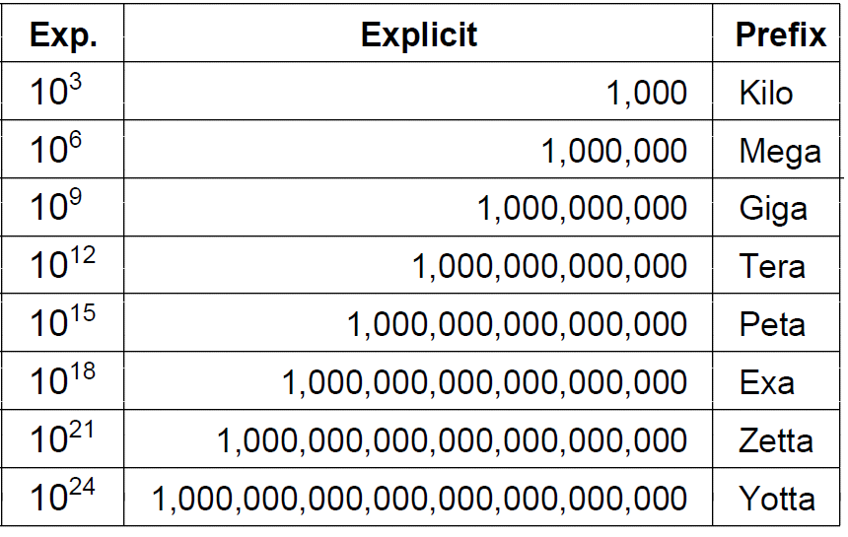
Metric Units (2)
The principal metric prefixes

Slide 41
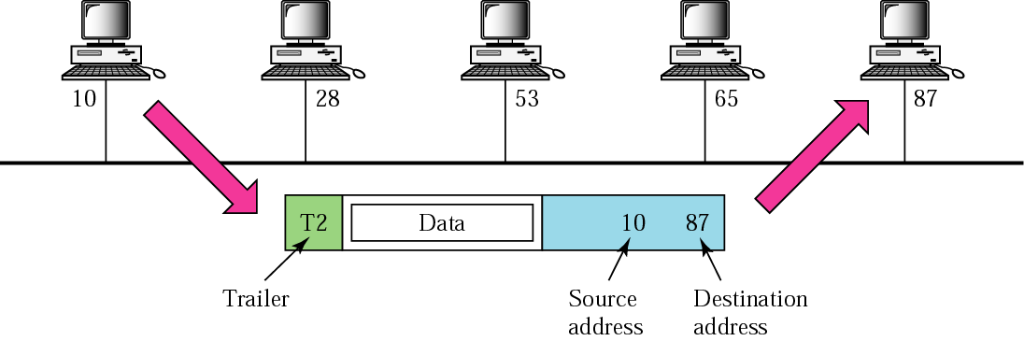
Physical addresses(MAC address)
Physical address is also known as the link address
Physical address can be different sizes (depend on the network)
Unicast type physical addresses – single Rx
Multicast type physical address – multiple Rxs
Broadcast type physical address – all Rxs can pickup message

Slide 42
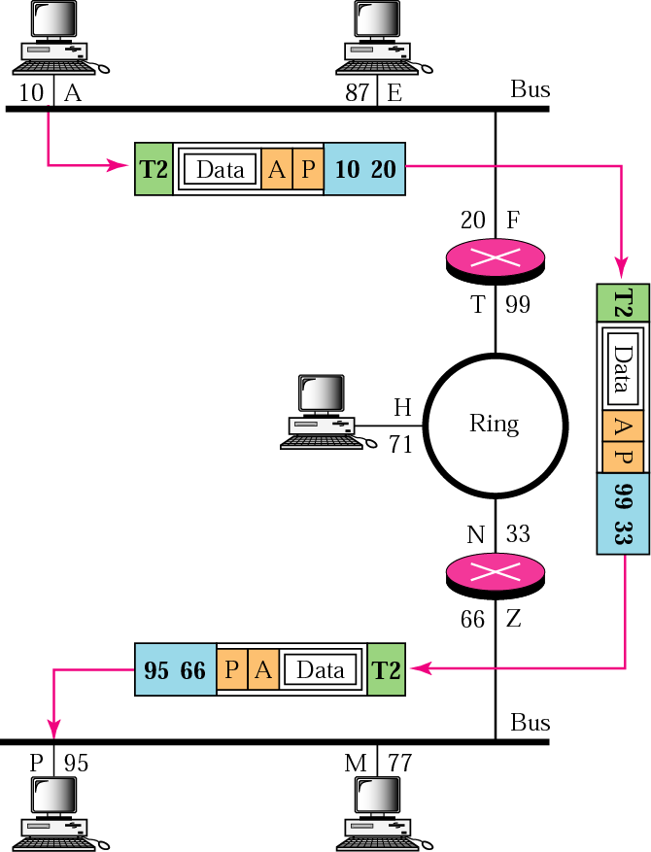
Communications at the network layer
IP Addresses can be either unicast, multicast or broadcast types
Going from network A physical address 10 to network P physical address 95.
Can’t use the physical address because different networks
The network layer address contains the uniqueness we need from source to sink. Network layer address is A-P
Unit at this layer - datagram

Slide 43
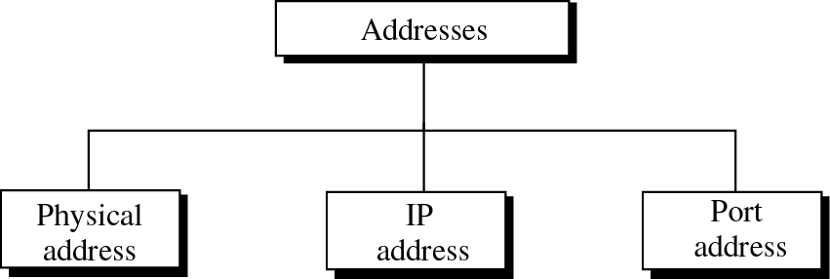
Addresses in TCP/IP
Application Specific Address
Converts to a part address

Slide 44
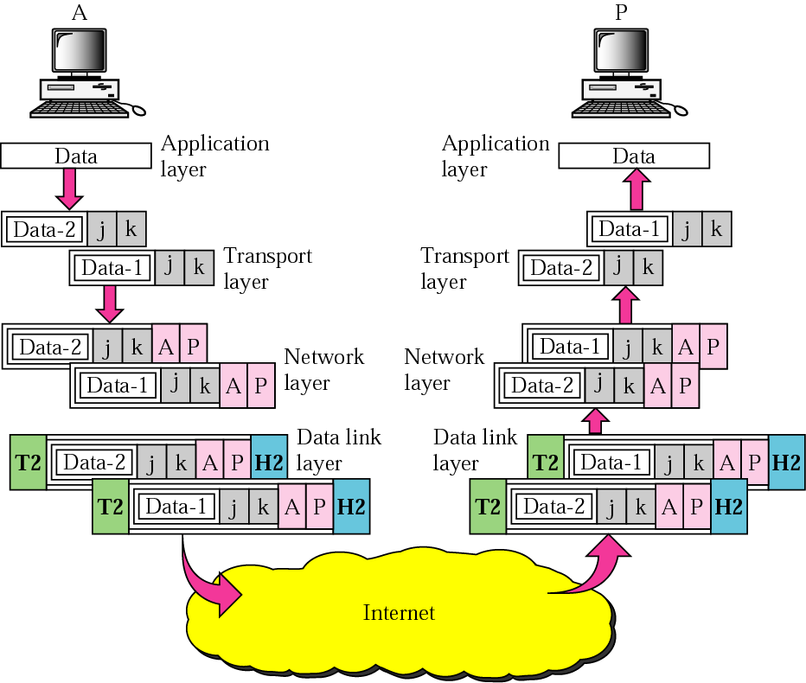
Port addresses
Addresses of sending and receiving processes (j and k)
Add IP address
Overhead (H2, T2) added for what ?

Slide 45
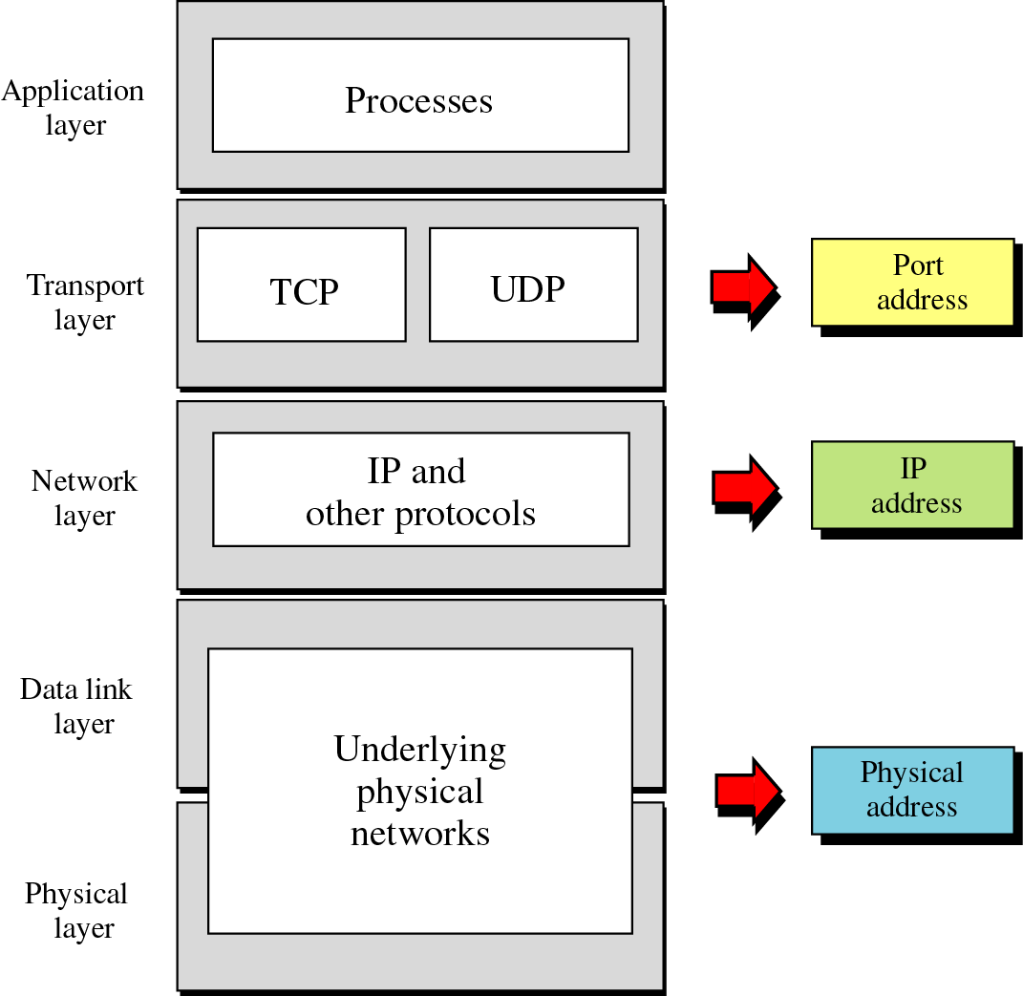
Messages
Segments
Datagrams (Packets)
Frames
Bits
Computer Network : A collection of transmission hardware and facilities, terminal equipment, and protocols
Signals

Slide 46
End

