Slide 2
Encoder block
Encoder block
Stacked Encoder blocks
Encoder block
Encoder block

Slide 3
Pointer
Stacked encoder blocks
Stacked encoder blocks
Encoder block
Stacked encoder blocks
Encoder block
Stacked encoder blocks
Question-Context Attention
Encoder block
Encoder block
Stacked encoder blocks
Stacked encoder blocks
Embedding
Embedding
Context
Question

Slide 4
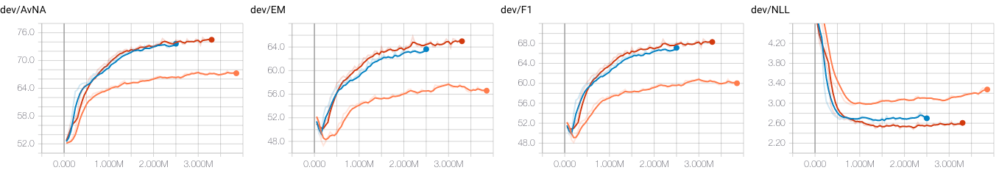
BiDAF
QANet – 1 head
QANet – 4 heads

Slide 5
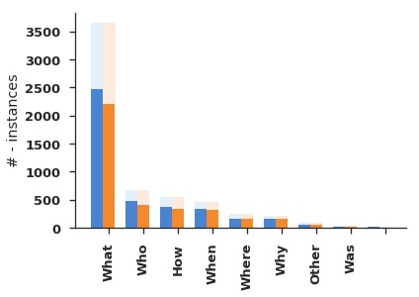
BiDAF
QANet – 1 head

Slide 6
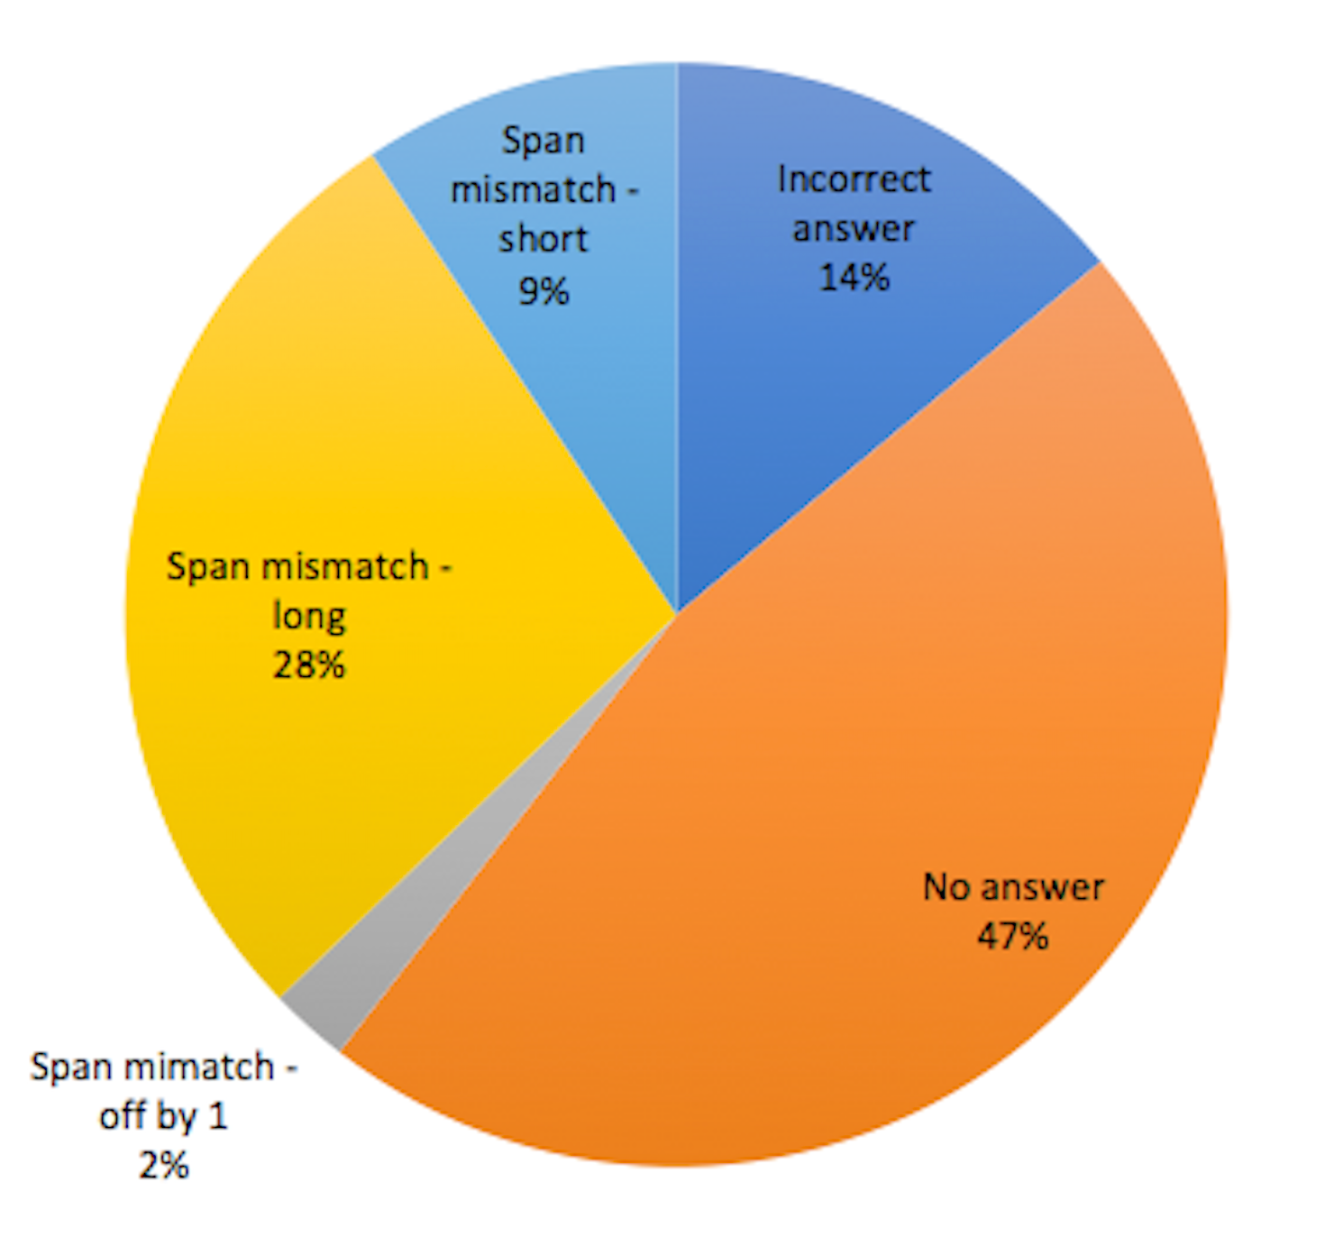

Slide 7
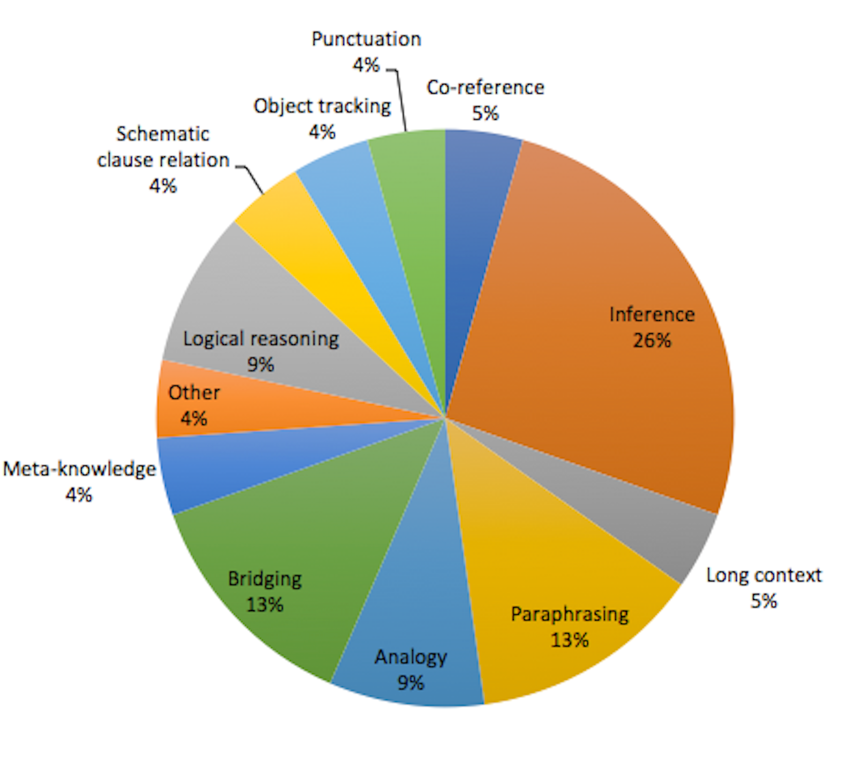

Slide 8
Pointer
Stacked encoder blocks
+
Feedforward layer
Stacked encoder blocks
Layernorm
Encoder block
+
Stacked encoder blocks
Self-attention
Encoder block
Stacked encoder blocks
Layernorm
Question-Context Attention
Encoder block
…
+
Repeat
Encoder block
Conv
Stacked encoder blocks
Stacked encoder blocks
Layernorm
Embedding
Embedding
Position Encoding
Context
Question

