Slide 1


Summer Internship (3170001) Semester VII
Face Detection Using ESP32 CAM Sensor
Makwana Yash K
180110107023
Dr.Priyang Bhatt

Slide 2
01
INTRODUCTION
Brif introduction.
02
Module
ESP-32 CAM,FTDI programmer.
Index
03
Hardware & softwere
Hardware,software
04
Application
where esp-32 cam sensor used?

Slide 3
Introduction

Slide 4


IoT
what is IoT?
Internet of Things
The Internet of Things (IoT) refers to a system of interrelated, internet-connected objects that are able to collect and transfer data over a wireless network without human intervention.

Slide 5
Module
ESP-32 CAM
FTDI programmer

Slide 6
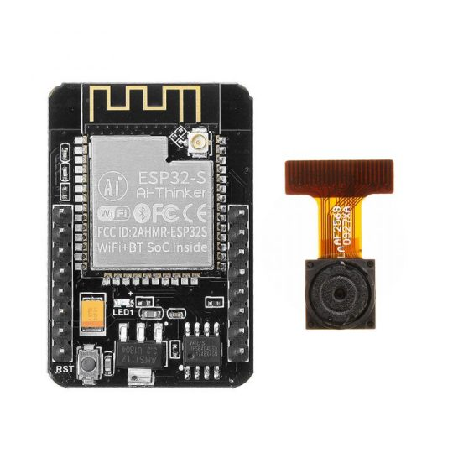
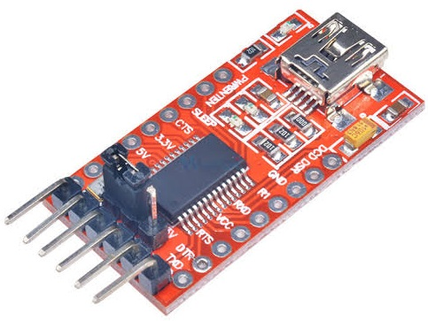
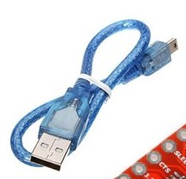
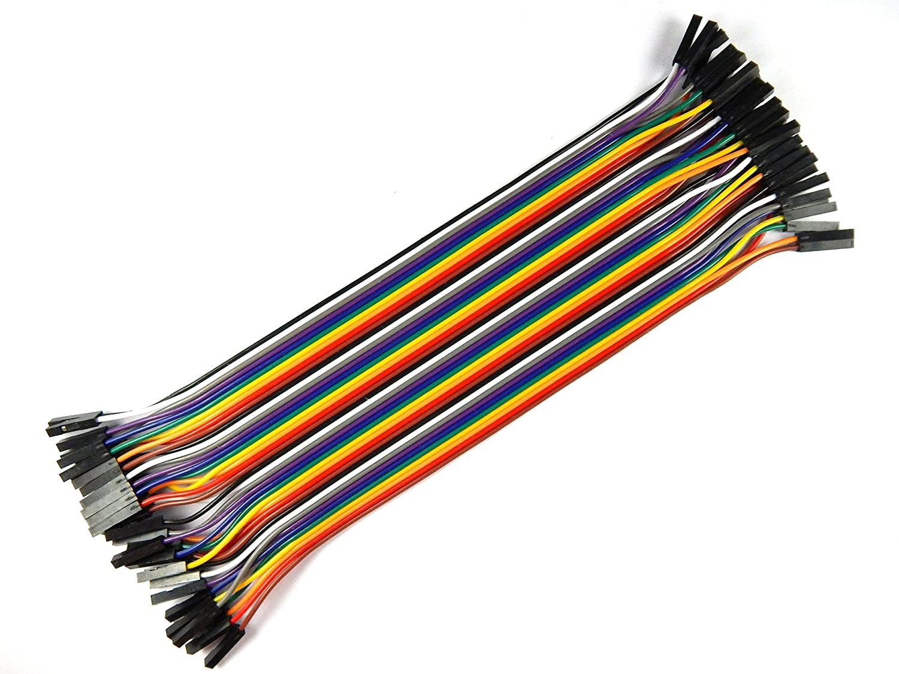
MODULE
ESP32-CAM
FTDI Programmer
FTDI CABLE
JUMPR CABLE

Slide 7
The ESP32-CAM is a small size, low power consumption camera module based on ESP32. It comes with an OV2640 camera and provides onboard TF card slot.
The ESP32-CAM can be widely used in intelligent IoT applications such as wireless video monitoring, WiFi image upload, QR identification, and so on
ESP32-CAM

Slide 8
FTDI USB to TTL serial converter modules are used for general serial applications. It is popularly used for communication to and from microcontroller development boards such as ESP32-CAM and Arduino micros.
FTDI PROGRAMMER

Slide 9
Hardware and Software

Slide 10
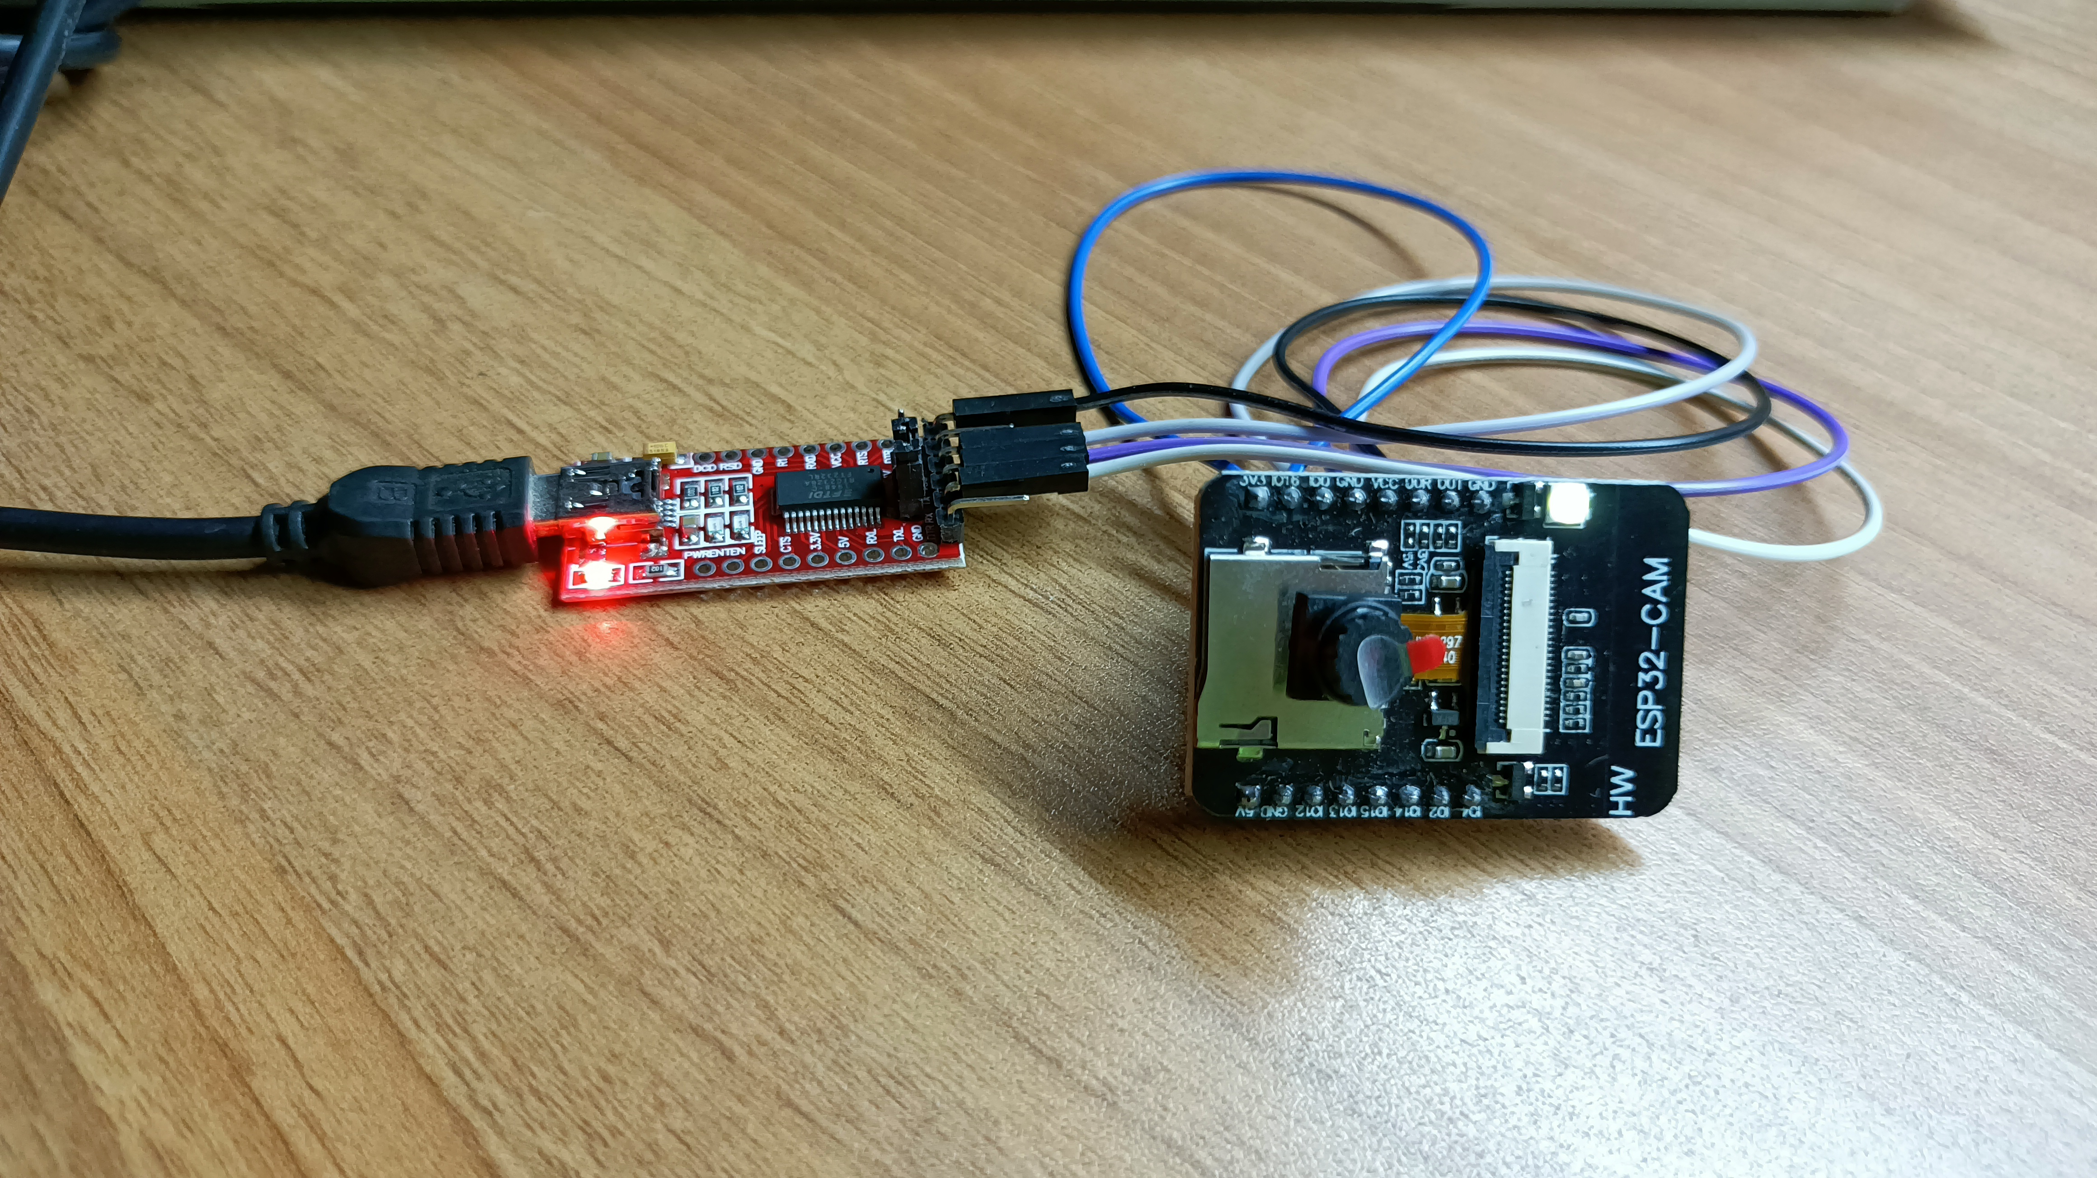
Hardware
1
ESP32-CAM
DETECT FACE
2
FTDI PROGRAMMER
POWER SUPLY
3
FTDI CABLE
CONNECTION BETWEEN LEPTOP AND FTDI PROGRAMMER

Slide 11
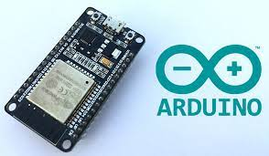
SOFTWARE
1
ARDUINO IDE
Install esp32 board
Select speed
select port number
verify the code
Upload te code

Slide 12
Application
where esp-32 cam sensor used?

Slide 13
Application
1.Face Detection
2.Machine Learning
3.Security
detect your face
used in IoT devices for data measurement
used in security like door alaram
4.home smart device
5.QR wireless identification
6.wireless monitoring
camara
wireless monitoring in industrial
scan QR code

Slide 14
Thank you

