Slide 1

Healthcare Analytics
What drives doctor visits?
Yash Sanjay Monde
STU69f055805a3e71777358208

Slide 2

PROBLEM STATEMENT
The challenge: 79.8% of people in this sample report zero visits.
Core question: Which patient factors are most strongly associated with visits?

Slide 3
Dataset Overview
Source: Supplied doctor-visits dataset: 5,190 records.
Data quality: No missing values, duplicate rows, or repeated IDs.
Key fields: Visits, coded age/income, illness, activity, health, and support.

Slide 4

WHO ARE THE END USERS?
Healthcare planners Review service demand and continuity needs.
Care teams Identify patterns that may warrant further review.
Analysts Reproduce and validate the reported associations.
Service leaders Use findings as questions for follow-up, not rules for care.

Slide 5

Technology Used
Python and Jupyter: Reproducible notebook analysis.
Pandas and NumPy: Data audit, cleaning, summaries, and preparation.
SciPy and statsmodels: Statistical checks and adjusted model.

Slide 6
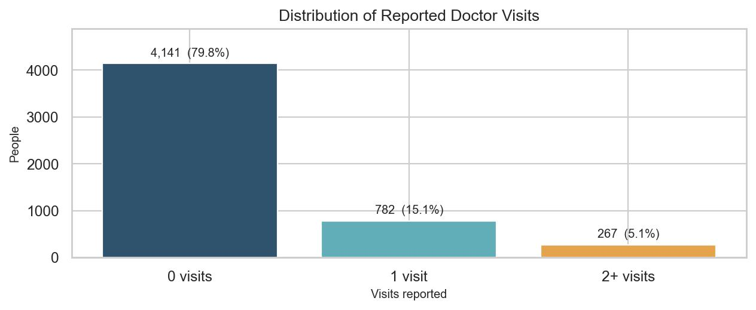
Most people reported no doctor visits
FINDING 1 OF 6
Main pattern: 4,141 people (79.8%) reported zero visits.
Typical value: Median is 0; mean is 0.30 visits.
Key takeaway: Separate no-visit and visit groups when reading averages.

Slide 7
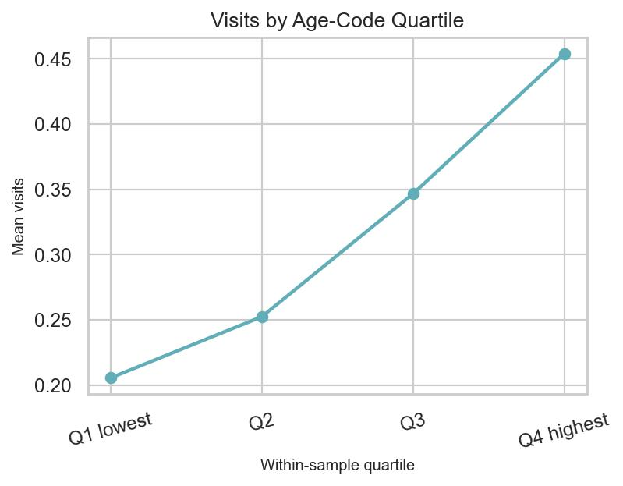
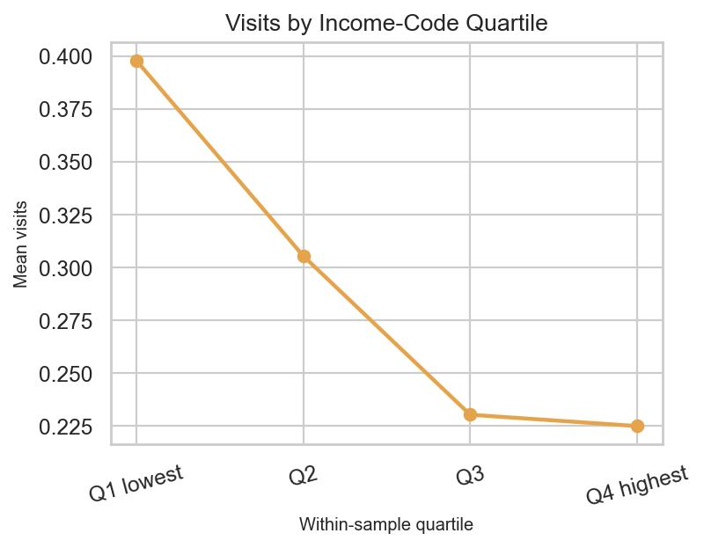
Age and income codes show different patterns
FINDING 2 OF 6
Age code: Mean visits rise from 0.21 in the lowest quartile to 0.45 in the highest.
Income code: Mean visits fall from 0.40 to 0.22 across income quartiles.
Read cautiously: These are coded scales; the guide does not define their units.

Slide 8
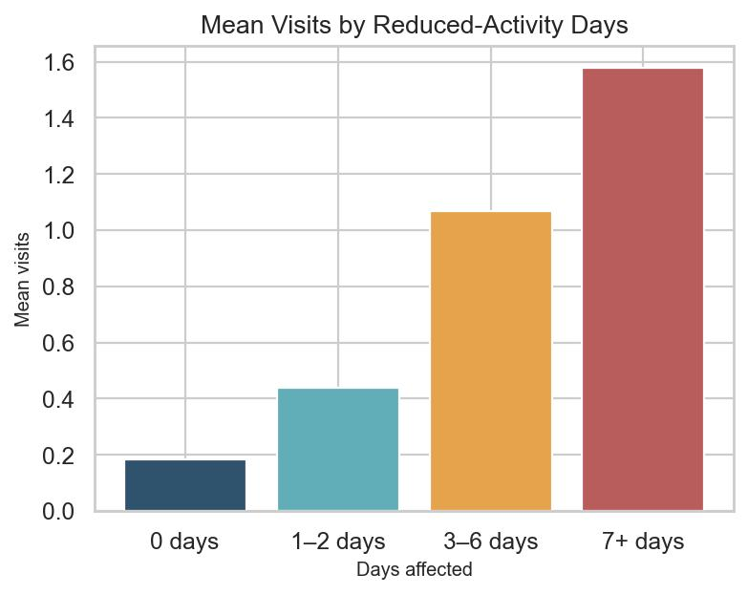
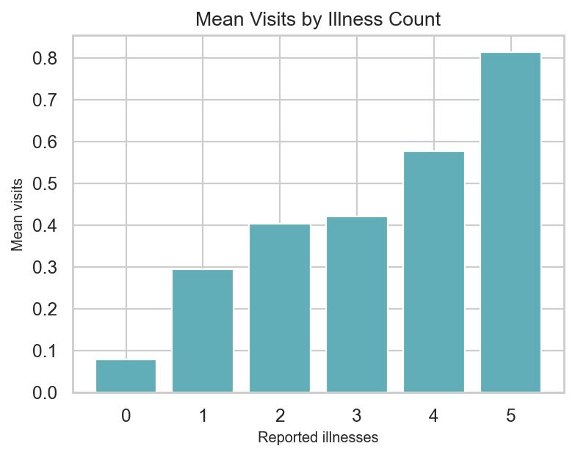
Illness and reduced activity link to visits
FINDING 3 OF 6
Illness: Mean visits rise from 0.08 with zero illnesses to 0.81 with five.
Reduced activity: Mean visits are 0.18 at zero days and 1.58 at 7+ days.
Health code: It relates more weakly; the guide does not define its direction.

Slide 9
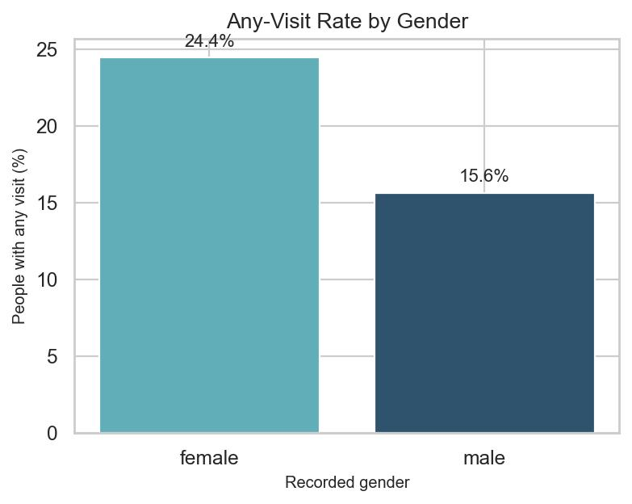
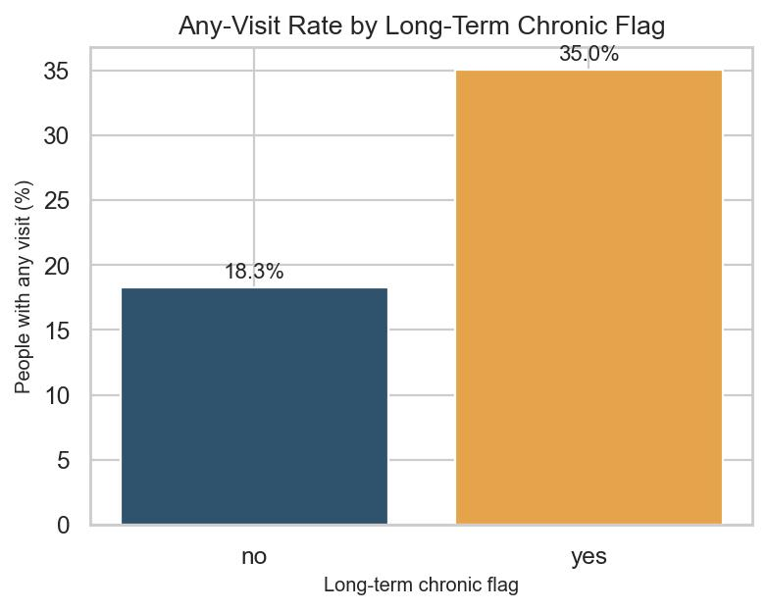
Visit rates vary across patient groups
FINDING 4 OF 6
Long-term chronic flag: Any-visit rate is 35.0% with the flag vs 18.3% without.
Recorded gender: Any-visit rate is 24.4% for females vs 15.6% for males.
Support group: Rate is 31.6% with freerepat vs 17.2% without; descriptive only.

Slide 10
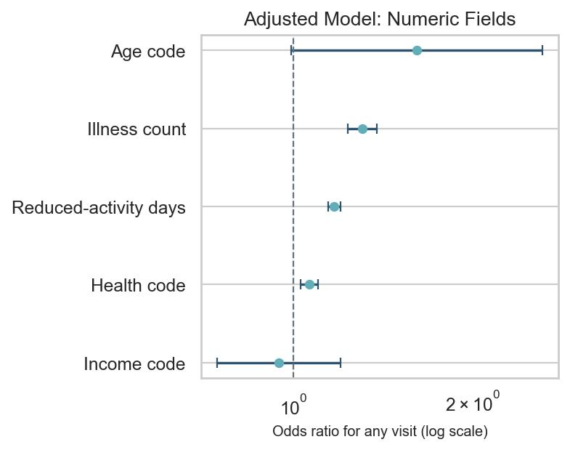
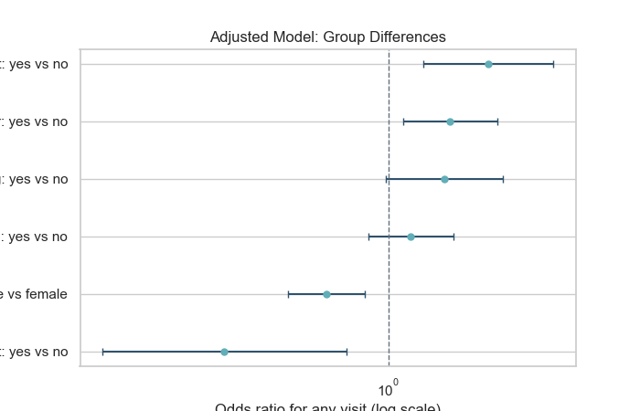
Illness and activity stand out after adjustment
FINDING 5 OF 6
Health factors: Illness OR 1.31 and reduced-activity OR 1.17 per unit.
Other differences: Female records have higher adjusted odds; private coverage changes after adjustment.
Model note: Adjusts for listed fields; it does not prove cause.

Slide 11
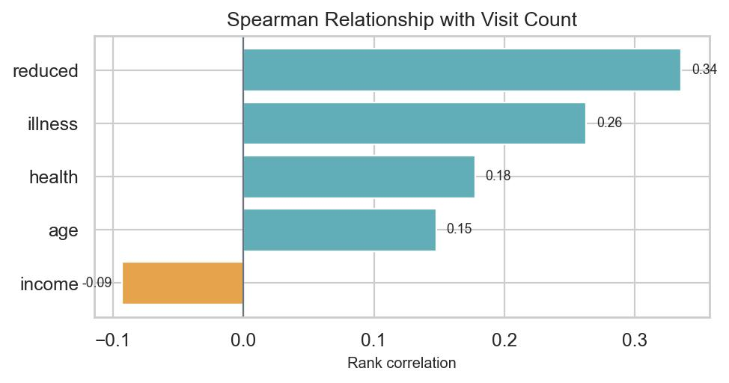
What the statistical checks support
FINDING 6 OF 6
Strongest rank links: Reduced days 0.34; illness count 0.26.
Second check: Both remain associated in the adjusted any-visit model.
Key takeaway: Validate in current, representative data before service decisions.

Slide 12
Analysis Method and Data Source
DATA SOURCE: Supplied CSV and Dataset explanation guide.
METHOD: Audit, cleaning, EDA, and statistical validation in Python.
VALIDATION: Spearman tests with Holm adjustment; adjusted logistic model.
LIMITS: Survey period, sampling method, and code scales are not defined.
FULL ANALYSIS: See Healthcare_Doctor_Visits_Analysis.ipynb.

Slide 13
GitHub Link
Project Repository & Source Code :
All code files, clean datasets and analysis notebooks for this project are completely open-source and hosted on GitHub.
Repository Link
Url : https://github.com/yashmonde24/health-analytics-
What You Will Find in the Repository:
python/ : Source code and Jupyter notebooks for data cleaning, EDA and generating visualization charts.
docs/ : A clean, presentation-ready slide deck outlining our main findings and recommendations for non-technical stakeholders.
.data/ : DoctorVisit dataset used for performing the analysis.
README.md : A detailed, step-by-step project guide featuring the exact visual charts and actionable recommendations shown.

Slide 14
Thank you
Healthcare Analytics for Doctor Visits
Questions or discussion?
  Supporting analysis is documented in the accompanying notebook.
.
.

