Slide 1

FAKE NEWS CLASSIFICATION
CS 579: Online Social Network Analysis
Prof. Kai Shu
TEAM 20
YASH PATEL - A20451170
NIRAV SONI - A20435538

Slide 2
Models We USED:
1. Multilayer Perception (MLP): With Accuracy 86.218%
2. Naïve Bayes: With Accuracy 71.75%

Slide 3
Data Preprocessing:
We convert articles in to list of sentences by splitting and create corpuses of articles.
Convert all sentences of corpuses to lower case.
Remove all non-word characters and useless all punctations in the corpuses.
Creating tokens of articles using these corpuses.

Slide 4
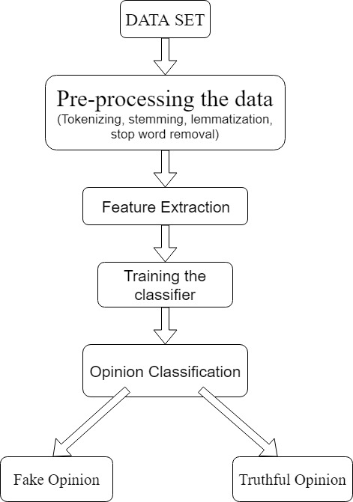
1. Multilayer Perception (MLP)

Slide 5
Preprocessing Data:
One hot encoder for output categorical data
Feature Extraction:
Use tf-idf vector as features (bag of words)
Vocabulary size – 40,618 unique words
Cosine similarity between feature vectors of fake and upcoming articles 2n+1 = 2(40,618)+1
Classifier and training:
Multi layer perception Classifier
1 hidden layer with 100 neurons
Input size 2n+1
During validation of this model we got 86.218% accuracy.

Slide 6
2. Naïve Bayes
Data Splitting:
Training model on 90% of training data 10% of trained data to validate.
Data Preprocessing:
Model:
Using train data, we calculate label wise (agreed/disagreed/unrelated) frequency of each token/word in processed data for both fake and upcoming article.
Using this calculated frequency, we are predicting probability of labels (agreed/disagreed/unrelated) and classify instance (fake article and upcoming article) of test data.
During validation of this model we got 71.75% accuracy.

Slide 7

Thank you

