Slide 1
CSP 584 ENTERPRISE WEB APPLICATIONS HOME HUB – PHASE 1
TEAM 13
DEEPAK KUMAR YADAV - A20447332
NIRAV SONI - A20435538
YASH PATEL - A20451170

Slide 2
PROJECT FEATURES:
Every user will have any one of the following role “User” or “Administrator” or “Contractor”.
User can search and order services based on current location or custom location
User can book and cancel services as per their convenience
User can view and post reviews for the services listed on the website
Administrator can add / approve new contractors to be listed in the website.
Contractors can request to be listed on the website
Contractors can cancel appointments
Contractors can also view and post review for customers.
Contractors can request for additional payment if they have worked for more than the initial planned hours.
For every transaction that happens through the website 20% goes to the Administrator and 80% goes to the Contractor
User / Administrator / Contractors will be able to see their current balance and detailed invoice of every transaction.

Slide 3
SERVICES:
Cleaning
Home sanitization
Kitchen
Bedroom
Bathroom
Living room
Workplace
Moving
Packers and Movers
Carpenter
Furniture repair
Furniture assemble
Wood work
Wood polishing
Customize furniture
Plumbing
Drain repair
Sink replace
Toilet repair
Plumbing service
Electrician
New wiring
Break down / Shot circuit
Repair / Fixes
Painting
Wall painting
Furniture painting
Others
Pest Control
Cockroach
Bed bugs
Ants
Termite
Mosquito
Appliances
Air Condition
Microwave
Refrigerator
Washing Machine
Water Purifier
Room Heaters
Television
Chimini

Slide 4
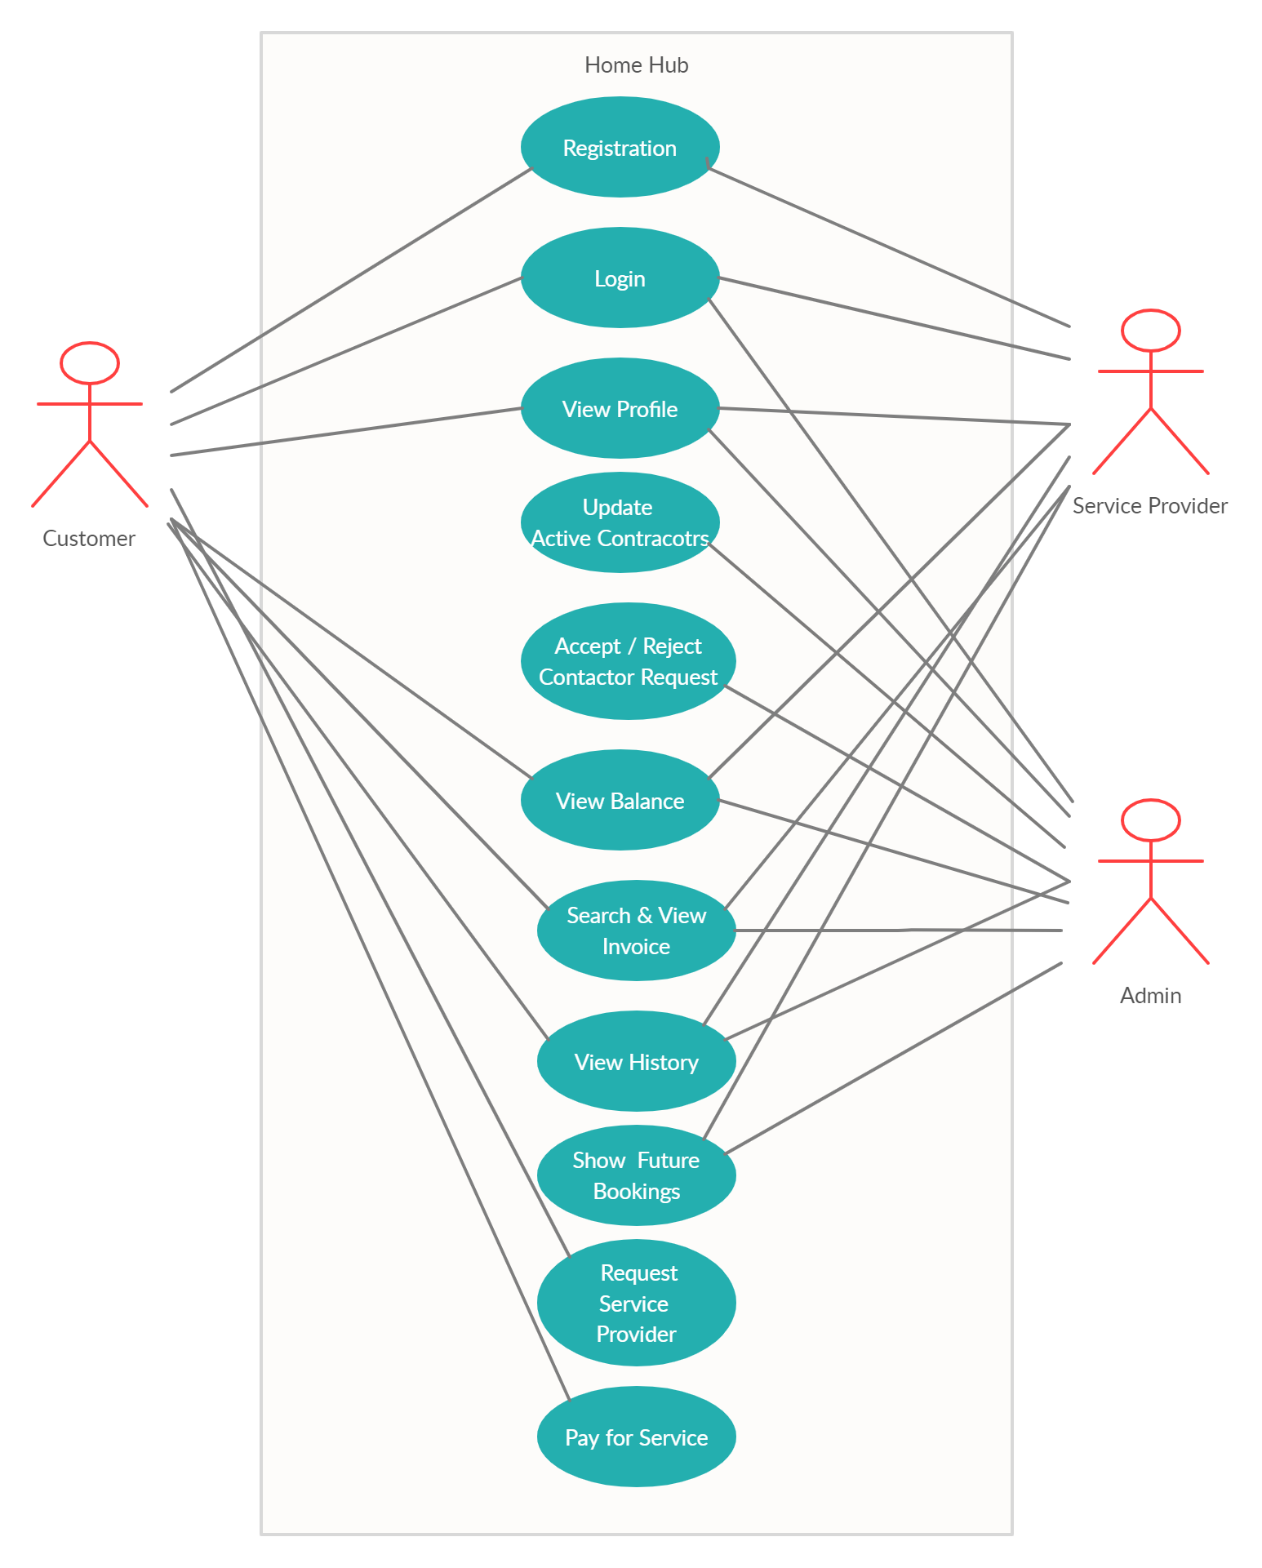

Slide 5
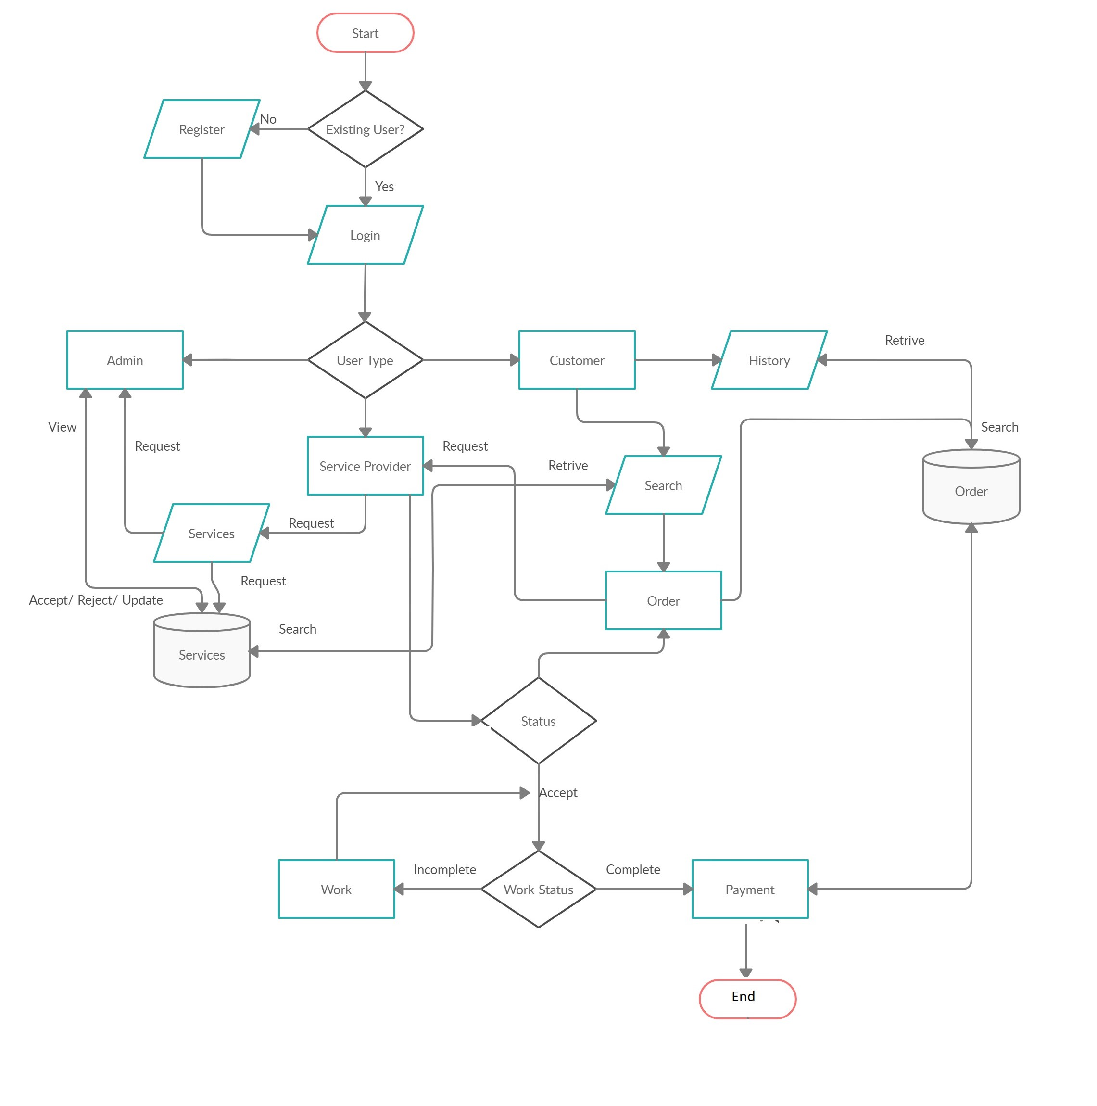

Slide 6
Tech Stack:
HTML-5
CSS-3
Javascript
Bootstrap
JSP
MySQL
MongoDB

Slide 7
Thank you
Team 13
DEEPAK KUMAR YADAV - A20447332
NIRAV SONI - A20435538
YASH PATEL - A20451170

